Slide 1
The Rust Support Group
Adam Carnaffan • Divy Raval • Aman Bhargava

Slide 2
About Us
Second-Year Engineering Science at University of Toronto.
Adam: Software & Network Engineering.
Divy: Algorithms & Scripting
Aman: Computer Vision & ML
Fun Fact: Same Engineering Design team!

Slide 3
Strategy
Main Steps:
Segmenting the flyers into ad blocks.
Performing Optical Character Recognition (OCR)
Natural Language Processing (NLP) to produce final CSV.
Optimizing For:
Rapid prototyping (minimum viable product/agile development).
Modular & interpretable design.

Slide 4
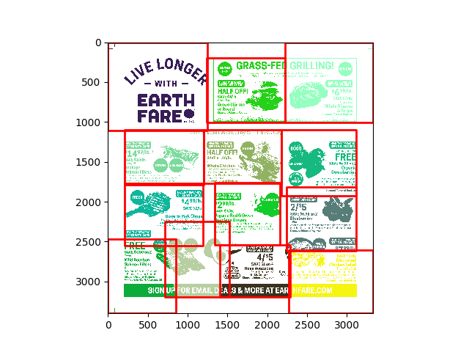
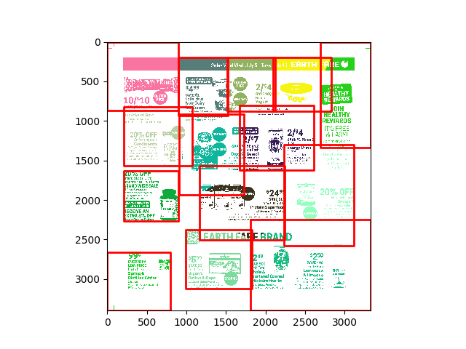
Segmenting
Used K-means in combination with a concentration map created using OCR

Slide 5
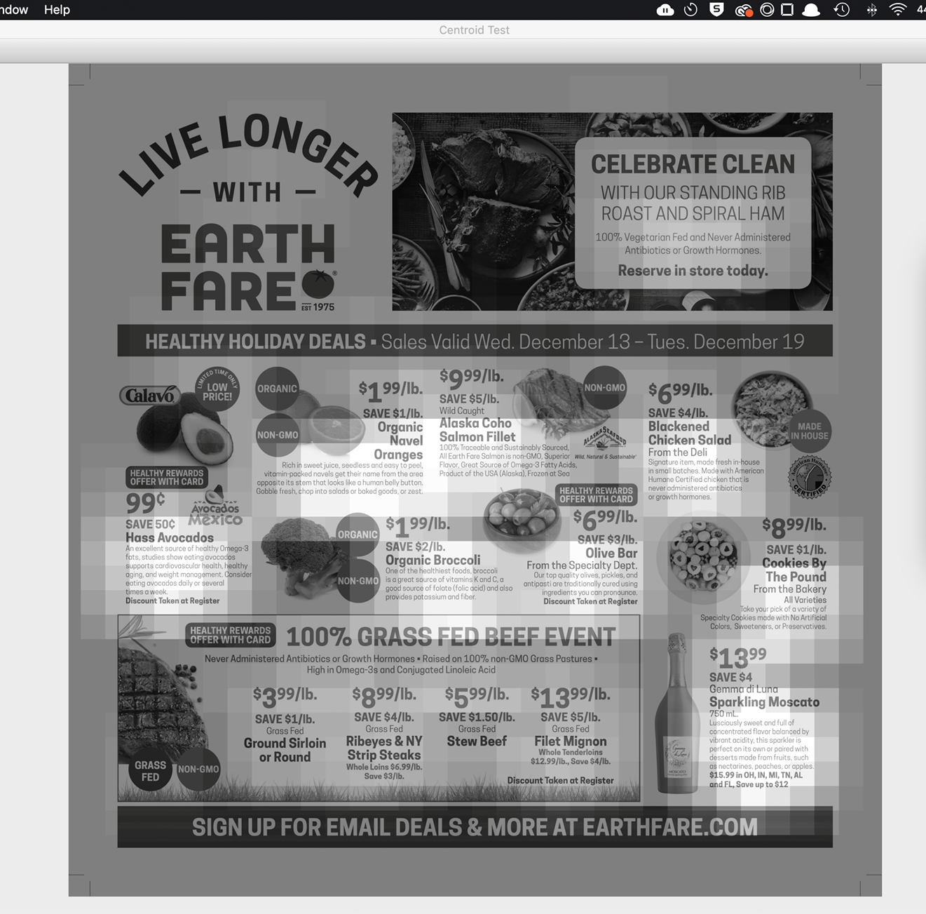
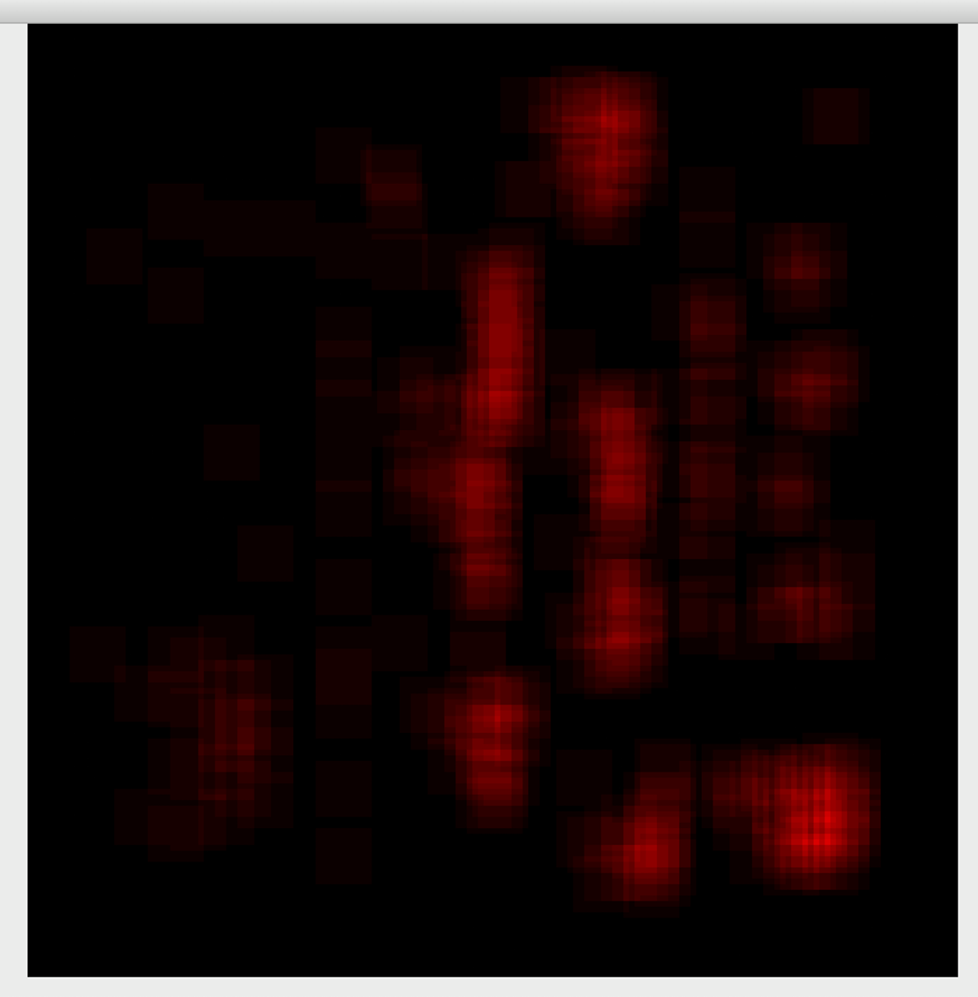
OCR
We used Tesseract to do text recognition with OCR

Slide 6
NLP
Implemented Regex to process and match with key words and trends.
Leveraged the Levenshtein distance-ratio to determine the best-fitting product name.

Slide 7
The Final Product
OCR feeds back into the segmentation algorithm.
The segmentation algorithm then provided precise boundaries to the OCR to divide the text into ad blocks
These blocks where then sent along with data about size and style to the NLP to be able to determine the product data in each block

