Slide 1
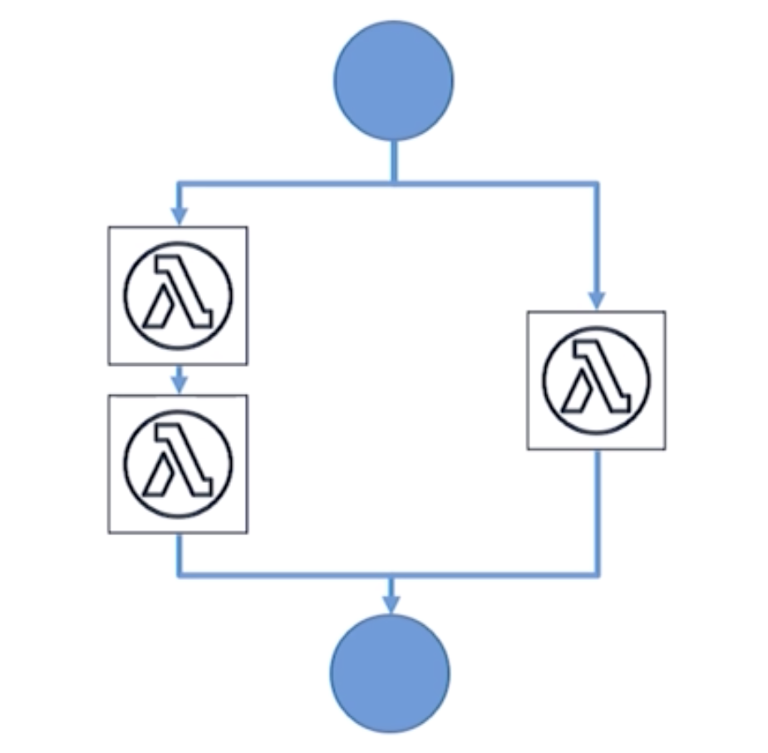
AWS Step Functions ?
AWS Step Function are the logical progression of AWS lambda functions
With Step Function, we can create visual workflows to co-ordinate or orchestrate different Lambda functions to work together.
This workflow contains series of steps, with output of one step feeding as input to the next.

Slide 2
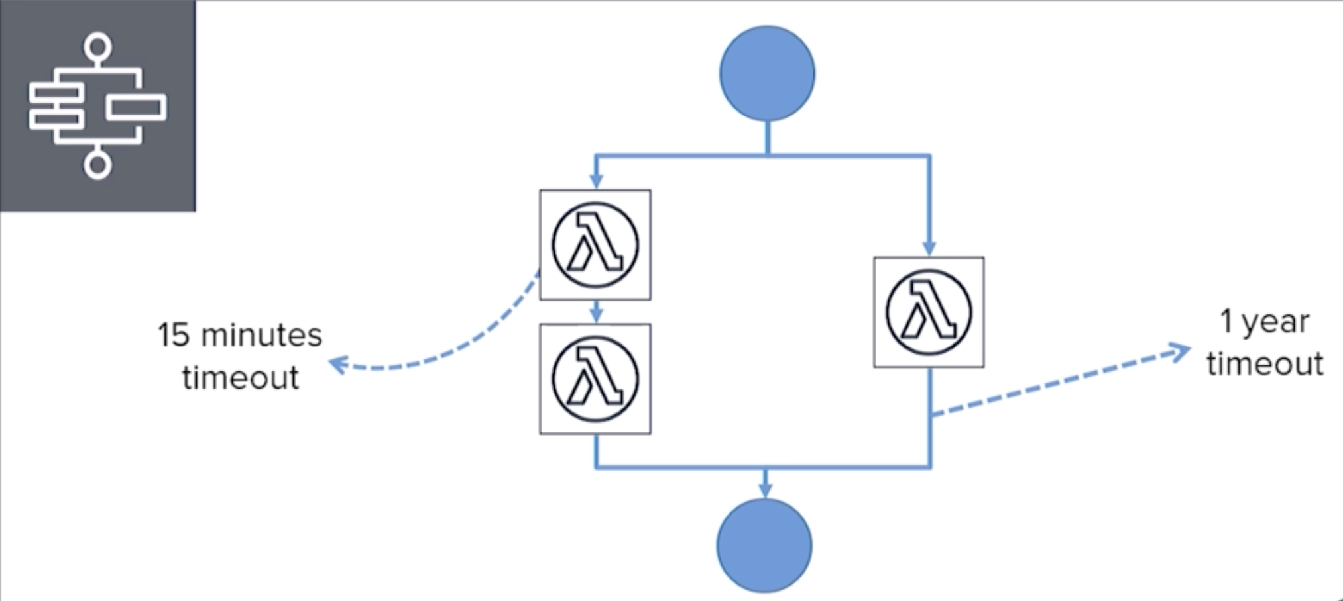
AWS Step Functions Time Out:
A Lambda function currently can run up to a maximum limit of about 15 minutes.
Step function on the other hand can run up to a period of one year, of course the individual steps within a workflow must still adhere to the lambda timeout limits.
The entire workflow can remain idle or can keep running up to a limit of 1 year.

Slide 3
Use Cases And Benefits:
We can use step functions to automate routine jobs like deployments, upgrades, migrations , patches and so on.
Most importantly, as I mentioned earlier, Step functions allow us to combine different Lambda functions to build Serverless applications and micro services.
So just like Lambda functions, there is no need to provision any resources like server resources or infrastructure.
Step functions allow us to build completely Serverless workflows without having to provision any server resources or infrastructure.
Step Functions manages the operations and underlying infrastructure for you to ensure your application is available at any scale.

Slide 4
Step Function Language:
ASL or Amazon State Language to define the workflow.
ASL is very simple and easy to use JSON based, structured language.
We use this language to define different states or steps of the workflow as well as the connections and interactions between these states. The resulting workflow is then called as State Machine.
The state machine is displayed in a graphical format, just like a flow chart , making it easy to understand the flow of logic.
this also makes monitoring of the state machine , so much easier.

Slide 5
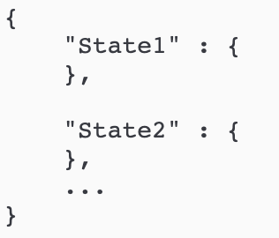
State Machine Structure:
Comment (Optional) : A human-readable description of the state machine.
StartAt (Required) : A string that must exactly match (is case sensitive) the name of one of the state objects.
TimeoutSeconds (Optional) : The maximum number of seconds an execution of the state machine can run. If it runs longer than the specified time, the execution fails with a States.Timeout Error Name.
Version (Optional) : The version of the Amazon States Language used in the state machine (default is "1.0").
States (Required) : An object containing a comma-delimited set of states.

Slide 6
State Machine Common Fields:
Type (Required) : The state's type.
Next : The name of the next state that is run when the current state finishes. Some state types, such as Choice, allow multiple transition states.
End : Designates this state as a terminal state (ends the execution) if set to true. There can be any number of terminal states per state machine. Only one of Next or End can be used in a state. Some state types, such as Choice, don't support or use the End field.
Comment (Optional) : Holds a human-readable description of the state.
InputPath (Optional) : A path that selects a portion of the state's input to be passed to the state's task for processing. If omitted, it has the value $ which designates the entire input. For more information, see Input and Output Processing).
OutputPath (Optional) : A path that selects a portion of the state's input to be passed to the state's output. If omitted, it has the value $ which designates the entire input. For more information, see Input and Output Processing.

Slide 7
State Machine States:
Pass : A Pass state ("Type": "Pass") passes its input to its output, without performing work. Pass states are useful when constructing and debugging state machines.
Task : A Task state ("Type": "Task") represents a single unit of work performed by a state machine.
Choice : A Choice state ("Type": "Choice") adds branching logic to a state machine.
Wait : A Wait state ("Type": "Wait") delays the state machine from continuing for a specified time.
Succeed : A Succeed state ("Type": "Succeed") stops an execution successfully.
Fail : A Fail state ("Type": "Fail") stops the execution of the state machine and marks it as a failure.
Parallel : The Parallel state ("Type": "Parallel") can be used to create parallel branches of execution in your state machine.

Slide 8
State Machine Structure

Slide 9
Step Function Error Names:
States.ALL : A wildcard that matches any known error name.
States.Timeout : A Task state either ran longer than the TimeoutSeconds value, or failed to send a heartbeat for a period longer than the HeartbeatSeconds value.
States.TaskFailed : A Task state failed during the execution.
States.Permissions : A Task state failed because it had insufficient privileges to execute the specified code.

Slide 10
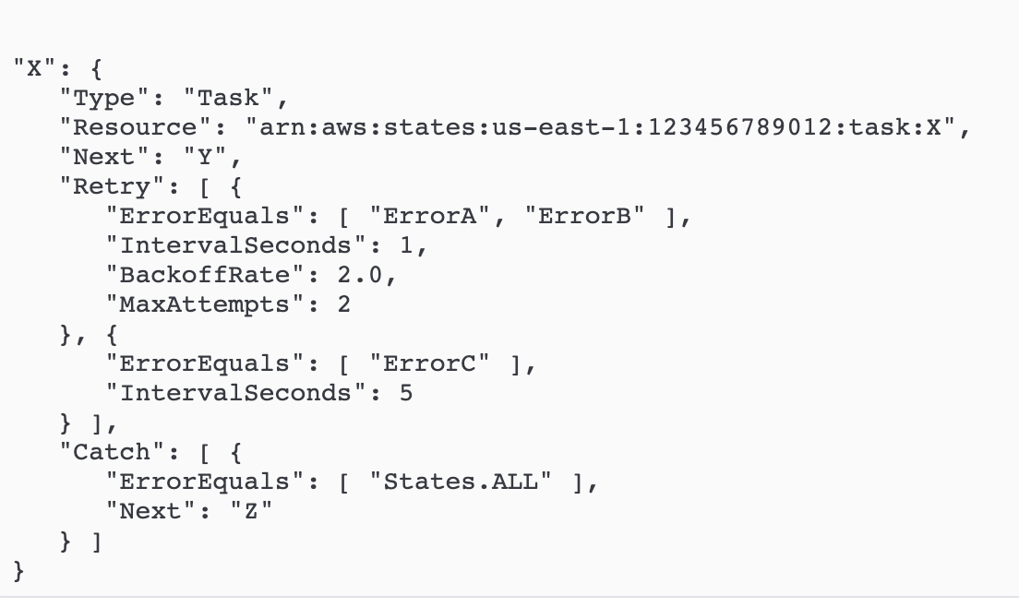
Step Function Error Handling
State machine also have built-in error handling mechanism.
We can retry operations based on different errors or certain conditions .
We can run different logic depending on different errors or conditions.
It automatically triggers and tracks each step, and retries when there are errors, so your application executes in order and as expected, every time. Step Functions logs the state of each step, so when things do go wrong, you can diagnose and debug problems quickly.

Slide 11
Step Function AWS Link
https://docs.aws.amazon.com/step-functions/latest/dg/amazon-states-language-state-machine-structure.html

