Slide 1
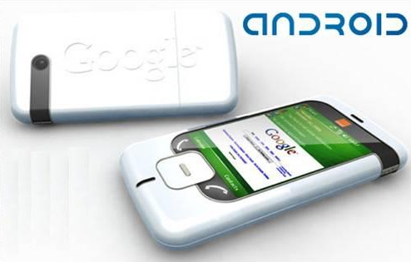
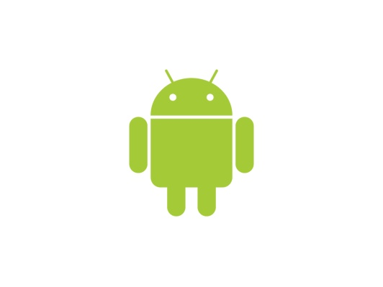
ANDROID OS

Slide 2

OUTLINE
1. INTRODUCTION TO ANDROID
2. INTRODUCTION TO PLATFORM
3. SECURE DATA STORAGE
4. EXECUTION ENVIRONMENT

Slide 3
What is ANDROID?
Android is a bunch of software
It is a mobile operating system
Founded in Palo Alto of California , U.s by Andy Rubin, Rich Miner, Nick Sears and Chris White in 2003. Later Acquired by Google in 2005.
Now developed by Google and Open Handset Alliance
So Android is simply an
  Operating System
  Middleware
  Applications

Slide 4
Why Android Was Created?
Software development
Run on very small electronic devices
Full phone software stack including applications
Android is open source OS.
Android is free

Slide 5
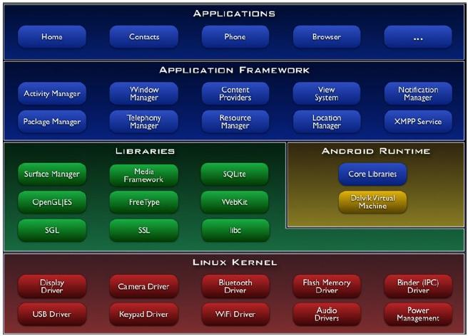
ANDROID ARCHITECTURE
Fig. Architecture of Android OS

Slide 6
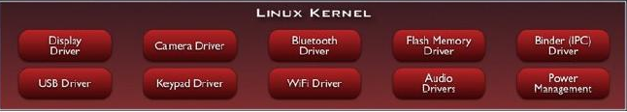
Linux Kernel
Linux Version 2.6 as - h/w abstraction layer
Security, Memory & Process Management
Efficient computing resource management
Stable and proven for mobile platform

Slide 7
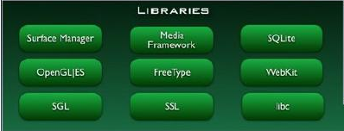
Libraries
Written in C/C++ - System C Library(libc)
Surface manager - composing different drawing screens
Display/Graphics(SGL)-for 2D graphics
OpenGLES – 3D Graphics Library
Media Libraries
SQLite –RDB engine-light weight
LibWebCore–web browser engine–embeddable web view

Slide 8
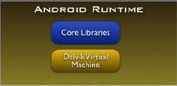
Android Runtime
Includes a set of core libraries that provides most of the functionality-JAVA
Every Android application runs in its own process
Dalvik VM executes files in the (.dex) format
Device can run multiple VMs efficiently

Slide 9
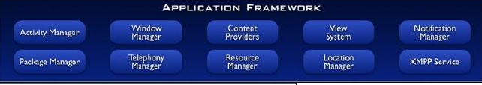
Application Framework
Activity Manager :
Manages the lifecycle of applications
Content provider :
Enable applications access data from other applications
Resource Manager :
Providing access to non-code resources
Window Manager
Notification manager

Slide 10
Techniques for saving data
    SQLite Databases:
    Relational database library for storing and managing complex data
    It is a very light database and consumes hardly few KiloBytes

Slide 11
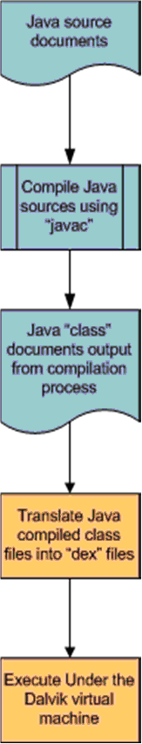
The Dalvik Virtual Machine
Interpreter only machine optimized for use on low powered, low memory devices like phones
Dalvik uses the Java programming language but not the JVM
Dalvik is not a Java virtual machine.
It uses bytecode format called “dex”.

Slide 12
Android Application Development
Android
SDK
Eclipse IDE
Android
Mobile
Device
Android
Emulator

Slide 13
Android Development
Java Source
Android Manifest
Generated Class
Java Compiler
.dex
File
Dalvik
VM
Resource XML
Android Libraries

Slide 14
Android Versions
Version | Nos of APIs
5.0 Jelly Bean | 15-16
4.0 Ice Cream Sandwich | 14.15
3.x.x Honeycomb | 11-13
2.3.x Gingerbread | 9-10
2.2 Froyo | 8
2.1 Éclair | 7
1.6 Donut | 4
1.5 Cupcake | 3
Brief Version overview

Slide 15
Android First Release…
Beta ver. (1.0) was released in November 2007
Developed by Google and Open Handset Alliance
Since April 2009, each Android versions has been developed under a codename based on a dessert item
These versions have released in alphabetical order: Cupcake, Donut, Eclair, Froyo, Gingerbread, Honeycomb and Ice Cream Sandwich.

Slide 16
Techniques for saving data
    SQLite Databases:
    Relational database library for storing and managing complex data
    It is a very light database and consumes hardly few KiloBytes

Slide 17



