Slide 1
Uber fares Prediction
Anthony mancia

Slide 2
Business scenario
The Challenge: Uber's dynamic pricing, while optimizing supply and demand, often leaves users uncertain about fare calculation and influencing factors.
Our Goal: To develop an interactive Streamlit application that closely mimics the real Uber fare estimation experience.
Value Proposition: Provide users with transparent, real-time-like fare predictions, empowering them to understand pricing dynamics and make informed ride decisions.

Slide 3
Key features
Dataset contains: 200,000 rows & 9 columns
key - a unique identifier for each trip
fare_amount - the cost of each trip in usd
pickup_datetime - date and time when the meter was engaged
passenger_count - the number of passengers in the vehicle (driver entered value)
pickup_longitude - the longitude where the meter was engaged
pickup_latitude - the latitude where the meter was engaged
dropoff_longitude - the longitude where the meter was disengaged
dropoff_latitude - the latitude where the meter was disengaged

Slide 4

Analytic INSIGHTS

Slide 5
Key statistics
Average Fare: $11.26
Average Distance: 3.36 km
Average Fare per km: $4.4/km
Most Common Passenger Count: 1 passengers
Busiest Hour: 19:00 (7:00pm)
Busiest Day: Friday
Weekend Rides %: 28.4%
Peak fare time: 5:00 (avg $15.87) (early morning has highest average fares)

Slide 6
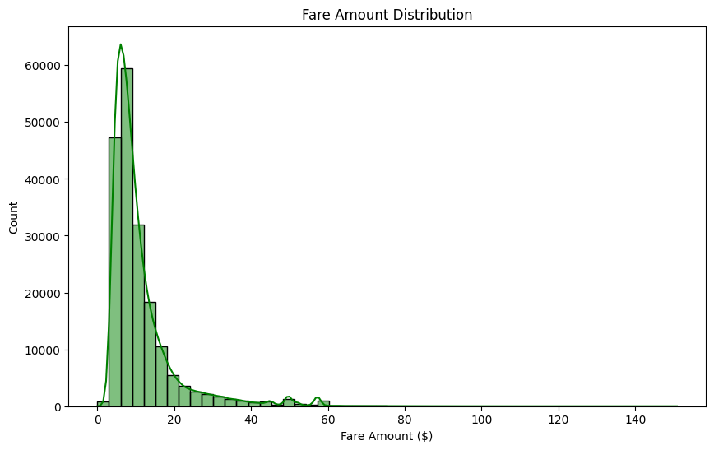

Slide 7
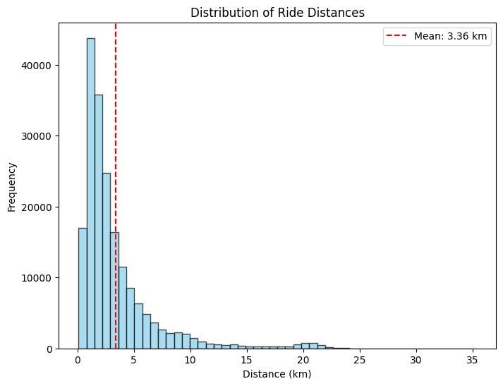

Slide 8
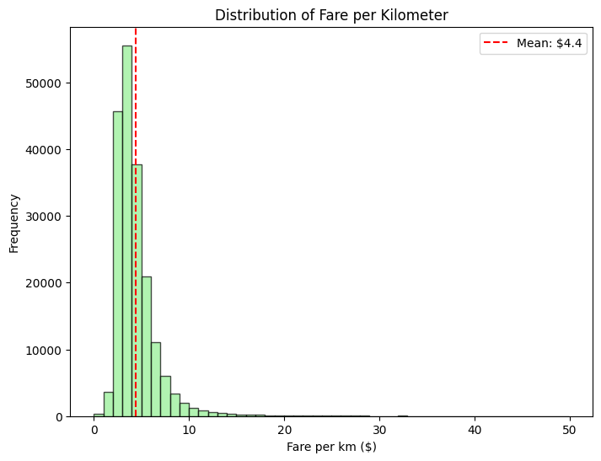

Slide 9
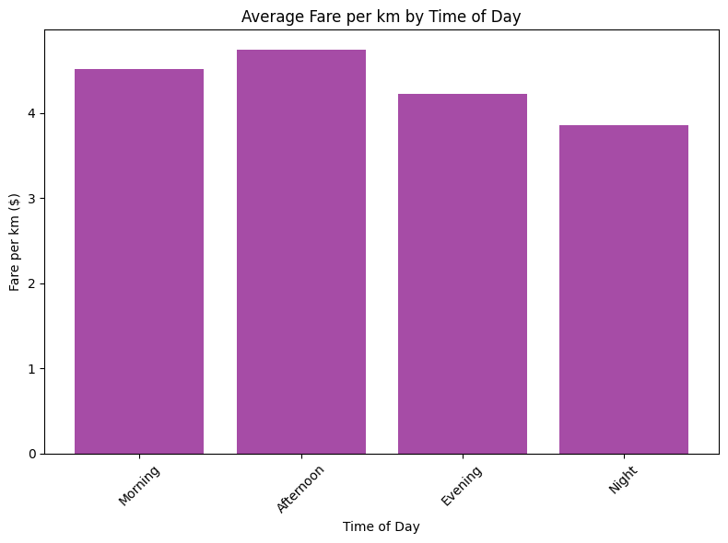

Slide 10
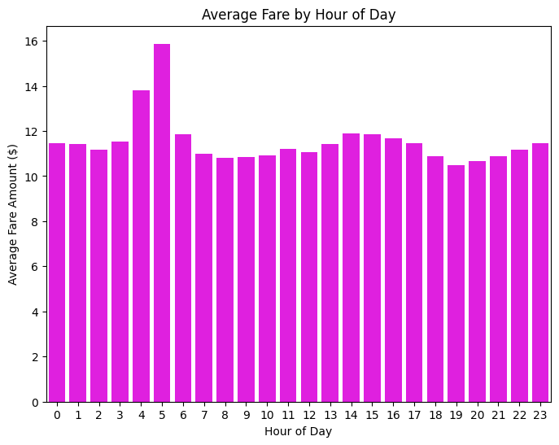

Slide 11
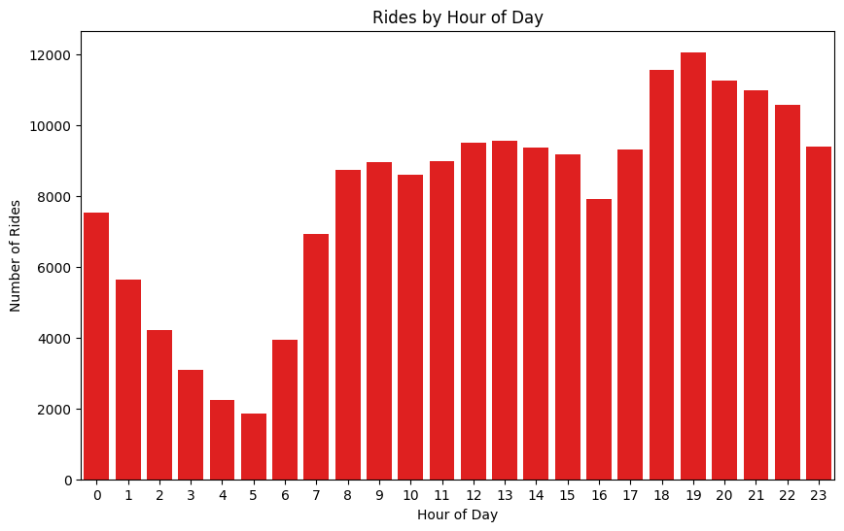

Slide 12
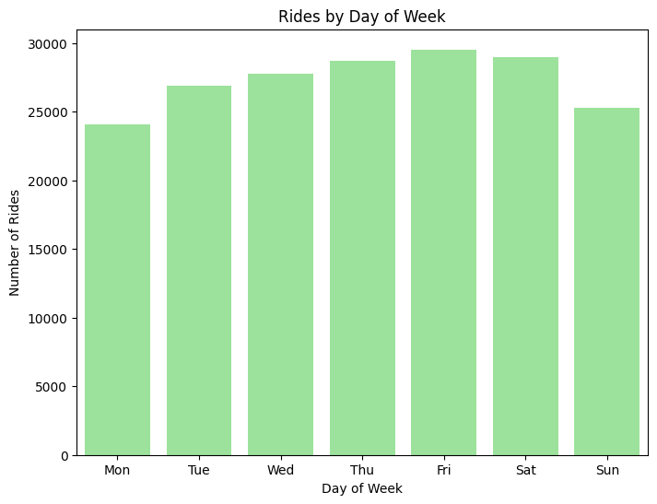

Slide 13
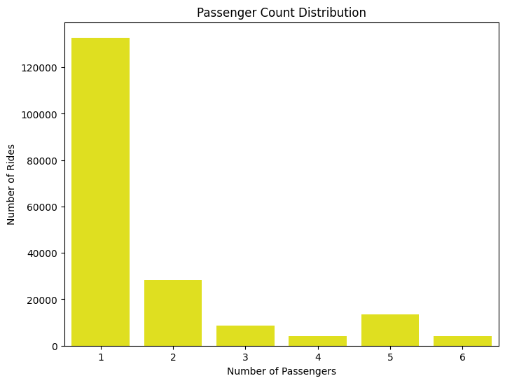

Slide 14
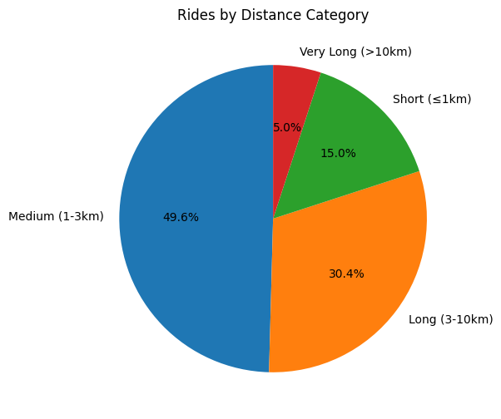

Slide 15
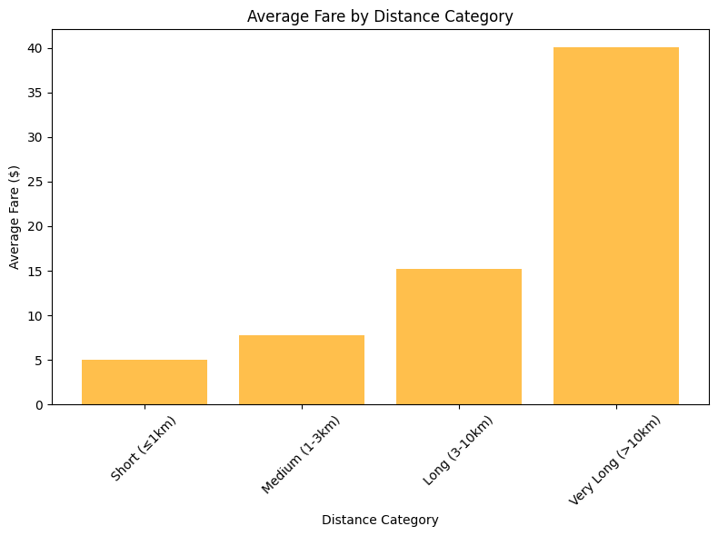

Slide 16
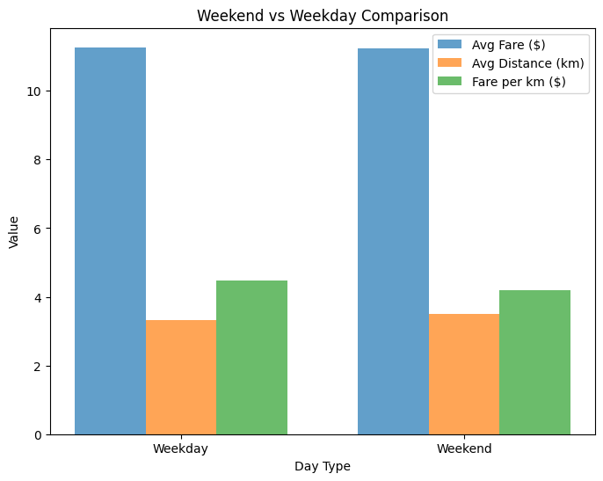

Slide 17
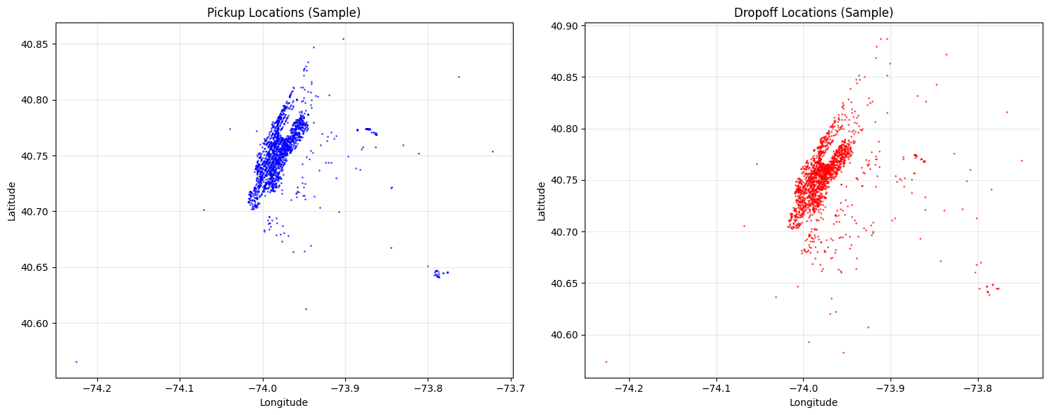
Pickup + dropoff latitude & longitudes

Slide 18
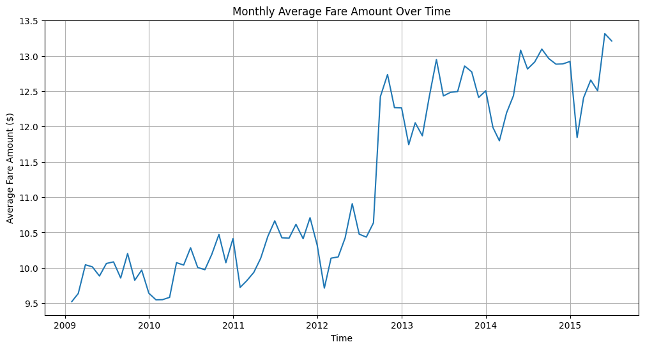
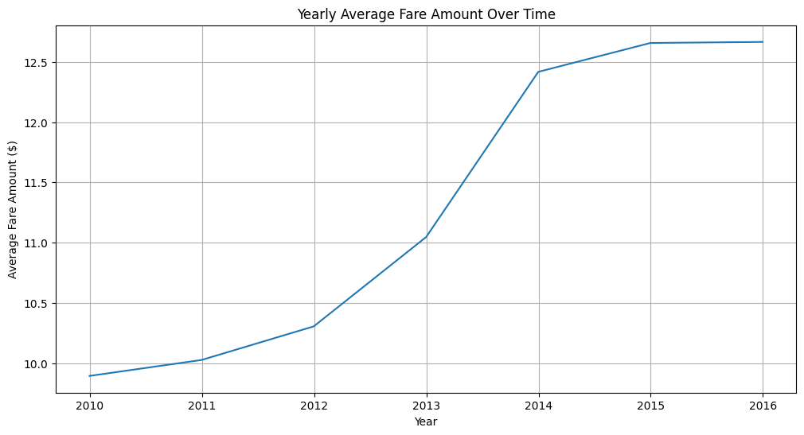
Fare amount over time
Uber introduced their surge pricing model in 2012

Slide 19
Feature engineering: columns added
distance_km: Haversine distance between pickup/dropoff
fare_per_km: Fare efficiency metric
estimated_duration_minutes: Estimated trip time
distance_category: Categorical distance grouping
time_of_day: Time period categorization
is_weekend: Weekend indicator

Slide 20
Machine learning

Slide 21
Features used in modeling
pickup_longitude
pickup_latitude
dropoff_longitude
dropoff_latitude
passenger_count
hour
day_of_week
month
year
distance_km
estimated_duration_minutes
Encoded features:
distance_category_encoded
time_of_day_encoded
is_weekend_int

Slide 22
model scores
Stacking Ensemble (Ridge) RMSE: 2.8455 MAE: 1.5170 R2: 0.9045
Best 3 Models Ensemble RMSE: 2.8530 MAE: 1.5316 R2: 0.9040
XGBoost RMSE: 2.8894 MAE: 1.5436 R2: 0.9015
LightGBM RMSE: 2.9258 MAE: 1.6047 R2: 0.8990
CatBoost RMSE: 2.9266 MAE: 1.5822 R2: 0.8900
Random Forest RMSE: 2.9987 MAE: 1.6552 R2: 0.8939
ElasticNet RMSE: 4.3006 MAE: 2.5433 R2: 0.7818

Slide 23
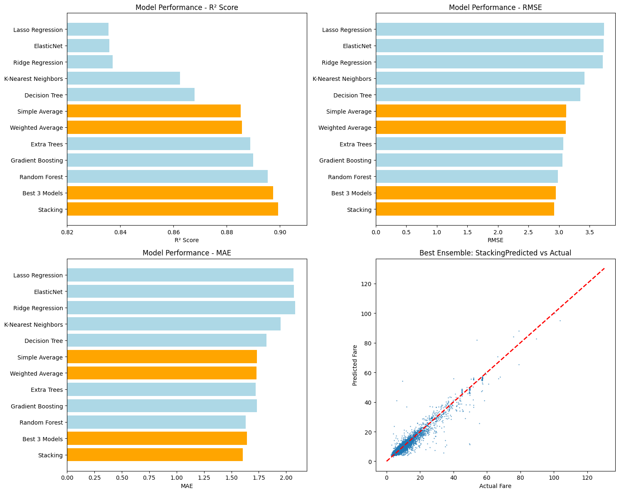
OLD Model evaluations

Slide 24
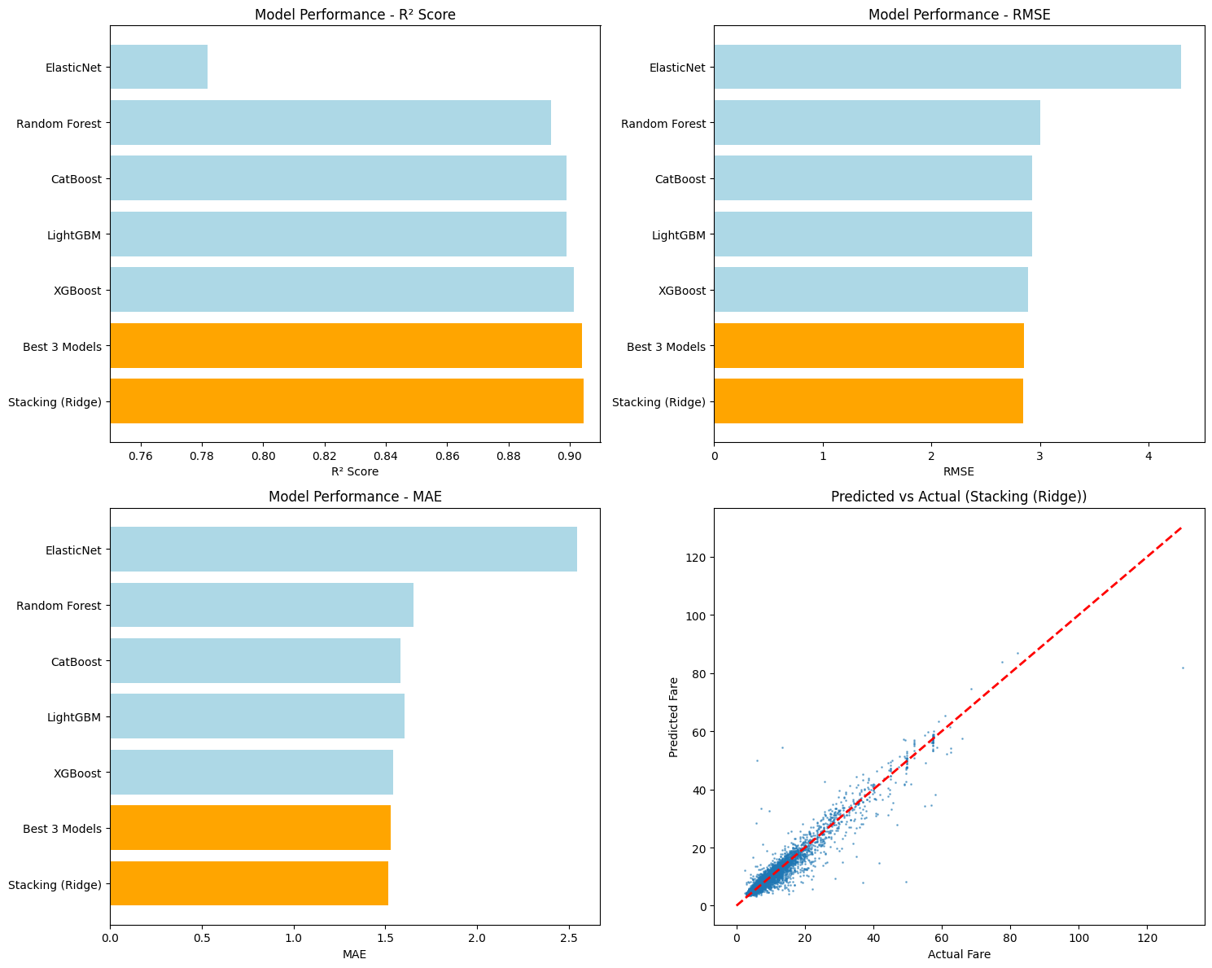
NEW Model evaluations

Slide 25
Streamlit app

Slide 26
conclusion

Slide 27
how this positively affects the business
🔁 More Accurate Fare Estimates
→ Enhances customer experience by reducing price surprises and building trust.
📈 Smarter Dynamic Pricing
→ Optimizes fares in real time based on distance, time of day, and location — boosting profitability.
🧠 Fraud Detection & Prevention
→ Flags suspicious trips (e.g., short distance, high fare) to reduce financial losses.
📊 Better Revenue Forecasting
→ Helps Uber predict earnings per ride, aiding in budgeting and business planning.
📍Identifying High-Value Areas & Time Slots
→ Informs targeted driver placement and promotions to maximize revenue.

Slide 28
Future improvements
Real-time Supply & Demand: Incorporate live data on available drivers and active rider requests, crucial for Uber's dynamic "surge" pricing.
Live Environmental Data: Integrate real-time traffic conditions (congestion, incidents) and hyperlocal weather updates that impact travel time and demand.
Real-World Event Recognition: Account for major events (concerts, sports, festivals, holidays) that create localized demand spikes.
Advanced Modeling: Explore deep learning architectures (e.g., LSTMs for time series, or even basic NLP for textual event descriptions) to capture more complex patterns.
Access to Proprietary Data: Acknowledge that real Uber models benefit from vast, internal historical trip data and operational metrics unavailable externally.

Slide 29
Thank you

