Slide 1
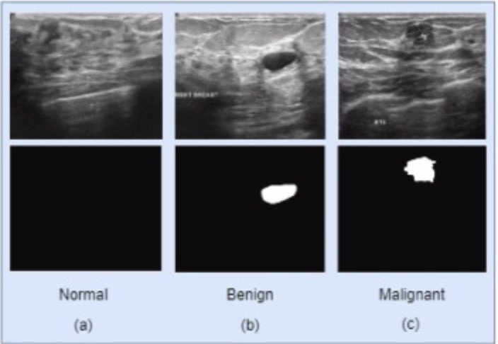
Breast Cancer Classification and Segmentation Using Deep Learning on Ultrasound Images
Null Pointers
Rasheed Azeez (z5547562)
Sashank Vermani (z5424501)
Aman Sharma (z5492132)
Gavin Zhang (z5216570)
Kiattechin (z5516202)

Slide 2
Introduction
Dataset
Methodology
Results
Next Steps
Contents
Presenter: Rasheed Azeez (z5547562)

Slide 3
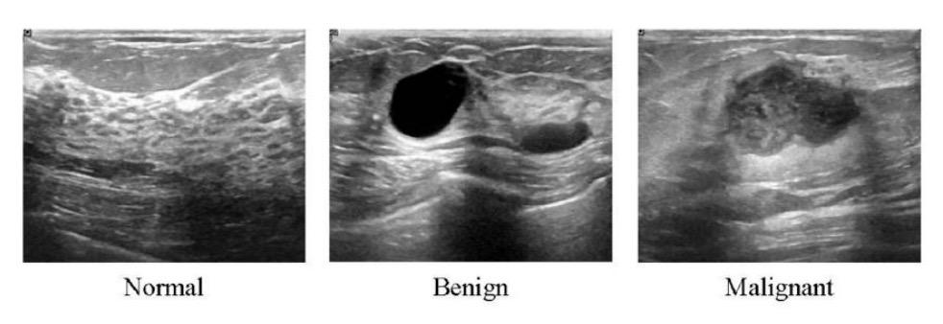
Motivation
Breast cancer is one of the leading causes of death among women worldwide.
Early detection plays a crucial role in reducing mortality rates and improving patient outcomes.
Ultrasound imaging is a safe and widely used technique for breast cancer examination and early detection.
However, the interpretation of ultrasound images can be challenging, even for experienced radiologists, due to the complexity and variability of breast lesions.
Presenter: Rasheed Azeez (z5547562)
Notes:
Why important to society

Slide 4
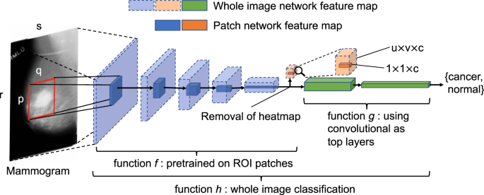
Problem Statement
Our goal is to develop a deep learning-based system for accurate
  classification and
  segmentation of breast masses in ultrasound images.
By leveraging state-of-the-art deep learning techniques and a comprehensive dataset of breast ultrasound images, we aims to assist radiologists in
  the early detection and diagnosis of breast cancer,
  potentially improving the efficiency and accuracy of the screening process.
Presenter: Rasheed Azeez (z5547562)
Notes:
What problem you’re solving that others aren’t doing

Slide 5
Dataset
Breast Cancer Ultrasound Images Dataset
https://huggingface.co/datasets/gymprathap/Breast-Cancer-Ultrasound-Images-Dataset
Source
  HuggingFace
  Kaggle
Discussed in
  Paper name: Al-Dhabyani, W., Gomaa, M., Khaled, H., & Fahmy, A. (2020). Dataset of breast ultrasound images. Data in Brief, 28, 104863.
  https://www.sciencedirect.com/science/article/pii/S2352340919312181
Content
  The paper provides a critical evaluation of the breast ultrasound dataset by W. The paper is widely cited.
  The dataset contains breast ultrasound images with binary masks highlighting lesions.
Presenter: Rasheed Azeez (z5547562)

Slide 6
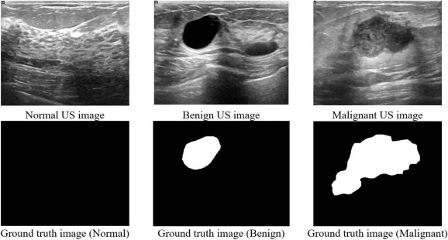
Data Analysis
Data Format
  Ultrasound images
  Segmentation masks per image
  Text classification label per image
780 image samples
  600 female patients
Presenter: Rasheed Azeez (z5547562)

Slide 7
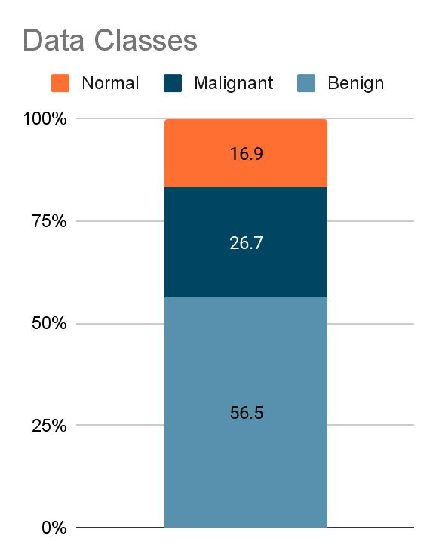
Data Analysis
3 classes, imbalanced
  Benign: 56.5%
  Malignant: 26.7%
  Normal: 16.9%
Issues
  Inconsistencies such as duplicates (235 images)
  Discrepancies in masks, and images with anomalies like foreign objects (e.g. needles).
  Some images are mislabeled
Fix with augmentation and resampling
Presenter: Rasheed Azeez (z5547562)

Slide 8
Literature Review
Classification
VGG19 - Breast cancer classification based on convolutional neural network and image fusion approaches using ultrasound images
Alotaibi, M., Aljouie, A., Alluhaidan, N., et al. (2023). Breast cancer classification using CNN and image fusion with ultrasound. Heliyon, 9(11), e22406. https://doi.org/10.1016/j.heliyon.2023.e22406
  VGG19 can have good performance for this task
  Image preprocessing such as denoising or RGB fusion can help raise accuracy significantly when combining multiple preprocess
Resnet50 - ResNet-50 based deep neural network using transfer learning for brain tumor classification
Sahaai, M. B., Jothilakshmi, G. R., Ravikumar, D., Prasath, R., & Singh, S. (2022). ResNet-50 based deep neural network using transfer learning for brain tumor classification. AIP Conference Proceedings, 2463(1), 020014. https://doi.org/10.1063/5.0082328
ResNet50 has residual connections which help train deep networks effectively by mitigating vanishing gradient issues, enabling improved accuracy on complex image datasets.
Presenter: Kiattechin Rungruengsakorn (z5516202)
Notes:
First paper - Compare vgg with and without preprocessing but tested for both classification and segmentation. We only use it for classification. Preprocessing required stacking 3-4 different one to get results

Slide 9
Literature Review
Segmentation
UNet - U-Net: Convolutional Networks for Biomedical Image Segmentation
Ronneberger, O., Fischer, P., & Brox, T. (2015). U-Net: Convolutional networks for biomedical image segmentation. arXiv preprint arXiv:1505.04597. https://arxiv.org/abs/1505.04597
  U-net is efficient for this task in both accuracy and amount of data required
  Its encoder-decoder structure with skip connections allows precise localization and detailed segmentation
DeepLabV3 - Rethinking Atrous Convolution for Semantic Image Segmentation
Chen, L.-C., Papandreou, G., Schroff, F., & Adam, H. (2017). Rethinking atrous convolution for semantic image segmentation. arXiv preprint arXiv:1706.05587. https://arxiv.org/abs/1706.05587
  DeepLabV3 leverages dilated convolutions and multi-scale context, which can enhance segmentation accuracy in challenging images.
Presenter: Kiattechin Rungruengsakorn (z5516202)
Notes:
it utilizes dilated convolutions and a different architecture that can capture multi-scale context
Both used different approaches to achieve the same goal of extracting different level of details
Unet - about the encoder-decoder logic and structure

Slide 10
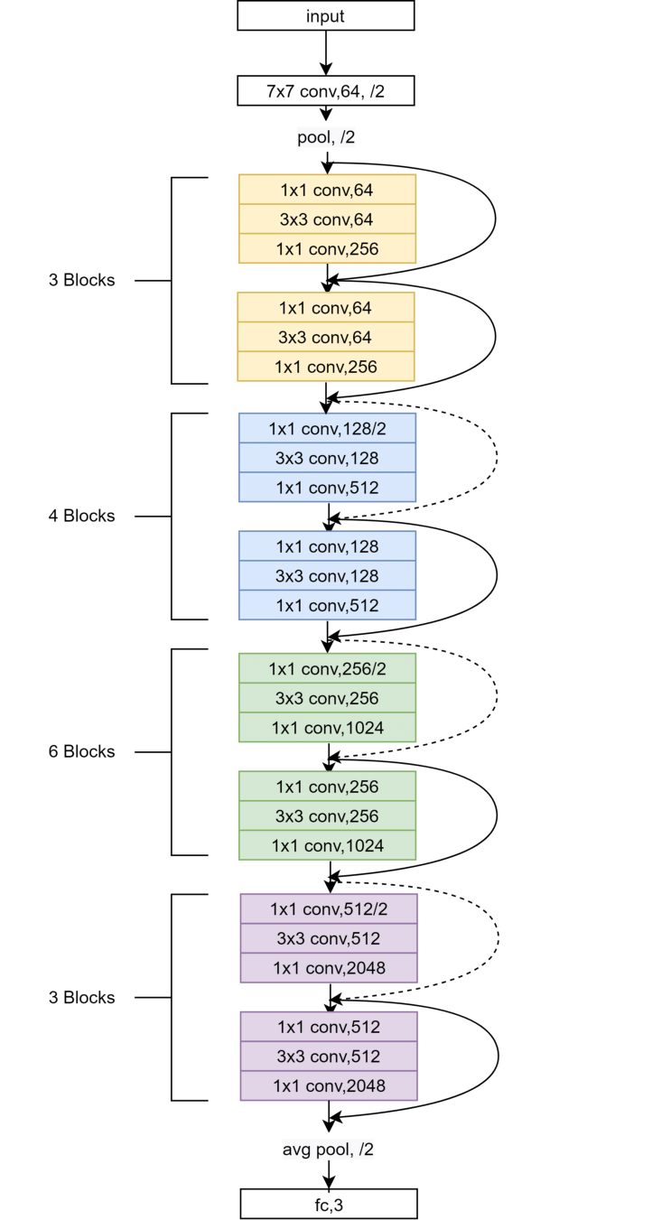
Classification
Utilise Convolutional Neural Network
Used pretrained model with transfer learning to fit our task
Classify into 3 types: Normal, Benign, and Malignant
Al-Humaidan, Norah & Prince, Master. (2021). A Classification of Arab Ethnicity Based on Face Image Using Deep Learning Approach. IEEE Access. PP. 1-1. 10.1109/ACCESS.2021.3069022.
Presenter: Kiattechin Rungruengsakorn (z5516202)
Notes:
Classify into 3 categories

Slide 11
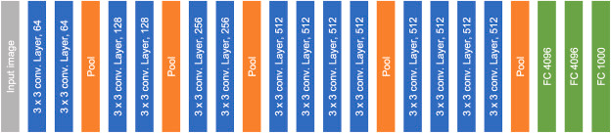
Classification
ResNet50
  Utilize skip connections
  Use Fully connected layer for the last layer
VGG-19
  Use fully convolutional layer.
  Pooling about every 2 - 4 layers
VGG19 Architecture
Alotaibi, M., Aljouie, A., Alluhaidan, N., et al. (2023). Breast cancer classification using CNN and image fusion with ultrasound. Heliyon, 9(11), e22406. https://doi.org/10.1016/j.heliyon.2023.e22406
Presenter: Kiattechin Rungruengsakorn (z5516202)
Notes:
Skip connection helps with gradient flow and combine high level info with local details.
Fully convolutional replace fully connected layers - Can handle input images of any size, uses less computational cost

Slide 12
Segmentation Approach
Three Steps Taken:
Traditional Segmentation Method
Attempt Various Different Models:
  DeepLab V3
  U-Net
Make an ensemble model to combine multiple trained models
Presenter: Aman Sharma (z5492132)
Notes:
There were three main steps to our segmentation approach,
starting with Traditional segmentation and
then moving on to using more established models like DeepLabV3 and Unet.
These models have been proven to be very effective in multiple are apparent across different papers.
Lastly, using the models trained to make and ensemble and finally a combined model.

Slide 13
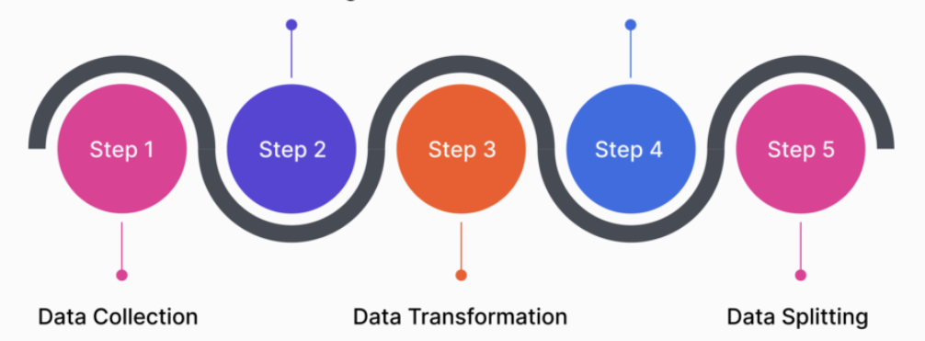
Data Preparation for Segmentation
Resize Image
Convert to PyTorch tensors
Load all three classes for training
Data augmentation of training set
Presenter: Aman Sharma (z5492132)
Notes:
In terms of data preparation we resized the images to a standard 256x256,
then converted the images to tensors.
We then load the all the three classes for the training of the model.
Finally, performed data augmentation to increase the training data volume
And resampling to better balance of images we had for each class.

Slide 14
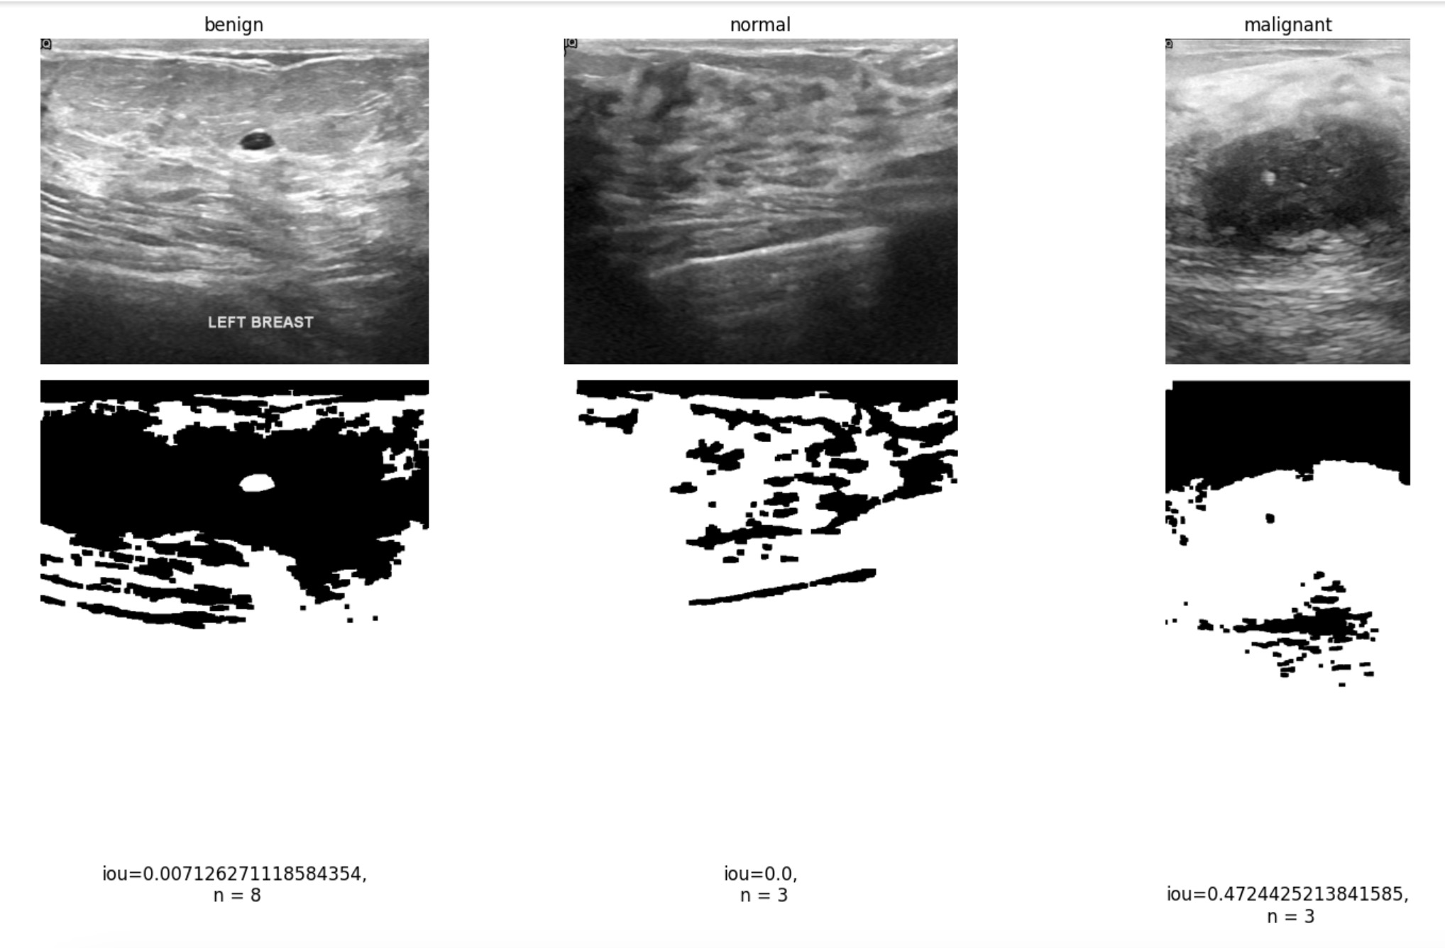
Traditional Segmentation
Segmentation Techniques
  Thresholding: Identifies regions of interest by intensity.
  Morphological Operations: Dilation, erosion to refine mask edges.
Presenter: Aman Sharma (z5492132)
Notes:
The goal here was to make an algorithm that performed image segmentation using
intensity thresholding and
binary morphological operators.
This was done comparative analysis as will be shown in the results.
~~ Morphological operators
Morphological operations manipulate an image based on its shape and structure.
They work by convolving a structuring element (also known as a kernel) over the image and applying an operation at each location.

Slide 15
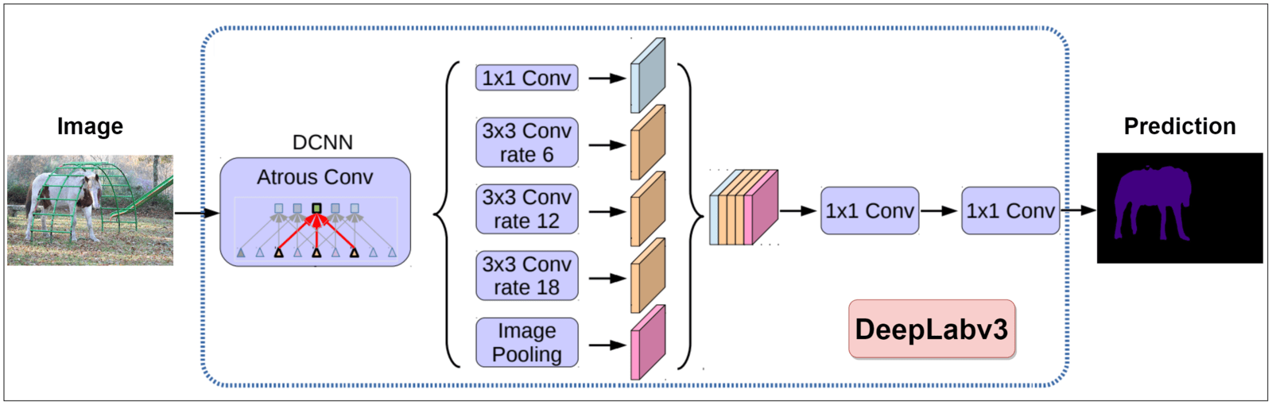
DeepLabV3 Segmentation
Model Architecture:
  Backbone: DeepLabV3 with pretrained ResNet101 for feature extraction.
Training Process:
  Loss Function: Cross-entropy for segmentation performance.
  Optimizer: Adam with learning rate adjustments.
  DataLoader: Batches of images and masks for model input.
Presenter: Aman Sharma (z5492132)
Notes:
Here we used theDeepLabV3 model for the breast cancer segmentation task
with a ResNet101 as its backbone.
DeepLabV3 was chosen as uses a special method that helps it understand the bigger picture in an image by looking at different detail levels.
This lets it capture more context without making the model more complicated or slower to process.

Slide 16
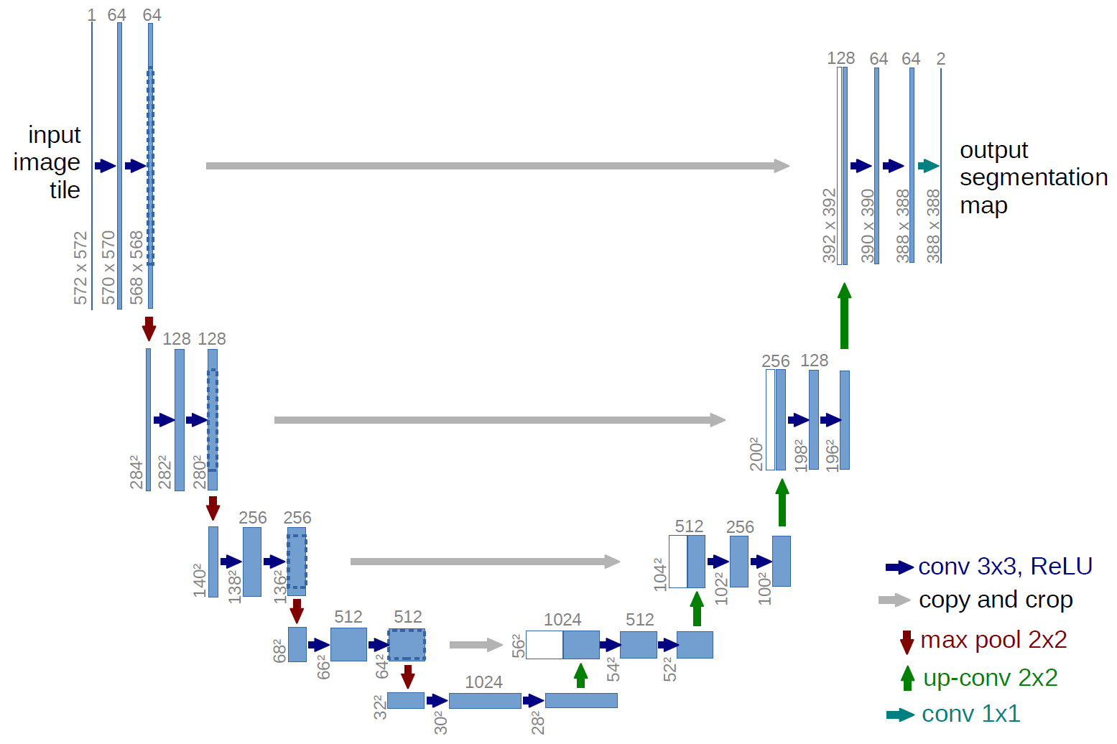
Unet segmentation
  Structure highlight：
    Symmetric structure for encoder and decoder path
    Each encoder layer is mirrored with a decoder layer
  Key feature:
    Skip connection to keep detailed spatial information and semantic information
Ronneberger, O., Fischer, P., & Brox, T. (2015). U-Net: Convolutional Networks for Biomedical Image Segmentation
Presenter: Gavin Zhang (z5216570)
Notes:
Skip connection: Keep detailed spatial information with high resolution from early layers and semantic information from deeper layers and send the directly to the decoder path.

Slide 17
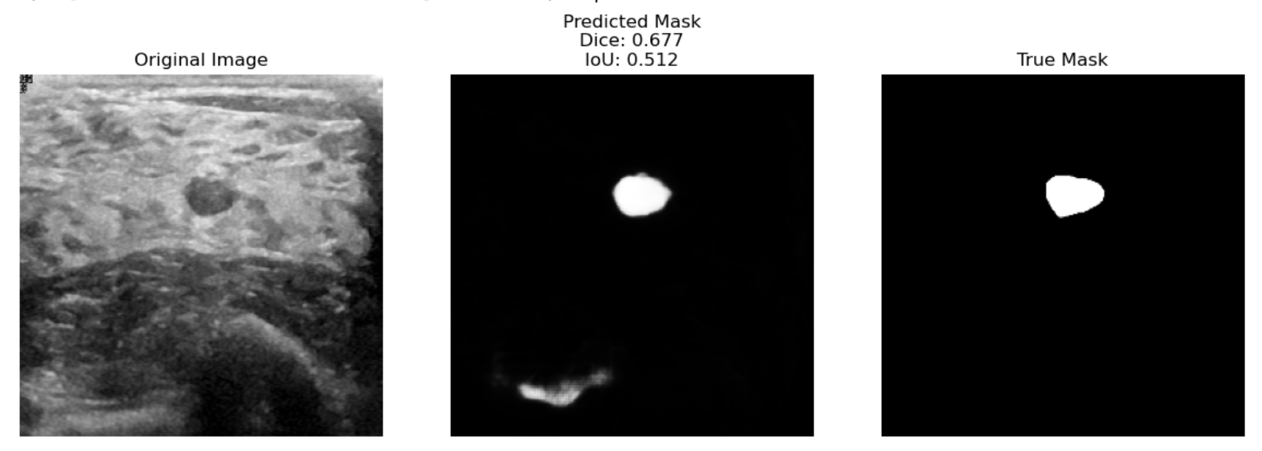
Unet segmentation
  Modified UNet:
    Batch Normalization implemented after each convolutional layer
      Stabilize the training process
      Improves generalization
    Combination of BCE loss and Dice Loss
      Addresses both pixel-level accuracy and overall segmentation quality
    Deeper UNet
Presenter: Gavin Zhang (z5216570)
Notes:
Deeper unet: one extra layer added

Slide 18
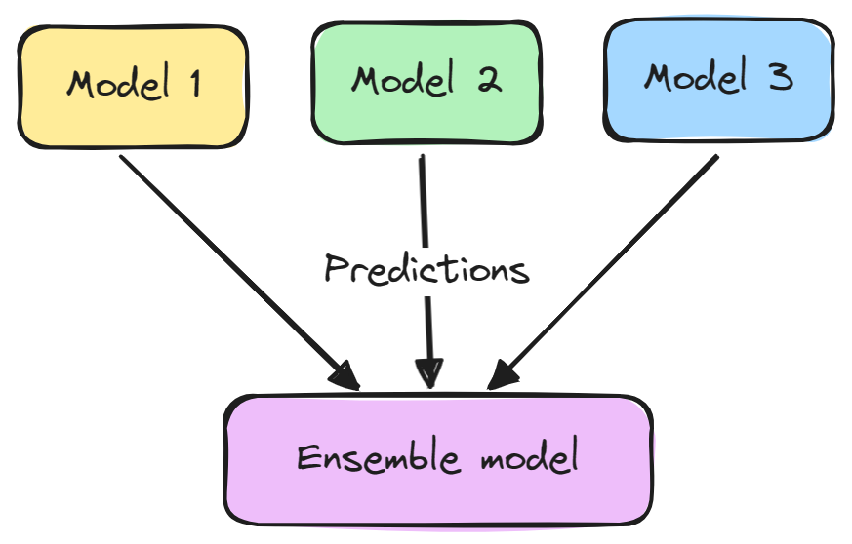
Ensemble
Combine results of deep learning models for improved segmentation results.
  Simple ensemble by averaging
  Confidence-based combination
Advantages
  Leverages deep learning models trained for the task
  Low computational cost
  Easily expandable
Presenter: Gavin Zhang (z5216570)
Notes:
Unet and deeplabv3 segmentation results were averaged to get the best ensemble result
Model with better performance - deeplabv3 for us - is prioritised, and swapped with unet only if confidence is below a certain threshold

Slide 19
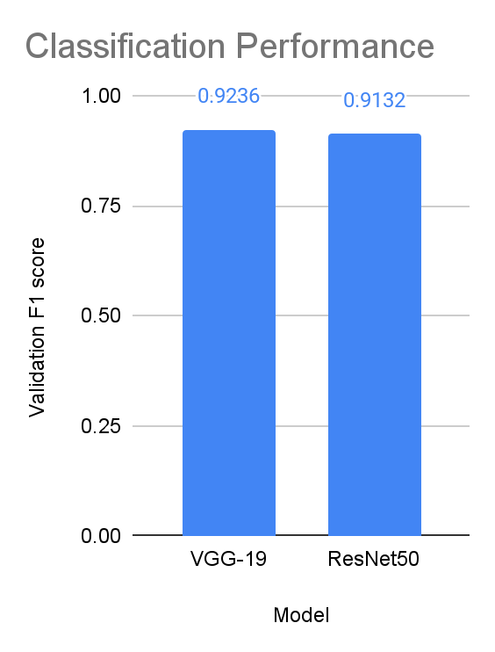
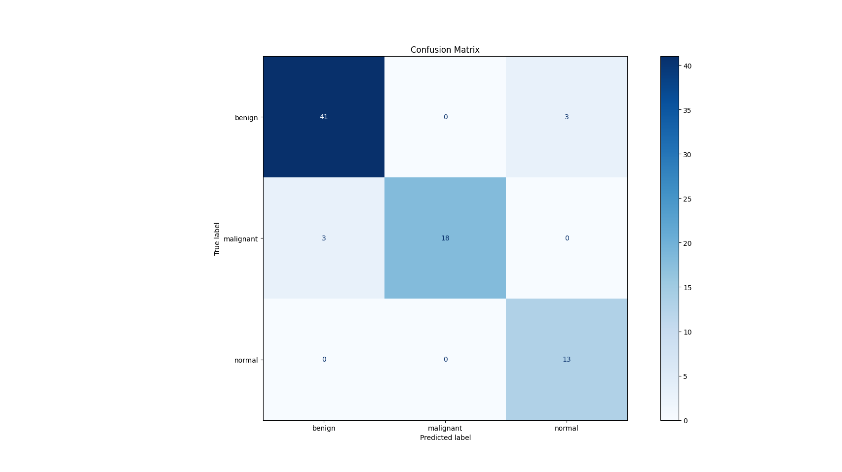
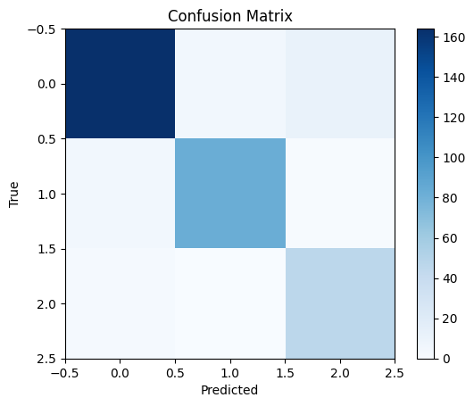
Results
Classification
VGG-19
ResNet50
F1 score was selected as it provides a robust validation metric that focuses on balances precision and recall making it an all rounder for evaluating overall performance.
We also have the confusion matrix which shows how well the model performed.
Presenter: Sashank Vermani (z5424501)
Notes:
F1 score was selected as it provides a robust validation metric that focuses on balances precision and recall making it an all rounder for evaluating overall performance. We also have the confusion matrix which shows how well the model performed

Slide 20
Results
Classification Analysis
VGG-19 has a higher validation F1 score than ResNet50, indicating slightly better performance.
The difference in F1 scores (0.0104) shows both models perform similarly, but VGG-19 is slightly better.
VGG-19 is the preferred choice due to its higher validation performance.
Presenter: Sashank Vermani (z5424501)

Slide 21
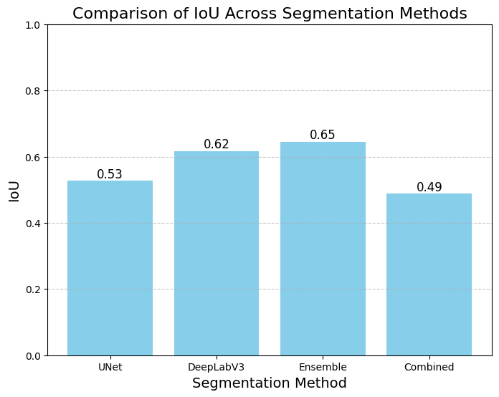
Results Analysis
Segmentation
While there are many, we chose IoU (Intersection over Union) as it is the most interpretable one.
We did not plot the traditional ml IoU results as they are close to 0.
Presenter: Sashank Vermani (z5424501)
Notes:
We did not plot the traditional ml iou results as they are close to 0.
While there are many, we chose iou (Intersection over Union) as it is the most interpretable one.

Slide 22
Results Analysis
Segmentation Analysis
Ensemble shows the strongest performance with an IoU of 0.645, demonstrating the advantages of model combination
DeepLabv3 achieves a solid IoU of 0.617, making it the best performing single model in our tests
The standard UNet maintains reasonable performance with an IoU of 0.528, providing a stable baseline
Surprisingly, the Combined approach shows underwhelming results with an IoU of 0.488, performing the lowest among all methods
The results highlight the effectiveness of ensemble learning while indicating that not all combination strategies yield improved results. This provides clear direction for future model selection and optimization efforts.
Presenter: Sashank Vermani (z5424501)

Slide 23
Next Steps
Improvement in Classification:
  Maintain current approach, as our classification meets requirements.
Enhancement in Segmentation:
  Integrate DeepLabv3+ for more precise segmentation outcomes.
  Explore advanced segmentation methods to refine model accuracy.
Model Ensemble Expansion:
  Use more intelligent weighted combination techniques for confidence-based ensemble.
  Experiment with various model architectures to identify the best ensemble combinations:
    Transformer based models combining SegFormer and Segmenter.
Further Research & Testing
  Conduct extensive testing with new models to analyze performance gains.
  Compare results across segmentation and classification to validate improvements.
Presenter: Sashank Vermani (z5424501)

Slide 24
Conclusion
Successful Classification of Breast Cancer Types, demonstrating robust capability across Benign, Malignant and Normal cases.
Successfully built models that perform segmentation of breast cancer areas:
  UNet variations
  DeepLabV3
  Ensemble methods
The models showcase advancements in the segmentation of complex tissue structures, which is vital for supporting early and accurate cancer detection.
Clear pathway to improve segmentation results through better models.
Presenter: Sashank Vermani (z5424501)

Slide 25

This Photo by Unknown Author is licensed under CC BY-SA

