Slide 1

Terrier Cyber Quest 2024 Datathon : Track 3
Territorial Army Cyber Challenge: Innovating for the Future of Defense
Prototype Title
"Real-Time Deepfake Detection Prototype Leveraging CNN, LSTM, and Transformer Architectures“
Team Name - MAVERICKS
Team Member 1 Name: AMAN KUMAR email id: amankumar_230280@aitpune.edu.in Mobile No: 8081571043 | Team Member Name 2: Name: ANIRUDH SHARMA email id: anirudhsharma_230426@aitpune.edu.in Mobile No: 8000687657

Slide 2
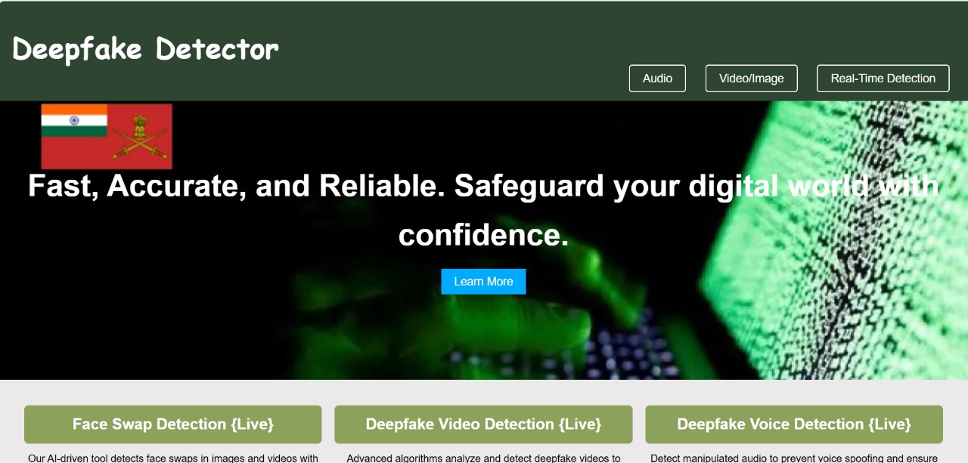
Deep Learning-Based Detection of Video Deepfakes Using CNNs, LSTMs, and Transformer Models
Proposed Solution :
The deepfake recognition prototype uses advanced deep learning to detect AI-generated media, focusing on image, video, and audio formats. It combines a ResNext CNN for feature extraction and an LSTM for classification, allowing accurate detection of fake content. Trained on a diverse dataset, the model ensures effective identification.
1.Data Acquisition: Users upload media via a web interface.
Feature Extraction: ResNext CNN extracts key features.
2.Data Classification: LSTM classifies media as "Real" or "AI-GENERATED.“
3.User Feedback: Results and confidence scores are provided.
4.Continuous Learning: Feedback updates the model with new deepfake examples.
5.Real-Time Monitoring: Immediate analysis and alerts for misleading content through live video audio recording.
Unique Value Propositions :
Adaptive Learning : Continuously updates to handle new deepfake techniques.
Real-Time Detection: Provides instant feedback on media authenticity.
Format Compatibility: Supports various video and audio formats.
High Accuracy: Trained on diverse datasets for precise detection.
User-Friendly: Simple interface for easy deepfake detection.
Scalable: Cloud-based for handling large data volumes efficiently.
Problem Resolution :
Static Learning: User feedback updates the dataset, enabling adaptation to new deepfake techniques.
Limited Dataset: The model is trained on sources like FaceForensics++, ensuring wide coverage and reduced bias.
Real-Time Deep Fake Detection : Provides immediate feedback to quickly identify deepfakes, preventing harmful content spread.

Slide 3



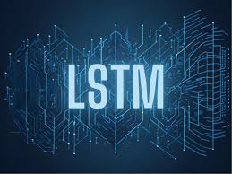



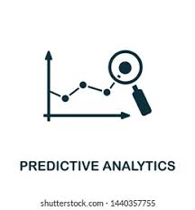


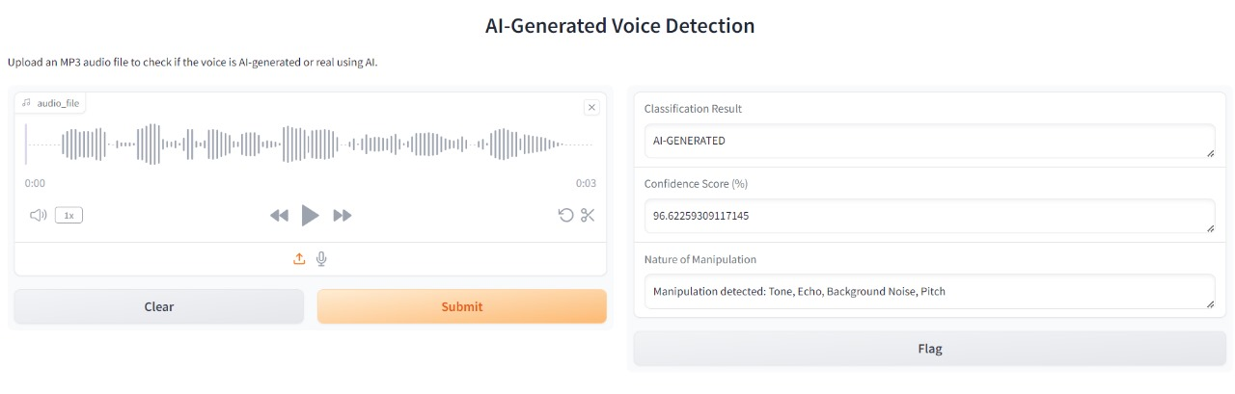


TECHNICAL APPROACH
FLOWCHART
TECH STACK
Pre Processing
Programming Languages
Python3
JavaScript
Upload Audio/Video via web interface
Splitting video into frames
DATA RETRIEVAl & PREPROCESSING
VIDEO
Face detection
Face cropping
Datasets collection from public datasets like face forensics for model training
Saving the face cropped video
AUDIO
Programming Frameworks
PyTorch
Django
Load and covert audio into mono
The extracted frame level features/audio signals are fed into the LSTM in a sequential manner and if there is any subtle change between consecutive frames/audio signals than it could indicate tempering
Resampling the audio
Segmenting Audio
MODEL PROCESSING
Use ResNext CNN to extract features from each frame of video
IDE
Google
Jupyter Notebook
Visual Studio Code
Feature vectors representing each frame / audio features
REAL / FAKE
Use parallel audio CNN to extract audio features
Prediction is displayed using confidence score
Along with the nature of manipulation
Cloud Services
Google Cloud Platform
OUTPUT & FEEDBACK
Confidence Score
Nature of Manipulation
Version Control
Git
3

Slide 4
FEASIBILITY AND VIABILITY
Potential Challenges and Risks
Resolution
Feasibility
Technological Feasibility:
Utilizes well-established deep learning frameworks and architectures (CNNs, LSTMs) that are proven effective in audio and video analysis.
Financial Feasibility:
Utilizes existing technologies and open-source frameworks, minimizing development costs while primarily requiring investment in GPUs and cloud infrastructure.
Evolving Deepfake Techniques:
New deepfake methods may outpace the model's ability to detect them.
Establish a continuous feedback loop for model updates, integrating user feedback and new data to enhance detection capabilities.
Model Bias:
The model may exhibit bias if trained on unrepresentative datasets, leading to inaccurate predictions.
Use diverse and balanced datasets for training and regularly evaluate model performance across different demographics and scenarios.
Viability
Scalability:
Can be implemented across various platforms with increasing data volumes.
Continuous Improvement:
Regular updates and user feedback keep the system relevant against evolving deepfake techniques.
Adversarial Attacks:
Deepfake creators may intentionally introduce small, imperceptible changes (adversarial noise) to fool detection models.
Incorporate adversarial training techniques, where the model is trained to recognize and withstand such manipulations..
4

Slide 5





















IMPACT AND BENEFITS
01
Enhanced Media Integrity:
Real Time Detection:
06
Helps identify manipulated media, promoting truth in digital content.
Provides fast, reliable deepfake identification for immediate media verification
02
Legal Support:
Scalable Solution:
07
Assists in legal cases involving deepfakes, such as defamation or blackmail.
B
E
N
E
F
I
T
S
Can be implemented across various platforms with increasing data volumes.
I
M
P
A
C
T
S
03
Reduced Misinformation:
User-Driven Feedback
08
Lowers the spread of fake news and harmful content in social media and news outlets.
Incorporates user feedback for improving detection accuracy, adapting quickly to new threats.
04
Cultural Preservations:
Transparency in Decision Making
09
Cultural Preservation: Prevents misuse of historical or public figures in deepfake media that distorts historical facts or public opinion.
Provides confidence scores and detailed explanations, enhancing user trust in predictions.
05
Corporate Security:
10
Shields businesses from deepfake-driven scams, fraud, and corporate espionage.
Future proof technology
Designed to evolve alongside advancements in deepfake creation, keeping detection methods up to date.
@SIH Idea submission- Template
5
5

Slide 6
RESEARCH AND REFERENCES
Research on ML for Deepfake Video Detection
Research on ML for Deepfake Audio Detection
Research Paper:
Title: " An Enhanced Deep Learning-Based DeepFake Video Detection and Classification System "
Authors: Cheng-Chi Lee, et al
Journal: Electronics,2023
Summary: This study proposes a deep learning model using a five-layered convolutional neural network (CNN) enhanced with ReLU for deepfake video detection. The model was evaluated on datasets like Face2Face and first-order motion, achieving a prediction accuracy of 74% for DeepFake videos and 68% for Face2Face videos.
LINK: Click Here
Research Paper:
Title: "Detection of Fake Audio: A Deep Learning-Based Comprehensive Survey"
Authors: Y. Ren, W. Liu, et al..
Journal: Springer
Summary: : This paper presents a comprehensive survey on the detection of fake audio using deep learning techniques. It explores various machine learning frameworks, focusing on methods like CNNs and RNNs for detecting synthetic or manipulated audio files. The paper also reviews the challenges faced in generalizing deepfake detection systems across different datasets.
Link: Click Here
w
Research Paper:
Title: " Deepfake Video Detection: Challenges and Opportunities "
Authors: Hemanth Karnati
Journal: : Artificial Intelligence Review, 2023
Summary: This paper reviews deepfake generation and detection methods, categorizing them into traditional approaches, deep learning-based methods, and blockchain-based techniques. It identifies gaps in current detection technologies, emphasizing the need for real-world application and improved dataset quality.
Link: ​Click Here
w
Research Paper :.
Title: "Detecting Deepfake Voice Using Explainable Deep Learning Technique"
Authors: S.-Y. Lim, D.-K. Chae
Journal: I: Applied Sciences
Summary: : This research outlines the use of explainable AI for deepfake voice detection, providing insights into how neural networks identify anomalies in audio signals. It highlights the importance of making AI decisions interpretable for better understanding and improvement of detection techniques.
Link: Click Here
6

