Slide 1

Deep Learning Project

Slide 2
Problem Statement
In many factory environments, when employees enter a designated area, they must be wearing proper Equoments such as a construction helmet.
This project shows a solution which can be used to issue an alert when an employee has been detected and is not wearing a helmet in a designated area
This has been accomplished using a deep learning technique - Object Detection

Slide 3

Dataset Division
Train
Test
Total
5269
1766
7041
Link : https://public.roboflow.com/object-detection/hard-hat-workers

Slide 4
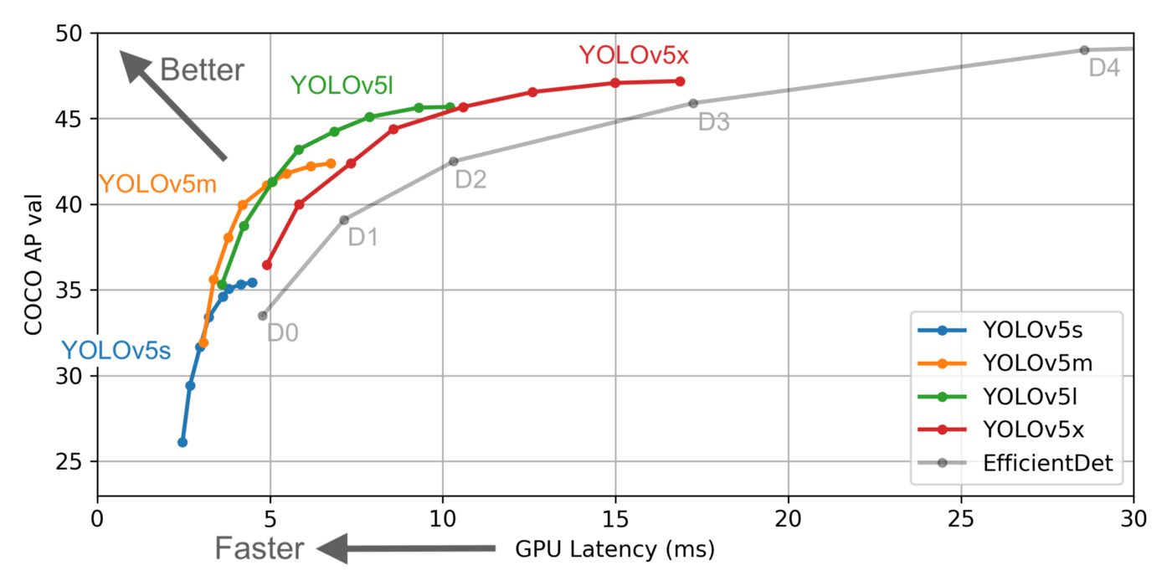
Training Specifics
Epochs : 80
Model Used : YoloV5s
Image Size : 416 X 416
Number of classes : 3

Slide 5
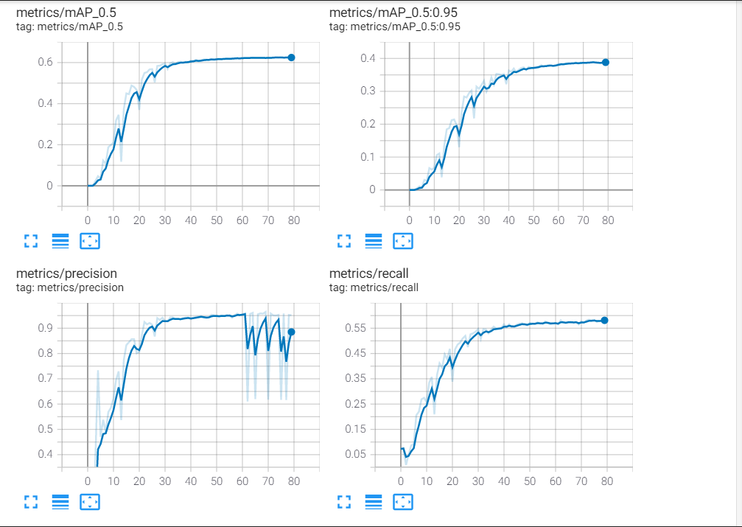
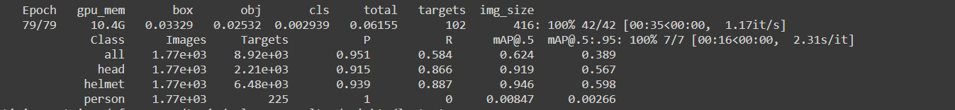
Metrics Results
Training Charts

Slide 6
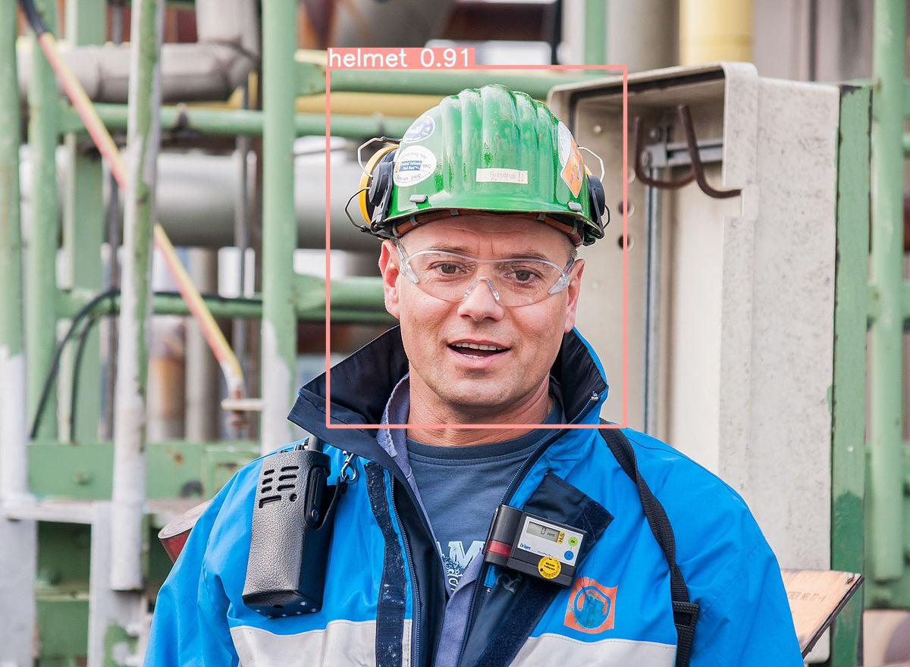


Results

Slide 7

Thank you
By -
Aman Tripathi
(DF2009CM)
amancrackpot@gmail.com

