Slide 1
Visualizing the contributions of an user in the Social Web
Maria Stamatoula Karavolia
Maria Schmidt

Slide 2
Outline
Motivation
Research Questions
Prototype
Aspects of User Visualization
Contribution over time
Summary of posts
Topic Models
Impact of posts
Demo
Conclusion

Slide 3
Motivation
Growing amount of data in social networks
Visualizing the data under different aspects can make it easier to make sense of the data
Interesting for users who want to analyze the contributions and their impacts in different social networks
Interesting for users who want to have an overview of contributions of public persons

Slide 4
Research Questions
How can we visualize the contribution of a user in social networks?
How can we interrelate the posts published by the same user?
How can we find similar posts in different social networks?

Slide 5
Prototype
Using data from files
Data was retrieved from Facebook and Twitter, for 25 public persons
Using Django framework for building the application
Retrieving data: JavaScript and Python
Analyzing data: Python
Visualizing data: JavaScript D3

Slide 6
Aspects of User Visualization

Slide 7
Contribution over time
How much did a user write?
Starting point for analysing the corpus further
Approach :
Counting the number of posts for every month for every social network
Notes:
2d bullet: if we see one time range, where they were a lot of posts we can identify interessting times and read more about what happened at this time

Slide 8
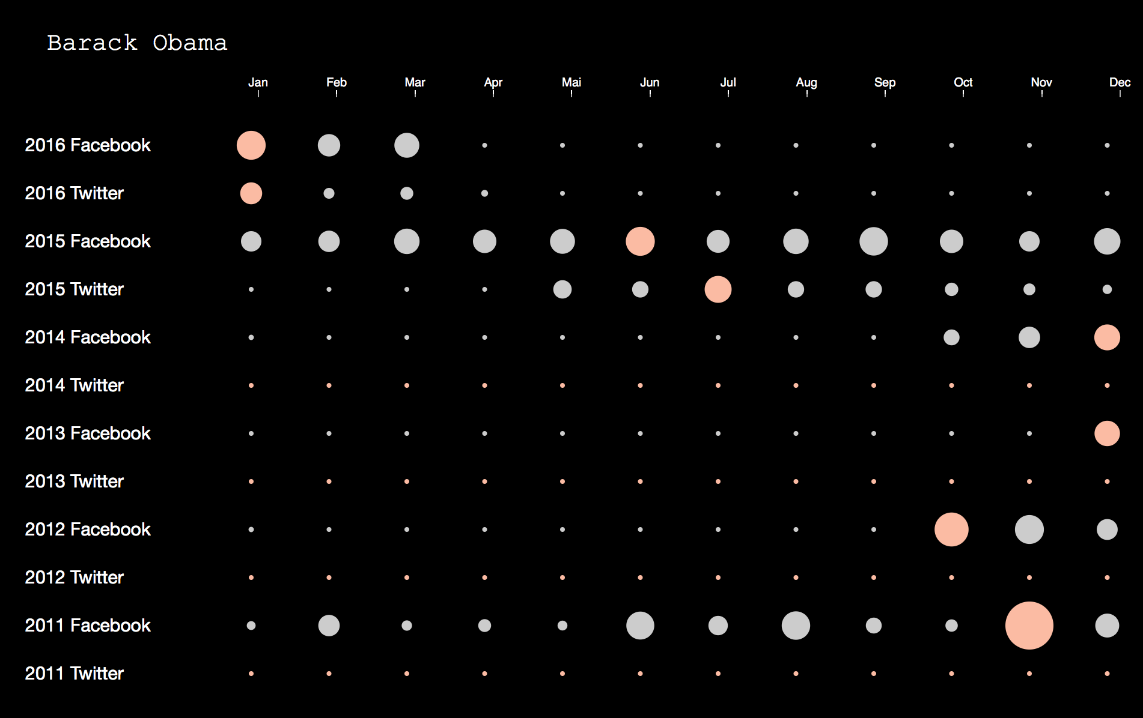

Slide 9
Summary of posts
What did a user talk about?
Visualizing the content of posts gives us a summary about the corpus without reading all the contributions
Adapted from http://textexture.com/
Notes:
- Used most → we lookes at time ranges

Slide 10
Summary of posts
Approach:
Fixed a time range (specific month or last n days)
Remove stop words from the corpus
Count appearance of every word in the corpus
Count how often two top words appear together

Slide 11
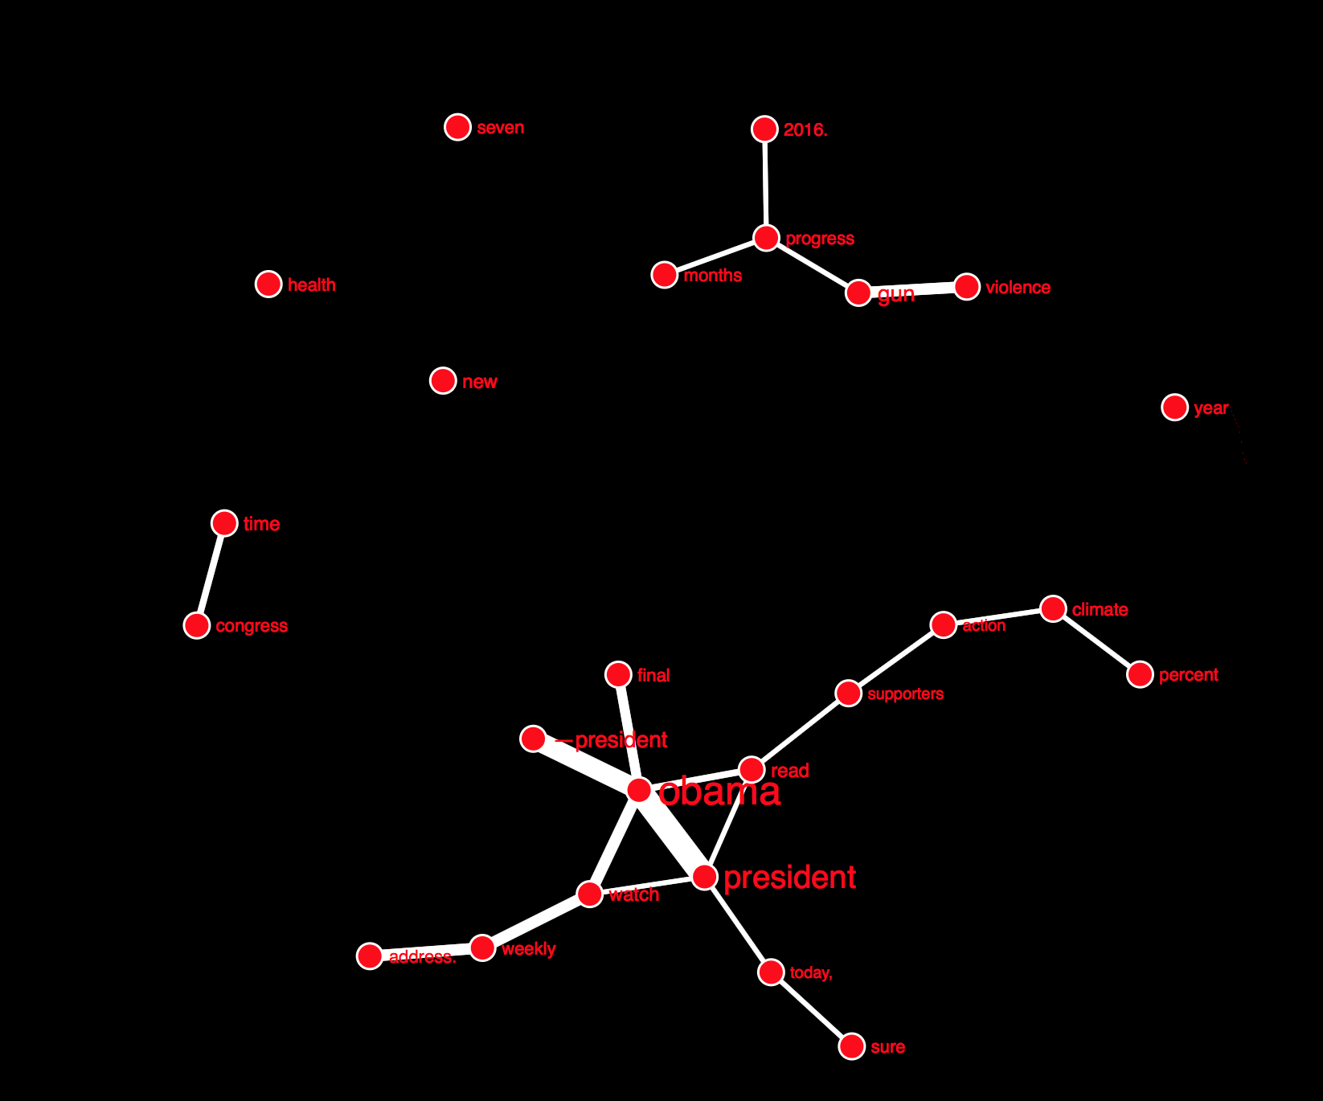

Slide 12
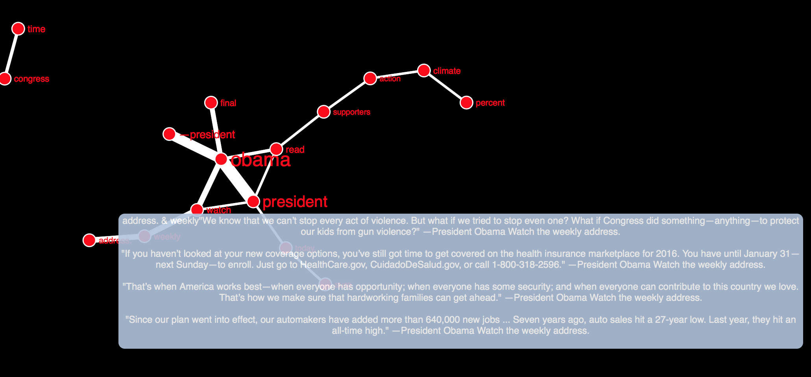

Slide 13
Topic Models
We want to find themes (or topics) in documents
topics that a user is discussing
Need an approach which automatically discovers the topics
This is essentially a clustering problem – can think of both words and documents as being clustered
Popular algorithms
LDA
NMF

Slide 14
Latent Dirichlet Allocation (LDA)
LDA is a generative probabilistic model of a corpus.
Documents are represented as random mixtures over latent topics, where a topic is characterized by a distribution words.
Generative Process:
For each document:
randomly choose a distribution over topics (a multinomial of length K)
for each word in the document:
Probabilistically draw one of the K topics from the distribution over topics obtained in (a), say topic βj
Probabilistically draw one of the V words from βj

Slide 15
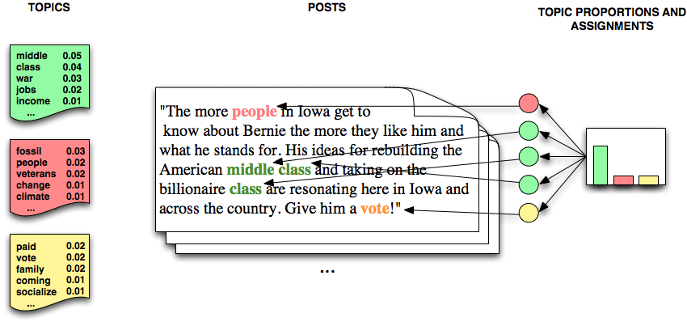
LDA Example

Slide 16
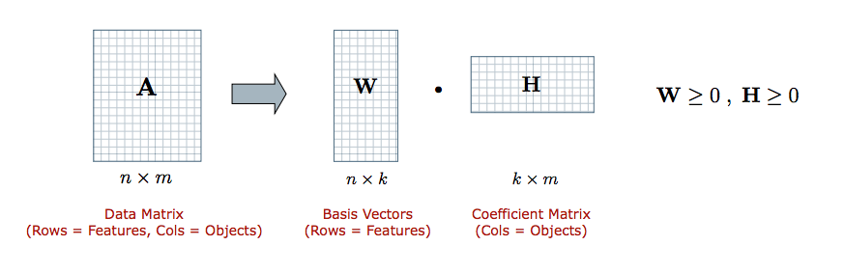
Non-negative Matrix Factorization
Unsupervised algorithm that simultaneously perform dimension reduction and clustering.
Given a non-negative matrix A, find k-dimension approximation in terms of non-negative factors W and H
Rows of W: provide weights for the input documents relative to the k topics​
Columns of H: provide weights for the terms relative to the topics

Slide 17
Topic Models- Visualization

Slide 18
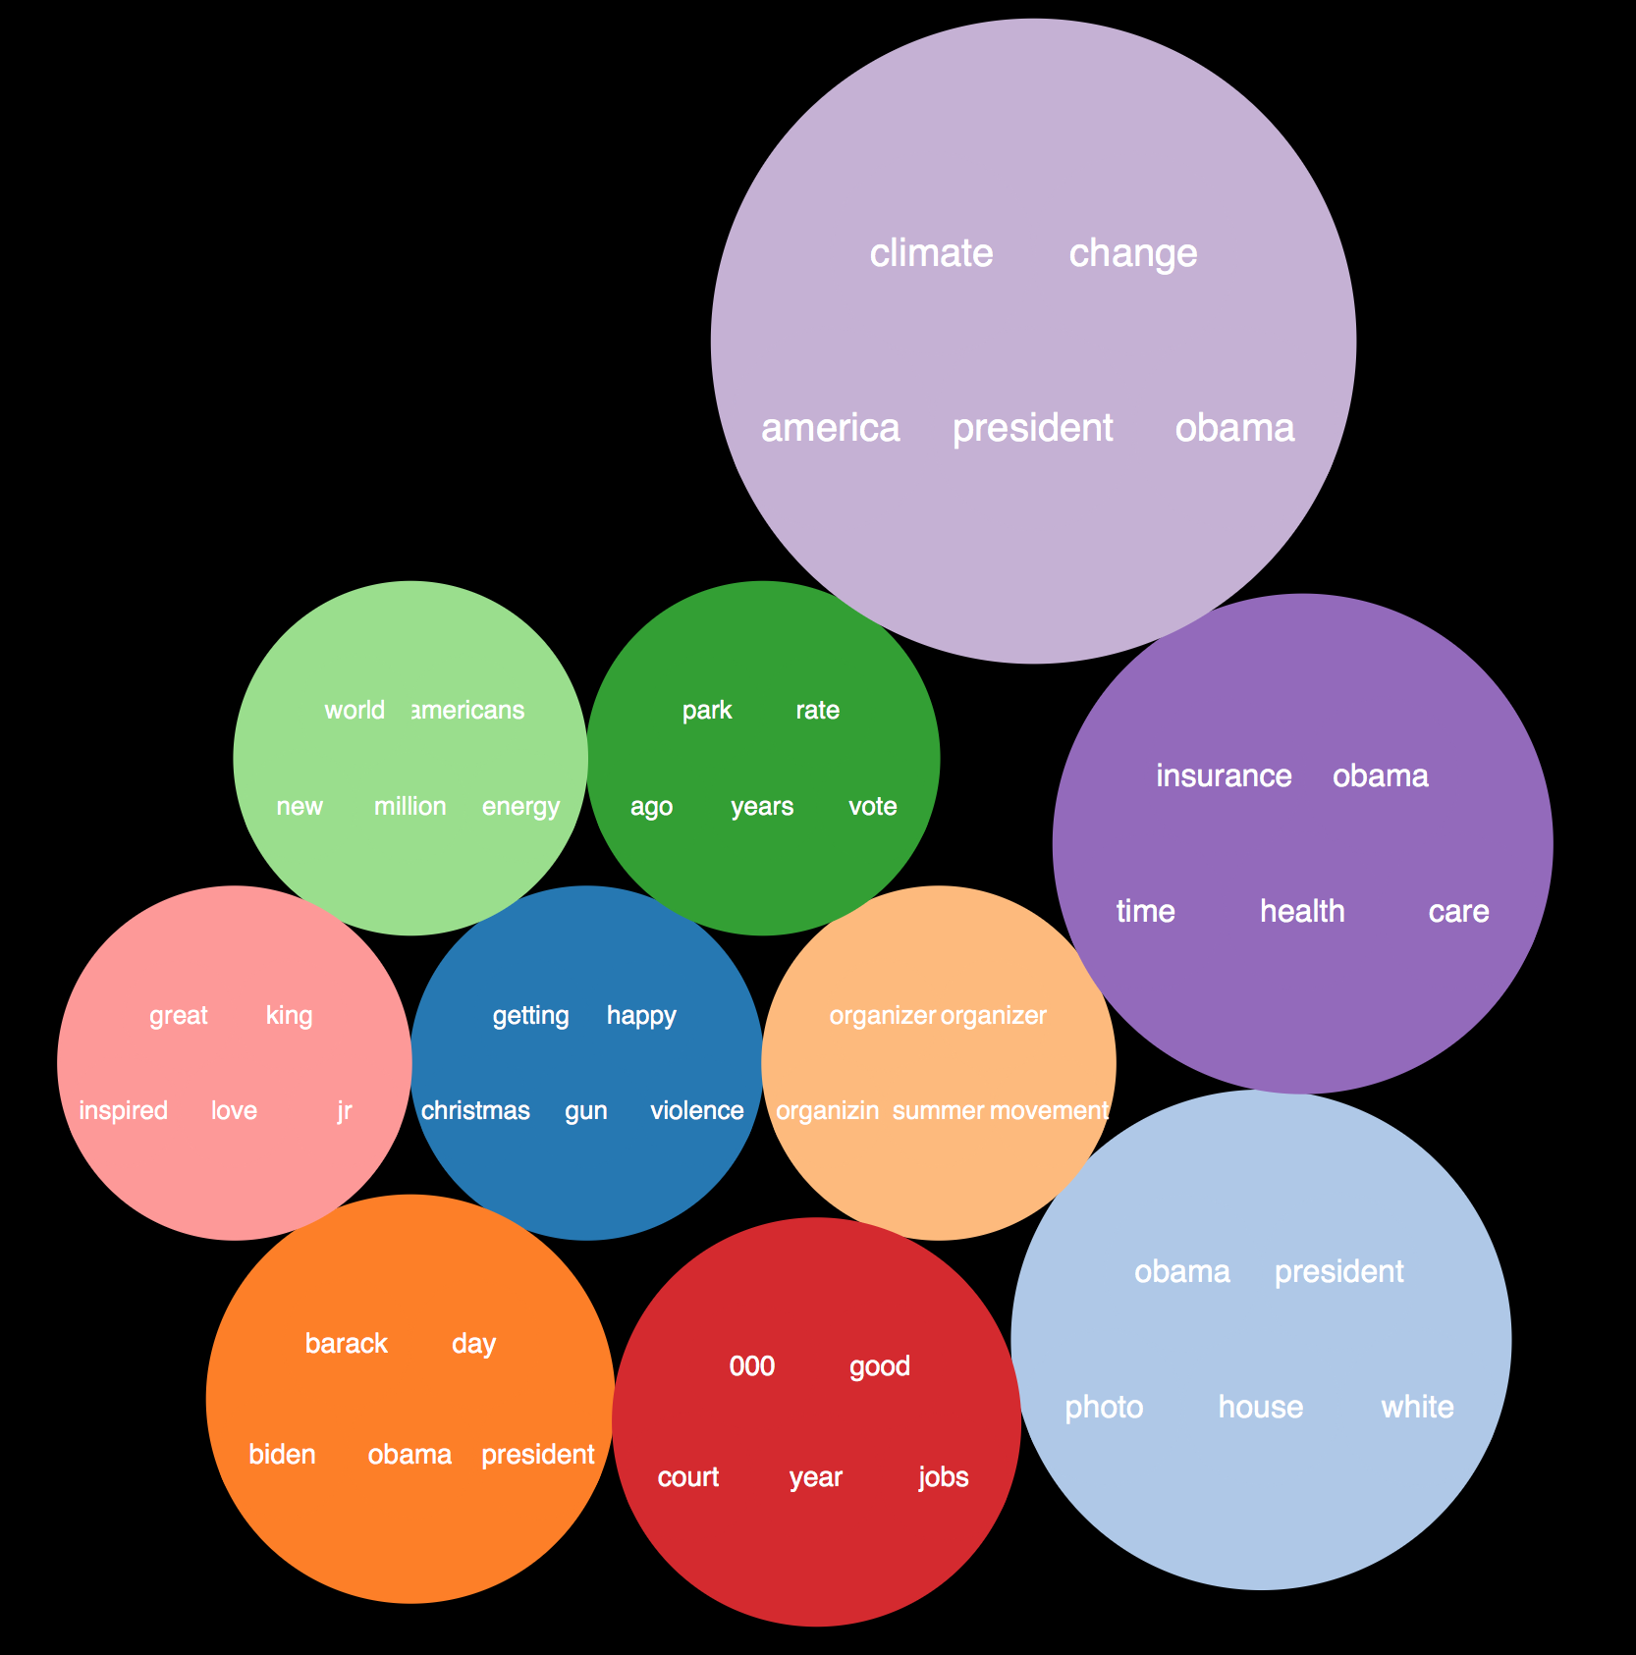

Slide 20
Impact of posts
Visualize how many responses a post got in a social network
Can help a user to identify in which social network he/she has more impact
Can help a user to identify which kind of posts are getting more responses
Approach:
Using cosine similarity to find similar posts for one user between different social networks

Slide 21




Finding similar posts
using Bag of Words approach
Every document is represented as a vector
Example
Dictionary: w = {sky, blue, bright, sun}
The sky is blue
$$v_{1}=(1, 1, 0, 0)$$
The sun is bright
$$v_{2}=(0, 0, 1, 1)$$
The sun in the sky is bright
$$v_{3}=(1, 0, 1, 1)$$
We can see the sun, the bright sun
$$v_{4}=(0, 0, 1, 1)$$
entries of vectors can be weighted
Notes:
Weight: proportion number of occurences in document / number of all words in documents
Tfidf: term frequency inverse document frequency
measures how important a term is.
While computing TF, all terms are considered equally important.
There are terms which appear often (stop words) but are not important
Thus we need to weigh down the frequent terms while scale up the rare ones, by computing the following: IDF(t) = log_e(Total number of documents / Number of documents with term t in it).

Slide 22

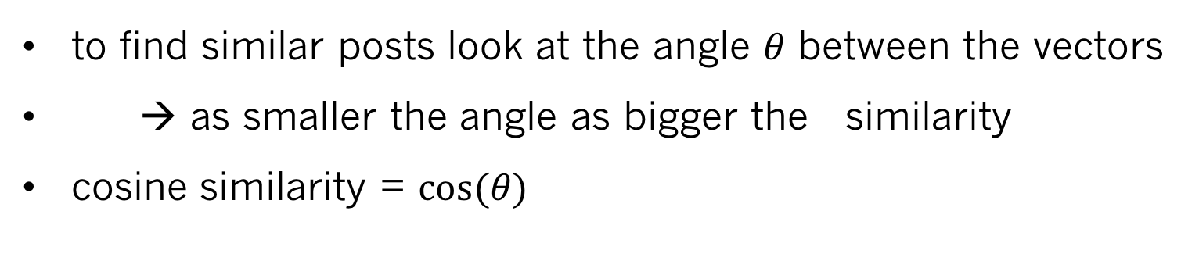
Finding similar posts
to find similar posts look at the angle $θ$ between the vectors
→ as smaller the angle as bigger the similarity
cosine similarity = $cos(θ)$
$$\cos\left(θ\right)= \frac{\vec{a} ∗ \vec{b}}{\left\|\vec{a}\right\|∗ \left\|\vec{b}\right\|}$$
Notes:
Weight: proportion number of occurences in document / number of all words in documents
Tfidf: term frequency inverse document frequency
measures how important a term is.
While computing TF, all terms are considered equally important.
There are terms which appear often (stop words) but are not important
Thus we need to weigh down the frequent terms while scale up the rare ones, by computing the following: IDF(t) = log_e(Total number of documents / Number of documents with term t in it).

Slide 23
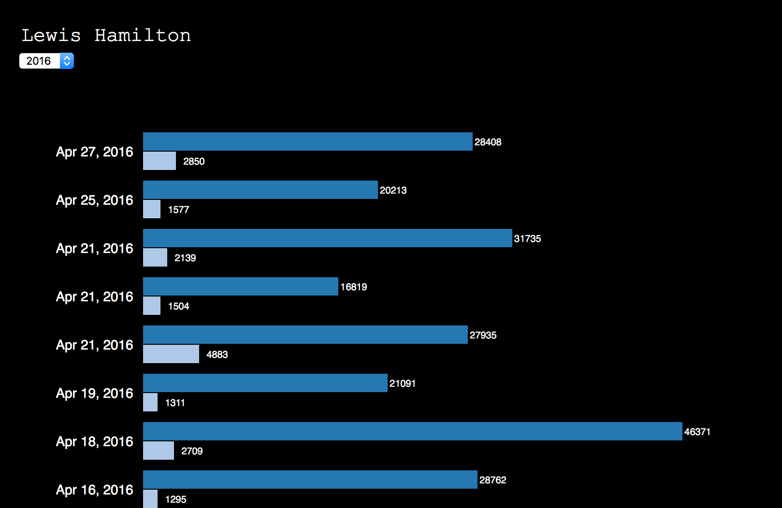
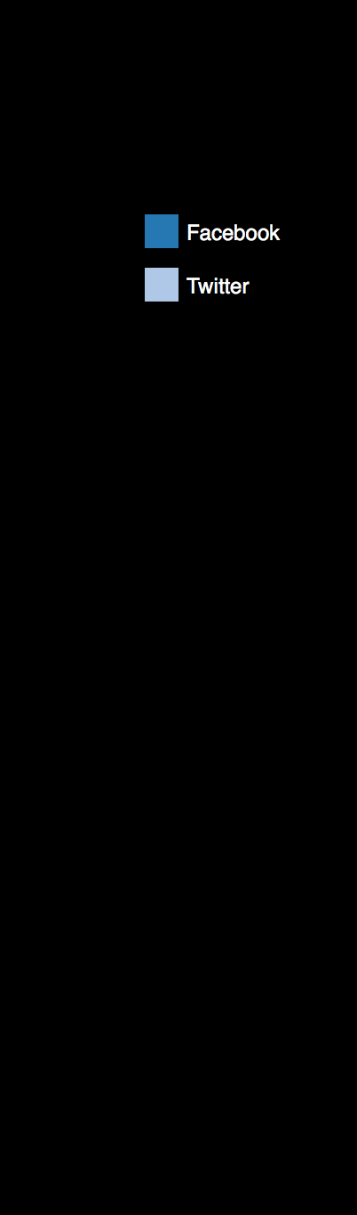

Slide 24
Impact of posts
after finding similar posts we can take the number of responses to visualize the impact
Visualization:
Used number of likes

Slide 25
Demo

Slide 26
Conclusion & Further Work
Presented different possibilities to visualize user contributions
Visualization helps to better analyse user contributions
Further Work:
Find similar posts among users
Try other approaches to visualize the posts
Take more values for the impact into account
Use the different visualizations together

Slide 27
Thank you for your attention!

Slide 28
References
Kiethmann, Hermkens, McCarthy, Silvestre (2011) : Social media? Get serious! Understanding the
functional building blocks of social media
Kwa, Lee, Park, Moon (2009) : What is Twitter, a Social Network or a News Media?
Kaplan, Haenlein (2010): What is Twitter, a Social Network or a News Media?
Steinbach, Karypis, Kumar (2000): A Comparison of Document Clustering Techniques
Becker, Naam, Gravano (2010) : Learning Similarity Metrics for Event Identification in Social Media
Fortuna, Mladenic, Grobelnik (2005): VISUALIZATION OF TEXT DOCUMENT CORPUS
Aletras, Stevenson (2014): Measuring the Similarity between Automatically Generated Topics
Chaney, Blei (2012): Visualizing Topic Models
Ramage, Dumais, Liebling (2010): Characterizing Microblogs with Topic Models
Blei, Y. Ng, Jordan (2003): Characterizing Microblogs with Topic Models
Xu, Liu, Gong (2003) : Document Clustering Based On Non-negative Matrix Factorization
Chen, Greyer, Dugan Muller, Guy (2006): Document Clustering Based On Non-negative Matrix Factorization
Java, Song, Finin, Tsen (2007): Why We Twitter: Understanding Microblogging Usage and Communities
Ryan, Bernard (2003): Techniques to Identify Themes
(16) Paranyushkin (2011): Identifying the Pathways for Meaning Circulation using Text Networ Analysis

