Slide 1

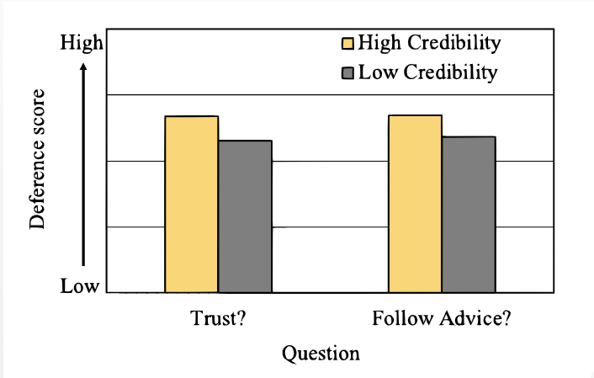
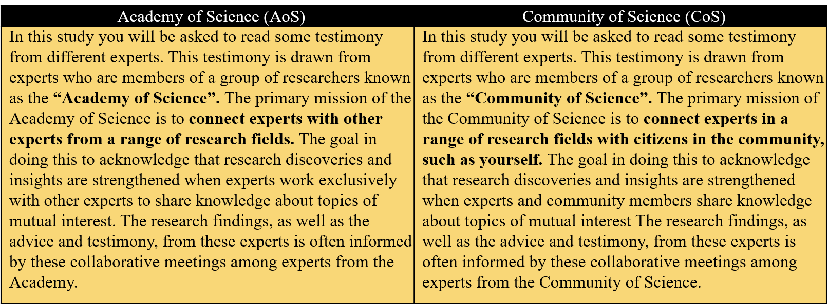
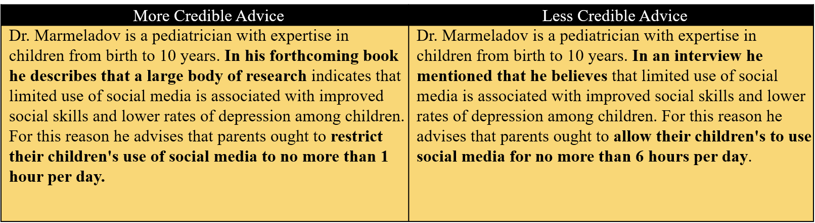
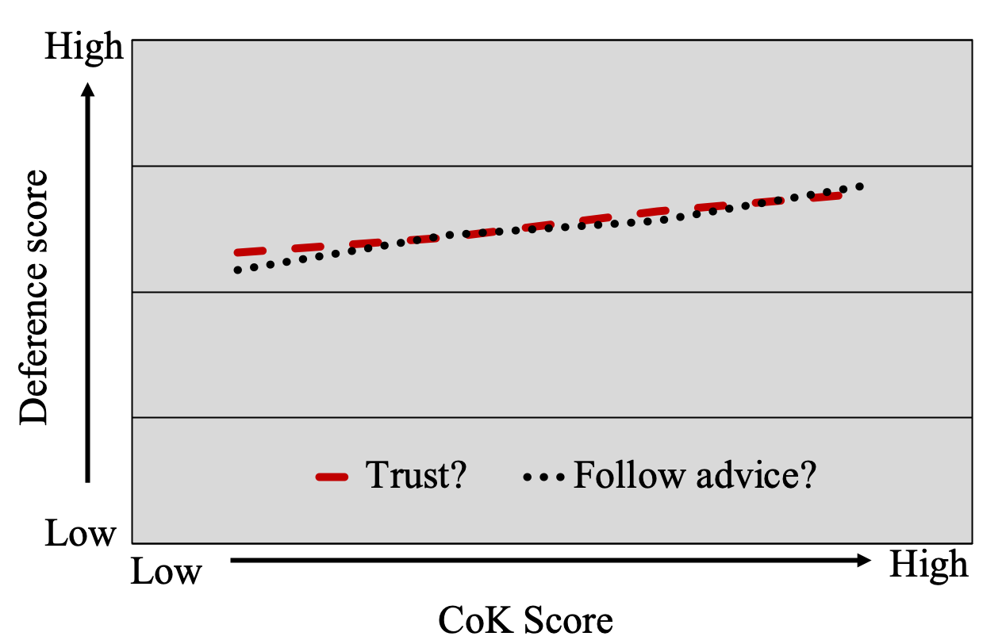
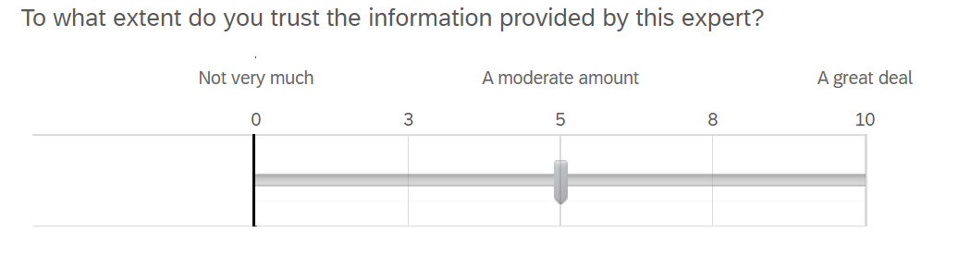
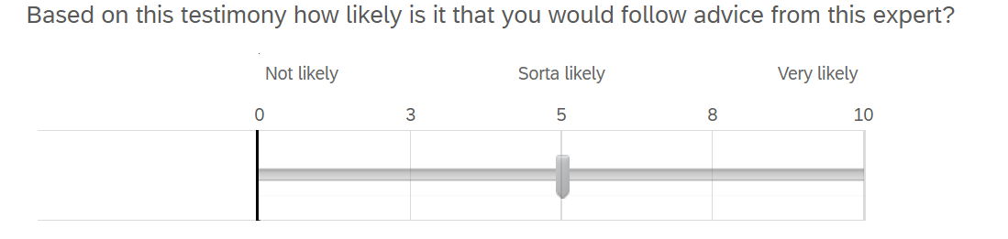
When do people defer to experts?: How feeling like a member of a community of knowledge supports epistemic trust
Amanda E. Crosby & Chris A. Lawson University of Wisconsin-Milwaukee
Introduction
Methodology
Results
Conclusions
Individuals can only have expertise about a few things, so we depend on others’ knowledge for information in outside areas. When we’re uncertain about something we typically trust the conclusion of another person for clarity (Rabb et. al, 2019). An example of this is if our car breaks down, and since we most likely have little to no expertise in this field, we rely on what the mechanic says is necessary to fix the car.
Previous work found that individuals are extremely vigilant when evaluating information presented to them. Even slight changes in the wording of advice were picked up by participants and had an affect on how they judged it (Harris & Lawson, 2021). Specifically, it was found that participants were more willing to trust advice than trust someone telling them what to do. In this study, we focused on how willing individuals were to trust advice if it was presented in a more credible versus a less credible way.
Rabb et. al (2019) additionally found that people are more likely to accept claims from members within their community of knowledge. Being a member of a community knowledge means to share and receive information to assist members with common goals. For example, a teacher is more likely to accept advice from another teacher than an outside member. The goal of this study is to understand how and why having an affiliation with a community makes a person deem the advice more credible.
Participants
There were 303 participants in total. 33.3% were female, 65.5% were male, 0.3% identified as other, and 0.9% preferred not to answer. Of this population, 8.6% had a high school equivalent education, 10.2% had some college education, 5.9% had an Associate’s Degree, 61.1% had a Bachelor’s Degree, 12.9% had a Master’s Degree, and 1.3% had a Doctorate Degree.
Materials
Each participant was directed to an online survey and consent form. Participants were first asked to rate topics based on their previous knowledge in the area. The survey then presented a number of expert testimonies in which participants were asked to rank how reasonable the advice is, how trustworthy the expert is, and how much the information presented added to their existing knowledge on the subject.
Design
This study followed a 2x2 factorial design, which means it had four conditions. These include advice from the Academy of Science (AoS), advice from the Community of Science (Cos), more credible advice, and less credible advice. Since participants either got credible or less credible advice and not a mix of both, this study is a between-subjects design.
We first generated average deference scores by compiling responses to each of the 7 items for each participant. To test our prediction about the overall effect of credibility on deference judgments we conducted paired samples t-tests for both questions.
As suggested by Figure 2, these tests confirmed our prediction, both ts>4.23, ps<.001, ds>1.43, with higher deference scores under High credibility than Low credibility.
This study was designed with two goals in mind. The first being to test if the advice is presented in a more credible way, the participant would rank it to be more trustworthy than if it was presented in a less credible way. The second being to test if the participant feels they are a member of a specific community of knowledge, they will be more likely to follow the advice of experts from such areas. Both hypotheses were supported by our study.
We found that there was a significant difference between deference when presented with more credible advice than less credible advice. It was also found that there was a significant correlation between deference scores and CoK scores.
The results of our study also fit with what was found previously. Harris and Lawson (2021) found that individuals were extremely vigilant to slight changes in information presented to them, and thus had an affect on how they judged it. Specifically, people were more likely to follow the advice of someone if it was recommended to them than if the advice was telling them what to do. Rabb et. al (2019) discovered that people are more likely to accept claims from members within their community of knowledge.
There are many additional factors that influence how an individual chooses to defer to and/or trust an expert. These factors include status aspects such as the expert’s past reliability and their level of expertise; but also, emotional factors such as the assumption that experts are being honest with good intentions and the level of confidence exuded by the expert (van Swol & Sniezek, 2005). Identifying more factors in the future is important to fully gauge how influential and impressionable humans are.
Figure 3. Deference scores for both question types in the High credibility and Low credibility condition
Hypotheses
To test our second hypothesis, we calculated a “community of knowledge” (CoK) score that included the Condition (AoS, CoS) and people’s judgment of their knowledge within a domain.
We then ran separate repeated measures ANOVAs with CoK score as a within-subjects variable. Both tests confirmed our predictions, such that higher CoK scores led to greater deference scores, both Fs>5.10, ps<.01.
The first hypothesis tests a prediction about people’s attention to the credibility of evidence. Specifically,
Hypothesis 1: If the advice is presented in a more credible way, the participant would rank it to be more trustworthy than if it was presented in a less credible way.
The second hypothesis tests the interaction between credibility and one’s sense of being a member of a community of knowledge. Specifically,
Hypothesis 2: If the participant feels they are a member of a specific community of knowledge, they will be more likely to follow the advice of experts from such areas.
References
Harris, E., & Lawson, C. (2021). What we ought to do is…’: Are we More Willing to Defer to Experts who Provide Descriptive Facts Than Those who Offer Prescriptive Advice? Proceedings of the Annual Meeting of the Cognitive Science Society, 43.
Rabb, N., Fernbach, P. M., & Sloman, S. A. (2019). Individual Representation in a Community of Knowledge. Trends in cognitive sciences, 23(10), 891–902. https://doi.org/10.1016/j.tics.2019.07.011
van Swol, L. M., & Sniezek, J. A. (2005). Factors affecting the acceptance of expert advice. British Journal of Social Psychology, 44(3), 443–461. https://doi.org/10.1348/014466604X17092
Figure 1. Academy of Science versus Community of Science cover stories, and example of more credible versus less credible advice.
Figure 4. Deference scores for both question types in relation to CoK score.
Contact Information
Figure 2. Example of trust & follow advice questions
Amanda Crosby – aecrosby@uwm.edu
Christopher Lawson – lawson2@uwm.edu

