Slide 1
Aspects of Robust Regression Analysis
Supervisors: Nancy Reid & Archer Gong Zhang
Research Students: Amanda Ng, Shangkai Zhu
Notes:
Good morning everyone. Today, I will be presenting on 'Aspects of Robust Regression,' a crucial area in statistical analysis that aims to improve the reliability of regression models in the presence of outliers and non-normal error distributions.
The objective of this presentation is to provide an overview of regression models we tried, focusing on simulation analysis and the comparison of different prior distributions. I will also discuss the challenges encountered and the solutions proposed during this research project. By the end of this presentation, I hope to convey the significance of robust regression techniques and their potential applications in various fields.
Name of conference, date of conference

Slide 2
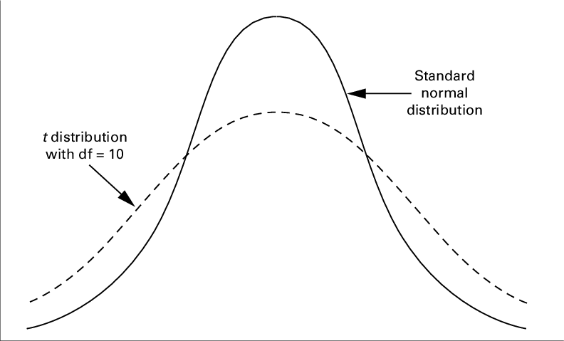
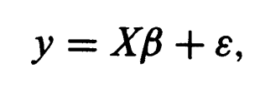
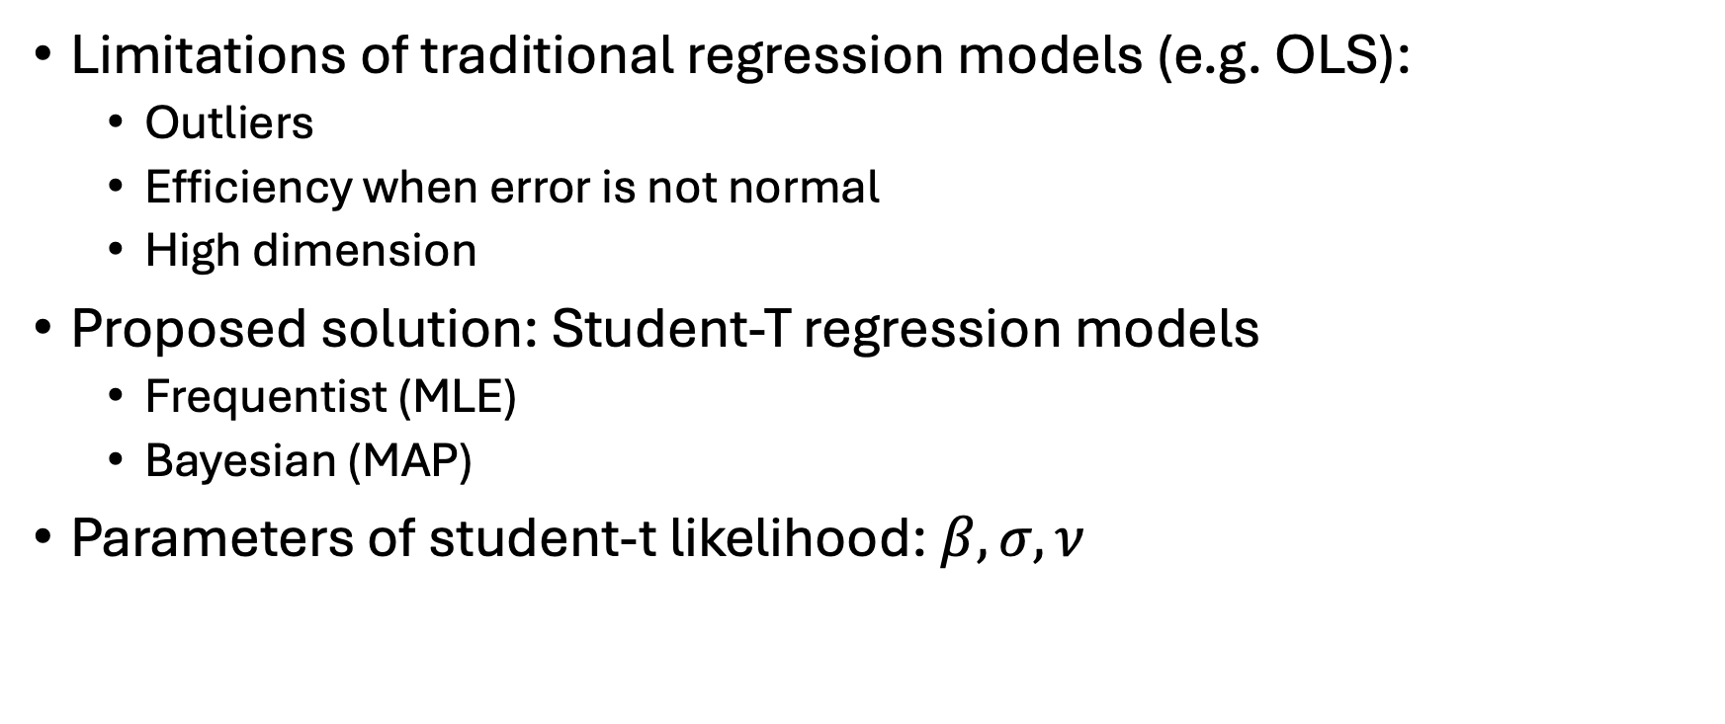
Introduction
Limitations of traditional regression models (e.g. OLS):
Outliers
Efficiency when error is not normal
High dimension
Proposed solution: Student-T regression models
Frequentist (MLE)
Bayesian (MAP)
Parameters of student-t likelihood:$β, σ,ν$
Notes:
Focus on nu

Slide 3




Frequentist approach using Profile likelihood
1. Likelihood of Student-T distribution:
Optimize
2. Nuisance parameter
3. Constrained MLE
4. Profile likelihood
Optimize
5. MLE

Slide 4
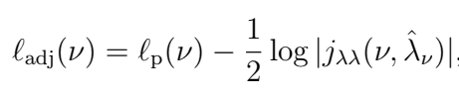

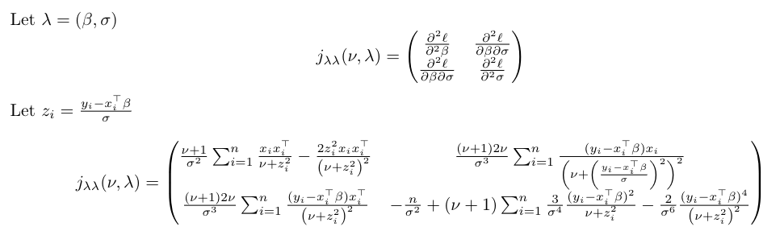
Frequentist approach using Adjusted profile likelihood
1. Adjusted profile log likelihood
*
Optimize
2. Adjusted MLE
*Observed Fisher information nuisance parameters block

Slide 5
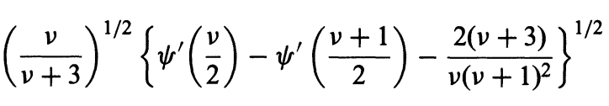







Bayesian approach using priors
$$β$$
$$∝$$
1
Flat prior
1. Improper priors
$$σ$$
$$∝$$
1/$σ$
Inverse prior
$$ν$$
$$∝$$
Jeffrey’s prior
2. Profile likelihood with constrained MLE
Optimize
3. Posterior distribution
4. MAP
Notes:
improper priors: don’t integrate to 1

Slide 6
Evaluate performance
Simulate covariate data (X) with using fixed true $β$, true $σ$
Loop over a range of true $ν$
Simulate Y (e.g. 50 repetitions) using true $ν$ and X
For each Y, optimize for:
MLE
Adjusted MLE
MAP
*Exclude those that do not converge successfully
Calculate averaged MSE for each approach
Plot MSE vs true $ν$

Slide 7
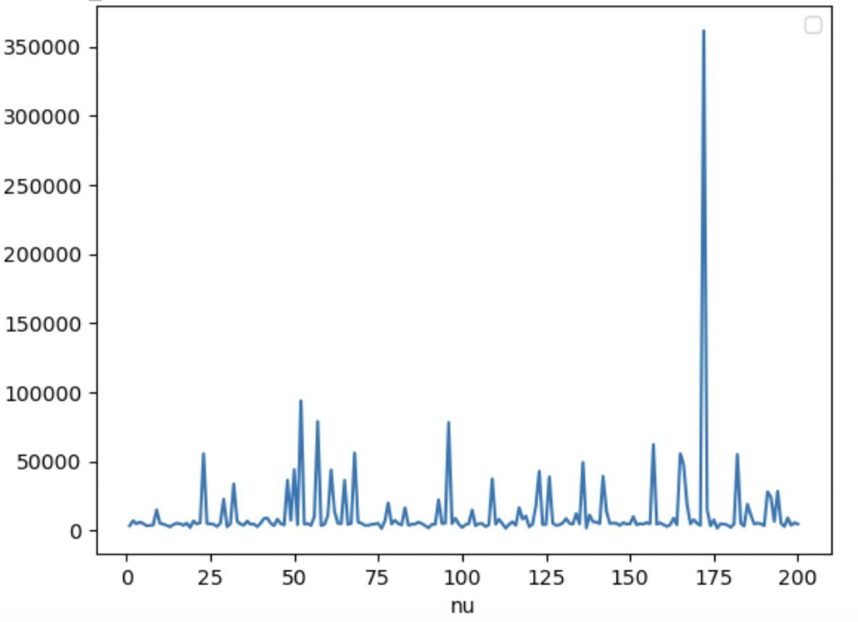
Challenges
Convergence issue in optimizations
Log profile likelihood
Run Time issue in two-step optimizations and PyMC MAP function
Notes:
Many spikes
Not well-behaved
May get stuck at local maximum

Slide 8
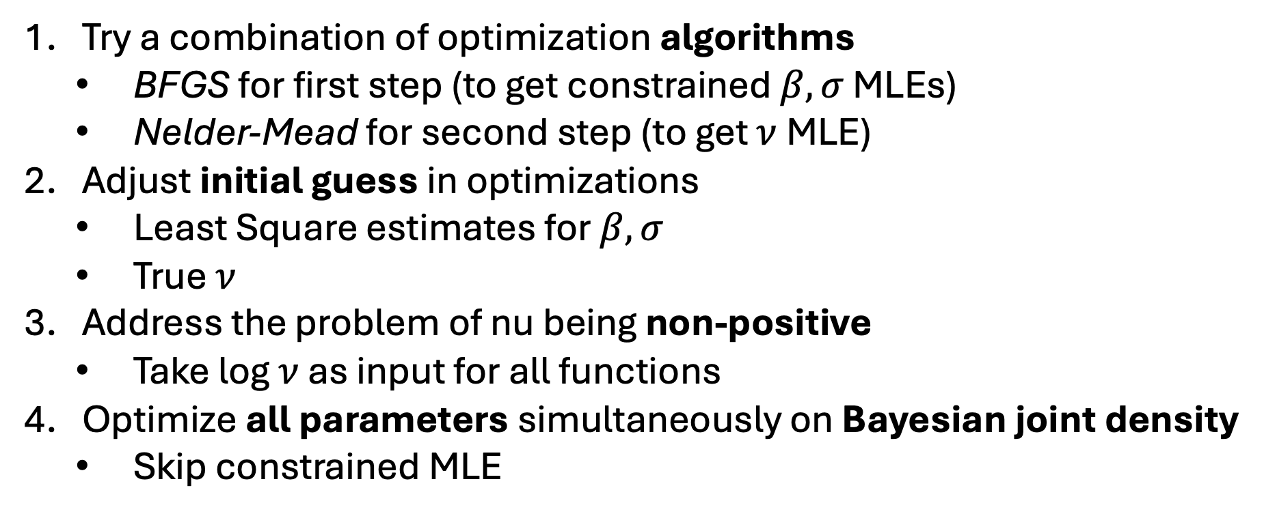
Solutions
Try a combination of optimization algorithms
BFGS for first step (to get constrained $β, σ$ MLEs)
Nelder-Mead for second step (to get $ν$ MLE)
Adjust initial guess in optimizations
Least Square estimates for $β, σ$
True $ν$
Address the problem of nu being non-positive
Take log $ν$ as input for all functions
Optimize all parameters simultaneously on Bayesian joint density
Skip constrained MLE
Notes:
difference between these algorithms:

Slide 9
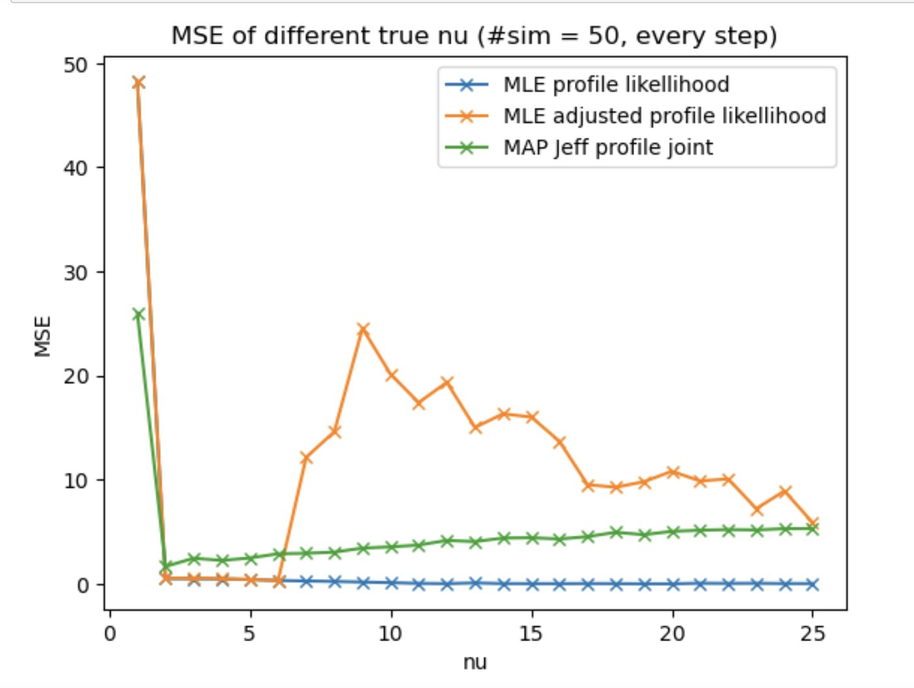
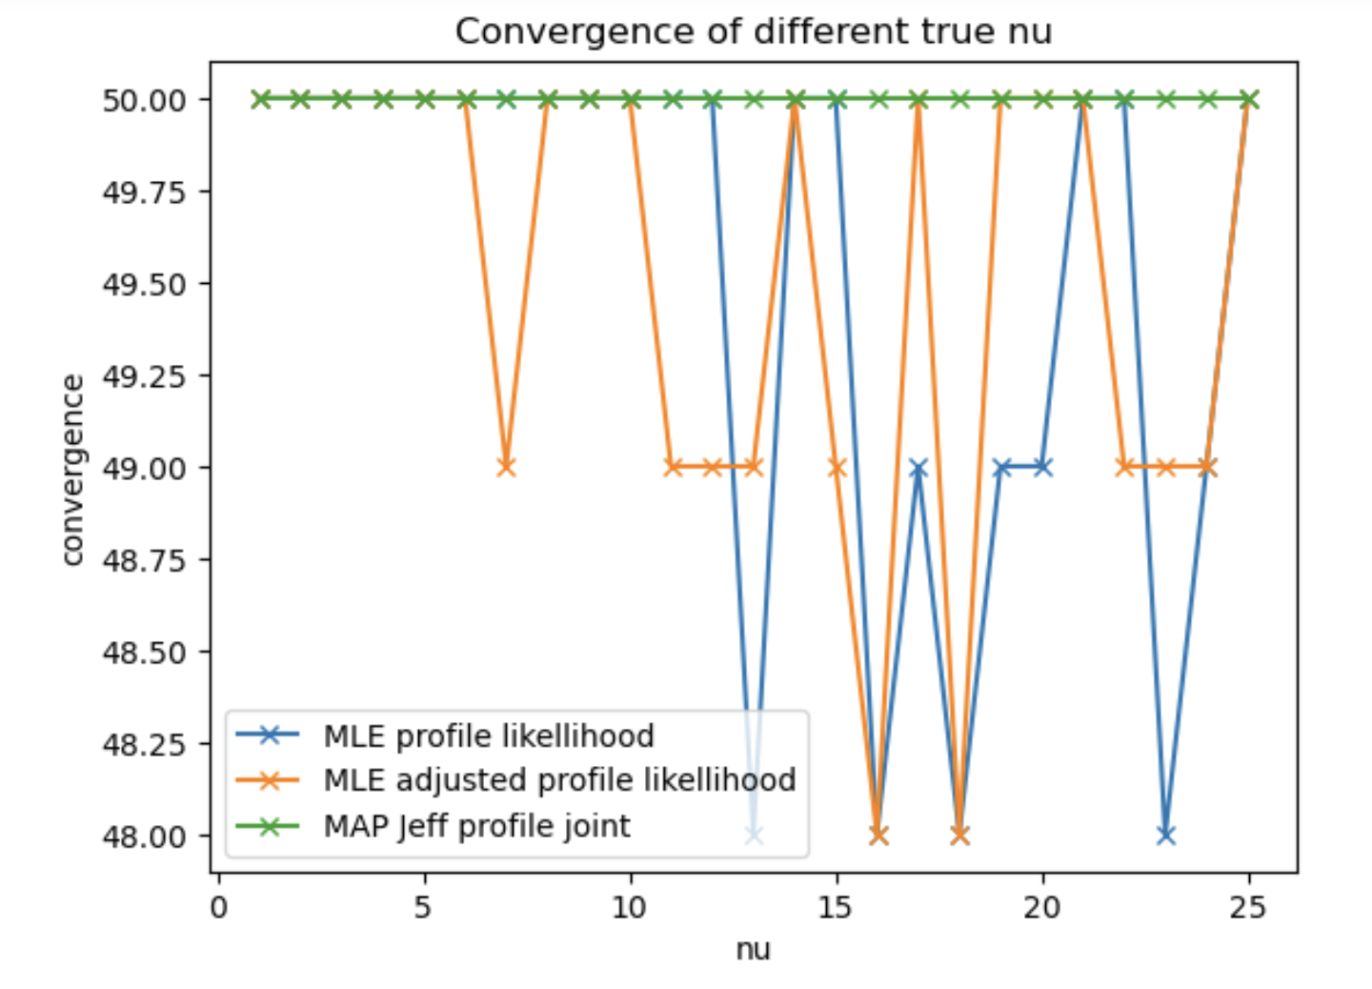


Results about $ν$
MLE
Adjusted MLE
MAP
MLE
Adjusted MLE
MAP

Slide 10
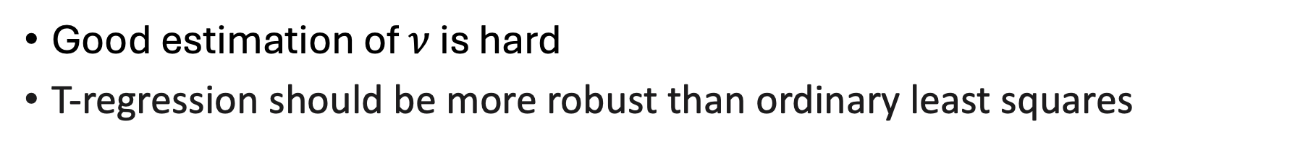
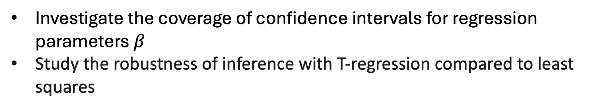
Conclusion
Good estimation of $ν$ is hard
T-regression should be more robust than ordinary least squares
Future Directions
Investigate the coverage of confidence intervals for regression parameters $β$
Study the robustness of inference with T-regression compared to least squares
Notes:
do you think we need to add the simulation results for OLS estimators (in the MSE plot) to support this claim? not sure how much more work it would be for you, but i think you can add the new results for outliers to support this claim, but you can decide! :-)

Slide 11
Supplementary Slides

Slide 12
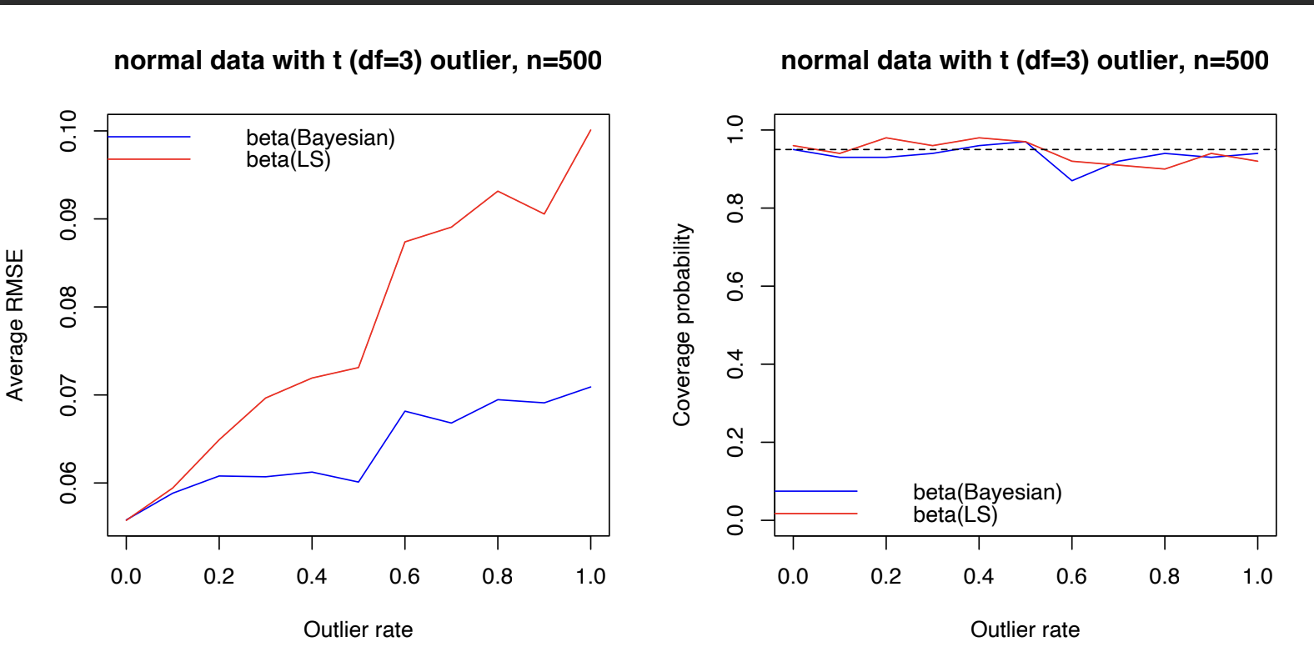
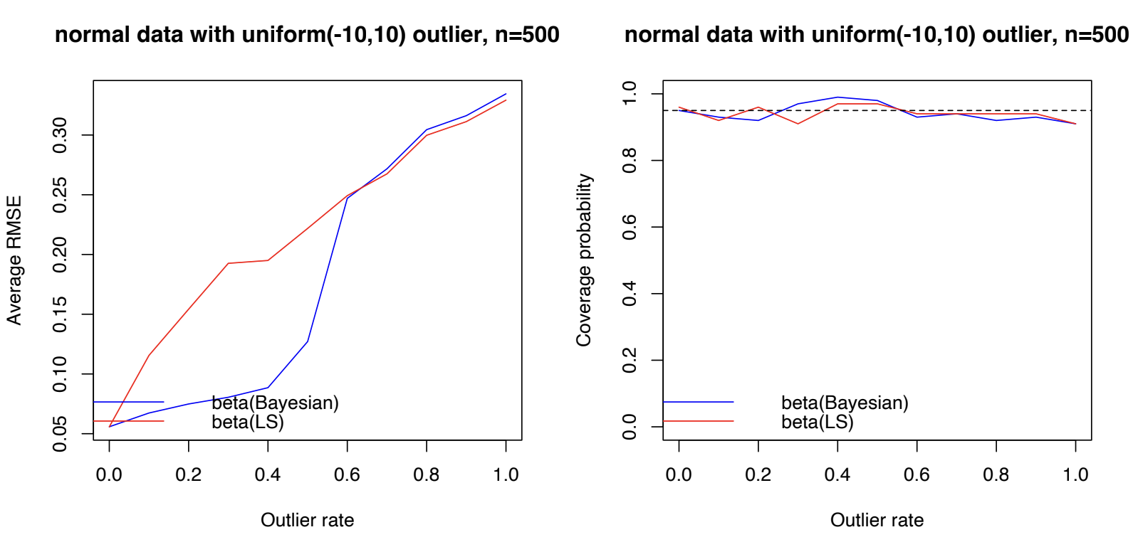

Results about outliers on $β$

Slide 13

Results about $β$ confidence interval

