Slide 1
Graduate School Project
Team Strawberry
Amanda T., Plamen P., Dhaval D., Visishta D.

Slide 2
Scope
This project will produce a web application to manage student registration, judge assignment, score tabulation and award assignment for the Wayne State University Graduate School’s yearly Graduate Exhibition in this and future years.

Slide 3
Functional Requirements:
User Registration
1 - All users must have a unique username and secret password.
1.1 - WSU login credentials (LDAP)
2 - The functionality exposed to each user should be restricted by the role they play in the exhibition.
3 - Allow grad students to register themselves and their projects as participants via the world wide web.
3.1 - A date after which registration is closed may be specified by an administrative user.

Slide 4
Functional Requirements:
Administrative Privileges
4 - Allow administrative users and their delegates to register judges for the exhibition.
5 - Administrative users should be able to add, view and modify all types of user accounts.
6 - Allow for the entry, modification and viewing of project categories
6.1 - Each category should have a default set of sub score categories that are editable by administrator.
6.2 - Each category should have a default set of awards and the formula by which they are awarded which may be edited by an administrative user.

Slide 5
Functional Requirements:
Assigning Judges
7 - Assign judges to evaluate projects.
7.1 - The number of judges per project may be specified by an administrative user.
7.2 - The number of projects per judge may be specified by an administrative user.
7.3 - Refrain from assigning judges to projects for which they may have a conflict of interest.
7.4 - The following reports should be available:
7.4.1 - Judges grouped by their assigned projects.
7.4.2 - Projects grouped by their assigned judges.
7.4.3 - Scorecards with the judge and project details

Slide 6
Functional Requirements:
Inputting & Summarizing Scores
8 - Input evaluation scores.
8.1 - Task may be performed by judges, administrative users or score entry users.
8.2 - Judges can only enter scores for the projects they have evaluated.

Slide 7
Functional Requirements:
Inputting & Summarizing Scores
9 - Summarize the scores of all participants.
9.1 - The following reports should be available:
9.1.1 - Scores grouped by category and sorted by any field.
9.1.2 - The top n participants in any category.
9.1.3 - The breakdown of all participants’ scores.
9.2 - Administrative, score entry and judge users should be able to search by name for participants to see their score breakdown.

Slide 8
Non-Functional Requirements:
Security
10 - All reasonable measure to prevent a user from modifying, viewing or deleting a record that they do not have permission to modify, view or delete should be taken.
10.1- All databases secured by username and password.
10.2 - Transmission of information between the client and server should not be in the clear.

Slide 9
Non-Functional Requirements:
Documentation
11 - All functionality implemented in the GERSP system must be documented. (i.e., user action to activate the feature and expected output should be defined.)
12 - All database fields must have some meta data associated with them giving precise descriptions and examples of the data they should contain.
13 - All Java code should be documented using Javadoc comments.

Slide 10
Non-Functional Requirements:
Performance
14 - Each user of the system should interact primarily with a single screen to perform their task to minimize the number of clicks and therefore the amount of time interacting with the electronic system.
15 - Score summary and award assignment must occur within 10 minutes after activation by the user.
16 - Judge assignment must occur within 10 minutes after activation by the user.

Slide 11
Non-Functional Requirements:
Reliability
17 - A daily backup of system data should be scheduled.
17.1 - Each backup must occur in two places, only one of which may be located physically near to the server.
18 - Man. ually triggered backups should be available to administrative users
18.1 - This backup may be saved to the media of the user’s choice. (e.g., a flash drive or a networked drive.) or to the default backup locations.

Slide 12
Non-Functional Requirements:
Availability
19 - Once opened for registration, the GERSP system servers should remain online and available 24/7 to allow students and judges to register.
20 - On the day of the exhibition, the system may be restricted to only essential users to ensure a timely response.

Slide 13
Team Organization
Team Leaders
Amanda, Plamen
Development
Amanda, Plamen
Testing
Vishi, Dhaval
Documentation
Vishi, Dhaval

Slide 14
Architecture & Technology Choices
Presentation Tier
HTML/CSS - WSU CSS attributes
Bootstrap (Responsive Design)
Javascript
Logic Tier
PHP - CodeIgniter: PHP Open Source Framework
JSP
Data Tier
MySQL
WSU LDAP
Apache - Tomcat Server

Slide 15
Analysis & Modeling
High Level Flow - Main Pages & User Permissions
High Level Flow - Main & Sub Pages
Registration & Sign In Flow
Use Case & Flow - Main Pages
Projects
Scores
Manage Users
System Settings
Website Mockups
Database ERD - In progress

Slide 16
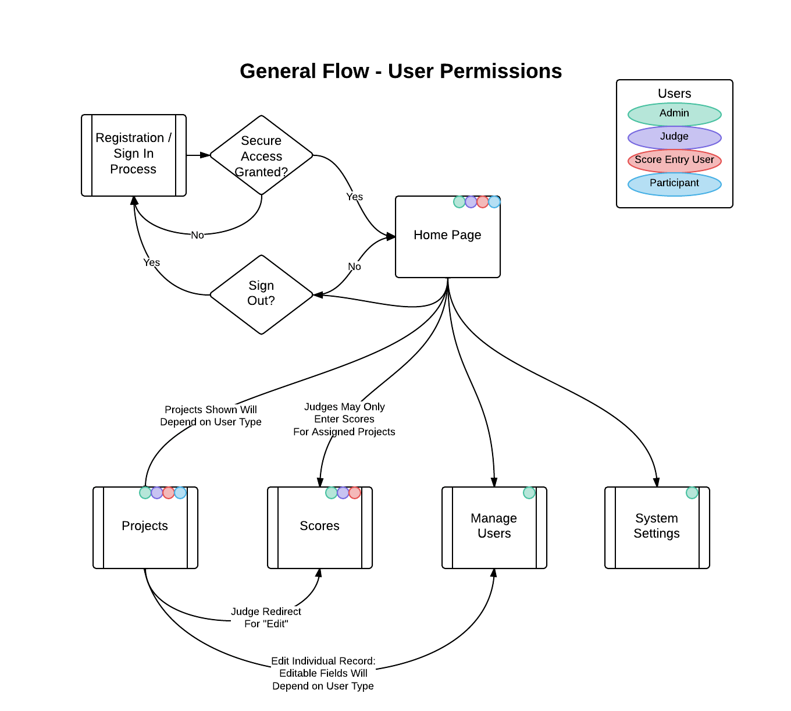
Domain Analysis
High Level Flow: Main Pages with User Permissions

Slide 17
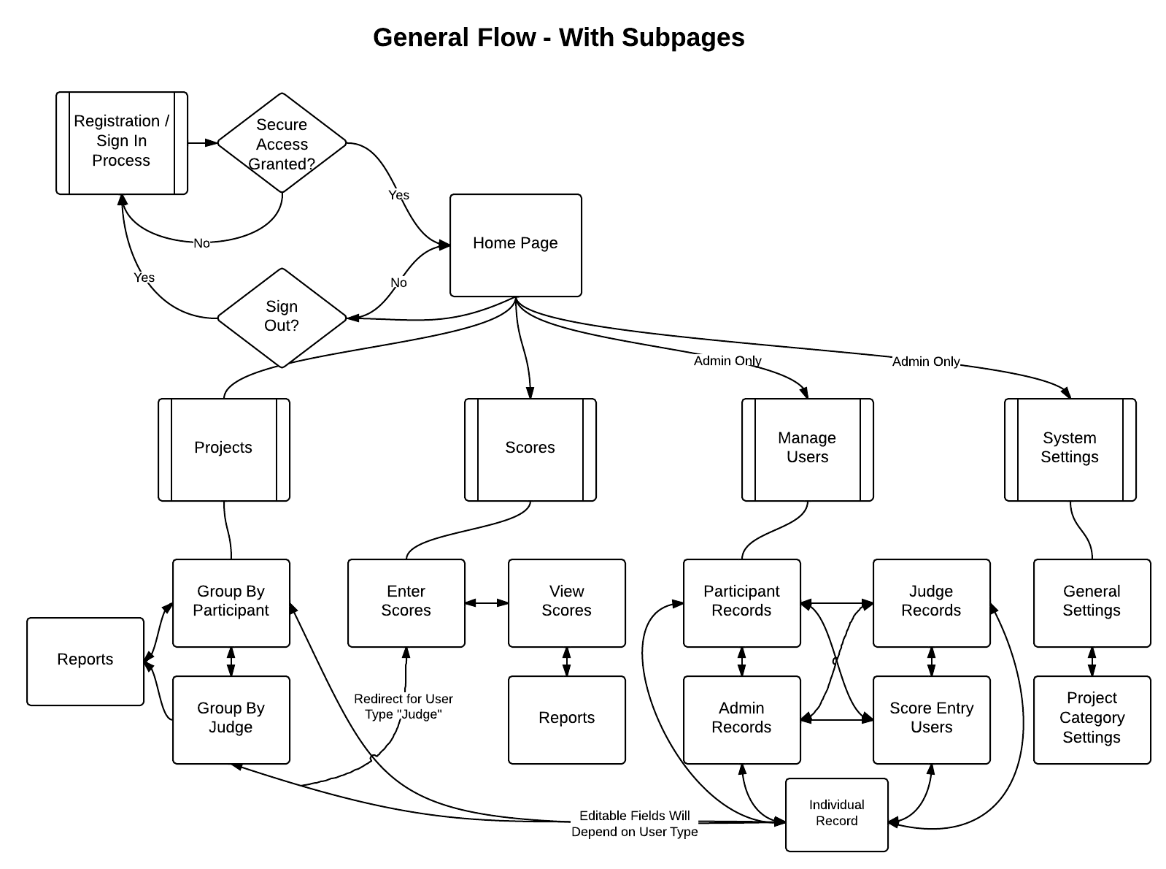
High Level Flow: Main & Sub Pages

Slide 18
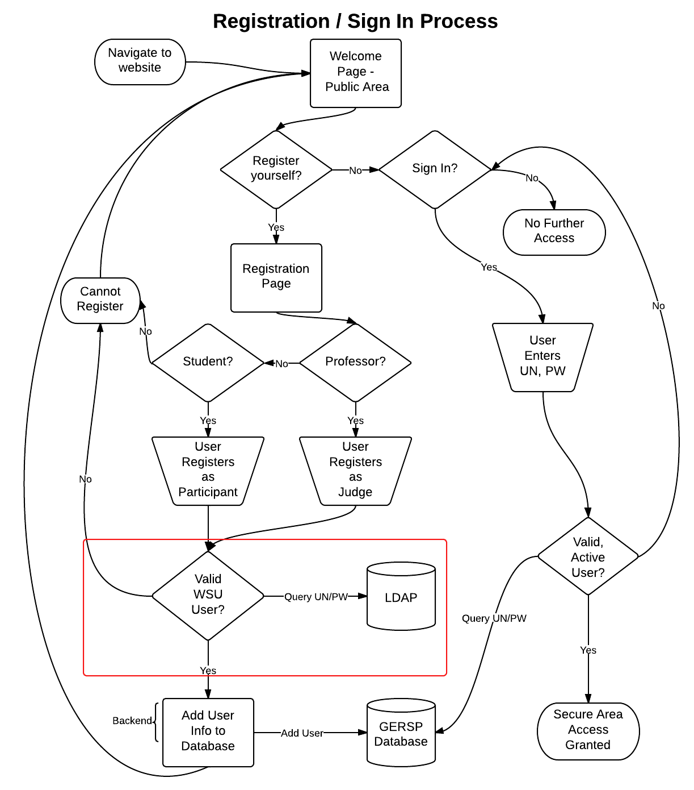
Registration & Sign In Flow

Slide 19
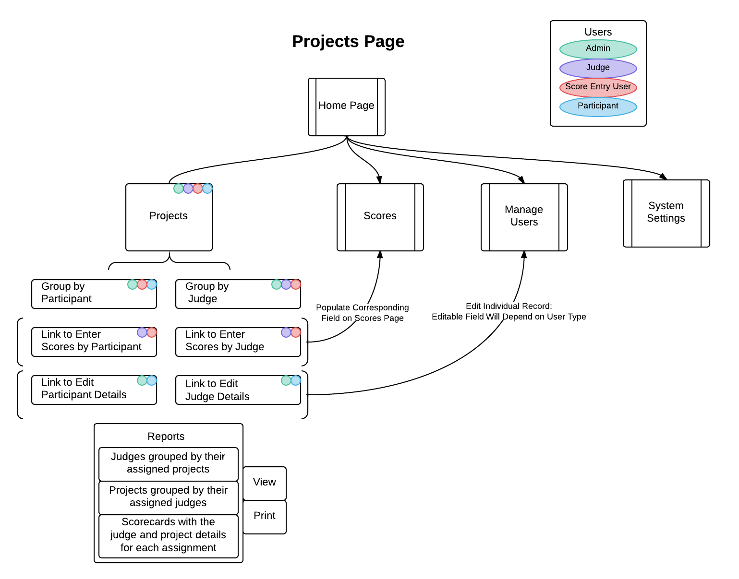
Projects Page

Slide 20
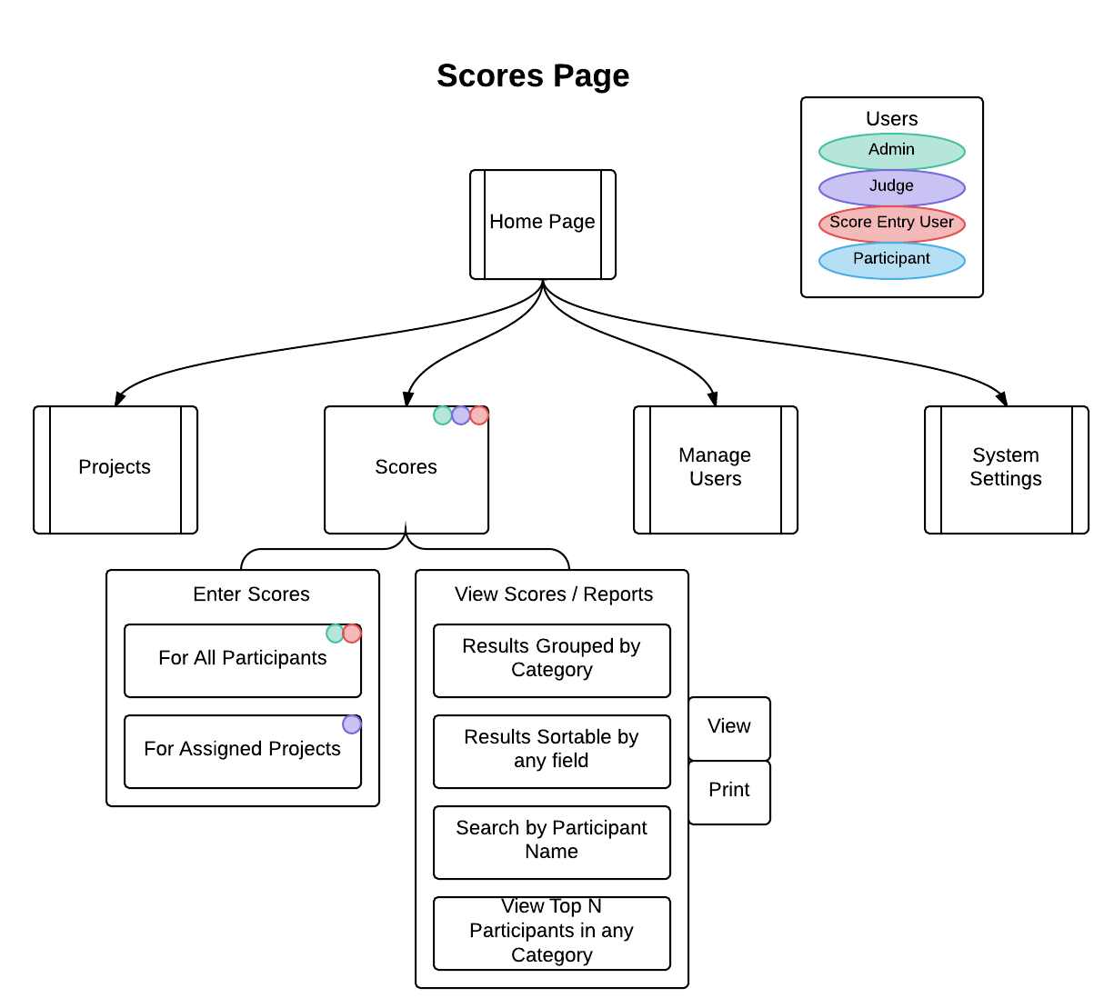
Scores Page

Slide 21
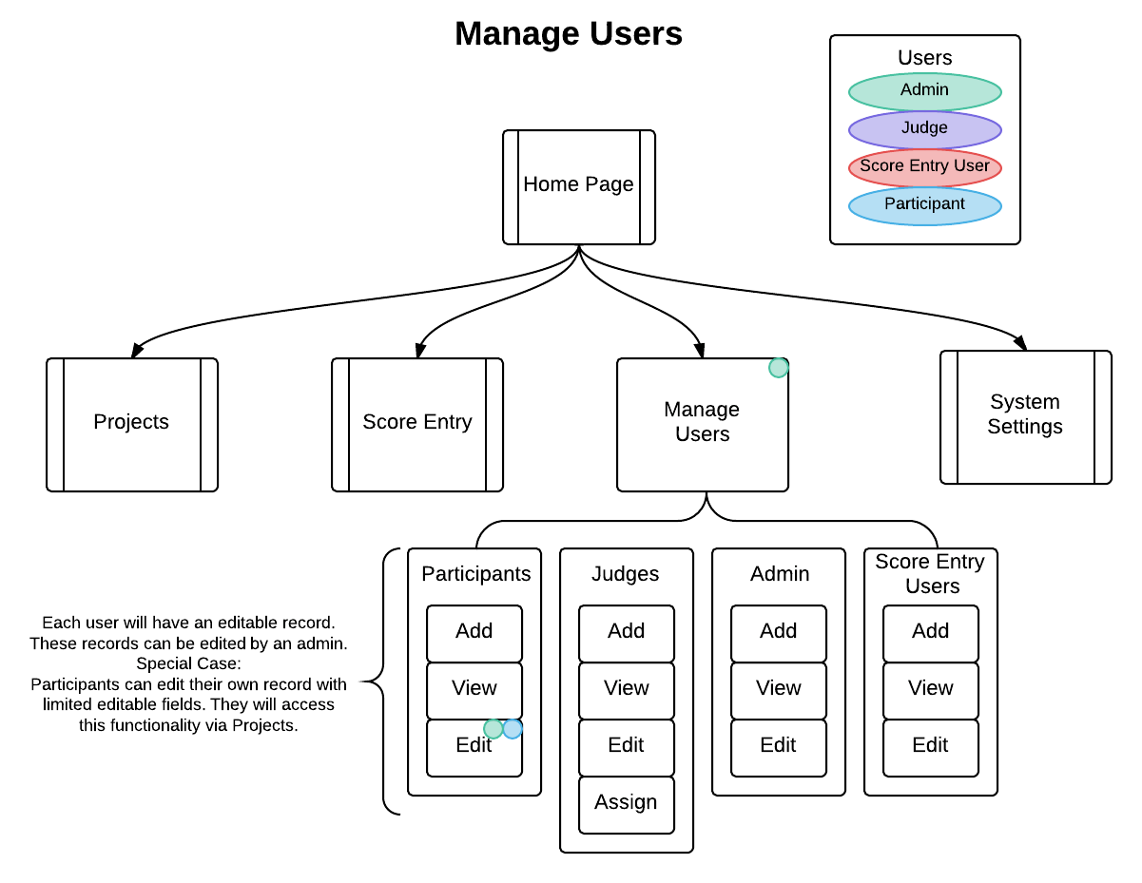
Manage Users Page

Slide 22
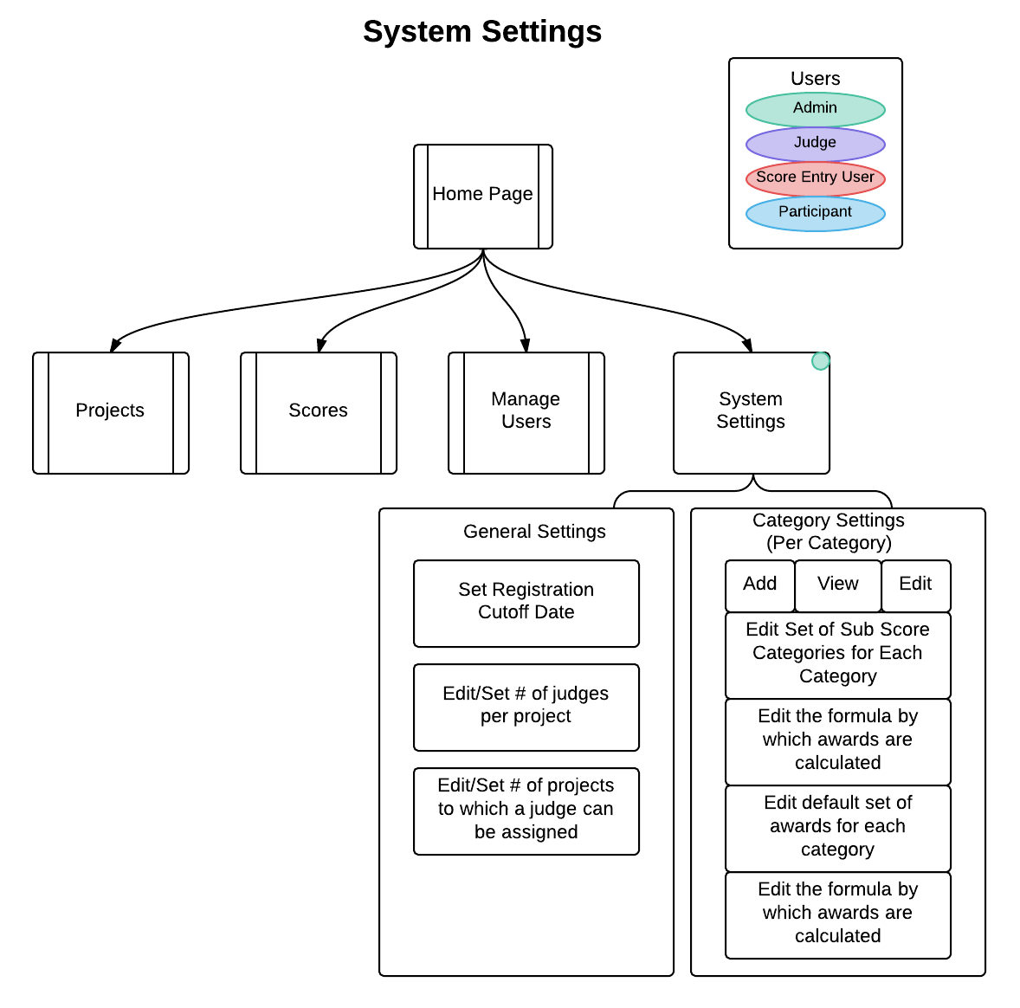
System Settings Page

Slide 23
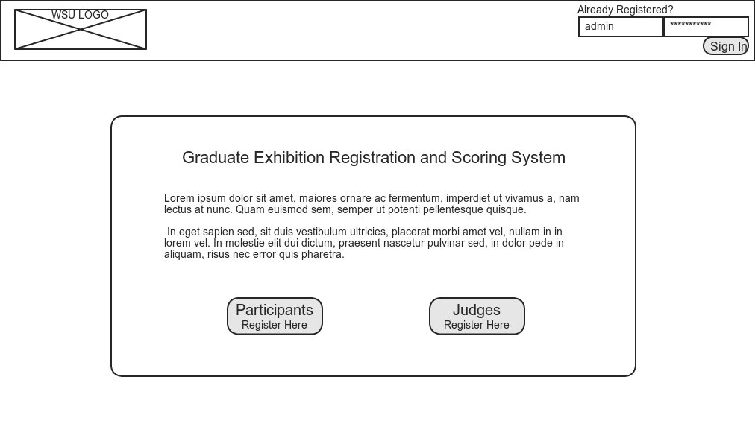
Mockups: Home Page

Slide 24
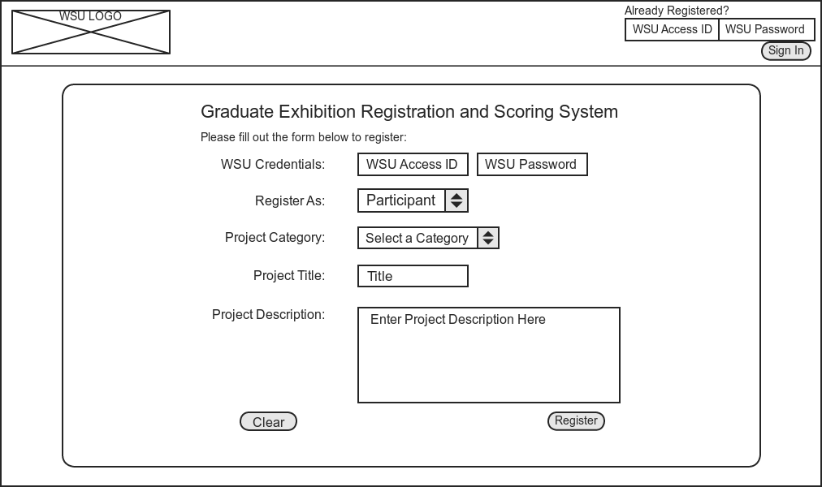
Mockups: Participant Registration

Slide 25
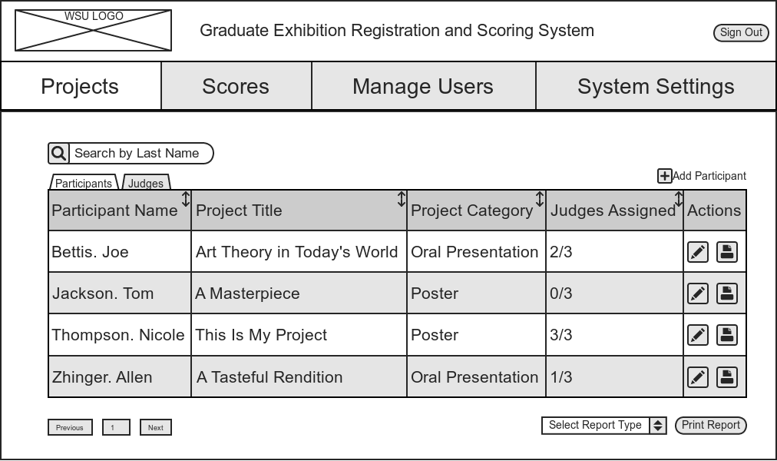
Mockups: Project Page - Grouped by Participants

Slide 26
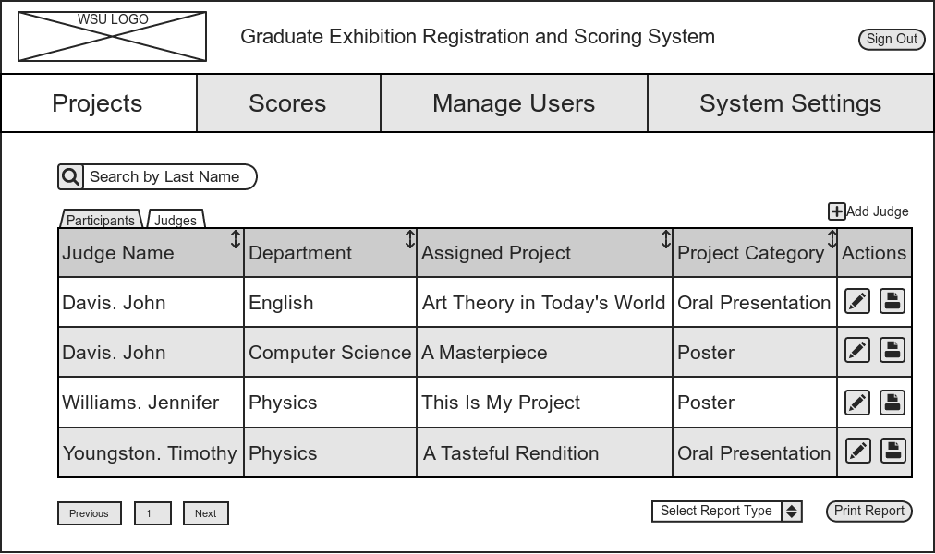
Mockups: Projects Page - Grouped by Judges

Slide 27
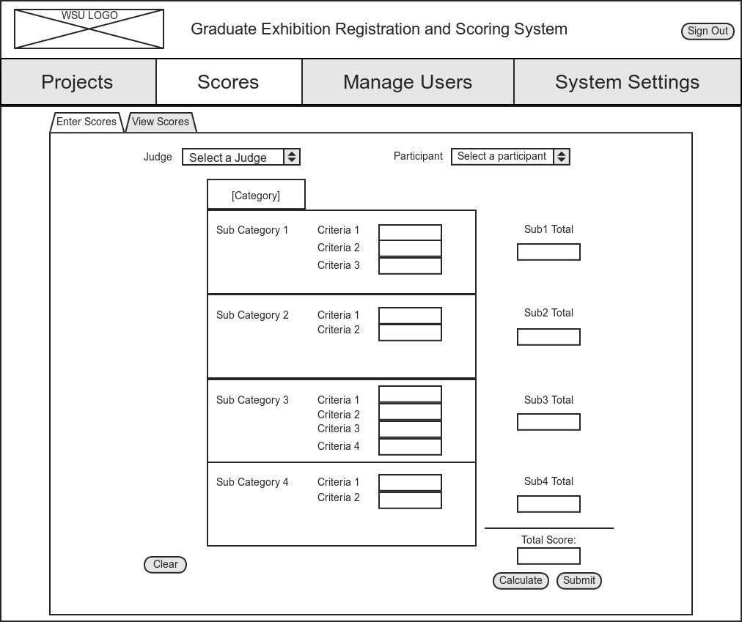
Mockups: Scores Page - Enter Scores

Slide 28
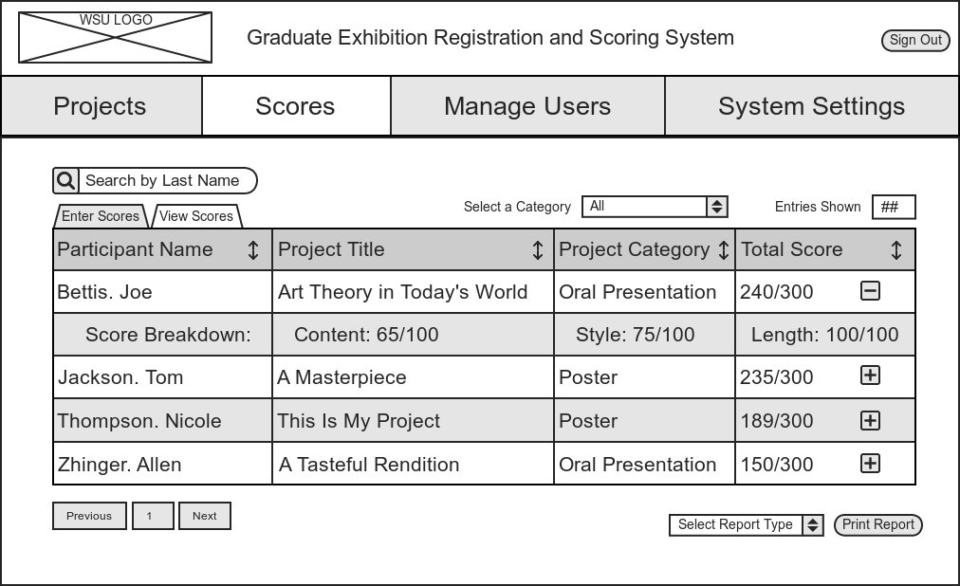
Mockups: Scores Page - View Scores

Slide 29
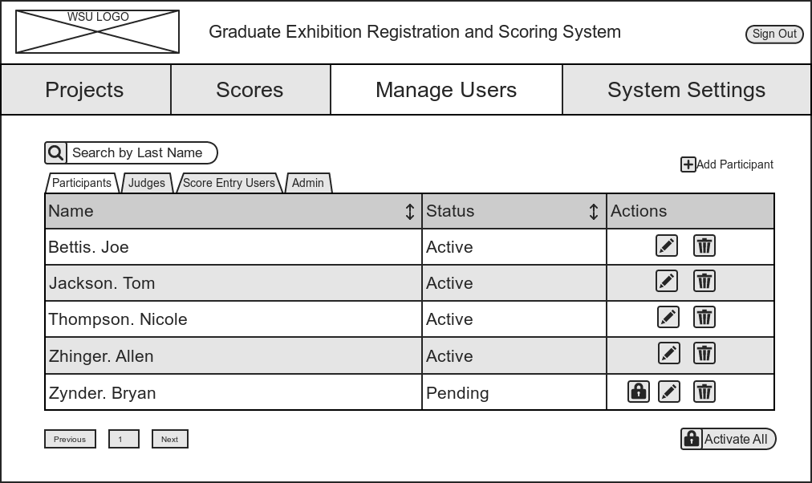
Mockups: Manage Users Page - Participants

Slide 30

Mockups: Manage Users Page - Judges

Slide 31
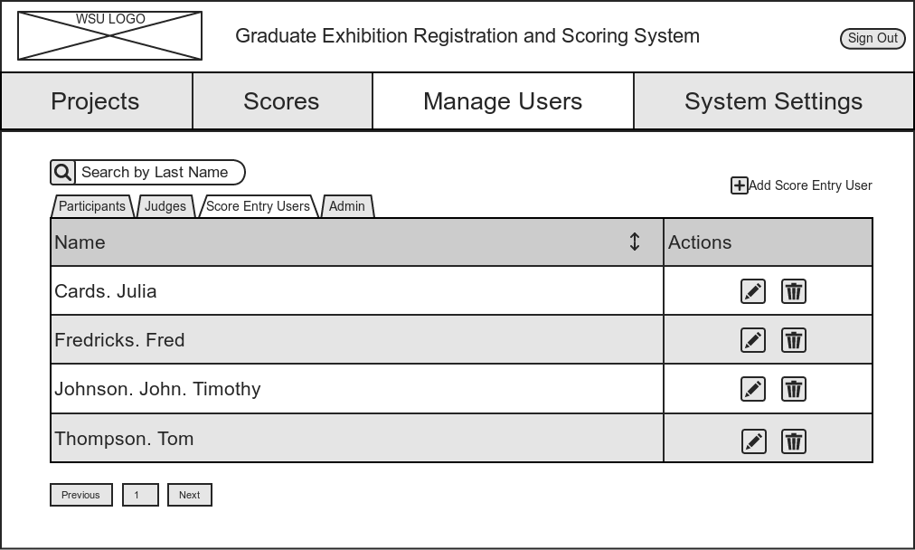
Mockups: Manage Users Page - Score Entry Users

Slide 32
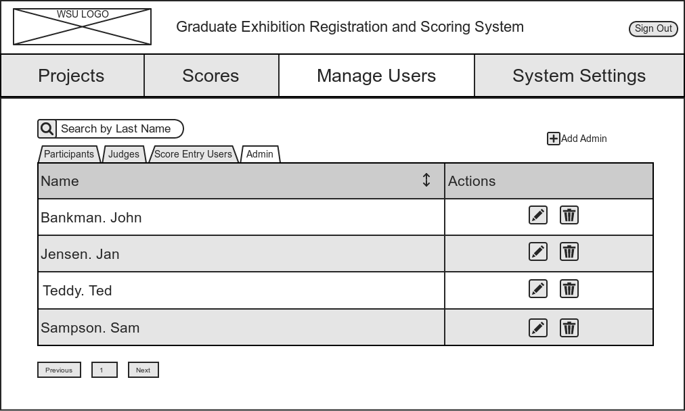
Mockups: Manage Users Page - Admin

Slide 33
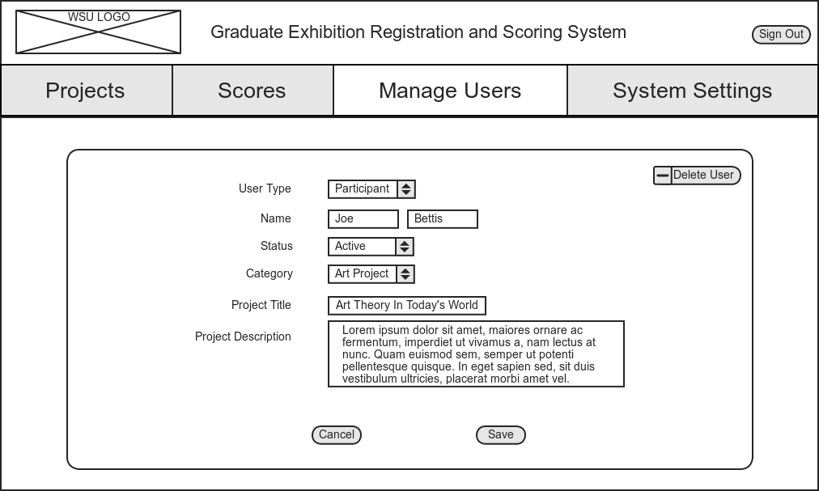
Mockups: Manage Users Page - Edit Individual Record

Slide 34
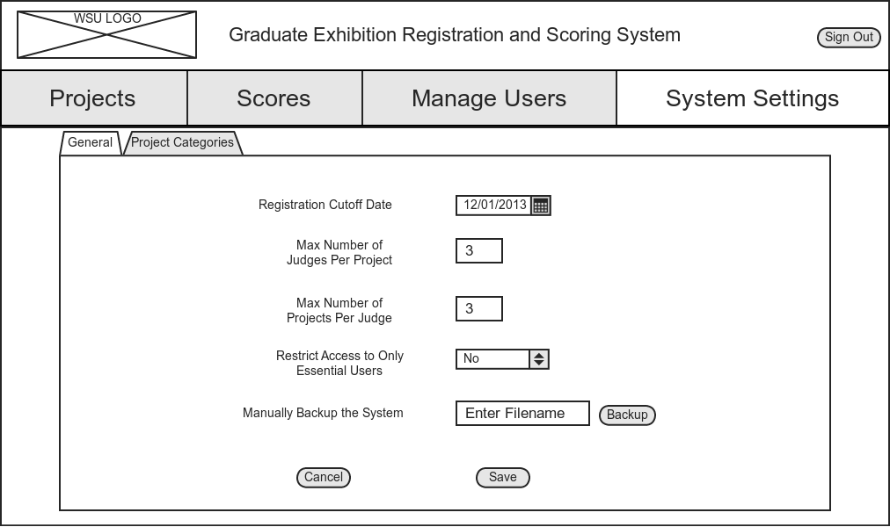
Mockups: System Settings Page - General Settings

Slide 35
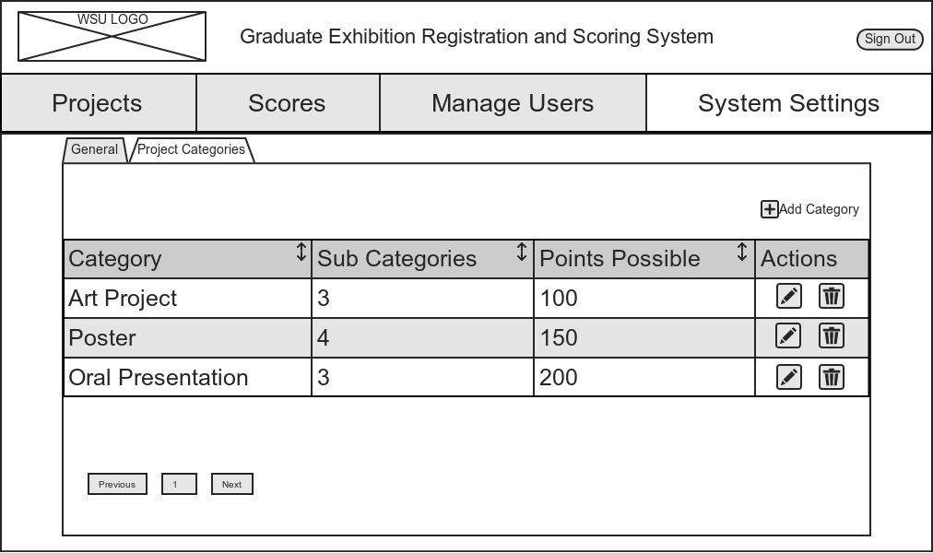
Mockups: System Settings - Category Settings

Slide 36
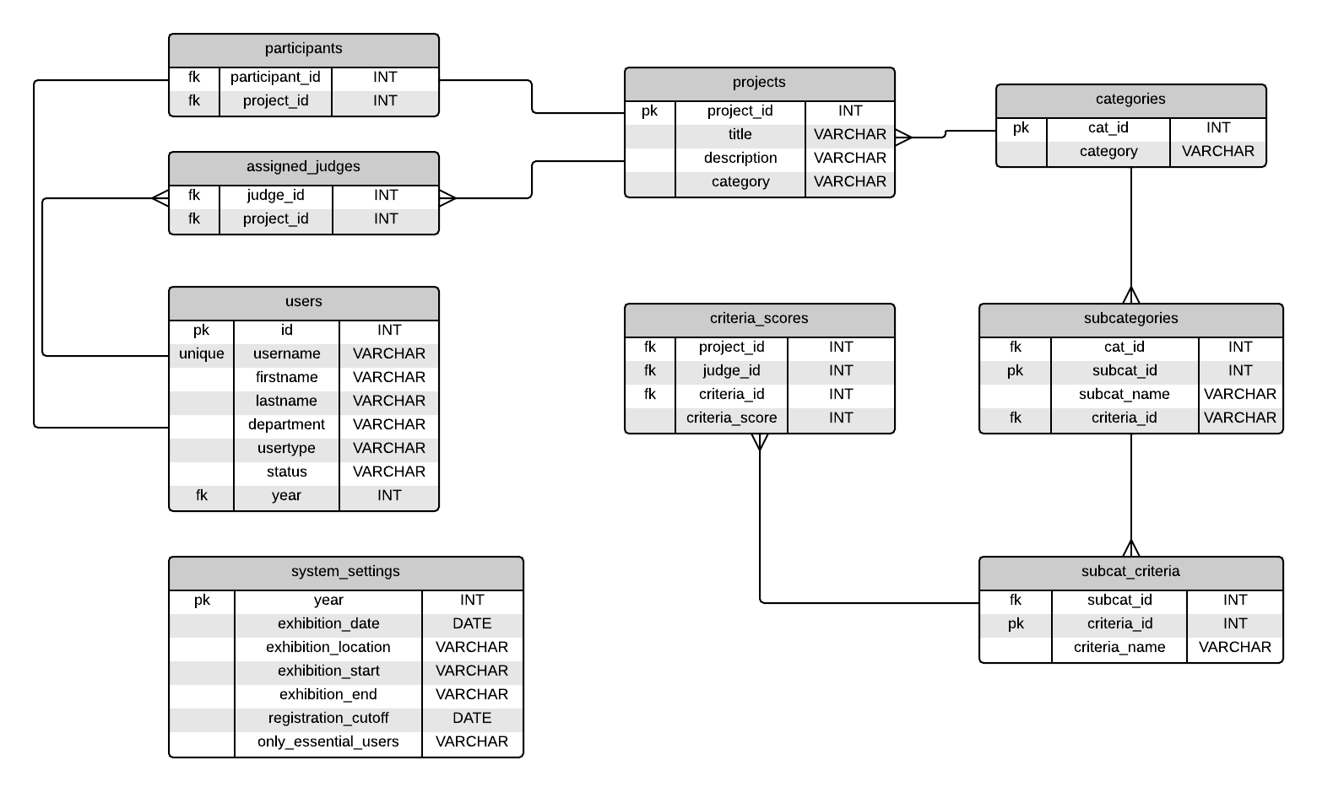
Database ERD

Slide 37
Iterations

Slide 38
Sept 24th - Oct 1st
Confirmed LDAP requirements will be postponed until later in the project
Updated registration flow chart
Decided to use PHP with CodeIgniter framework
Researched Bootstrap, PHP, CodeIgniter
Converted Home and Projects pages from HTML/CSS to PHP
Started sign in validation, adding users, session ids, and populating tables with database records
Linux server environment

Slide 39
Oct 1st - Oct 8th
Continue migration to CodeIgniter framework - Done
Database ERD - Moved to next iteration
Complete Layouts of:
Registration - Done
Sign In - Done
Projects-Participants - Need Reports, Pagination
Projects-Judges - Need Reports, Pagination

Slide 40
Oct 8th - Oct 15th
Manage Users
View Users
Add Users
Search & Clear
Registration Field Requirements
Password - Six characters, alphanumeric
Project Description - 250 word maximum
Database ERD
Version 1 complete - Not satisfactory. Continue in next iteration.
Test Plan

Slide 41
Oct 15th - Oct 22nd
Priority:
Database ERD - Version 2 (Continue)
Manage Users & Projects Pages
Modify/Delete Users (Continue)
System Settings Page - Layout, Functionality
General Settings
Category Settings (Next Iteration)
Rally! - Transfer backlog, test plan (Continue)
Learning Cucumber - Automated Testing
Time Permits:
Scores Page - Layout (Next iteration)

Slide 42
Oct 24th - Oct 31st
Database ERD - Version 2 (cont.)
Manage Users & Projects Pages
Modify/Delete Users (cont.)
Confirmation Prompt on Delete
System Settings Page
Category Settings
Scores Page
LDAP
Rally! - Transfer backlog, test plans (cont.)
Testing
Bug Fixes

Slide 43
Oct 31st - Nov 7
System Settings Page
Category Settings
Add
Delete
Edit - Needs to Insert/Update database
Assigning Judges
Scores Page
LDAP
Cucumber Tests
Bug Fixes

Slide 44
Nov 7th - Nov 14th
Category Settings
Edit - Needs to Insert/Update database
Assigning Judges
Scores Page
Populate forms after validations fail
Set Settings Date/Time fields to be editable - Needs validation on backend
LDAP
Testing

Slide 45
Plan: Nov 14th - Nov 21st
Scores Page
Populate forms after validations fail
Set Settings Date/Time fields to be editable - Needs validation on backend
LDAP
Testing
User Permissions
Bug Fixes/Updates

Slide 46
LDAP
There are some requirements that we would need to discuss before allowing a site to accept university credentials. These requirements are there to ensure the safe handling of identity information as important as a username and password. In short, these are:
The site would need to be SSL enabled with a signed SSL certificate. We can provide the signed certificate at no charge, but the machine it is placed on would need to be audited.
This machine where the site is hosted must be on the WSU physical network, not an outside hosting company. This is to ensure that we could cut network access in case of a compromise.
We would need a full time faculty or staff sponsor at WSU to take responsibility for site, and ongoing maintenance
We would need to audit the code, to ensure that there is no recording of AccessID or password data on the server side.
Rob Thompson
Director
Academic & Core Applications
Computing & Information Technology
Wayne State University
phone: 313-577-5645

Slide 47
LDAP
SSL Certificate - Issued to Faculty and Staff
The DNS name of the web service must end in "wayne.edu"
The requesting party must be a full time WSU staff member or a faculty member
The server receiving the certificate must be hosted within the WSU-owned 141.217.0.0/16 or 146.9.0.0/16 address space
The certificate may not be re-used on any server(s) outside of WSU's network or any system that is not explicitly authorized by C&IT
C&IT reserves the right to block network access to any system that violates the trust of our customers
C&IT reserves the right to revoke the certificate at any time
The certificate will be issued only to the requesting party
The requesting party may not share the certificate and/or keys with any other party
Any exception to this policy must be explicitly approved by C&IT's Security department
C&IT reserves the right to inspect and/or audit the server receiving the certificate

Slide 48
Nov. 21st - Nov. 26th
Pulling info from LDAP
Home Page to Nav - shows exhibition info
Manually Assign Judges in Manage Users (Admin Only)
Cannot Use Automatic Judge Assignment after a score has been entered
Printable Scorecards for Projects - Projects Participants
Input Scores
New
Edit
View Scores
Toggle System Access - Per User
Registration button hidden if past registration cut off date
Score Entry Disabled Until:
Day of exhibition
All participants have at least one judge
UI Updates
Header
Tooltips (hints)

Slide 49
What’s Left.
Reports
Delete/Archive Current Year & Start New Year
Manual Backup
Move everything to WSU Server
Documentation - Site Functionality / Code Dependencies
Scores
Print
Input - Judges drop down - add [entries]/[total assigned]
Smarter Error Reporting - Why isn’t scoring enabled?
Filter Score View by Category & Top N
Collapse/Expand rows- Projects Pages, View Scores Page
Settings
Field for Home Page message
Field for Registration Start Date
Update DB - Limit Access to only Admin/SEU
Manage Users
Enable/Disable Access - All user type
Registration / Add users with LDAP
Don’t let users with ‘Disabled’ status log in
User Permissions - by URL and UI
Scorecards - By Judge

