Slide 1
Graduate School Project
Team Strawberry
Amanda T., Plamen P., Dhaval D., Visishta D.

Slide 2
Plan: Oct 15th - Oct 22nd
Priority:
Database ERD - Version 2
Manage Users & Projects Pages
Modify/Delete Users
Registration Email - Layout, Content
System Settings Page - Layout, Functionality
Time Permits:
Scores Page - Layout

Slide 3
Oct 8th - Oct 15th
Manage Users
View Users
Add Users
Search & Clear
Registration Field Requirements
Password - Six characters, alphanumeric
Project Description - 250 word maximum
Database ERD
Version 1 complete - Not satisfactory. Continue in next iteration.

Slide 4
Oct 1st - Oct 8th
Continue migration to CodeIgniter framework - Done
Database ERD - Moved to next iteration
Complete Layouts of:
Registration - Done
Sign In - Done
Projects-Participants - Need Reports, Pagination
Projects-Judges - Need Reports, Pagination

Slide 5
Sept 24th - Oct 1st
Confirmed LDAP requirements will be postponed until later in the project
Updated registration flow chart
Decided to use PHP with CodeIgniter framework
Researched Bootstrap, PHP, CodeIgniter
Converted Home and Projects pages from HTML/CSS to PHP
Started sign in validation, adding users, session ids, and populating tables with database records
Linux server environment

Slide 6
Scope
This project will produce a web application to manage student registration, judge assignment, score tabulation and award assignment for the Wayne State University Graduate School’s yearly Graduate Exhibition in this and future years.

Slide 7
Functional Requirements:
User Registration
1 - All users must have a unique username and secret password.
1.1 - WSU login credentials (LDAP)
2 - The functionality exposed to each user should be restricted by the role they play in the exhibition.
3 - Allow grad students to register themselves and their projects as participants via the world wide web.
3.1 - A date after which registration is closed may be specified by an administrative user.

Slide 8
Functional Requirements:
Administrative Privileges
4 - Allow administrative users and their delegates to register judges for the exhibition.
5 - Administrative users should be able to add, view and modify all types of user accounts.
6 - Allow for the entry, modification and viewing of project categories
6.1 - Each category should have a default set of sub score categories that are editable by administrator.
6.2 - Each category should have a default set of awards and the formula by which they are awarded which may be edited by an administrative user.

Slide 9
Functional Requirements:
Assigning Judges
7 - Assign judges to evaluate projects.
7.1 - The number of judges per project may be specified by an administrative user.
7.2 - The number of projects per judge may be specified by an administrative user.
7.3 - Refrain from assigning judges to projects for which they may have a conflict of interest.
7.4 - The following reports should be available:
7.4.1 - Judges grouped by their assigned projects.
7.4.2 - Projects grouped by their assigned judges.
7.4.3 - Scorecards with the judge and project details

Slide 10
Functional Requirements:
Inputting & Summarizing Scores
8 - Input evaluation scores.
8.1 - Task may be performed by judges, administrative users or score entry users.
8.2 - Judges can only enter scores for the projects they have evaluated.

Slide 11
Functional Requirements:
Inputting & Summarizing Scores
9 - Summarize the scores of all participants.
9.1 - The following reports should be available:
9.1.1 - Scores grouped by category and sorted by any field.
9.1.2 - The top n participants in any category.
9.1.3 - The breakdown of all participants’ scores.
9.2 - Administrative, score entry and judge users should be able to search by name for participants to see their score breakdown.

Slide 12
Non-Functional Requirements:
Security
10 - All reasonable measure to prevent a user from modifying, viewing or deleting a record that they do not have permission to modify, view or delete should be taken.
10.1- All databases secured by username and password.
10.2 - Transmission of information between the client and server should not be in the clear.

Slide 13
Non-Functional Requirements:
Documentation
11 - All functionality implemented in the GERSP system must be documented. (i.e., user action to activate the feature and expected output should be defined.)
12 - All database fields must have some meta data associated with them giving precise descriptions and examples of the data they should contain.
13 - All Java code should be documented using Javadoc comments.

Slide 14
Non-Functional Requirements:
Performance
14 - Each user of the system should interact primarily with a single screen to perform their task to minimize the number of clicks and therefore the amount of time interacting with the electronic system.
15 - Score summary and award assignment must occur within 10 minutes after activation by the user.
16 - Judge assignment must occur within 10 minutes after activation by the user.

Slide 15
Non-Functional Requirements:
Reliability
17 - A daily backup of system data should be scheduled.
17.1 - Each backup must occur in two places, only one of which may be located physically near to the server.
18 - Manually triggered backups should be available to administrative users.
18.1 - This backup may be saved to the media of the user’s choice. (e.g., a flash drive or a networked drive.) or to the default backup locations.

Slide 16
Non-Functional Requirements:
Availability
19 - Once opened for registration, the GERSP system servers should remain online and available 24/7 to allow students and judges to register.
20 - On the day of the exhibition, the system may be restricted to only essential users to ensure a timely response.

Slide 17
Team Organization
Team Leaders
Amanda, Plamen
Development
Amanda, Plamen
Testing
Vishi, Dhaval
Documentation
Vishi, Dhaval

Slide 18
Architecture & Technology Choices
Presentation Tier
HTML/CSS - WSU CSS attributes
Bootstrap (Responsive Design)
Javascript
Logic Tier
PHP - CodeIgniter: PHP Open Source Framework
JSP
Data Tier
MySQL
WSU LDAP
Apache - Tomcat Server

Slide 19
Analysis & Modeling
High Level Flow - Main Pages & User Permissions
High Level Flow - Main & Sub Pages
Registration & Sign In Flow
Use Case & Flow - Main Pages
Projects
Scores
Manage Users
System Settings
Website Mockups
Database ERD - In progress

Slide 20
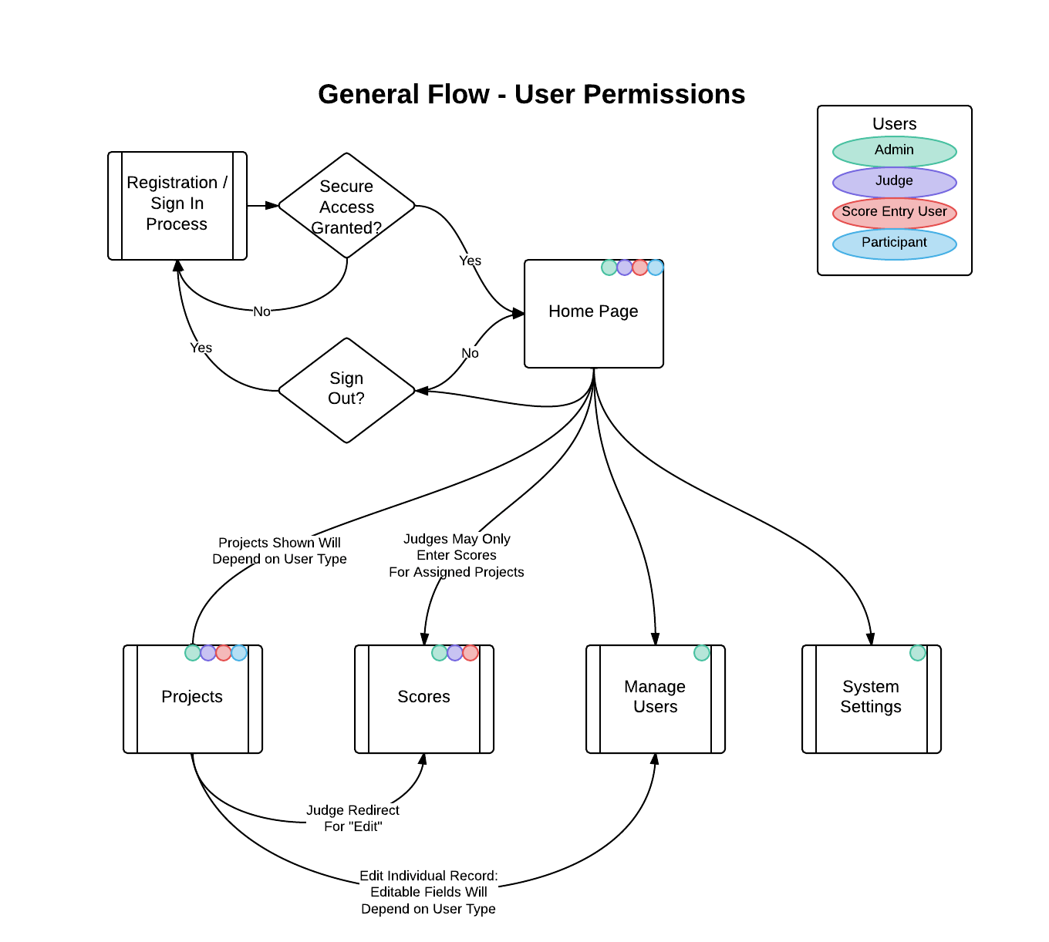
Domain Analysis
High Level Flow: Main Pages with User Permissions

Slide 21
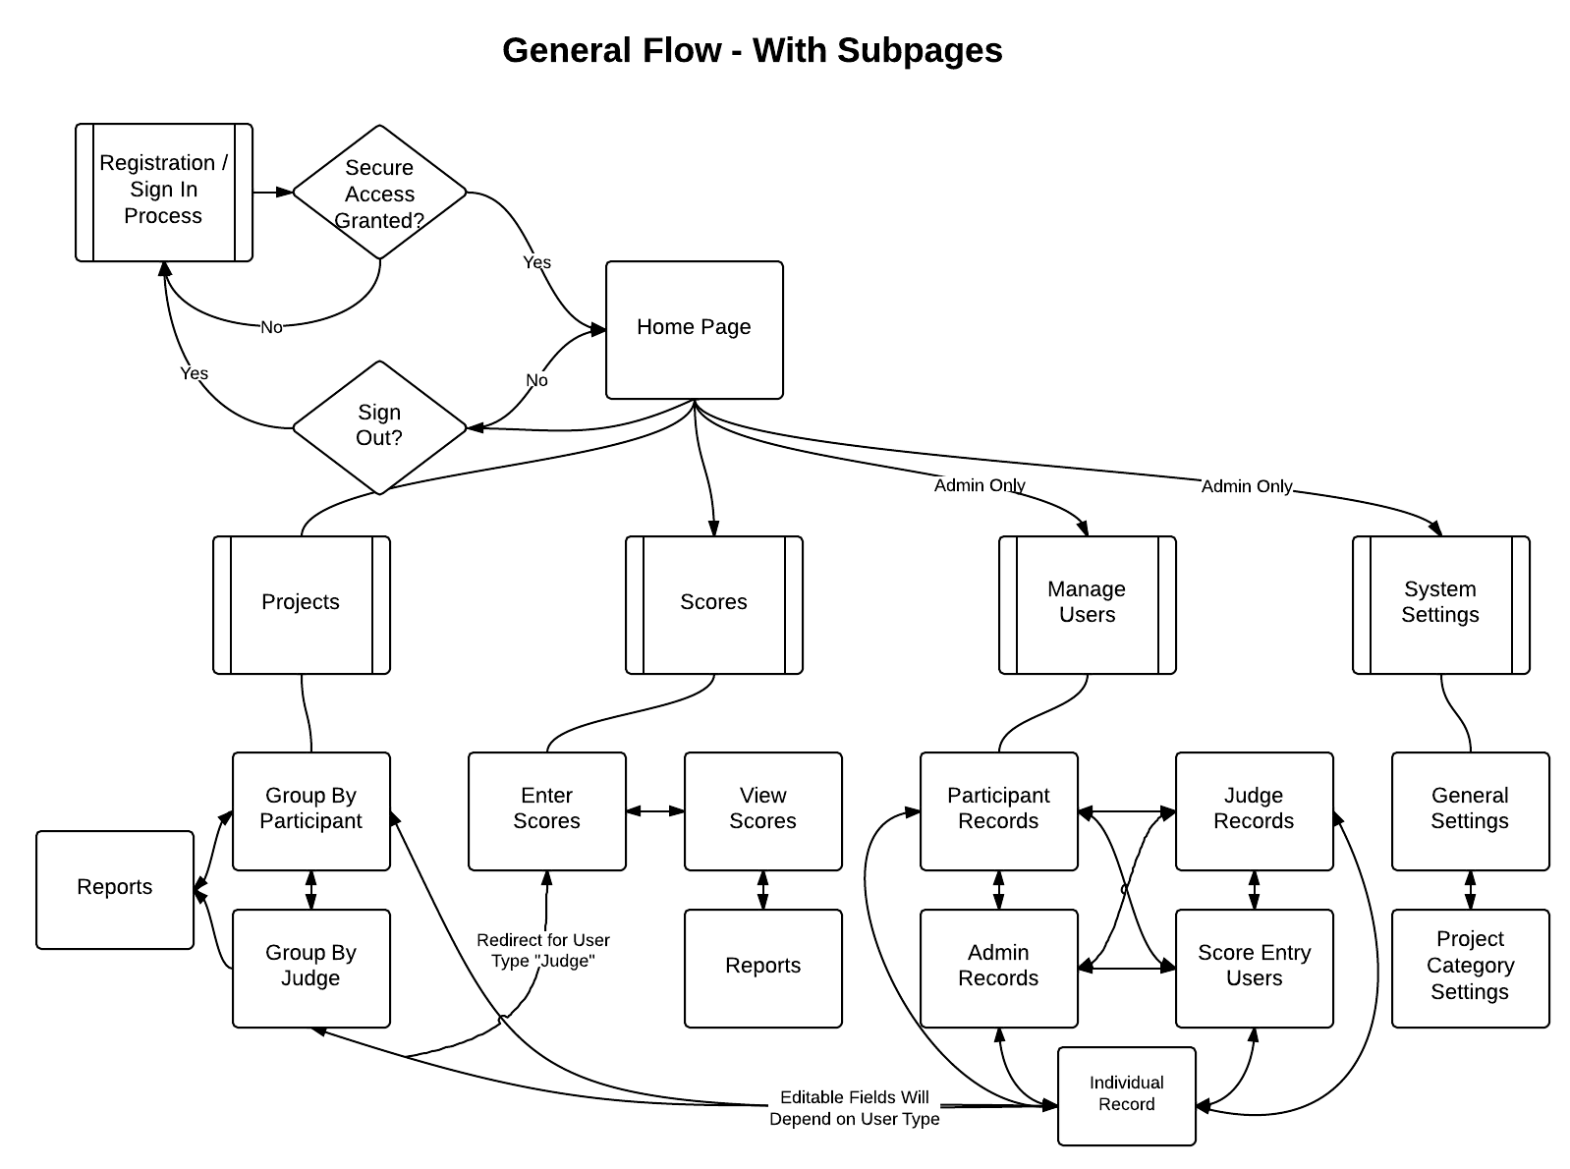
High Level Flow: Main & Sub Pages

Slide 22
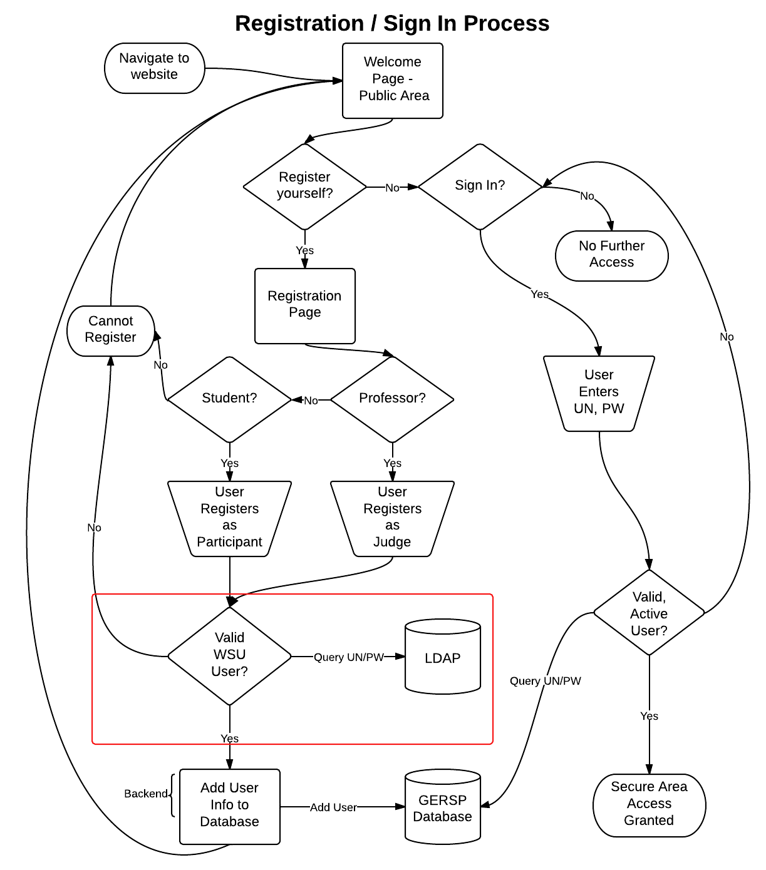
Registration & Sign In Flow

Slide 23
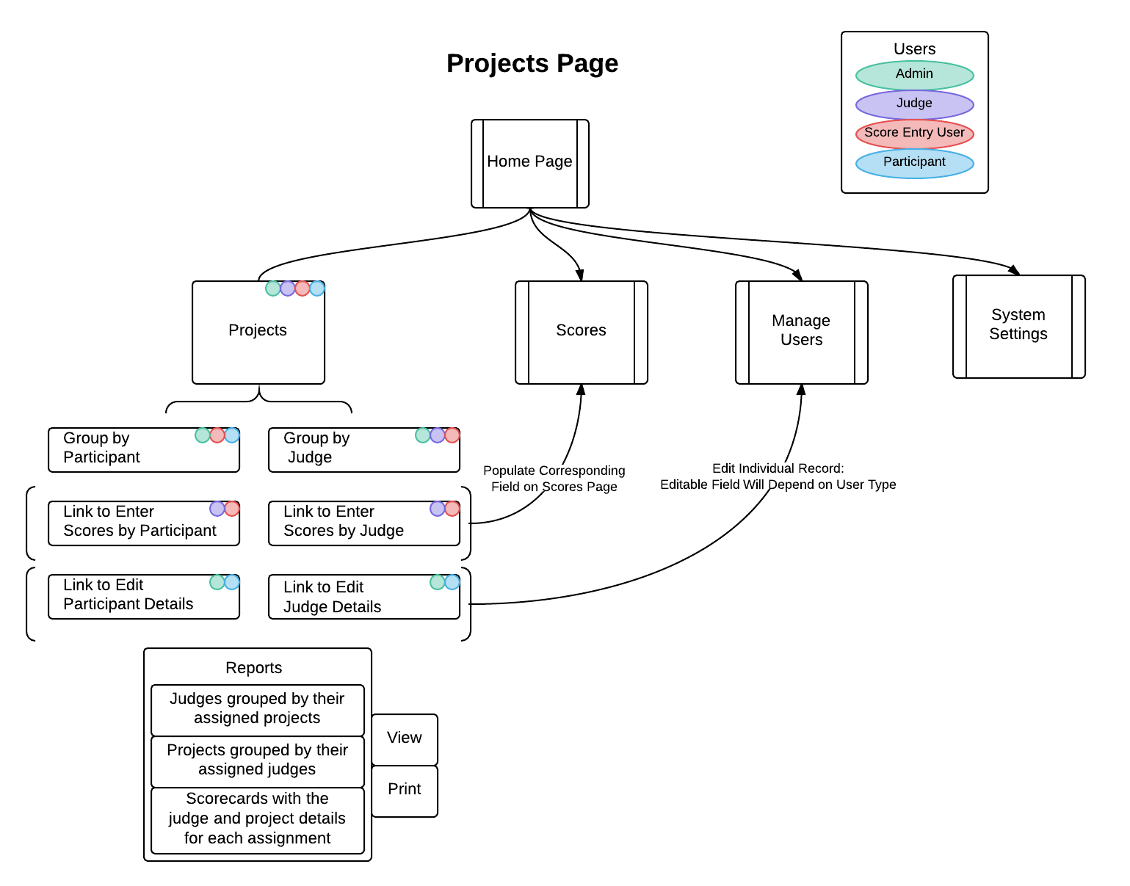
Projects Page

Slide 24
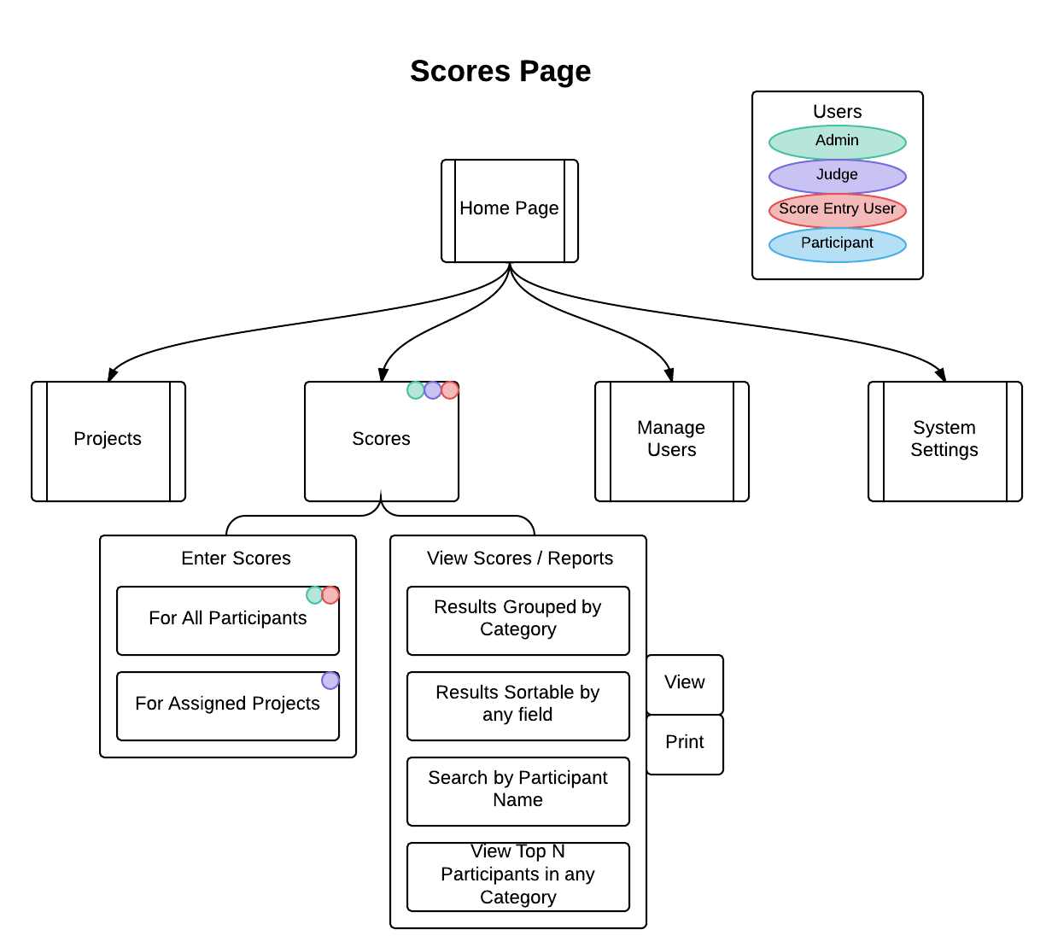
Scores Page

Slide 25
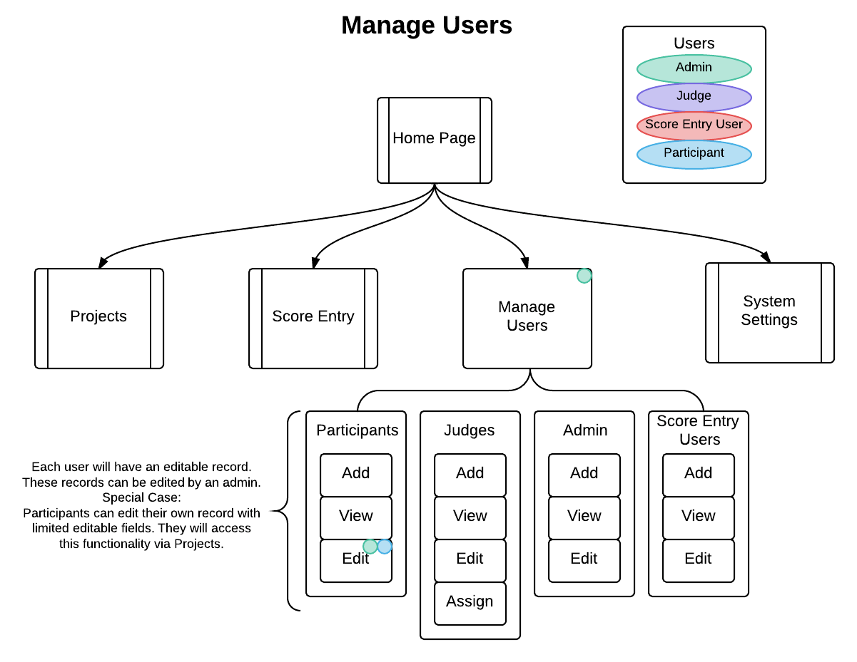
Manage Users Page

Slide 26
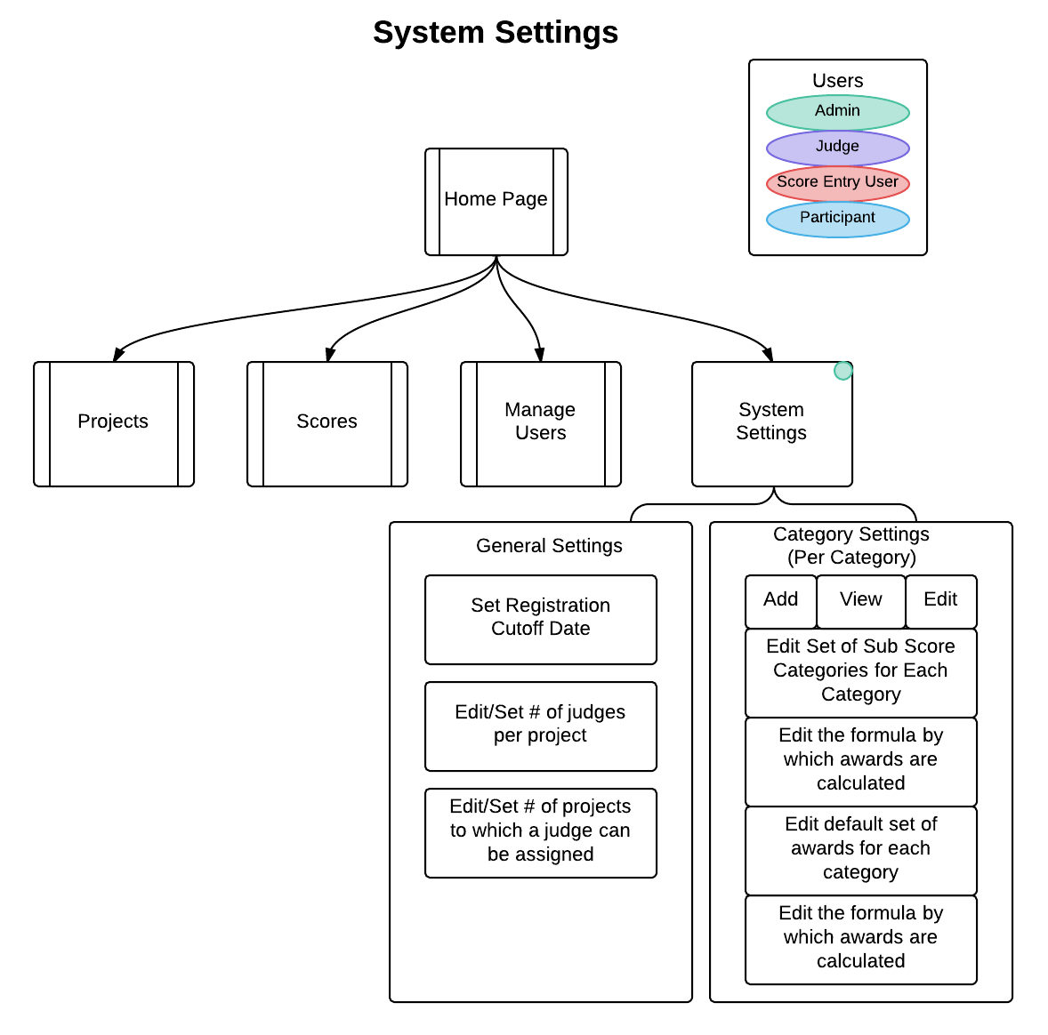
System Settings Page

Slide 27
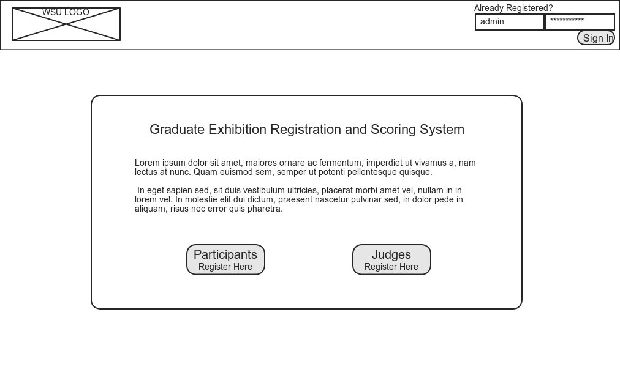
Mockups: Home Page

Slide 28
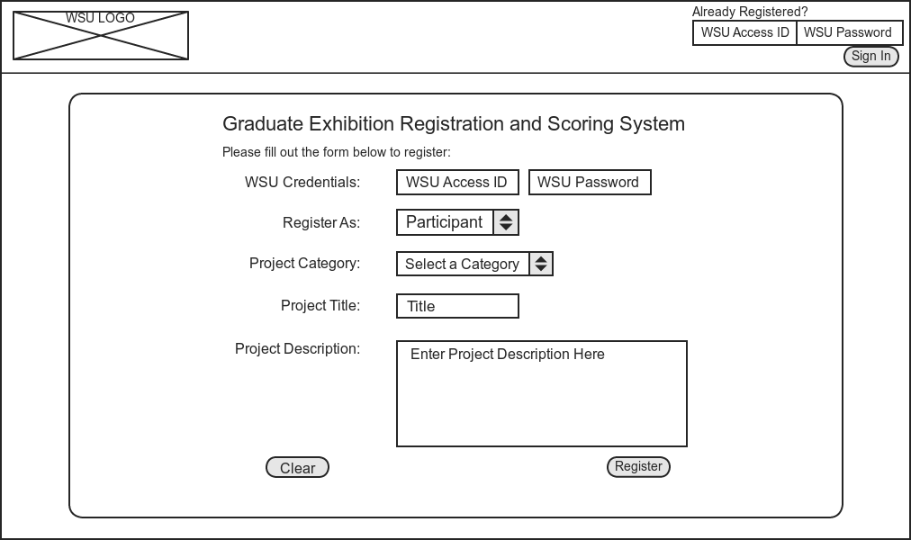
Mockups: Participant Registration

Slide 29
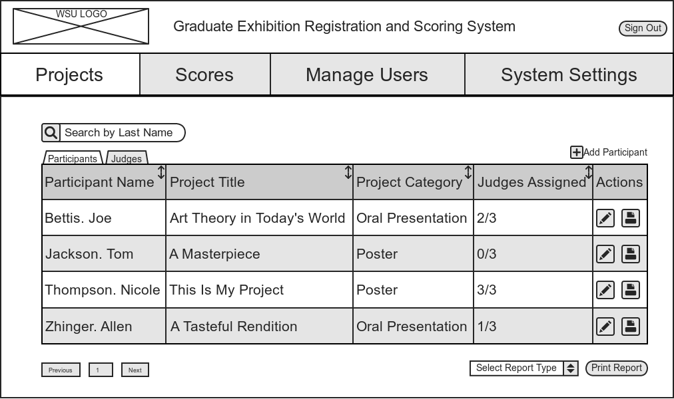
Mockups: Project Page - Grouped by Participants

Slide 30
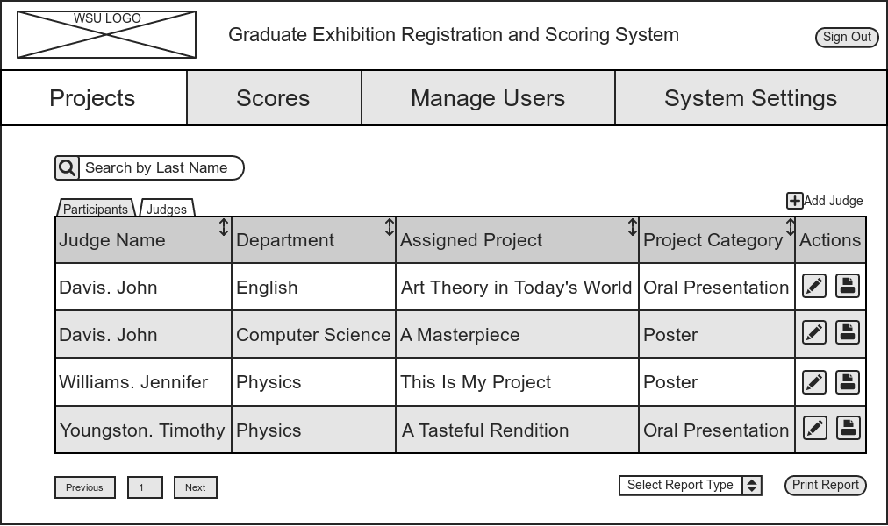
Mockups: Projects Page - Grouped by Judges

Slide 31
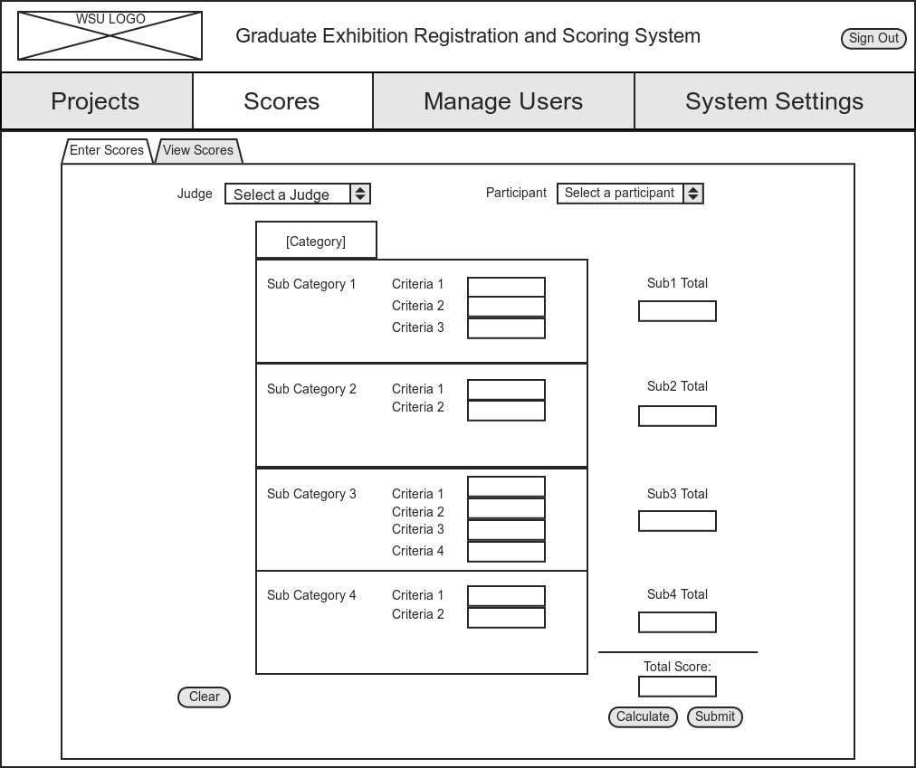
Mockups: Scores Page - Enter Scores

Slide 32
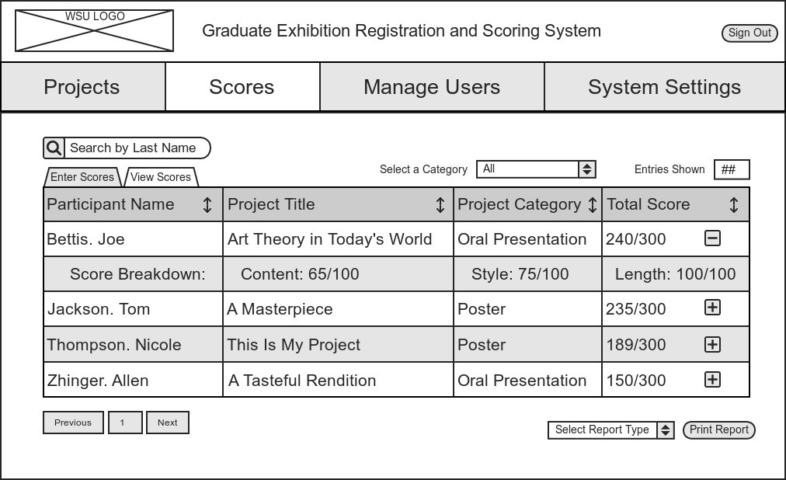
Mockups: Scores Page - View Scores

Slide 33
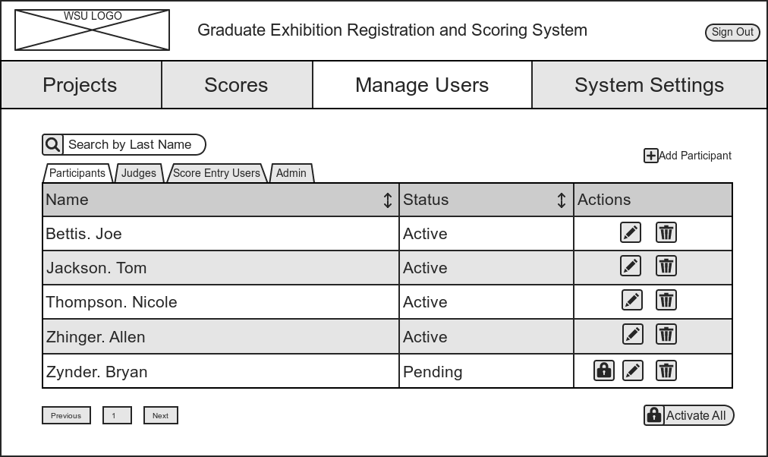
Mockups: Manage Users Page - Participants

Slide 34

Mockups: Manage Users Page - Judges

Slide 35
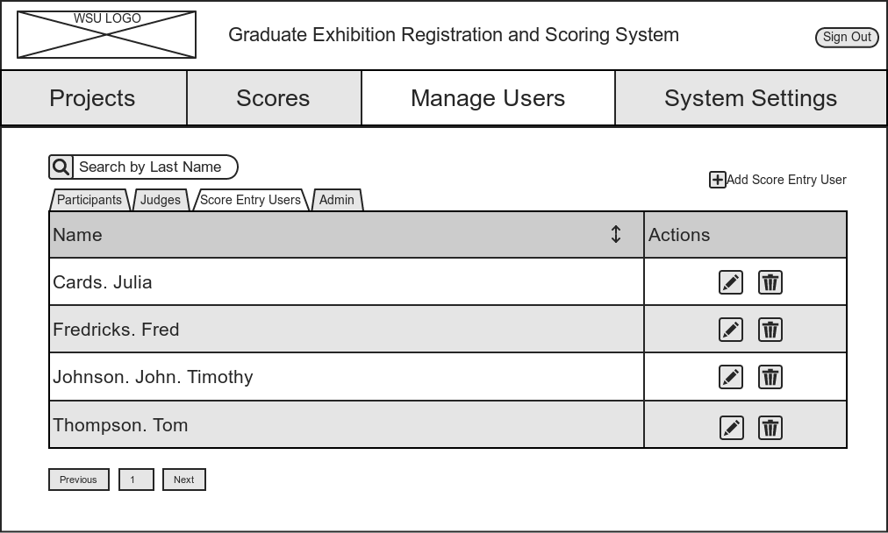
Mockups: Manage Users Page - Score Entry Users

Slide 36
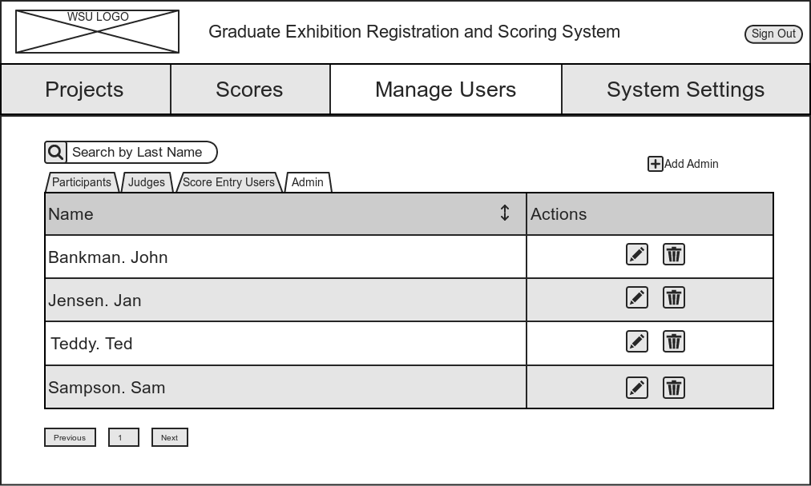
Mockups: Manage Users Page - Admin

Slide 37
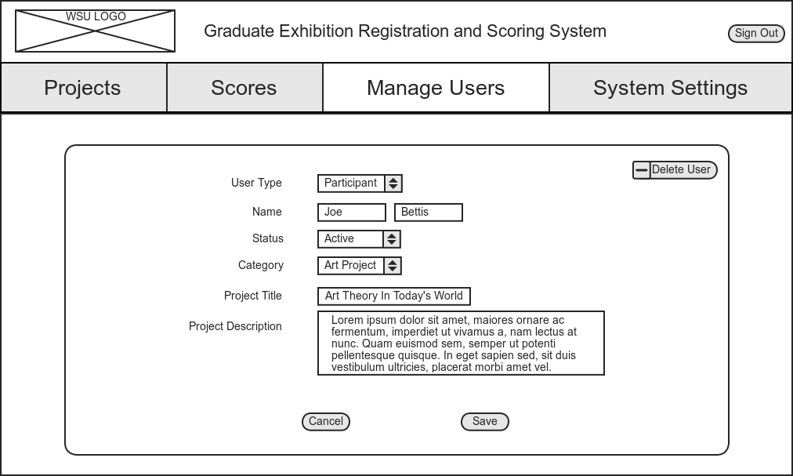
Mockups: Manage Users Page - Edit Individual Record

Slide 38
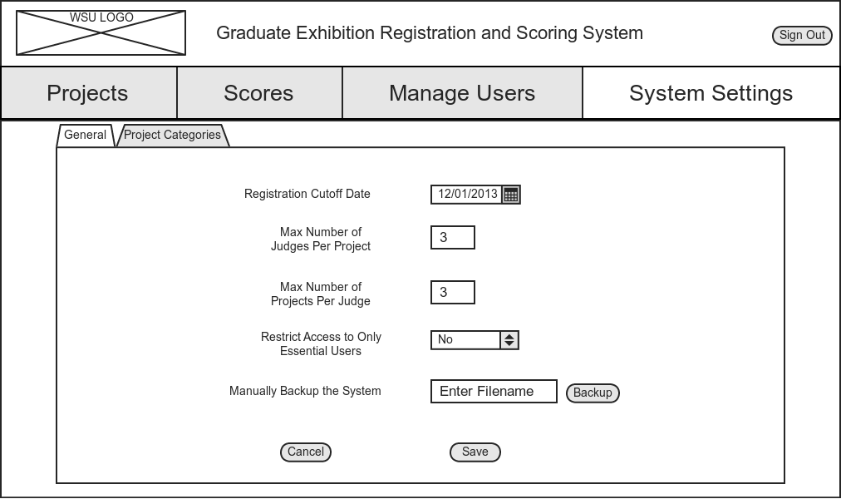
Mockups: System Settings Page - General Settings

Slide 39
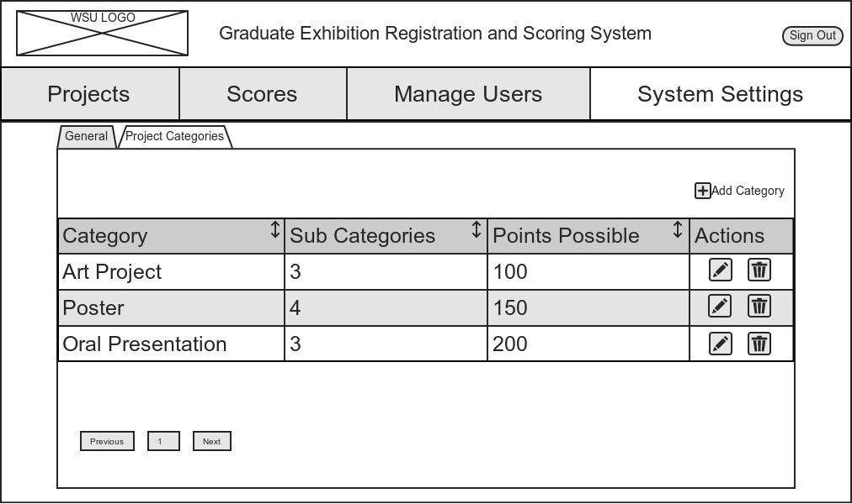
Mockups: System Settings - Category Settings

