Slide 1

<Experience>

Slide 2
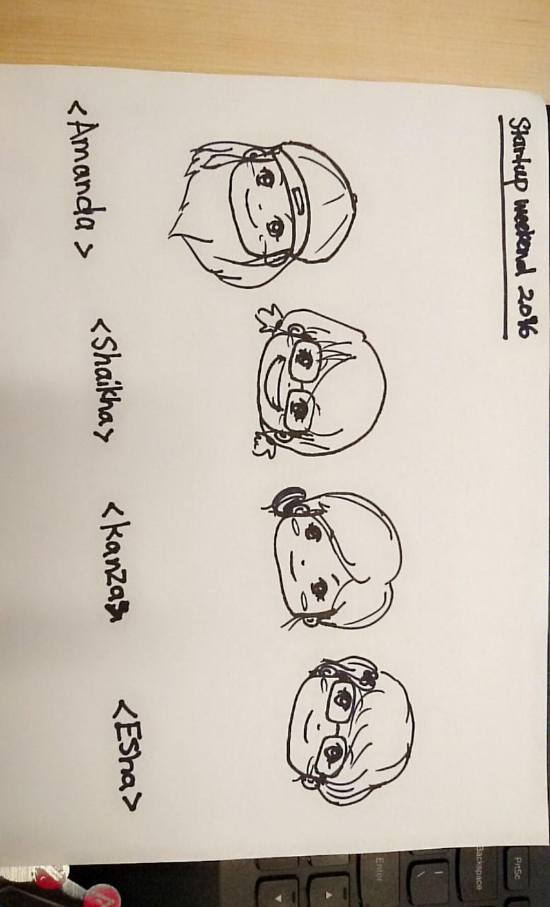
<Experience> Team
<Amanda Alfaro>
<Kanza Siddiqui >
<Shaikha Al-Mashaykhi>
<Esha Samavarapu>

Slide 3
The Problem
Gap between fast paced work force and slower paced academia
Finding talents for companies
Notes:
CS & ISDS students lack skills, knowledge and experience to bring to the industry

Slide 4
The Solution
Having industries provide mini projects
Providing a resources collection

Slide 5





How this works

Slide 6
User base
500
2/3
5%
Students
Notes:
Want companies to provide projects

Slide 7
First year
Pilot test
Profit
Revenue
Cost
$500
$0
$0
Notes:
Want companies to provide projects

Slide 8
Second
Year
Profit
Revenue
Cost
$2,500
$500/ Company
$500
Notes:
Want companies to provide projects

Slide 9
Third year
Profit
Revenue
Cost
$4,000
$500/
Company
$1000
Notes:
Want companies to provide projects

Slide 10
Let’s go on to the demo!

