Slide 1
Immunization Portal💉
So Man Amanda Au-Yeung
MSCS Align Candidate
Spring 2022
CS5001

Slide 2
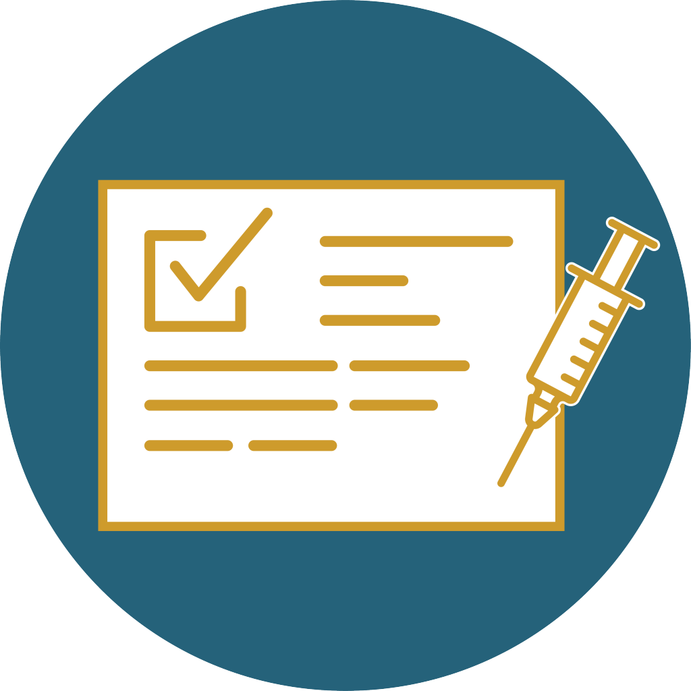
Goal of the Project
Collect database from users to keep track of their vaccination record

Slide 3
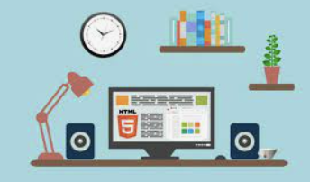
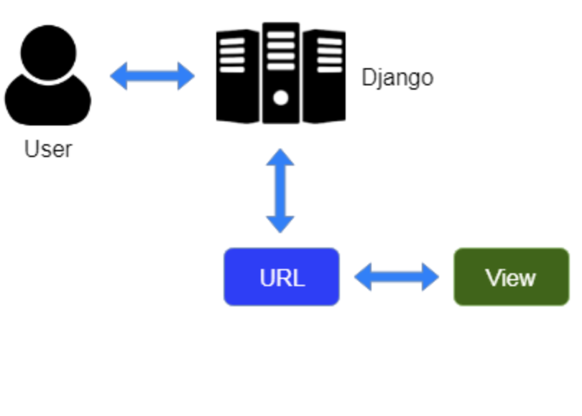
METHODS: What tools and techniques were used to accomplish
Implemented a full stack project
Used html, CSS, JavaScript, bootstrap to build the frontend
Used Django as the framework with python to build the backend
Model View Template (MVT)
used Classes to build models
used dictionaries to build the setting, URL pages
imported different Django libraries, such as forms, paths
used functions to create a user interface to link the pages to the backend database in the administration

Slide 4

FINDINGS: What was learned, possible future extension
What was learned?
Learned to use Django framework with python!
Learned how to build models to create forms
Learned to route URLS via a dictionary
Utilize Classes by passing in imported libraries
Possible future extension
User authentication
Having user importing their own vaccination record with a general recommendation per CDC guidelines
Ultimately, comply with HIPAA and FERPA as well!

Slide 5

Source/Citation
Built-in types¶. Built-in Types - Python 3.10.4 documentatio. (n.d.). Retrieved April 29, 2022, from https://docs.python.org/3/library/stdtypes.html
Django MVT - javatpoint. www.javatpoint.com. (n.d.). Retrieved April 29, 2022, from https://www.javatpoint.com/django-mvt
Documentation. Django. (n.d.). Retrieved April 29, 2022, from https://docs.djangoproject.com/en/4.0/
HTML: Hypertext markup language. MDN. (n.d.). Retrieved April 29, 2022, from https://developer.mozilla.org/en-US/docs/Web/HTML

