Slide 1
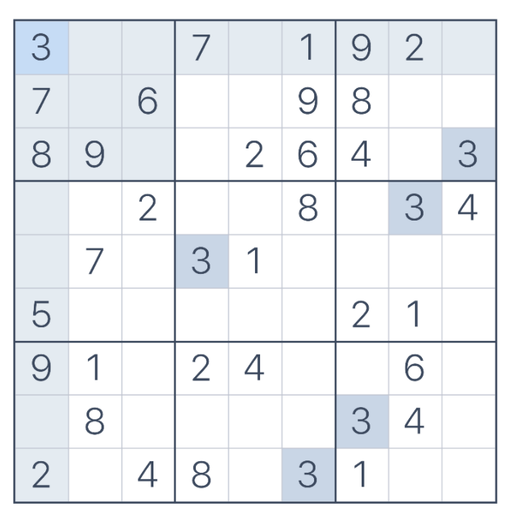
Sudoku
So Man Amanda Au-Yeung
CS5004

Slide 2
Table of Content
Goals and Rationale
Methods
Findings and Lessons Learned
Limitations and Future Extensions
Citations

Slide 3
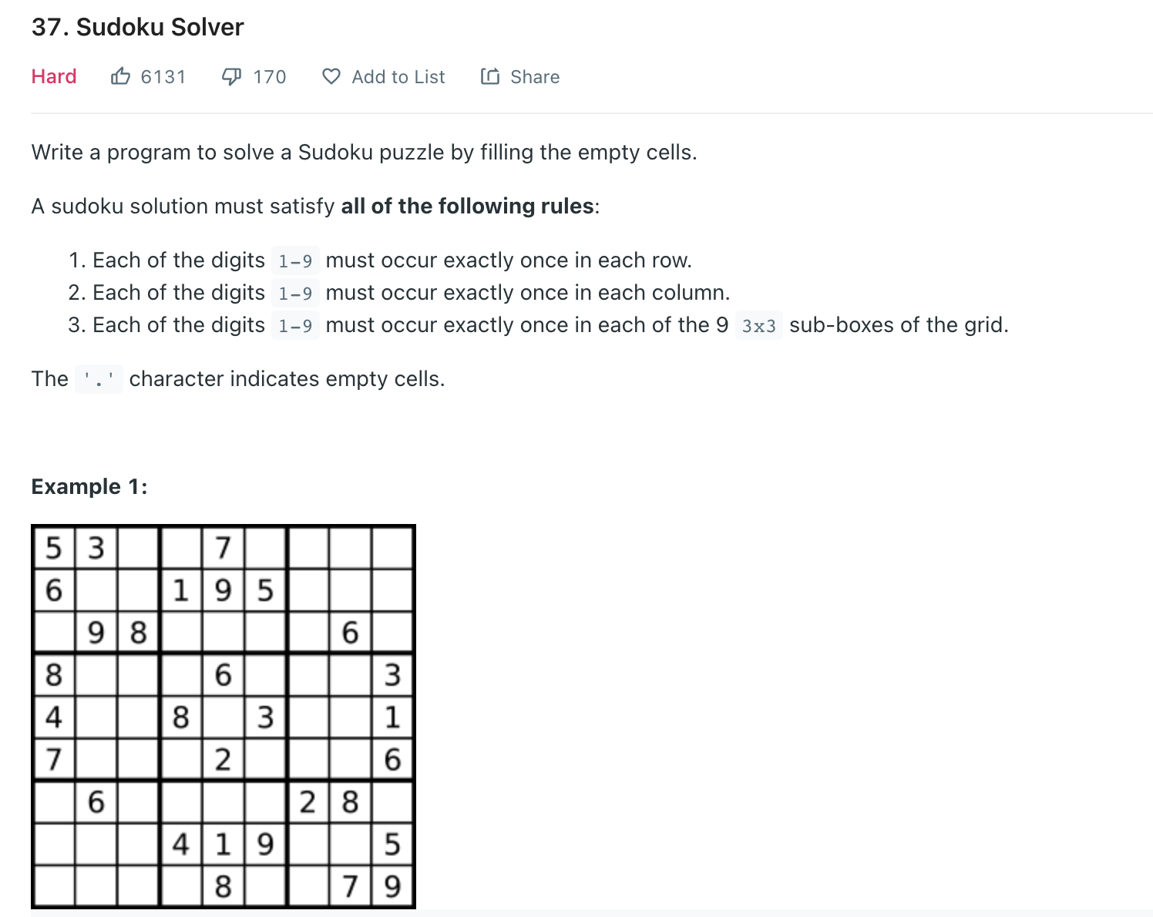
Goals and Rationale
Create a sudoku game using the backtracking algorithm
Notes:
This used to be a childhood game where I will find on the newspaper. Coincidently, I happen to find it as a leetcode.

Slide 4
Methods
Implemented a sudoku game with the MVC module using OOD
Used Tic Tac Toe homework as my framework
Used the backtracking algorithm to check if sudoku board is valid
created mock models for test for the controller
Junit tests

Slide 5
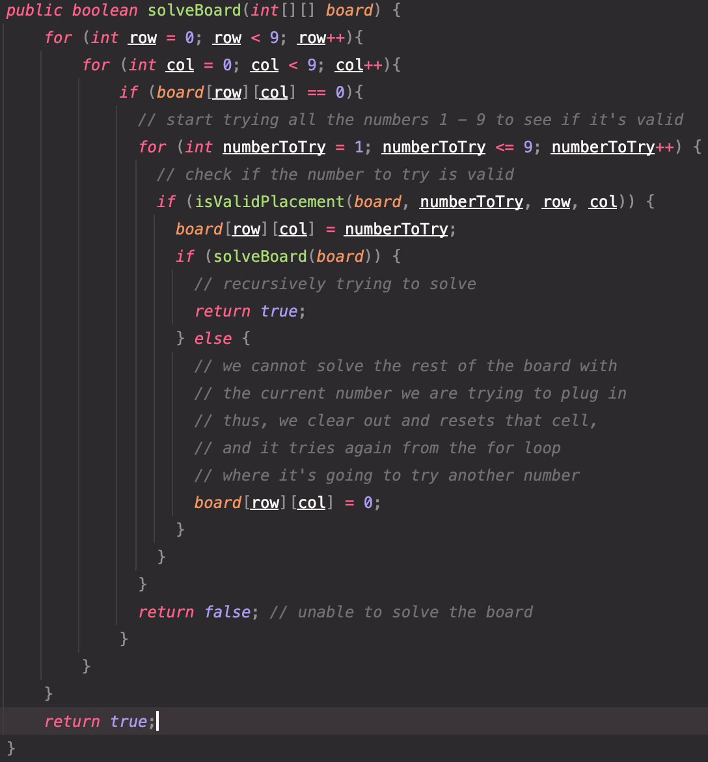
Findings and Lesson
Learned the backtracking algorithm
Implemented MVC separately
Implemented Junit testing and mock models

Slide 6
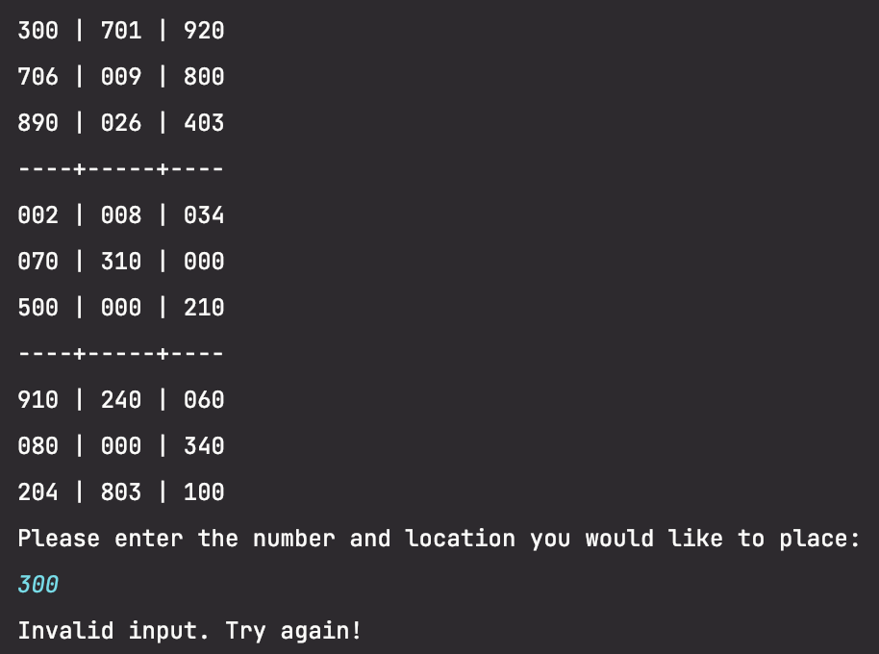
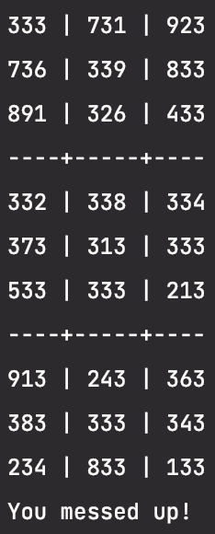
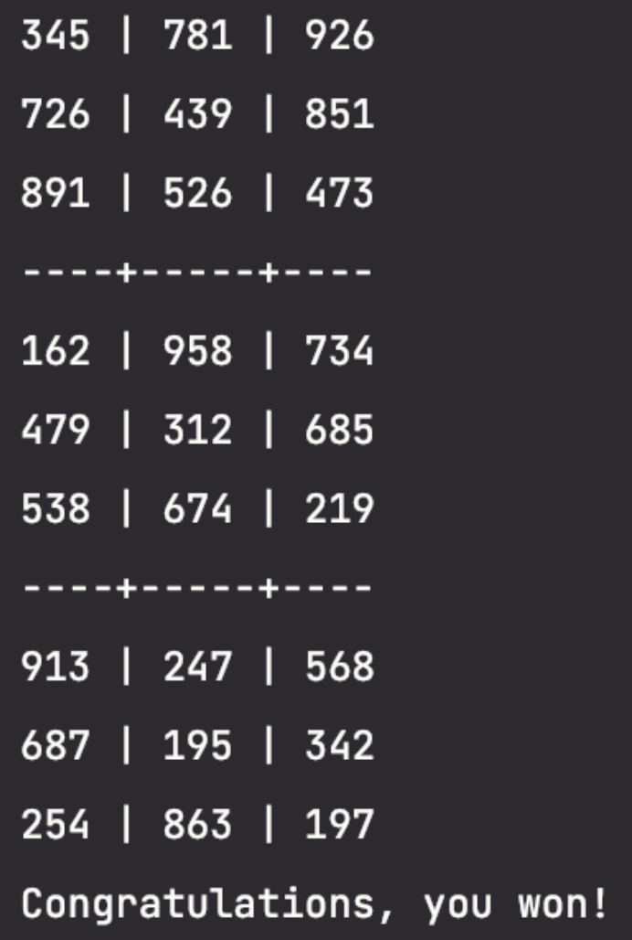
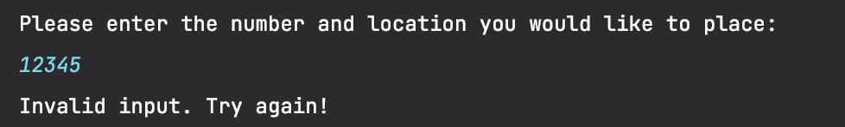
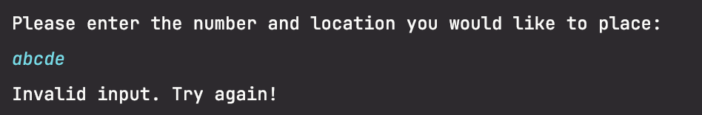
Results
Notes:
winning solution: 122 401 502 211 608 804 413 314 523 727 517 118 987 847 278 868 581 566 788 684 351 631 362 765 772 670 440 130 942 852 173 974 575 455 245 736 646 548 958 933 653 754 534

Slide 7
Limitations and Future Extensions
Limitations:
Default sudoku board
Only playing on the console
Future Extensions:
Create a sudoku web app or a simplify swing version
Add an algorithm to generate a new sudoku board every time

Slide 8

Citations
“Backtracking algorithms,” GeeksforGeeks. [Online]. Available: https://www.geeksforgeeks.org/backtracking-algorithms/. [Accessed: 14-Aug-2022].
Baeldung, “Create a sudoku solver in Java,” Baeldung, 23-May-2022. [Online]. Available: https://www.baeldung.com/java-sudoku. [Accessed: 14-Aug-2022].
Loading... [Online]. Available: https://leetcode.com/problems/sudoku-solver/. [Accessed: 14-Aug-2022].
“One way to test a two dimensional array in java with junit,” One way to test a two dimensional array in Java with JUnit. [Online]. Available: http://zijab.blogspot.com/2007/06/one-way-to-test-two-dimensional-array.html. [Accessed: 14-Aug-2022].
String (java platform SE 7 ), 24-Jun-2020. [Online]. Available: https://docs.oracle.com/javase/7/docs/api/java/lang/String.html. [Accessed: 14-Aug-2022].
Unsolvable sudoku puzzles. [Online]. Available: https://www.sudokudragon.com/unsolvable.htm. [Accessed: 14-Aug-2022].

