Slide 1
Amanda Hickman
I’m working on a new project to bring powerful AI and data analysis to investigative reporting. I led BuzzFeed Open Lab for Journalism, Technology, and the Arts from its founding in 2015 until the lab wrapped up in 2017 and have taught reporting, data analysis and audience engagement at graduate journalism programs at UC Berkeley, Columbia University and the City University of New York. I was DocumentCloud’s founding program director. I has a long history of collaborating with both reporters and community organizers to design and create the tools they need to be more effective.
Notes:
https://www.buzzfeed.com/amandahickman/buzz-bot-what-we-learned
You’re probably looking for something specific: there’s someone you want to reach. Have a plan to gracefully catch all those people who *aren’t* what you’re looking for so they don’t feel disappointed.

Slide 2

BuzzFeed Open Lab for Journalism, Technology and the Arts
2015 Fellows | 2016 Fellows
Notes:
I spent the last two years running an arts and technology fellowship inside of BuzzFeed News and it was a whirlwind.
We did a ton of awesome things: we prototyped a bunch of 360 video rigs and developed some fantastic tools for annotating physical space in virtual reality. Christine Sunu built a truly weird and wonderful menagerie of animals to demonstrate IoT functions. And we built a lot of bots.
I know the schedule says I’m going to talk about Factful, and I will, but right now Factful is in a very active research stage. We don’t have tools you can actually use now. So I wanted to talk about some things I’ve worked on that you can you use right now.

Slide 3
Tinker, experiment, learn
Start small, and if a project doesn’t go the way you were hoping it would go, think about what you will do differently next time.
Notes:
I live just north of Silicon Valley, where it’s very chic to celebrate failure. Not everyone has the money or the privilege to fail without consequences, and I don’t think catastrophic failure is a great way to learn, but in the Open Lab we always looked for opportunities to learn from projects that didn’t go the way we had hoped they would go. If something doesn’t work out, use that as an opportunity to figure out why, and do better the next time.
Anytime a fellow came to me and said they didn’t want to write about a particular project because “it was a disaster” we found a way to write instead about what we learned and why it didn’t work. Those posts are some of our most important because they really did a good job of articulating where a project hit walls, and what we realized afterwards about why we had hit those walls.

Slide 4
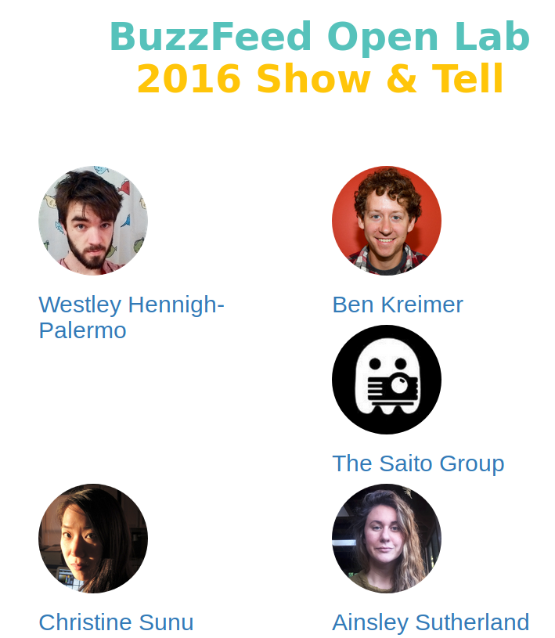
2016 Fellows

Slide 5
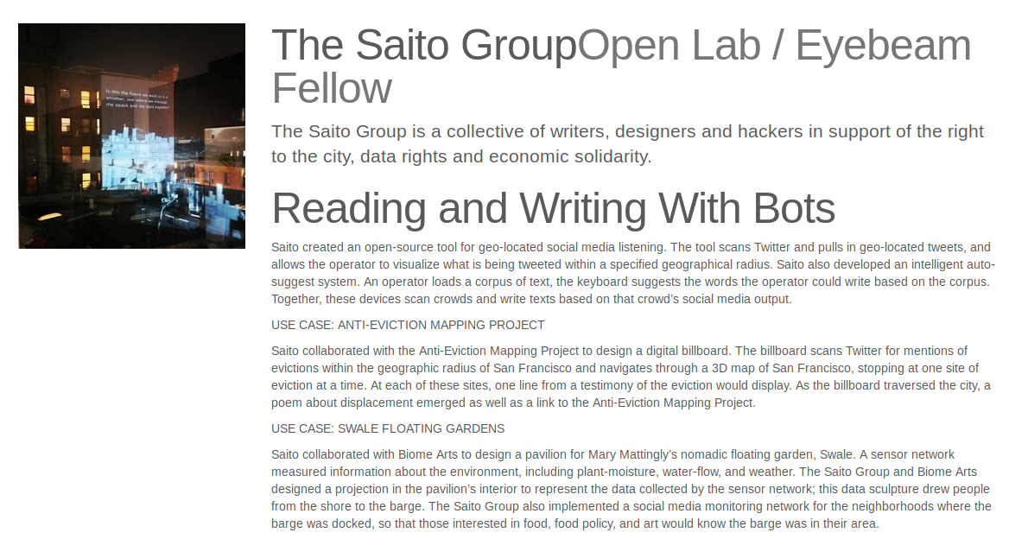

Slide 6
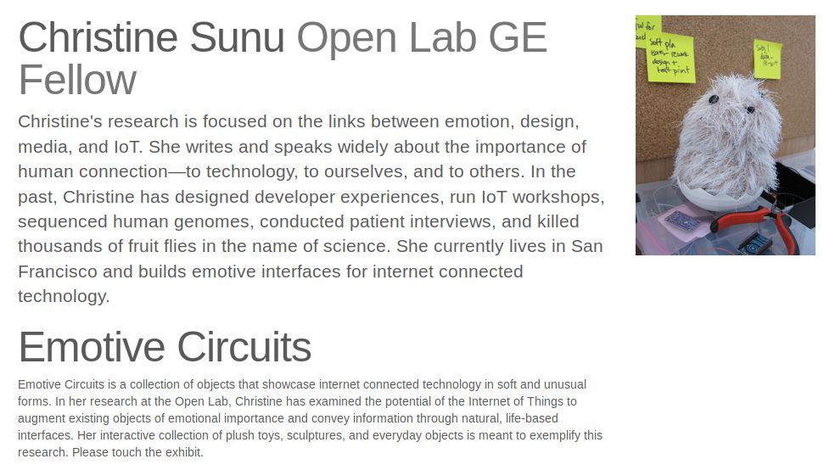

Slide 7
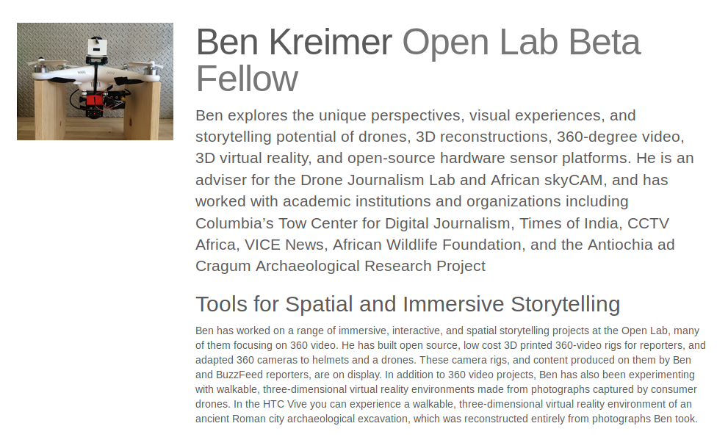

Slide 8
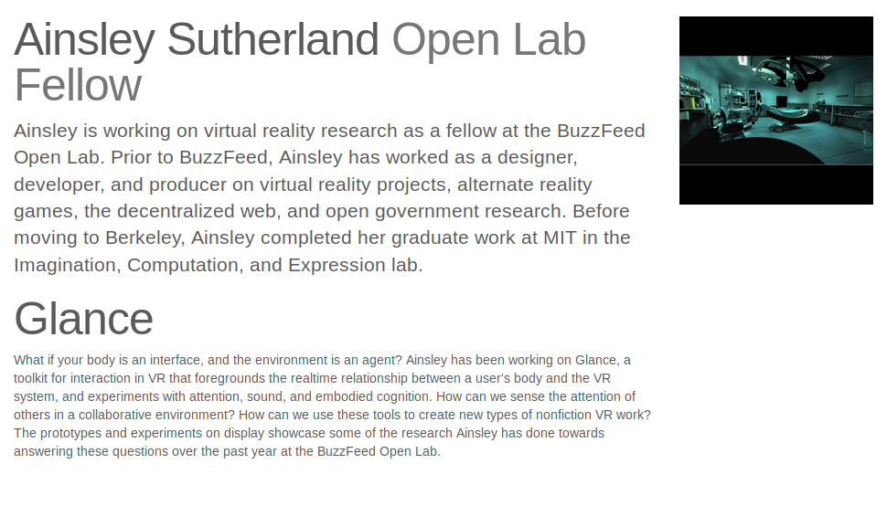

Slide 9
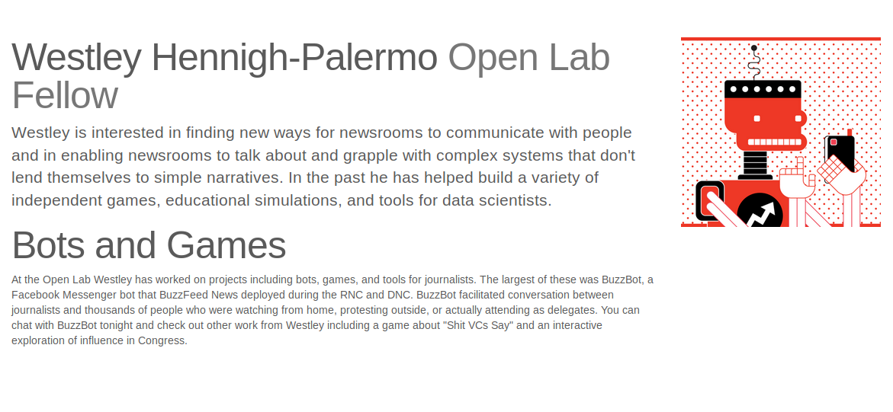

Slide 10
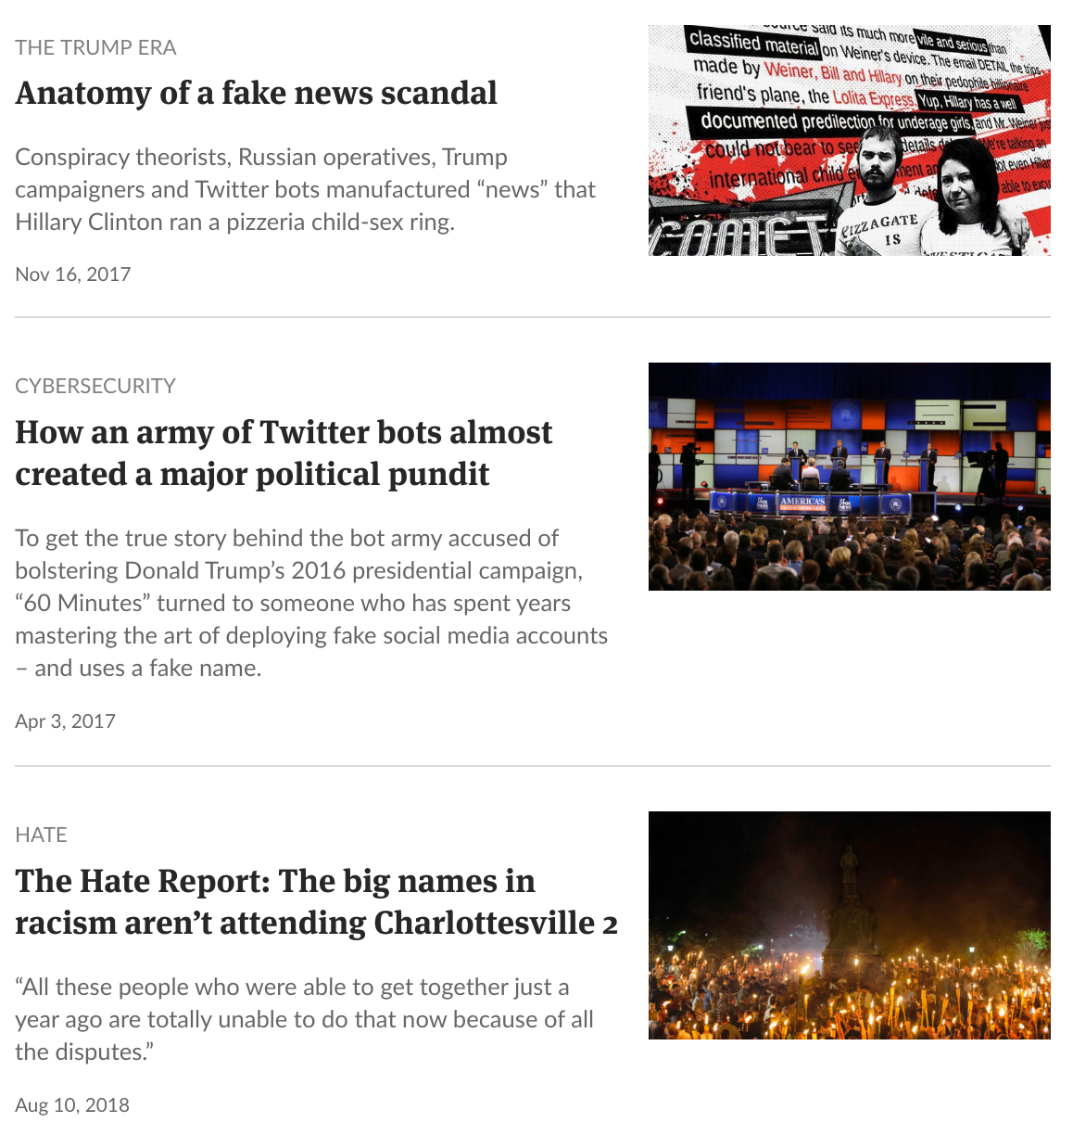
Not Those Bots
Not those bots
I’m a lot less interested in bots that create chaos or the illusion of mass support. But I am interested in bots that make us think.
Notes:
I should start by saying that there are a lot of different things out there going by the title of “bots” -- I’m not interested in bots that make an online crowd look bigger than it is. (Or, rather, I’m very interested in them and how they impact news and civic conversations, but I’m not here to build them.) I’m interested in bots that allow us to build relationships with our readers.

Slide 11
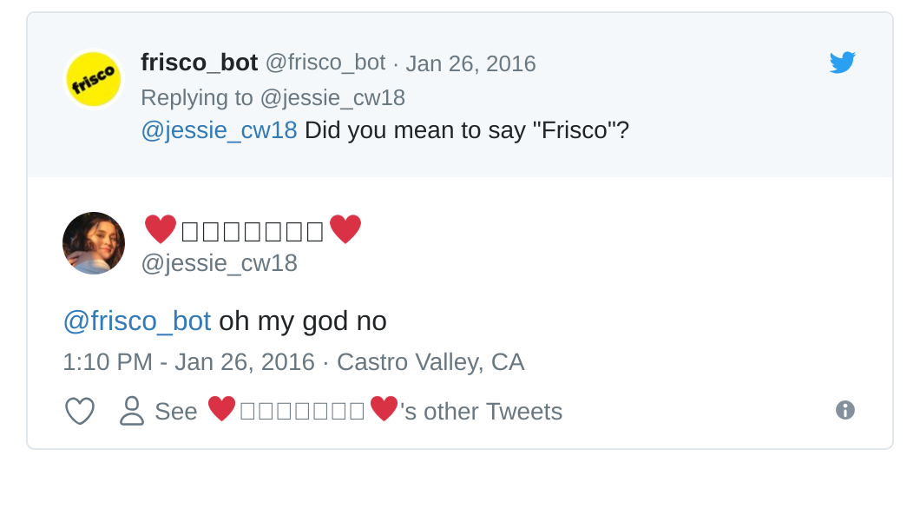
Very Annoying Bots
Bots that feed puppies, or listen for keywords to respond to are kind of dumb, but sometimes dumb stuff inspires more … inspired stuff.
Notes:
At the Open Lab we did a lot of goofing around. A lot. We live streamed some puppies in the office and set up a kibble dispenser that dropped a bit of puppy chow everytime someone said “good dog” in the comments.
https://github.com/buzzfeed-openlab/interactive-video-bot
https://github.com/buzzfeed-openlab/geotweets
https://www.buzzfeed.com/saito/writing-robots-anti-eviction-mapping-floating-forests
https://github.com/buzzfeed-openlab/unwelcome-bot

Slide 12
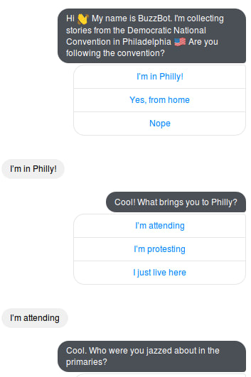
Buzz Bot
Bots that invite our audience to help us cover important news events.
Notes:
And then we started thinking about a few different things at the same time:
It would be fun to write a Facebook messenger bot.
And, we were going to have to cover the Presidential nominating conventions that summer (it was 2016).
We’d been hearing a lot about ways that newsrooms were exploring Facebook Messenger’s API to serve stories to readers and customize recommendations, but we wanted to play with engagement. So we built Buzz Bot. Or, rather Westley Hennigh-Palermo built Buzz Bot.
Credits: Westley Hennigh-Palermo, Ben Smith, Sara Yasin and Brandon Wall.
The API is set up so that you can’t ping people until they ping you. So if you said anything to Buzz bot it replied with a little tree of questions that let us sort users into some basic groups. And on night one we realized …
The conventions are a news event and there are a lot of people there. We wanted to connect with folks on the ground: delegates, protesters, flacks. We had a lot of ideas about how we wanted to engage with folks on the ground in Cleveland or Philadelphia, but we quickly realized something that is totally obvious in retrospect: the vast majority of people who had reached out to Buzz Bot weren’t anywhere near the convention. And a lot of them weren’t even particularly interested in the convention. But we’d taken over the BuzzFeed News Facebook page completely. We didn’t say “if you’re at the RNC ping Buzz Bot” we said “Buzz Bot is awesome!”
So most users answered that first question with “Nope”; with “Yes, from home” as the second choice. Again: duh. But
We quickly regrouped and came up with some smart ways to connect with folks who weren’t on the ground in at the conventions. But there’s an important lesson in this: often when we start to think about connecting with audiences, we’ve got something we want from our audience. But to reach the folks we do want to talk to, we cast a wide net and then lure in all these … other people. People we aren’t interested in right now, and we haven’t thought through how to make sure they feel good about their exchange with us, too.
So that’s lesson one: think about what you’re going to say to the outliers.

Slide 13
It isn’t failure if you learn something.
It is chic in Silicon Valley to talk about “failing fast” which is great for VC. A better strategy is to organize your work so you can learn from it.
Notes:
https://www.buzzfeed.com/amandahickman/buzz-bot-what-we-learned
I don’t think that we fully plumbed the depths of what is possible (not even close) but BuzzBot was almost always one step behind our reporters on the ground. Invariably the BuzzFeed News team was able to verify or debunk reports, and often to cut a video clip, write around it, and post it, before Buzz Bot’s users got back to us.
Some of the kinds of stories we tried to verify: Twitter rumors that protesters were being arrested at a particular intersection (there weren't any Buzz Bot users nearby, but a BuzzFeed Politics reporter got there very quickly); reports of protesters burning flags outside the convention center (again, our reporters had the story much faster than the bot). On Day 2 of the GOP Convention we heard someone shout what sounded like "no Islam!" from the audience as a Muslim speaker led a prayer. By the time that Buzz Bot's users in the convention hall had told us they didn't hear the shout, BuzzFeed politics reporters had found a clip where the exclamation is audible, cut it and posted it on our live post for the day.

Slide 14
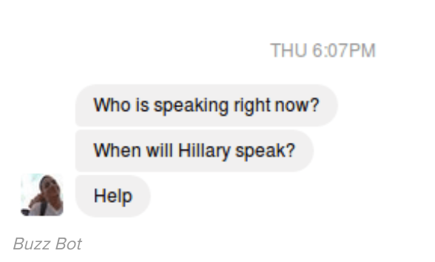
Read your logs.
Your logs can tell you a lot about what your audience wants.
Notes:
People are really good at talking to bots. They’ll feel around for a prompt, try rephrasing if they aren’t getting the answer they expected. That means that if you watch your logs you can learn a lot about what your users are looking for. Often they have pretty good ideas.
This user asked three really good questions. As ever, in retrospect I think we should have been prepared for all three, but you can’t prepare for everything. But you can keep an eye on your logs and notice which prompts fall on deaf ears and warrant repair.

Slide 15
Nothing good happens overnight.
Don’t expect your bot to take off overnight. Keep trying, keep experimenting with prompts, keep playing with tone.
Notes:
If something doesn’t work, don’t give up. Try again. Unless you really want to give up. 🤷‍♀️ Sometimes giving up is the right thing to do.

Slide 16
Everything changes.
Something that worked might not work again. Don’t stop experimenting.
Notes:
If something doesn’t work, don’t give up. Try again. Unless you really want to give up. 🤷‍♀️ Sometimes giving up is the right thing to do.

Slide 17
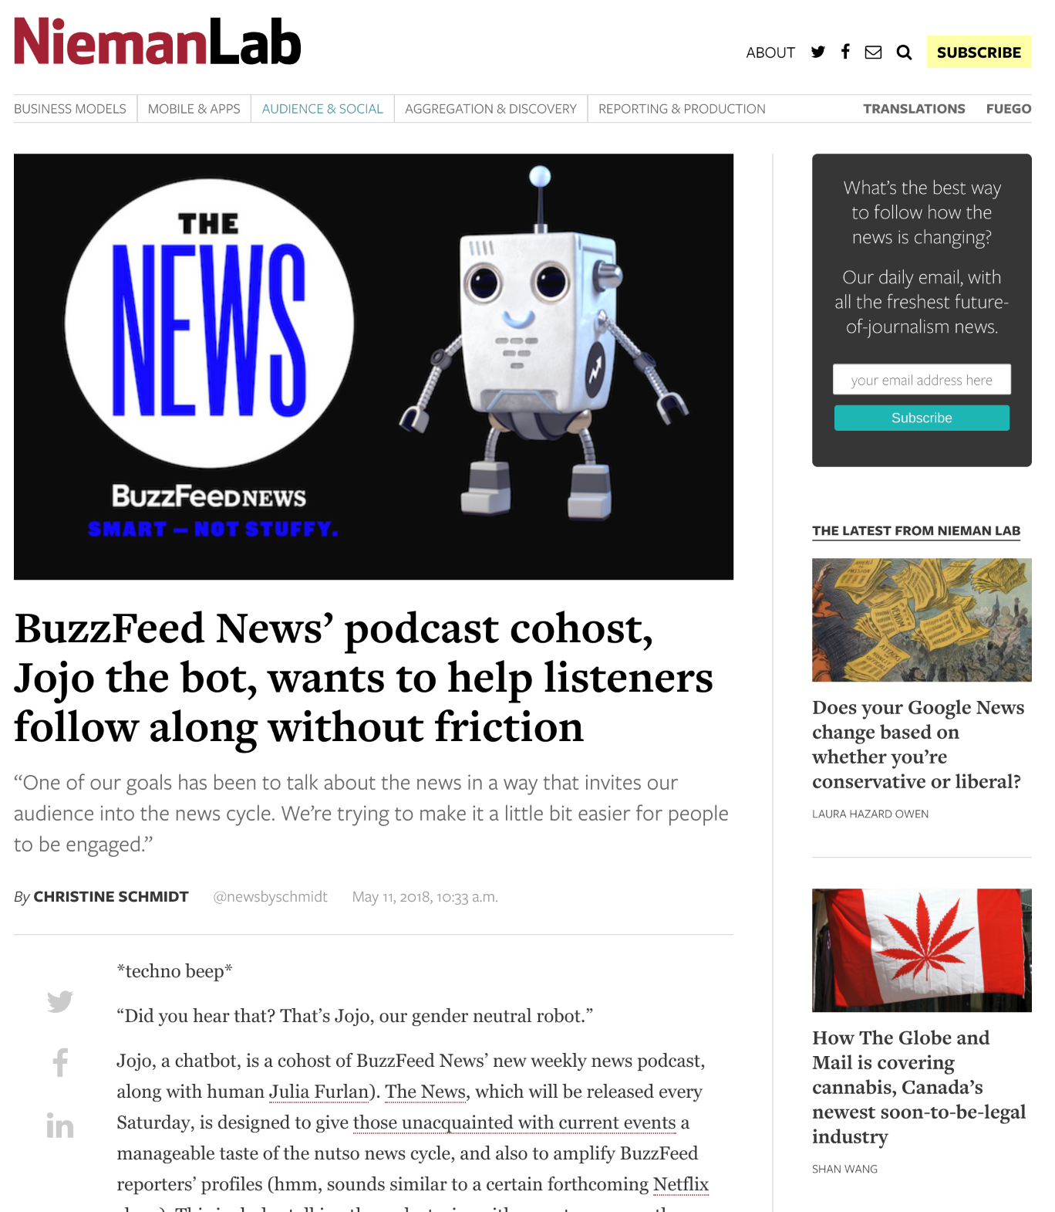
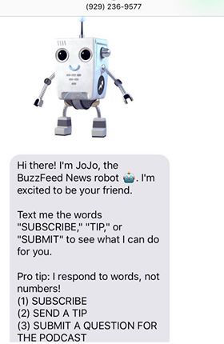
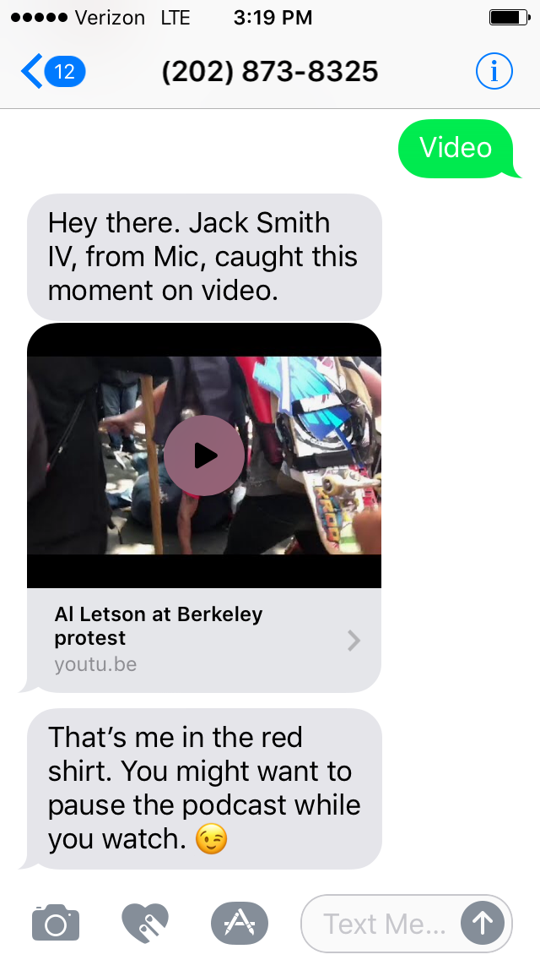
Even More Bots
Notes:
BuzzFeed didn’t stop experimenting after the Open Lab closed up -- this Spring they launched Jojo, a podcast cohost who can answer questions about current events: http://www.niemanlab.org/2018/05/buzzfeed-news-podcast-cohost-jojo-the-bot-wants-to-help-listeners-follow-along-without-friction/
Reveal, a podcast and radio show, from Center for Investigative Reporting, has an SMS bot, too.
https://www.poynter.org/news/17-million-monthly-downloads-reveal-podcast-wanted-give-its-listeners-more-solution-sms

Slide 18
2017 Fellows
+ Jamica El
+ Logan Williams
+ Lam Thuy Vo
+ Cathy Deng
+ Caroline Sinders
Notes:
Logan Williams and Cathy Deng each took very different approaches to exploring conversational interfaces, and while their results are distinct, they've both produced interactions that are engaging and warm. Jamica El's projects are nominally about hardware, but at the heart her work is about who gets a voice and whose story matters. Her work overlaps beautifully with Cathy's exploration of ways to amplify – and hear to – quiet voices. Lam Thuy Vo’s look at the tone and language we encounter online, added vital perspective.
Logan and Caroline Sinders each brought wonderful creativity to the project of inviting machine learning algorithms into photographic narratives, using personal snapshots as a starting place. Reflection, public and private, shaped many of our projects. Where Logan’s work asks participants to craft personal narratives and reflections, Lam looked for a reflection of our selves in the data trails we leave online, while Jamica’s study of sousveillance pulled privacy back into the frame.
Advertisement
For me, this year has been a chance to think about the stories and data we don’t want to share and how to help more people keep their private records private.
Each project tackles a central question about who gets heard. Not by "giving voice to the voiceless" but starting with the premise that no one needs to be “given” a voice, and that the challenge is in finding better ways to hear and new ways to listen.

Slide 19
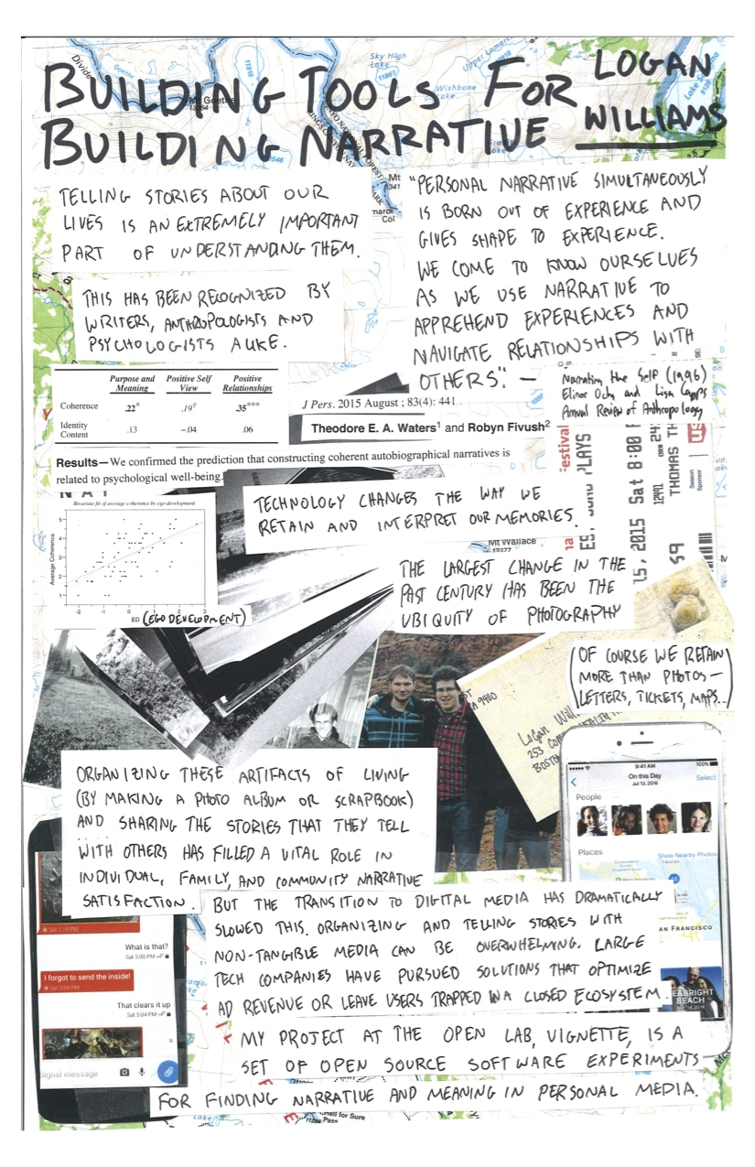
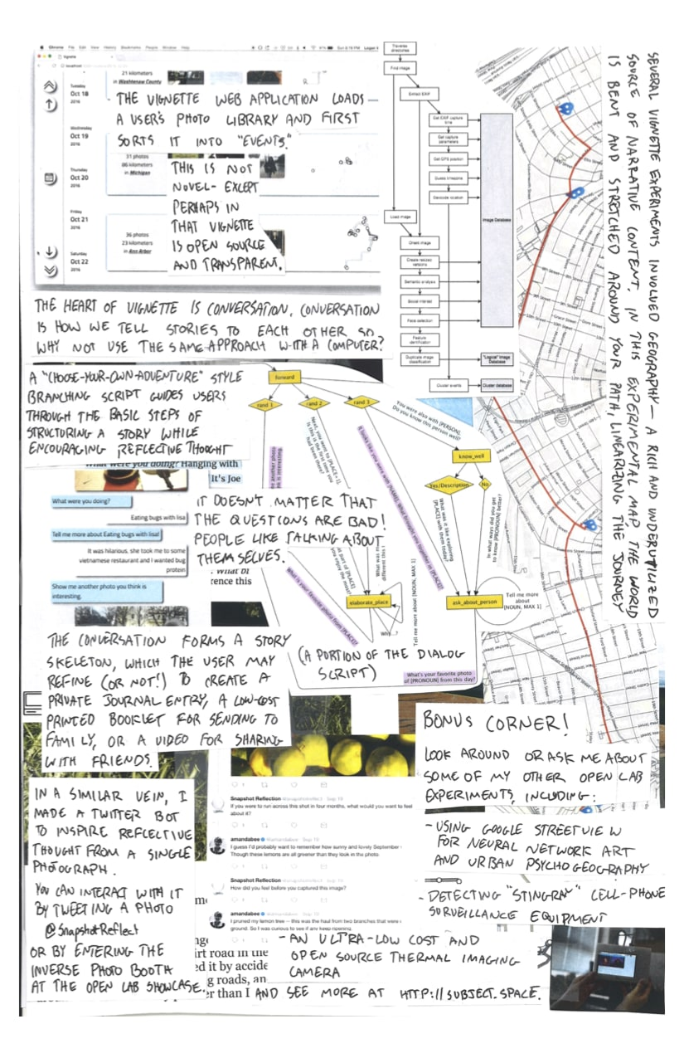
Logan Williams is building technology that encourages people to transform personal photographs into reflective stories.

Slide 20
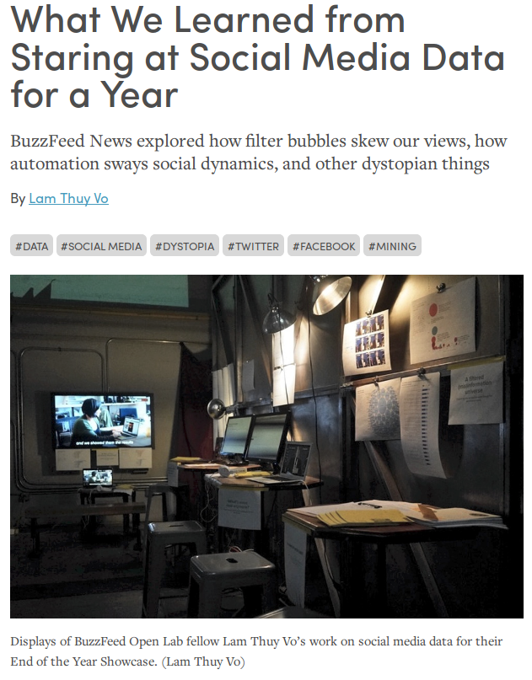
Lam Thuy Vo explores ethical ways to mine and utilize social media data for storytelling.
https://source.opennews.org/articles/what-buzzfeed-news-learned-after-year-mining-data-/
Notes:
Lam Thuy Vo explored ethical ways to mine and utilize social media data for storytelling.

Slide 21
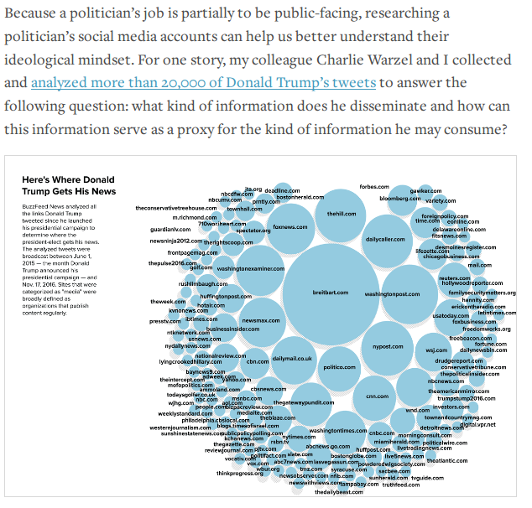

Slide 22
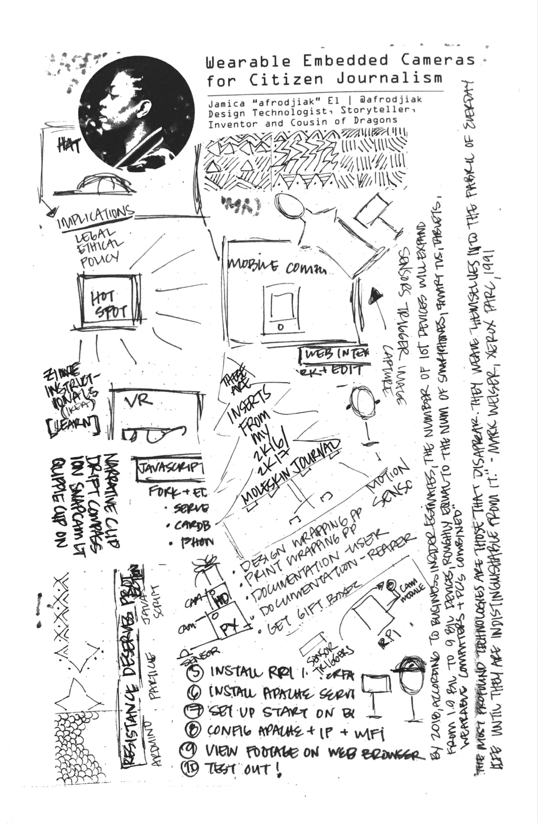
Jamica El prototyped wearable surveillance gear by embedding cameras into textiles and accessories for news gathering.
Notes:
Jamica El is prototyping wearable surveillance gear by embedding cameras into textiles and accessories for news gathering.

Slide 23
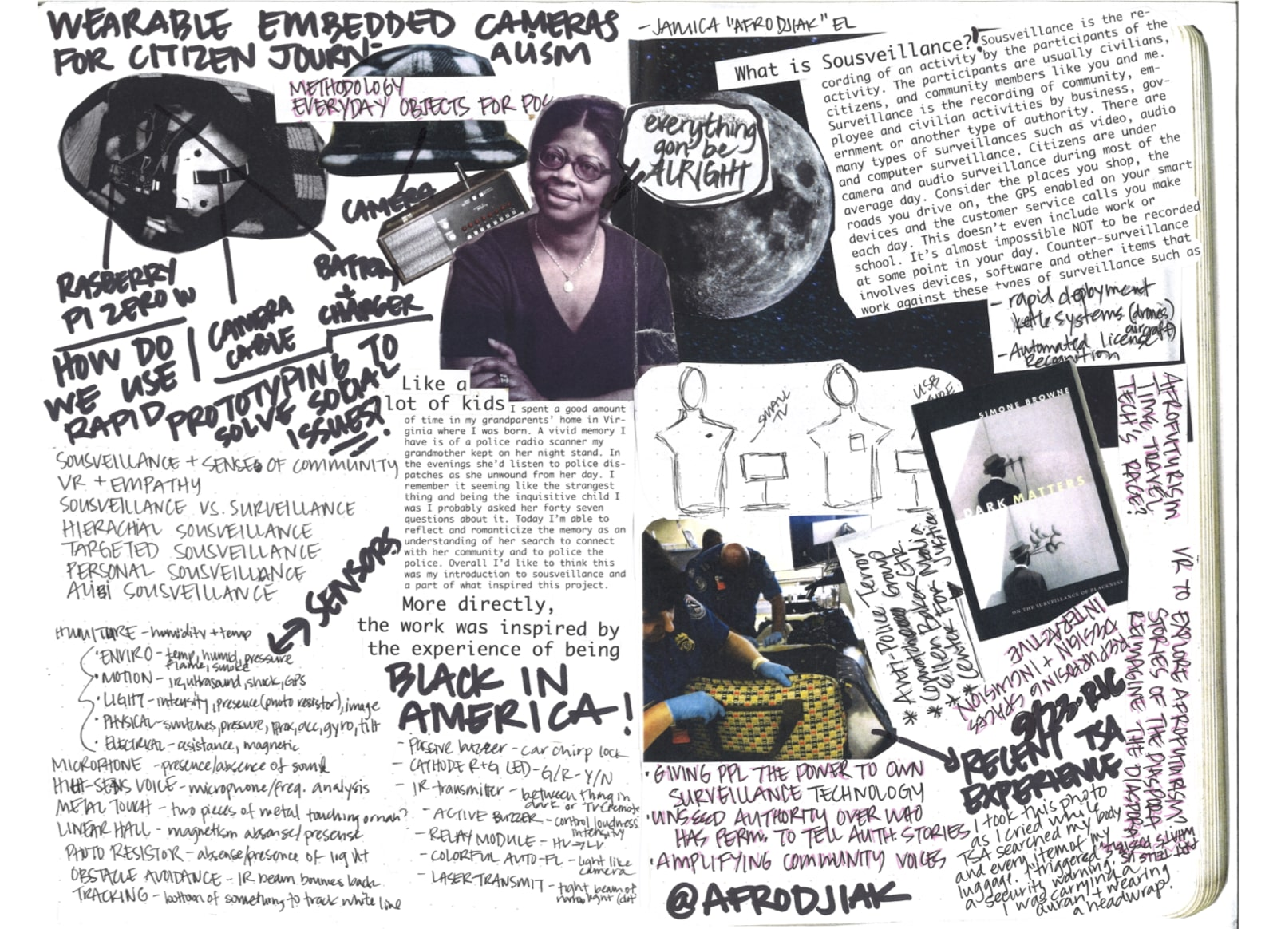

Slide 24
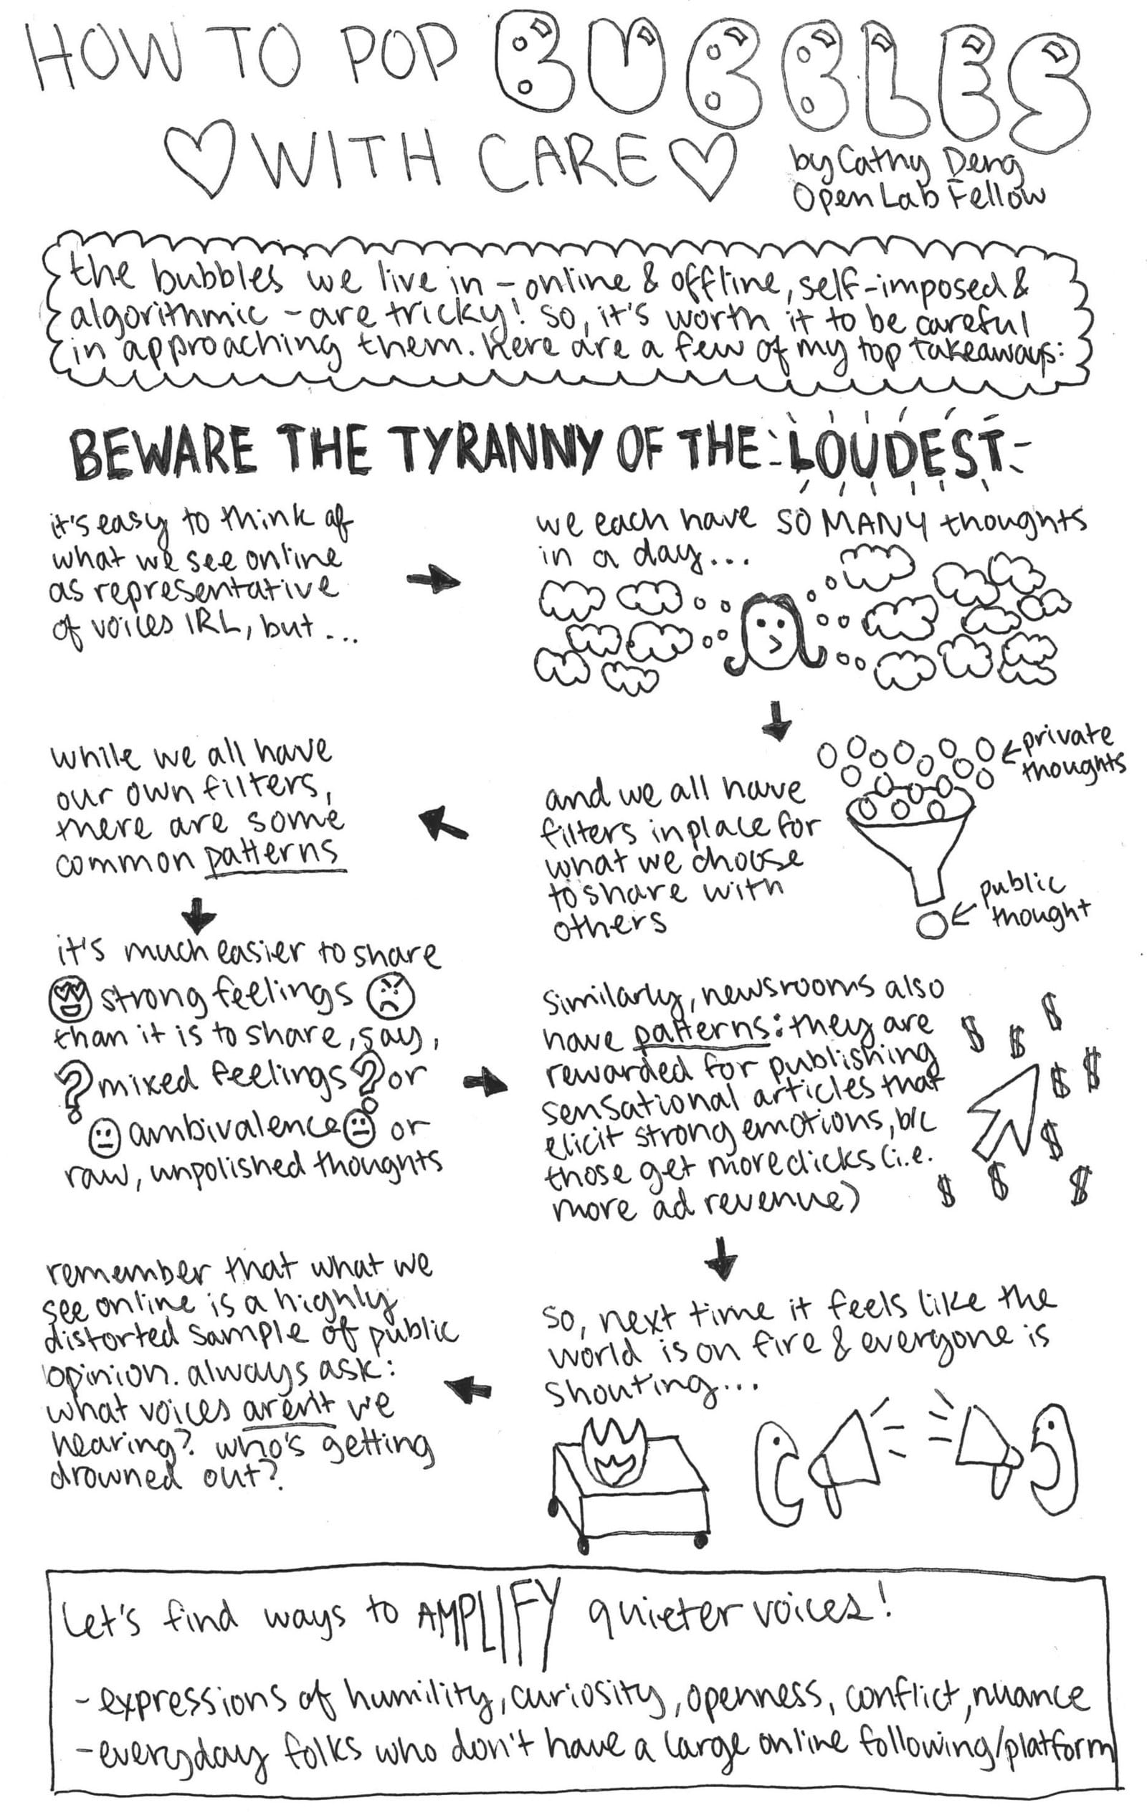
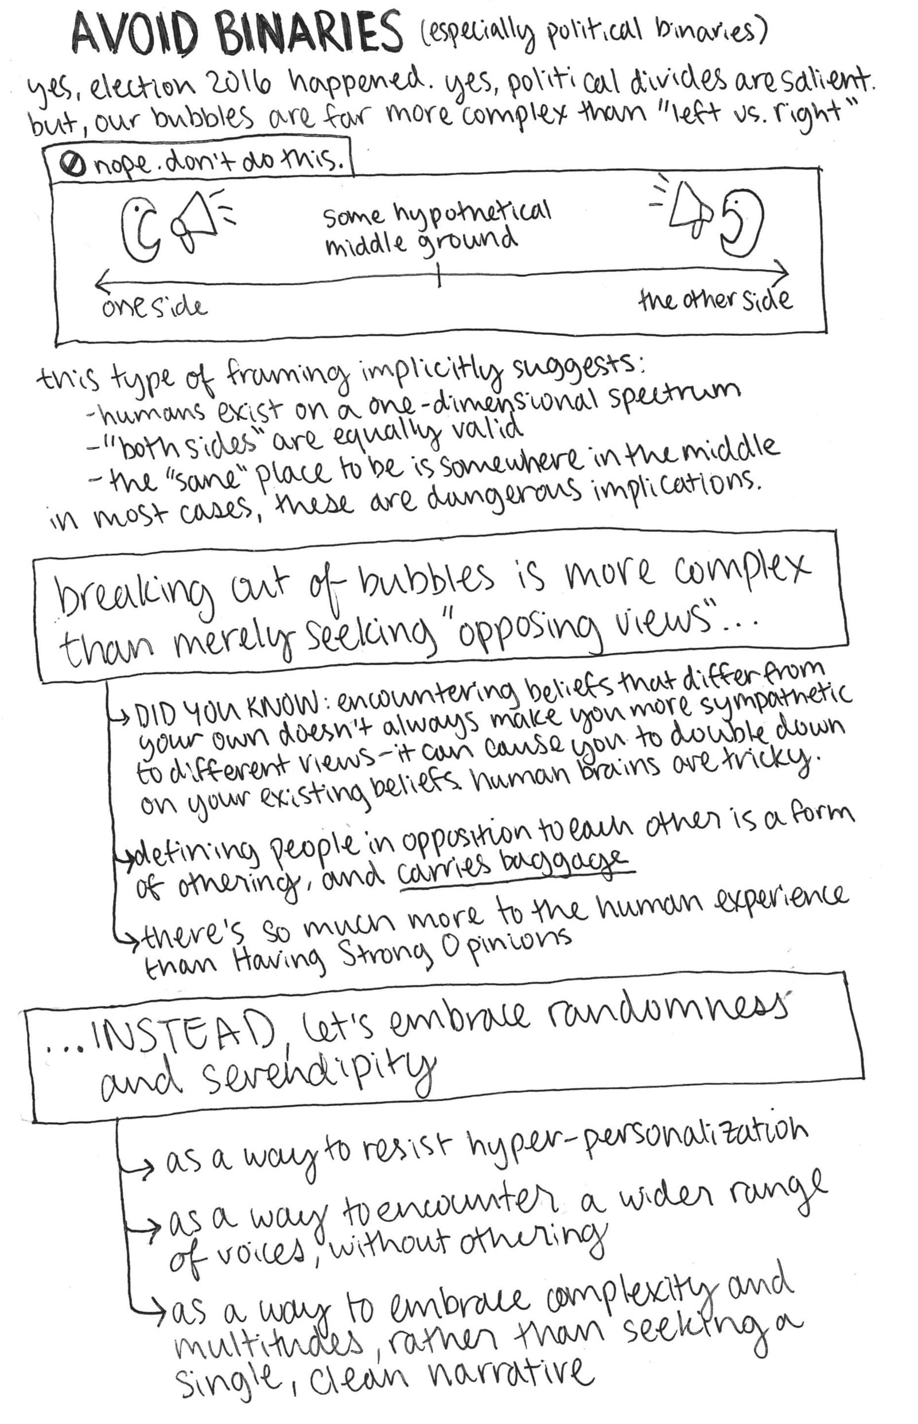
Cathy Deng is engineering playful, serendipitous encounters to break people out of their echo chambers.

Slide 25
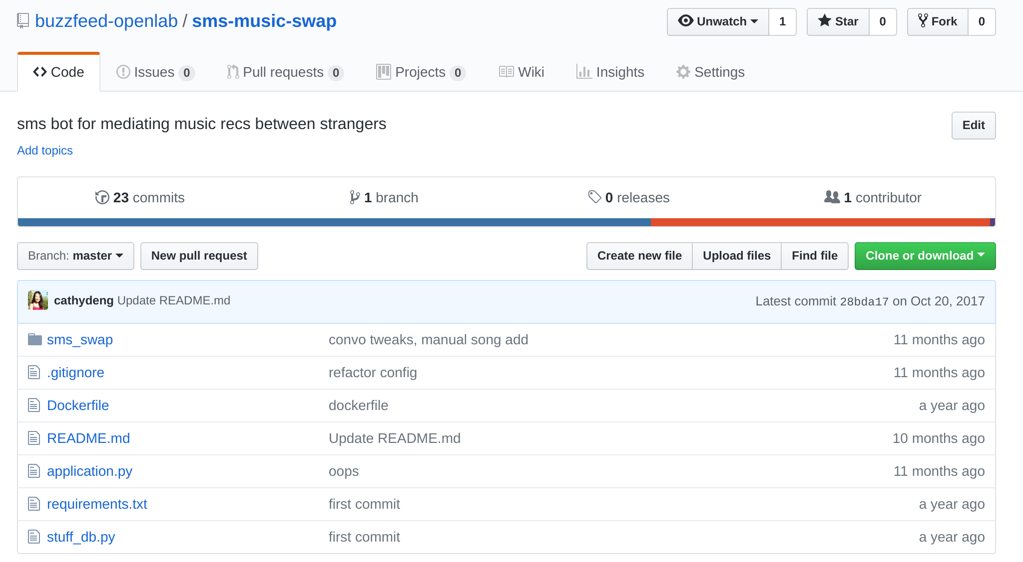
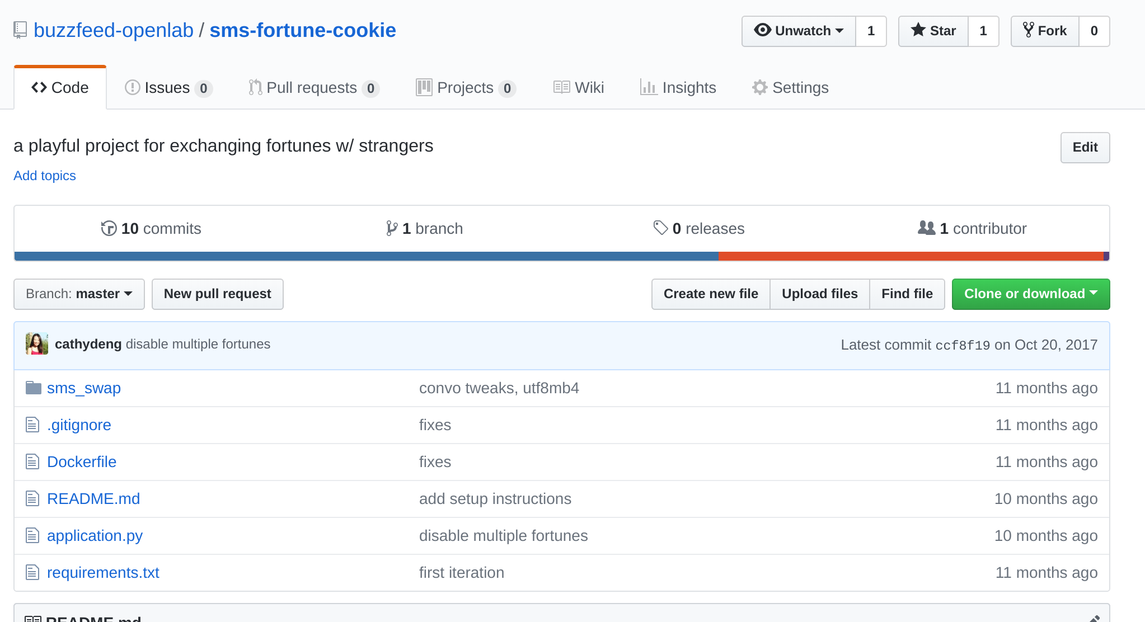
Music Swap, Fortune Swap
Notes:
Cathy Deng came to the Open Lab to play with curating serendipity. She built a series of SMS bots that ask users to share something (a fortune, or a favorite album) and get something in return. These were very playful, but they gave us a chance to think about how SMS tools might work, how much guidance people need to sort out prompts. They also gave us a chance to play with Twilio’s API.
From there we started building a “press freedom bot” that took questions about access to public meetings and access to public records. When you send the Press Freedom Bot a question, it asks you a few questions about where you are (which US state) and sends you contact information for a number of resources, including and ombudsperson who can help with access issues.
In the first iteration, that’s all we could do with it. From there we had to review the logs and take stock of what people were actually asking, in order to plan out the more complex questions we were going to try to answer. (so that’s another big tip: start small.)

Slide 26

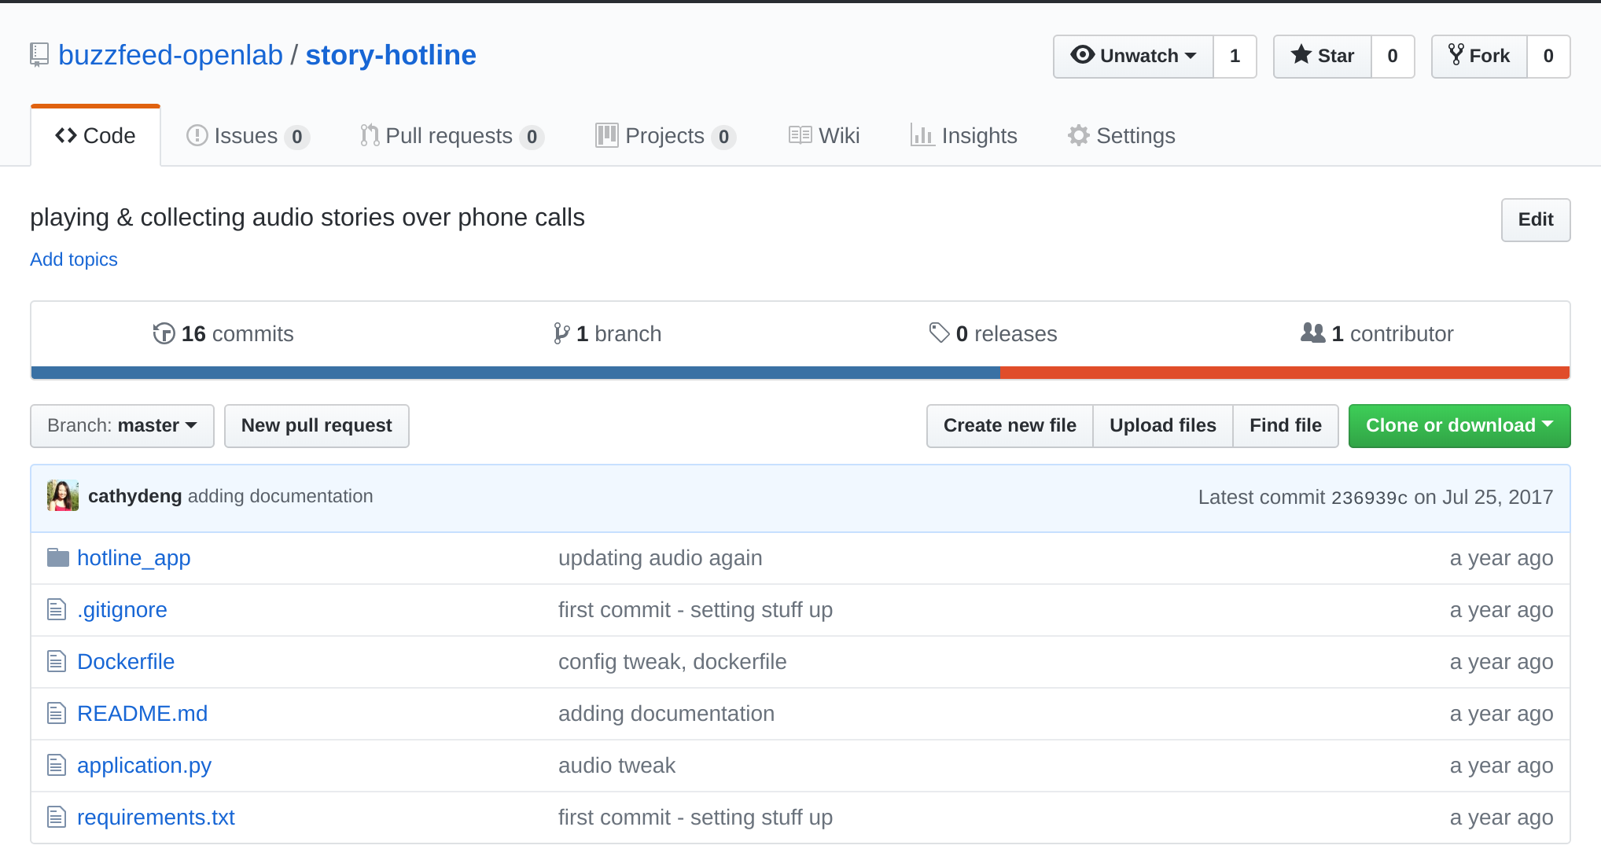
Iftar Stories
Notes:
Picking up the phone and making a call is a high bar.
But the intimacy of listening to a recording is pretty powerful.

Slide 27
Capture Lessons
When you’re done with a project, or sometimes sooner, write it up. What did you set out to learn? What did you learn? If you can’t make that writing public, at least share it internally.
Notes:
https://www.buzzfeed.com/amandahickman/buzz-bot-what-we-learned
I don’t think that we fully plumbed the depths of what is possible (not even close) but BuzzBot was almost always one step behind our reporters on the ground. Invariably the BuzzFeed News team was able to verify or debunk reports, and often to cut a video clip, write around it, and post it, before Buzz Bot’s users got back to us.
Some of the kinds of stories we tried to verify: Twitter rumors that protesters were being arrested at a particular intersection (there weren't any Buzz Bot users nearby, but a BuzzFeed Politics reporter got there very quickly); reports of protesters burning flags outside the convention center (again, our reporters had the story much faster than the bot). On Day 2 of the GOP Convention we heard someone shout what sounded like "no Islam!" from the audience as a Muslim speaker led a prayer. By the time that Buzz Bot's users in the convention hall had told us they didn't hear the shout, BuzzFeed politics reporters had found a clip where the exclamation is audible, cut it and posted it on our live post for the day.

Slide 28
Document Everything
Set aside a place where your code lives, along with documentation that will let you replicate the experiment, even if you think it was an utter failure.
Notes:
https://www.buzzfeed.com/amandahickman/buzz-bot-what-we-learned
I don’t think that we fully plumbed the depths of what is possible (not even close) but BuzzBot was almost always one step behind our reporters on the ground. Invariably the BuzzFeed News team was able to verify or debunk reports, and often to cut a video clip, write around it, and post it, before Buzz Bot’s users got back to us.
Some of the kinds of stories we tried to verify: Twitter rumors that protesters were being arrested at a particular intersection (there weren't any Buzz Bot users nearby, but a BuzzFeed Politics reporter got there very quickly); reports of protesters burning flags outside the convention center (again, our reporters had the story much faster than the bot). On Day 2 of the GOP Convention we heard someone shout what sounded like "no Islam!" from the audience as a Muslim speaker led a prayer. By the time that Buzz Bot's users in the convention hall had told us they didn't hear the shout, BuzzFeed politics reporters had found a clip where the exclamation is audible, cut it and posted it on our live post for the day.

Slide 29
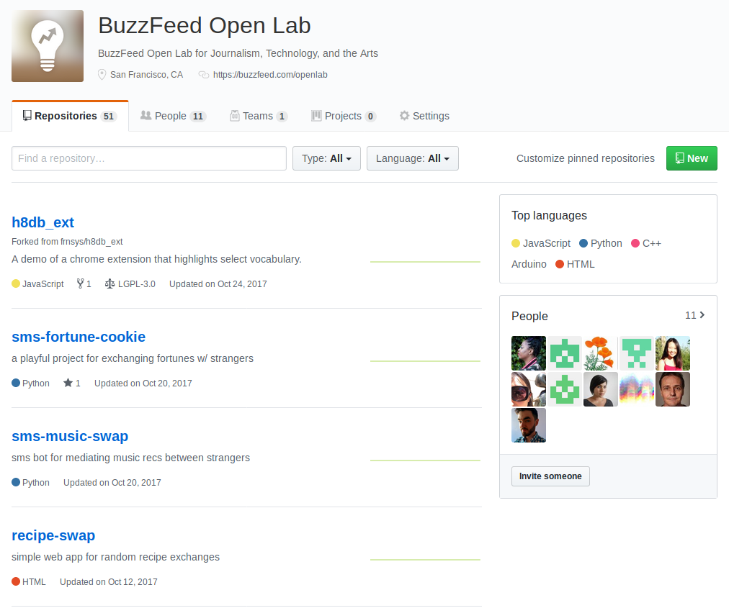
https://github.com/buzzfeed-openlab/

Slide 30

+ Magic isn’t real.
+ Integration matters.
+ Clear goals ftw
Notes:
Logan Williams and Cathy Deng each took very different approaches to exploring conversational interfaces, and while their results are distinct, they've both produced interactions that are engaging and warm. Jamica El's projects are nominally about hardware, but at the heart her work is about who gets a voice and whose story matters. Her work overlaps beautifully with Cathy's exploration of ways to amplify – and hear to – quiet voices. Lam Thuy Vo’s look at the tone and language we encounter online, added vital perspective.
Logan and Caroline Sinders each brought wonderful creativity to the project of inviting machine learning algorithms into photographic narratives, using personal snapshots as a starting place. Reflection, public and private, shaped many of our projects. Where Logan’s work asks participants to craft personal narratives and reflections, Lam looked for a reflection of our selves in the data trails we leave online, while Jamica’s study of sousveillance pulled privacy back into the frame.
Advertisement
For me, this year has been a chance to think about the stories and data we don’t want to share and how to help more people keep their private records private.
Each project tackles a central question about who gets heard. Not by "giving voice to the voiceless" but starting with the premise that no one needs to be “given” a voice, and that the challenge is in finding better ways to hear and new ways to listen.

Slide 31
Questions?
We’re about to switch gears.
Notes:
https://www.buzzfeed.com/amandahickman/buzz-bot-what-we-learned
I don’t think that we fully plumbed the depths of what is possible (not even close) but BuzzBot was almost always one step behind our reporters on the ground. Invariably the BuzzFeed News team was able to verify or debunk reports, and often to cut a video clip, write around it, and post it, before Buzz Bot’s users got back to us.
Some of the kinds of stories we tried to verify: Twitter rumors that protesters were being arrested at a particular intersection (there weren't any Buzz Bot users nearby, but a BuzzFeed Politics reporter got there very quickly); reports of protesters burning flags outside the convention center (again, our reporters had the story much faster than the bot). On Day 2 of the GOP Convention we heard someone shout what sounded like "no Islam!" from the audience as a Muslim speaker led a prayer. By the time that Buzz Bot's users in the convention hall had told us they didn't hear the shout, BuzzFeed politics reporters had found a clip where the exclamation is audible, cut it and posted it on our live post for the day.

Slide 32
Data Journalism
Notes:
I spent the last two years running an arts and technology fellowship inside of BuzzFeed News and it was a whirlwind.
We did a ton of awesome things: we prototyped a bunch of 360 video rigs and developed some fantastic tools for annotating physical space in virtual reality. Christine Sunu built a truly weird and wonderful menagerie of animals to demonstrate IoT functions. And we built a lot of bots.
I know the schedule says I’m going to talk about Factful, and I will, but right now Factful is in a very active research stage. We don’t have tools you can actually use now. So I wanted to talk about some things I’ve worked on that you can you use right now.

Slide 33
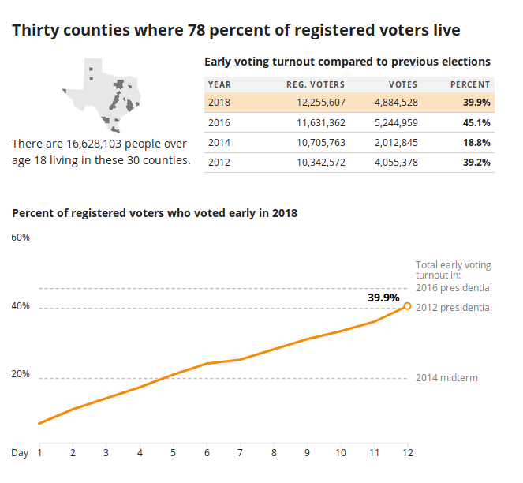
J200: Introduction to Data
+ Data Lies
+ Spreadsheet Skills
+ OpenRefine (or Workbench) for cleaning data.
+ Datawrapper for charts and maps.
Notes:
Logan Williams and Cathy Deng each took very different approaches to exploring conversational interfaces, and while their results are distinct, they've both produced interactions that are engaging and warm. Jamica El's projects are nominally about hardware, but at the heart her work is about who gets a voice and whose story matters. Her work overlaps beautifully with Cathy's exploration of ways to amplify – and hear to – quiet voices. Lam Thuy Vo’s look at the tone and language we encounter online, added vital perspective.
Logan and Caroline Sinders each brought wonderful creativity to the project of inviting machine learning algorithms into photographic narratives, using personal snapshots as a starting place. Reflection, public and private, shaped many of our projects. Where Logan’s work asks participants to craft personal narratives and reflections, Lam looked for a reflection of our selves in the data trails we leave online, while Jamica’s study of sousveillance pulled privacy back into the frame.
Advertisement
For me, this year has been a chance to think about the stories and data we don’t want to share and how to help more people keep their private records private.
Each project tackles a central question about who gets heard. Not by "giving voice to the voiceless" but starting with the premise that no one needs to be “given” a voice, and that the challenge is in finding better ways to hear and new ways to listen.

Slide 34
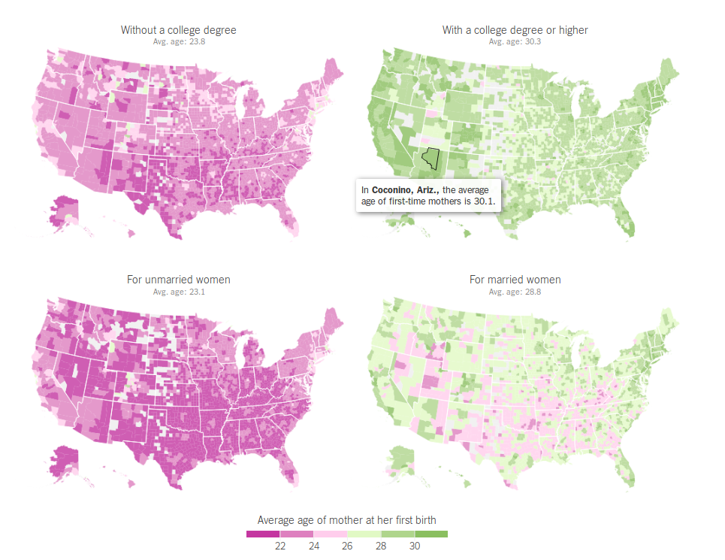
J298: Advanced Electives
Not those bots
+ csvkit
+ R (and Python Notebooks)
+ QGIS (and PostGIS)
+ Mapbox for tilemaps
+ D3 for charting
Notes:
Logan Williams and Cathy Deng each took very different approaches to exploring conversational interfaces, and while their results are distinct, they've both produced interactions that are engaging and warm. Jamica El's projects are nominally about hardware, but at the heart her work is about who gets a voice and whose story matters. Her work overlaps beautifully with Cathy's exploration of ways to amplify – and hear to – quiet voices. Lam Thuy Vo’s look at the tone and language we encounter online, added vital perspective.
Logan and Caroline Sinders each brought wonderful creativity to the project of inviting machine learning algorithms into photographic narratives, using personal snapshots as a starting place. Reflection, public and private, shaped many of our projects. Where Logan’s work asks participants to craft personal narratives and reflections, Lam looked for a reflection of our selves in the data trails we leave online, while Jamica’s study of sousveillance pulled privacy back into the frame.
Advertisement
For me, this year has been a chance to think about the stories and data we don’t want to share and how to help more people keep their private records private.
Each project tackles a central question about who gets heard. Not by "giving voice to the voiceless" but starting with the premise that no one needs to be “given” a voice, and that the challenge is in finding better ways to hear and new ways to listen.

Slide 35
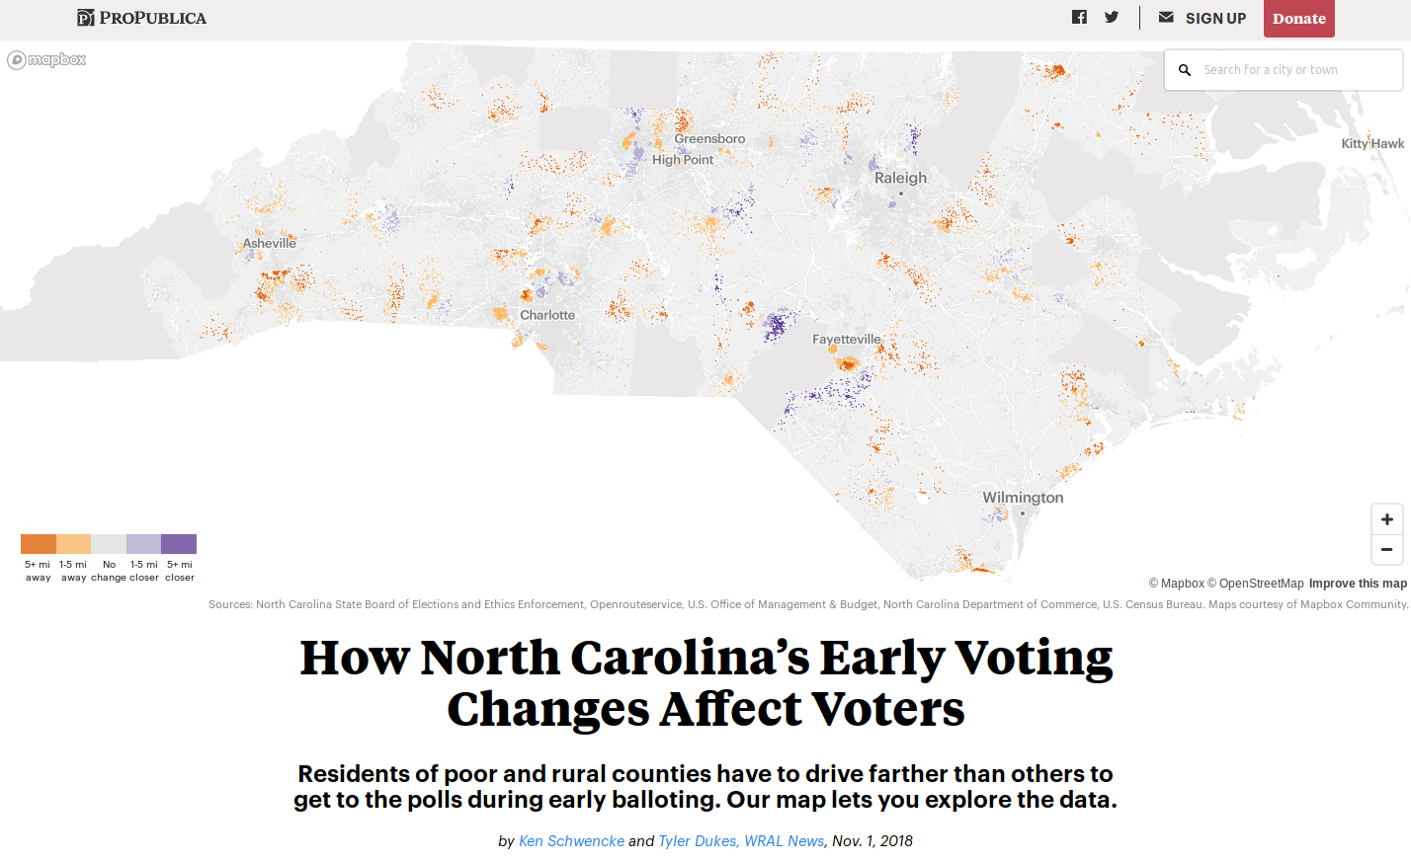
Election Coverage
Not those bots
It’s a good week to check out how newsrooms are covering the election:
+ NY Times
+ ProPublica
+ NPR
+ Baltimore Sun
Notes:
Logan Williams and Cathy Deng each took very different approaches to exploring conversational interfaces, and while their results are distinct, they've both produced interactions that are engaging and warm. Jamica El's projects are nominally about hardware, but at the heart her work is about who gets a voice and whose story matters. Her work overlaps beautifully with Cathy's exploration of ways to amplify – and hear to – quiet voices. Lam Thuy Vo’s look at the tone and language we encounter online, added vital perspective.
Logan and Caroline Sinders each brought wonderful creativity to the project of inviting machine learning algorithms into photographic narratives, using personal snapshots as a starting place. Reflection, public and private, shaped many of our projects. Where Logan’s work asks participants to craft personal narratives and reflections, Lam looked for a reflection of our selves in the data trails we leave online, while Jamica’s study of sousveillance pulled privacy back into the frame.
Advertisement
For me, this year has been a chance to think about the stories and data we don’t want to share and how to help more people keep their private records private.
Each project tackles a central question about who gets heard. Not by "giving voice to the voiceless" but starting with the premise that no one needs to be “given” a voice, and that the challenge is in finding better ways to hear and new ways to listen.

Slide 36

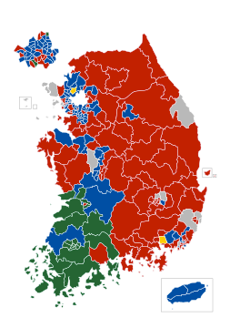
Scaled by Population
Not those bots
20대 국회의원 총선거 개표결과/ 2016년 Results of the general election of the 20th National Assembly
Notes:
Logan Williams and Cathy Deng each took very different approaches to exploring conversational interfaces, and while their results are distinct, they've both produced interactions that are engaging and warm. Jamica El's projects are nominally about hardware, but at the heart her work is about who gets a voice and whose story matters. Her work overlaps beautifully with Cathy's exploration of ways to amplify – and hear to – quiet voices. Lam Thuy Vo’s look at the tone and language we encounter online, added vital perspective.
Logan and Caroline Sinders each brought wonderful creativity to the project of inviting machine learning algorithms into photographic narratives, using personal snapshots as a starting place. Reflection, public and private, shaped many of our projects. Where Logan’s work asks participants to craft personal narratives and reflections, Lam looked for a reflection of our selves in the data trails we leave online, while Jamica’s study of sousveillance pulled privacy back into the frame.
Advertisement
For me, this year has been a chance to think about the stories and data we don’t want to share and how to help more people keep their private records private.
Each project tackles a central question about who gets heard. Not by "giving voice to the voiceless" but starting with the premise that no one needs to be “given” a voice, and that the challenge is in finding better ways to hear and new ways to listen.

Slide 37
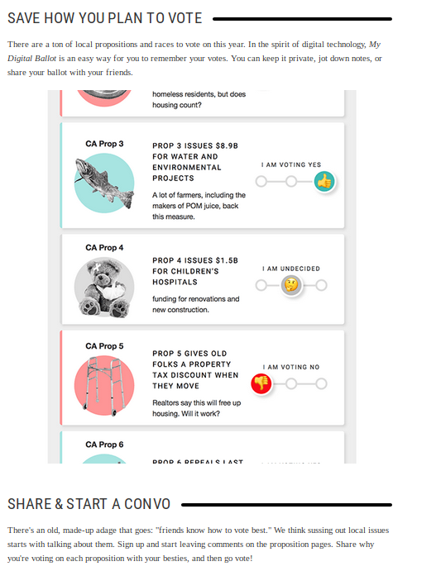
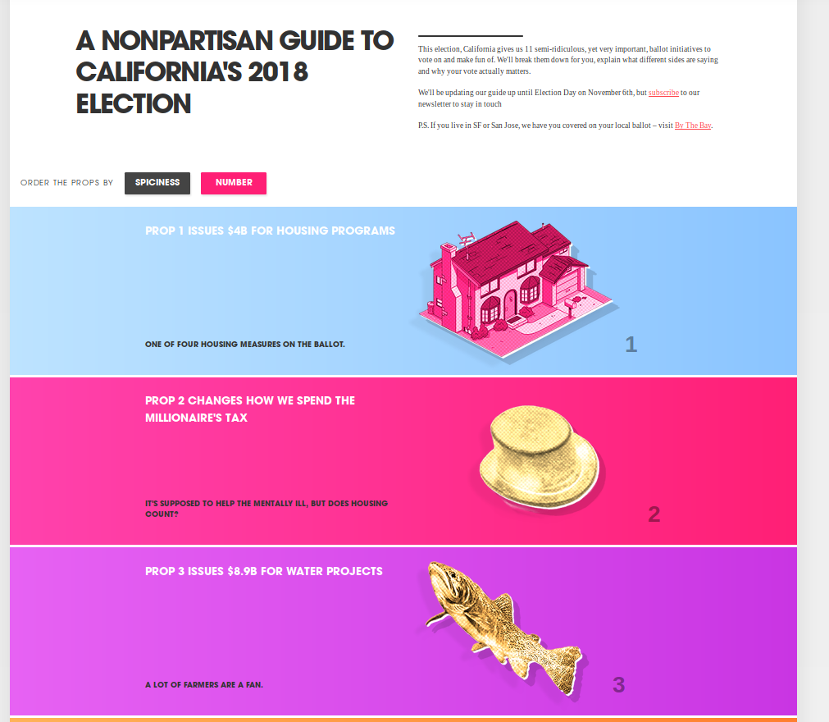
Ballot.fyi
Not those bots
`
Notes:
Logan Williams and Cathy Deng each took very different approaches to exploring conversational interfaces, and while their results are distinct, they've both produced interactions that are engaging and warm. Jamica El's projects are nominally about hardware, but at the heart her work is about who gets a voice and whose story matters. Her work overlaps beautifully with Cathy's exploration of ways to amplify – and hear to – quiet voices. Lam Thuy Vo’s look at the tone and language we encounter online, added vital perspective.
Logan and Caroline Sinders each brought wonderful creativity to the project of inviting machine learning algorithms into photographic narratives, using personal snapshots as a starting place. Reflection, public and private, shaped many of our projects. Where Logan’s work asks participants to craft personal narratives and reflections, Lam looked for a reflection of our selves in the data trails we leave online, while Jamica’s study of sousveillance pulled privacy back into the frame.
Advertisement
For me, this year has been a chance to think about the stories and data we don’t want to share and how to help more people keep their private records private.
Each project tackles a central question about who gets heard. Not by "giving voice to the voiceless" but starting with the premise that no one needs to be “given” a voice, and that the challenge is in finding better ways to hear and new ways to listen.

Slide 38
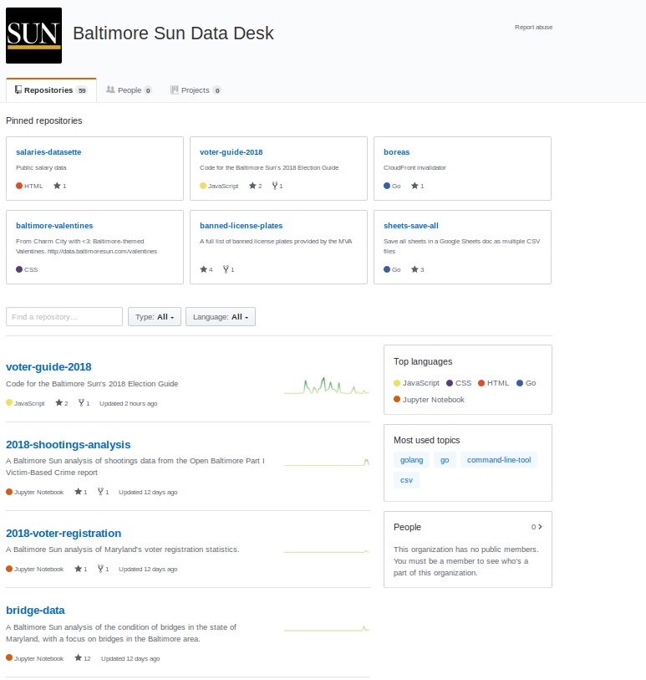
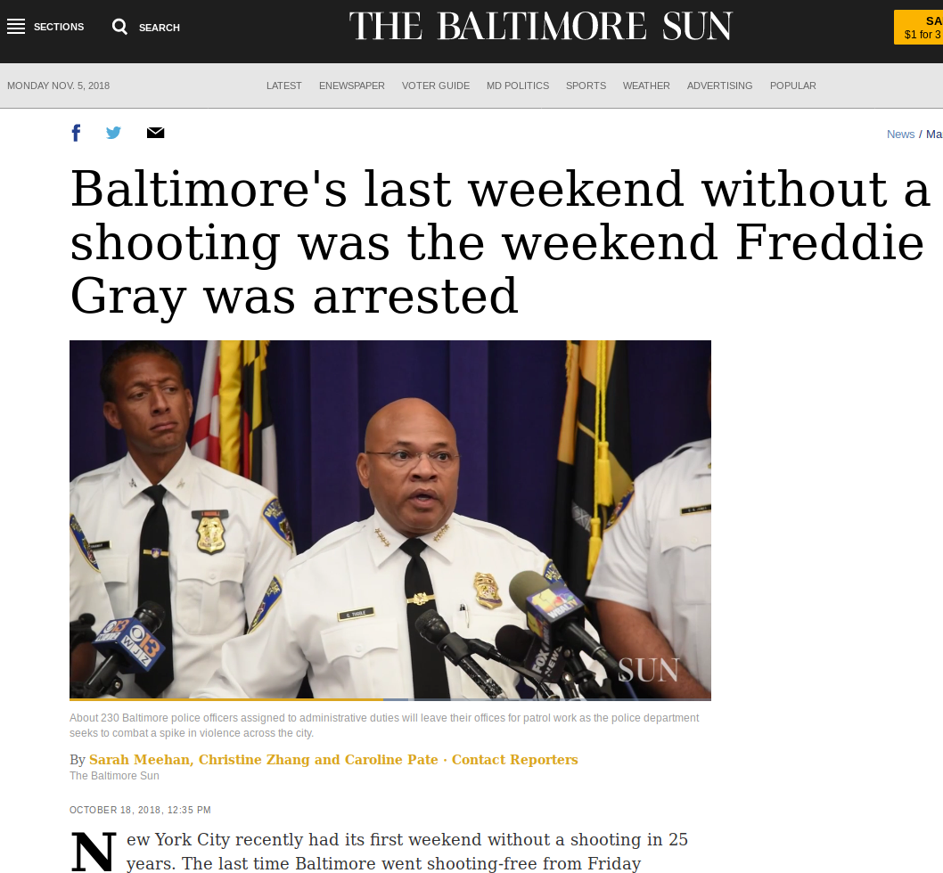
Show Your Work
Not those bots
https://twitter.com/statwonk/status/1054019909116706821
Notes:
Logan Williams and Cathy Deng each took very different approaches to exploring conversational interfaces, and while their results are distinct, they've both produced interactions that are engaging and warm. Jamica El's projects are nominally about hardware, but at the heart her work is about who gets a voice and whose story matters. Her work overlaps beautifully with Cathy's exploration of ways to amplify – and hear to – quiet voices. Lam Thuy Vo’s look at the tone and language we encounter online, added vital perspective.
Logan and Caroline Sinders each brought wonderful creativity to the project of inviting machine learning algorithms into photographic narratives, using personal snapshots as a starting place. Reflection, public and private, shaped many of our projects. Where Logan’s work asks participants to craft personal narratives and reflections, Lam looked for a reflection of our selves in the data trails we leave online, while Jamica’s study of sousveillance pulled privacy back into the frame.
Advertisement
For me, this year has been a chance to think about the stories and data we don’t want to share and how to help more people keep their private records private.
Each project tackles a central question about who gets heard. Not by "giving voice to the voiceless" but starting with the premise that no one needs to be “given” a voice, and that the challenge is in finding better ways to hear and new ways to listen.

Slide 39
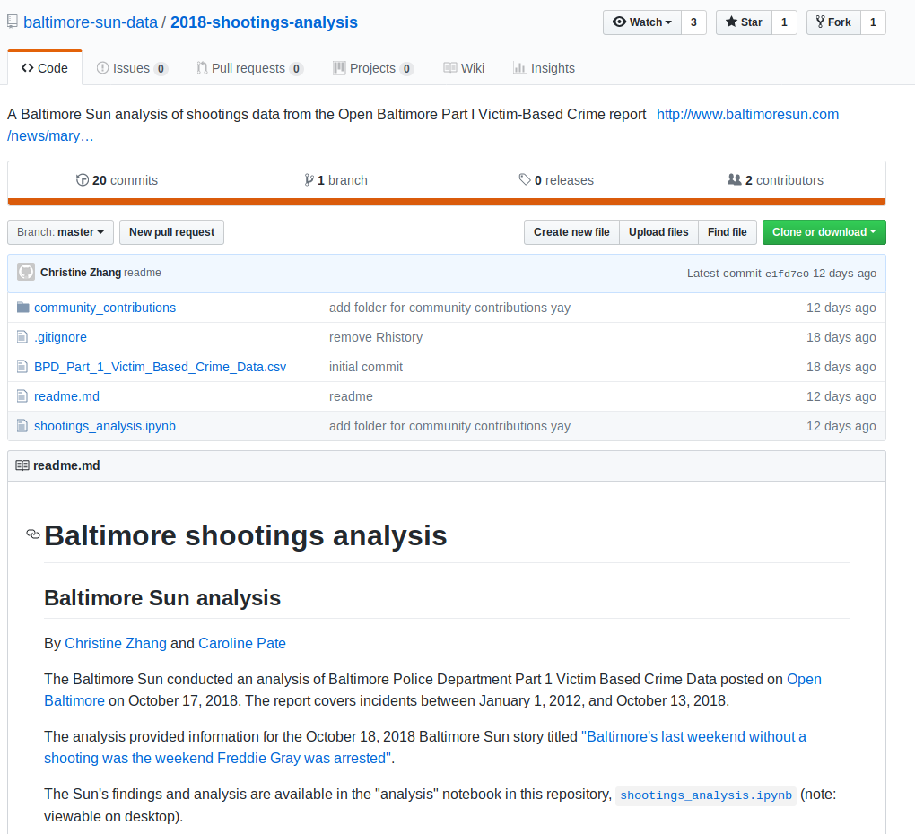
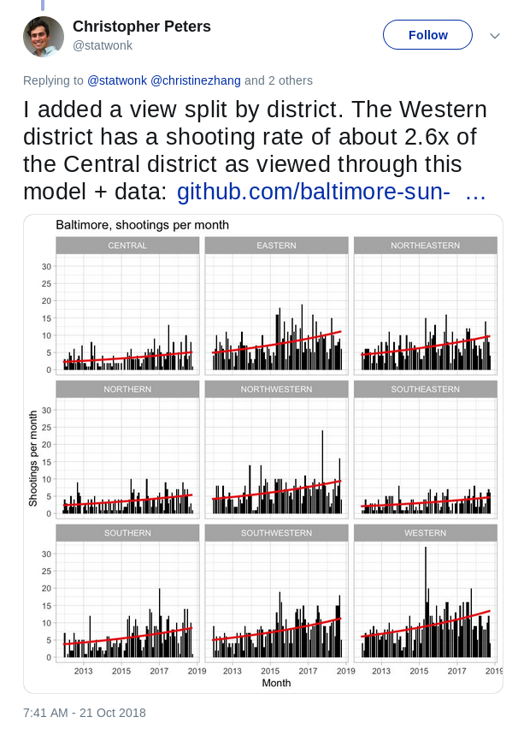
Show Your Work
https://twitter.com/statwonk/status/1054019909116706821

Slide 40
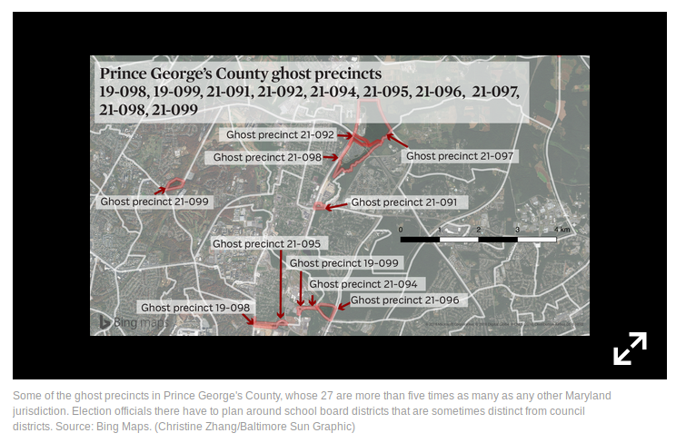
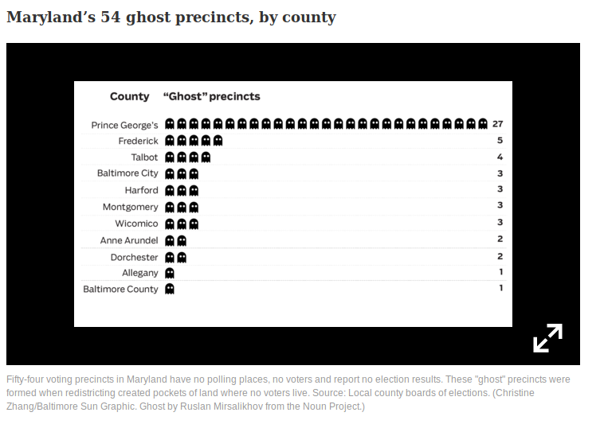
Ghosts!
The redistricting process sometimes results in ghost precincts, which have no polling places, no voters and no election results. Most of the 54 in Maryland are as bare as their name suggests, but a few overlap with well-known landmarks.
https://www.baltimoresun.com/news/maryland/politics/bs-md-ghost-precincts-20181030-story.html

Slide 41
thank you!

Slide 42
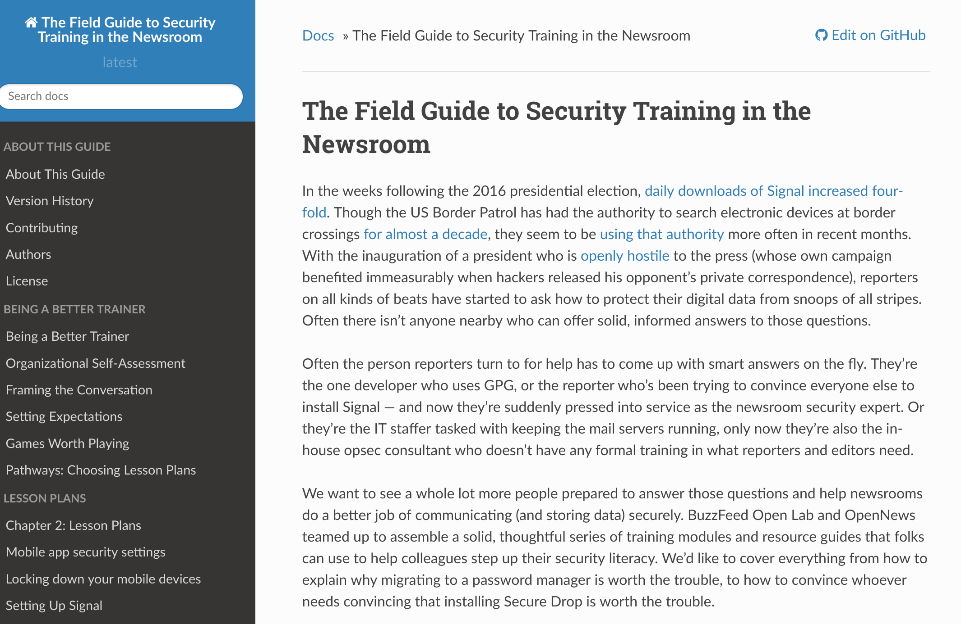
Field Guide to Security Training in the Newsroom
https://securitytraining.opennews.org/en/latest/
Notes:
If you aren’t totally excited about bots, that’s okay. We can still be friends. I have a few other projects that I’d love to talk more about. I worked with OpenNews to develop an extensive curriculum (or collection of lesson plans) for newsroom digital security training and I’ll be leading a workshop on that tomorrow.

Slide 43
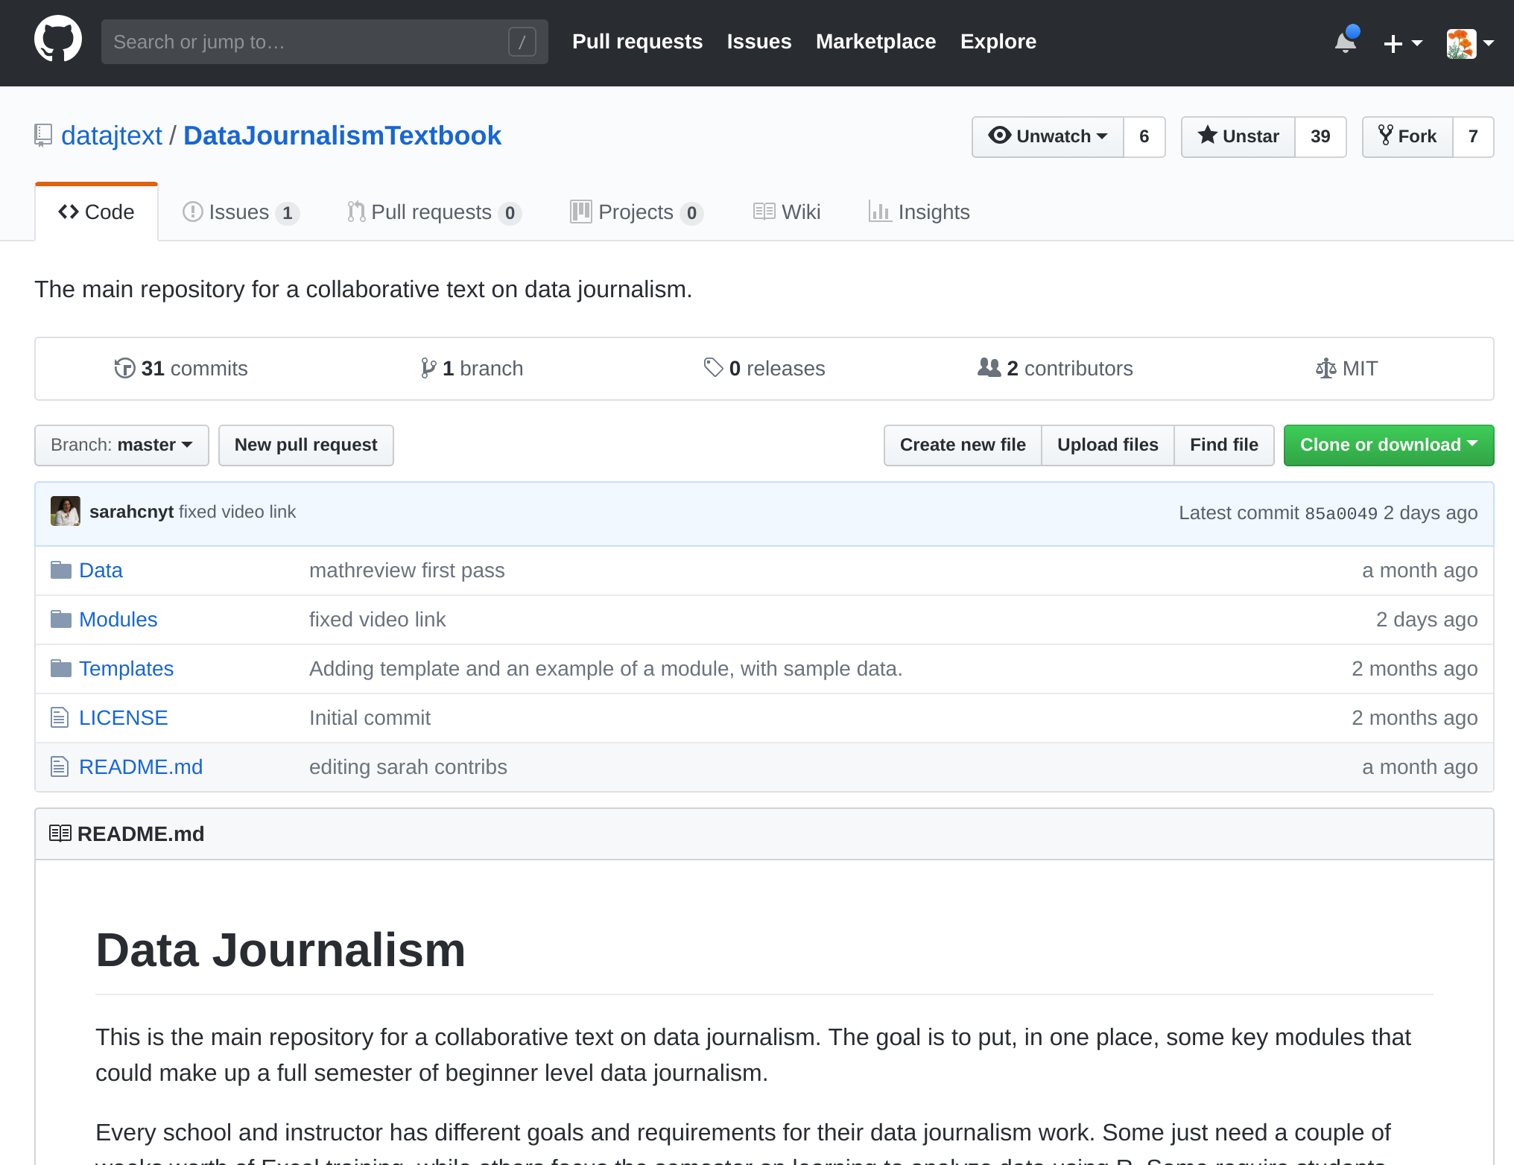
Data Journalism
Textbook
Notes:
I teach a data investigations class at UCB Graduate School of Journalism, and I’m collaborating with a bunch of other faculty on a textbook for data journalism, which is a great resource that I’d love to show you. We welcome collaborators and there’s no reason that this project can’t be multilingual.

Slide 44





Emojination
Notes:
I’m also super proud to be responsible for the spool, safety pin, and yarn emoji. Though for reasons I cannot fathom, the Unicode Consortium Emoji Subcommittee to has declined the “needle”. If you’re excited about emoji definitely come find me.

Slide 45
thank you!

