Slide 1
Movie Analysis
By: Amanda Gaeta

Slide 2
Agenda
Movie landscape
Top genres
Budget versus gross
Breakeven genres
Best investment by rating
Top genres overview and recommendations

Slide 3
Movie Landscape
TO DO:
Top studio to look model portfolio after?
IDEA: Slide per top genre with suggested release month, avg budget, top directors, top writers

Slide 4
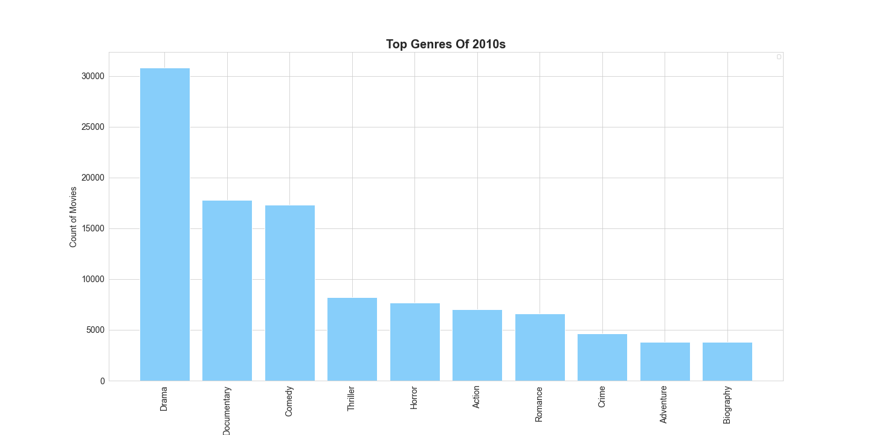
Movie Landscape: Genres
N=73,856
Note: Movies with multiple genres counted once for each genre they were categorized under
Notes:
IMDB Basics

Slide 5
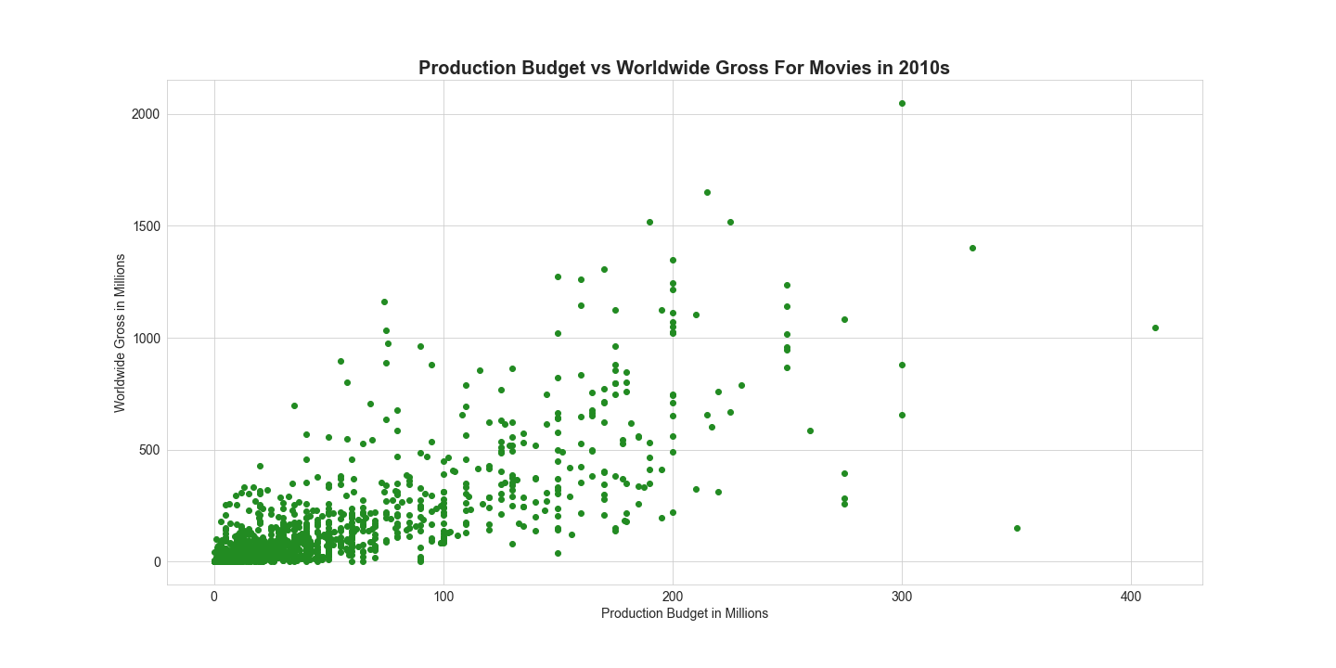
Movie Landscape: Production Budget
N=1,498
Notes:
Less data on budget
Can see many fall between 0-75million, many not making their money back

Slide 6
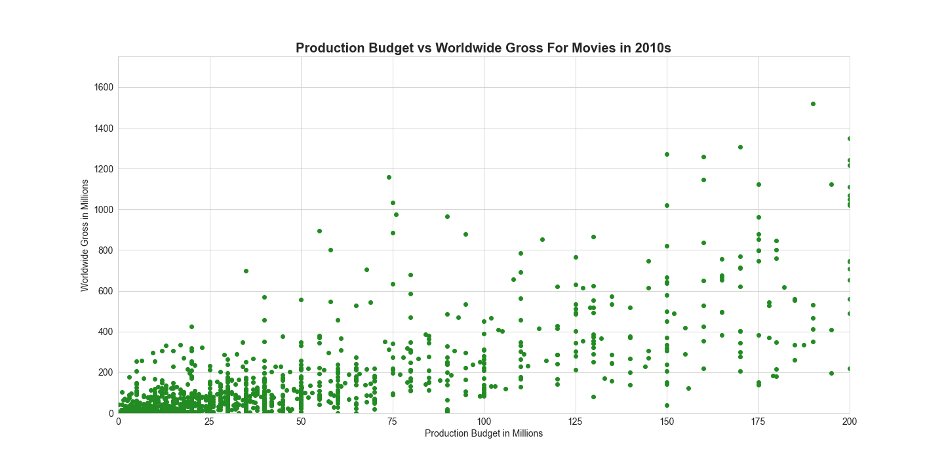
Movie Landscape: Production Budget
N=1,471
Notes:
Zooming you can see this phenomenon better
At ~100M it’s more likely that get what you put in (and more) in gross

Slide 7
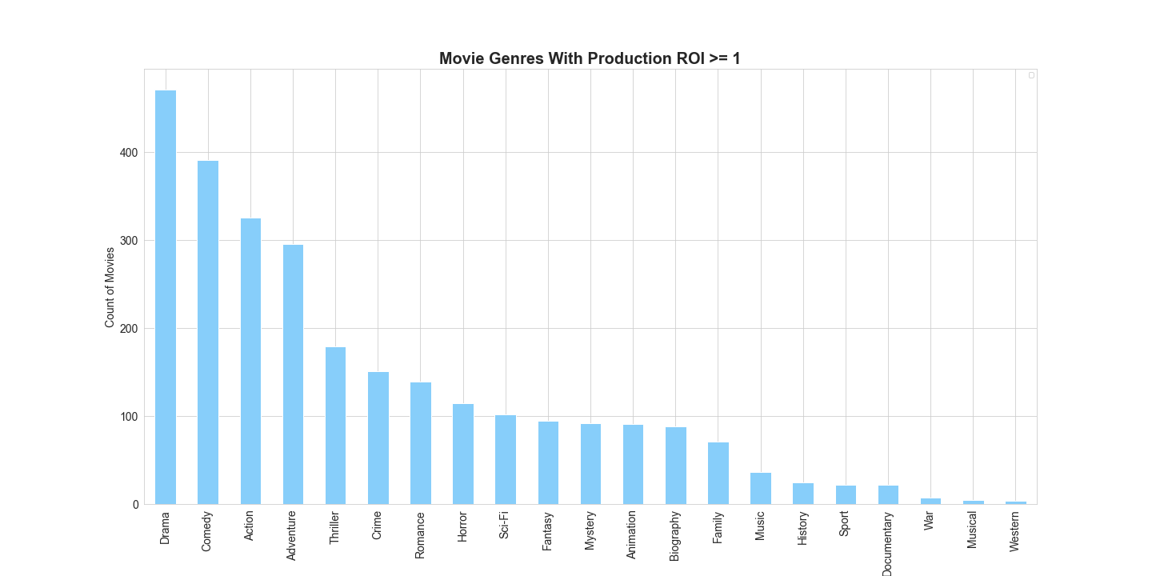
Of movies that reach breakeven, these are the top genres represented
N=1,049
Note: Movies with multiple genres counted once for each genre they were categorized under
Notes:
Drama, Comedy, Action, Adventure and Thriller are genres most represented in movies that have achieved breakeven

Slide 8
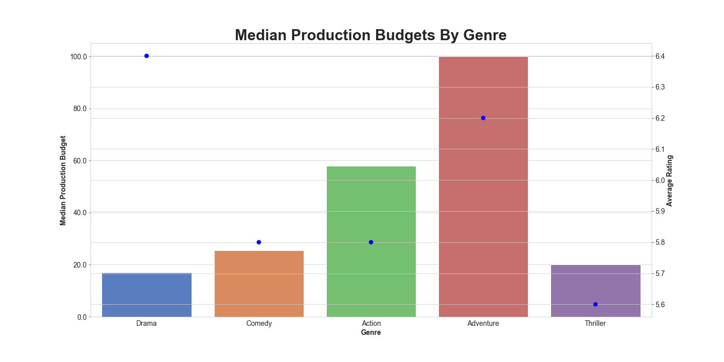
Dramas are the best investment
N=73,856
Note: Movies with multiple genres counted once for each genre they were categorized under
Notes:
Drama in cheapest to produce with highest average rating¶
Data Review: Drama is cheapest to produce and most likely to return ROI; Thrillers also less money, but have lowest average rating Drama and Adventure have highest average rating, but Adventure 5.8x more to produce
Business rec: If money is a concern, best investment would be in Dramas. Next best investment would be in Comedy.
If up front money is not a concern, then can consider Adventure or Action movies. Adventure is 2x the production budget, so depending on how much budget there is, Action is the more conservative choice of the two.
For "filler" movies that generally make their money back - can produce Thrillers and Drama for cheapest

Slide 9
Top Genre Recommendations: Runtime and Directors
Genre | Drama | Comedy | Action | Adventure | Thriller
Average Runtime | 107 mins | 104 mins | 118 mins | 106 mins | 107 mins
Recommended Directors | Nagaraja Uppunda | Quentin Tarantino | Shankar | Karzan Kardozi | Shivkumar Parthasarathy
 | Arsel Arumugam | Sudheer Shanbhogue | Quentin Tarantino | Zolbayar Dorj | Amitabh Reza
 | Sudheer Shanbhogue | Abhinav Thakur | Ajay Andrews Nuthakki | [Team] Kevin Schlanser, Zack Bennett | Chowdhury Gvr Vasu
 | Paul Michael Bloodgood | Amr Gamal | Ram Kumar | Christina Kyi | Sushanth Reddy
 | Colonelu Morteni | Karan R Guliani | Thiagarajan Kumararaja | Matt Horton | Ram Kumar

