Slide 1
From TableGateway to Domain:
Demystifying Doctrine
zend.com
v1.1.0
Notes:
Welcome everyone. Warm up the crowd.
Show of hands how many have been using PHP for at least 1 year,
2 years
4 years
5 years or more
We don’t really care about the outcome, the point is to get people involved in the class. This is harder to do in an online class. We have to pull them in if we want them to be engaged. Otherwise, you will see people starting to fade. The class will go into the background and they will do email or whatever else can get their attention.

Slide 2
What we will learn
Domain model concepts and terms
Doctrine basics
Installing Doctrine ORM module for ZF2
From TableGateway to Doctrine
Notes:
Talk about the the core, internals, fights, etc. It’s like watching sausage being made in that it’s an ugly process but it does work.
Talk about how there are not many things in 7 that will cause people problems. Most are edge cases. The PHP 4 stuff being removed is about the biggest thing that will cause BC breaks.
Talk about the cool things coming up. No specifics, just general things, improved security, improved performance, etc.
PHP 7 and PSR-7 will allow us to build middleware in PHP. It will allow for long-running processes. This means that a Zend Server application can spin up and sit, waiting for requests. When a request comes in, since all of the code is already in memory and in OPCODE, it doesn’t have to resolve includes, and compile. It just has to run. This will be significantly faster than anything we’ve seen in PHP thus far.

Slide 3
Demystifying Doctrine
What is the domain model?
https://en.wikipedia.org/wiki/Domain_model
https://en.wikipedia.org/wiki/Domain-driven_design
Notes:
The output buffering technique is used to speed up output, but also to capture intermediate output and use it elsewhere.
Often, particularly with functions which directly generate output, this is the only way to accumulate that data.

Slide 4
What is the domain model?
Conceptual model
Events
Registrations
Attendees
Purchase
Entity
Value Object
Notes:
Briefly discuss the origins of PHP. Rasmus, then the community, then Andi & Zeev.
Talk about “Scratch your own itch” development of PHP. Wez developed the mail() function because he needed to send mail from within PHP. This is how PHP was developed until ~2009.
This is why we get needle/haystack issues. different develoePrs approach problems form different directions.

Slide 5
What is the domain model?
COLLECTION OF DESIGN PATTERNS
Creational
  Factory, Singleton, Builder
Structural
  Adapter, Module, Decorator, Proxy
Behaviorial
  Pub/Sub, Strategy, Iterator, Strategy
Concurrency
  Active Object, Lock, Reactor, Scheduler
Notes:
Harken back to “Scratch your own itch” development. sometimes it worked, sometimes it didn’t. That’s how we got things like an AOLSERVER SAPI. Someone needed it, nobody cared, it got added into the codebase.
What Are RFCs?
Invented in 1969 by Steve Crocker for ARPANET, RFCs were popularized by the Internet Engineering Task Force. In PHP, they are how we present a suggestion for a change to the language. Some changes are small, others are sweeping. Once an RFC is presented, it is discussed on the Internals mailing list. Eventually, it is voted upon. If it passes, it is implemented.
RFCs affecting the language itself (Namespaces, Scalar Type Hints, etc) require a 2/3 majority, while RFCs like “Remove the date.timezone warning” only require a 50%+1 majority to pass.
How I’ve classified them
RFCs are not classified by php.net. However, looking at them, it is easy to tell which ones are important and which are not. So I’ve broken them up into two categories.
High Impact
These RFC will impact how developers write PHP code.
BC breaks
These RFCs may affect your existing applications. You will need to get your code to make sure everything still works.

Slide 6
What is the domain model?
major terms/concepts
Entity
Repository
Mapper
Notes:
Harken back to “Scratch your own itch” development. sometimes it worked, sometimes it didn’t. That’s how we got things like an AOLSERVER SAPI. Someone needed it, nobody cared, it got added into the codebase.
What Are RFCs?
Invented in 1969 by Steve Crocker for ARPANET, RFCs were popularized by the Internet Engineering Task Force. In PHP, they are how we present a suggestion for a change to the language. Some changes are small, others are sweeping. Once an RFC is presented, it is discussed on the Internals mailing list. Eventually, it is voted upon. If it passes, it is implemented.
RFCs affecting the language itself (Namespaces, Scalar Type Hints, etc) require a 2/3 majority, while RFCs like “Remove the date.timezone warning” only require a 50%+1 majority to pass.
How I’ve classified them
RFCs are not classified by php.net. However, looking at them, it is easy to tell which ones are important and which are not. So I’ve broken them up into two categories.
High Impact
These RFC will impact how developers write PHP code.
BC breaks
These RFCs may affect your existing applications. You will need to get your code to make sure everything still works.

Slide 7
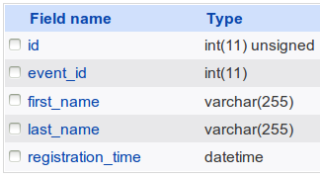
What is the domain model?
entity
“registration” entity
“registration” table
$id
$event
$firstName
$lastName
$registrationTime
Notes:
Harken back to “Scratch your own itch” development. sometimes it worked, sometimes it didn’t. That’s how we got things like an AOLSERVER SAPI. Someone needed it, nobody cared, it got added into the codebase.
What Are RFCs?
Invented in 1969 by Steve Crocker for ARPANET, RFCs were popularized by the Internet Engineering Task Force. In PHP, they are how we present a suggestion for a change to the language. Some changes are small, others are sweeping. Once an RFC is presented, it is discussed on the Internals mailing list. Eventually, it is voted upon. If it passes, it is implemented.
RFCs affecting the language itself (Namespaces, Scalar Type Hints, etc) require a 2/3 majority, while RFCs like “Remove the date.timezone warning” only require a 50%+1 majority to pass.
How I’ve classified them
RFCs are not classified by php.net. However, looking at them, it is easy to tell which ones are important and which are not. So I’ve broken them up into two categories.
High Impact
These RFC will impact how developers write PHP code.
BC breaks
These RFCs may affect your existing applications. You will need to get your code to make sure everything still works.

Slide 8
What is the domain model?
Repository
“registration” table
Registration
$id
$event
$firstName
$lastName
$registrationTime
Registration
$id
$event
$firstName
$lastName
$registrationTime
Registration
$id
$event
$firstName
$lastName
$registrationTime
Registration
Repo
find()
findBy()
findOneBy()
Notes:
Harken back to “Scratch your own itch” development. sometimes it worked, sometimes it didn’t. That’s how we got things like an AOLSERVER SAPI. Someone needed it, nobody cared, it got added into the codebase.
What Are RFCs?
Invented in 1969 by Steve Crocker for ARPANET, RFCs were popularized by the Internet Engineering Task Force. In PHP, they are how we present a suggestion for a change to the language. Some changes are small, others are sweeping. Once an RFC is presented, it is discussed on the Internals mailing list. Eventually, it is voted upon. If it passes, it is implemented.
RFCs affecting the language itself (Namespaces, Scalar Type Hints, etc) require a 2/3 majority, while RFCs like “Remove the date.timezone warning” only require a 50%+1 majority to pass.
How I’ve classified them
RFCs are not classified by php.net. However, looking at them, it is easy to tell which ones are important and which are not. So I’ve broken them up into two categories.
High Impact
These RFC will impact how developers write PHP code.
BC breaks
These RFCs may affect your existing applications. You will need to get your code to make sure everything still works.

Slide 9
What is the domain model?
mapper
“registration” table
“registration” entity
$id
$event
$firstName
$lastName
$registrationTime
Mapper
Notes:
Harken back to “Scratch your own itch” development. sometimes it worked, sometimes it didn’t. That’s how we got things like an AOLSERVER SAPI. Someone needed it, nobody cared, it got added into the codebase.
What Are RFCs?
Invented in 1969 by Steve Crocker for ARPANET, RFCs were popularized by the Internet Engineering Task Force. In PHP, they are how we present a suggestion for a change to the language. Some changes are small, others are sweeping. Once an RFC is presented, it is discussed on the Internals mailing list. Eventually, it is voted upon. If it passes, it is implemented.
RFCs affecting the language itself (Namespaces, Scalar Type Hints, etc) require a 2/3 majority, while RFCs like “Remove the date.timezone warning” only require a 50%+1 majority to pass.
How I’ve classified them
RFCs are not classified by php.net. However, looking at them, it is easy to tell which ones are important and which are not. So I’ve broken them up into two categories.
High Impact
These RFC will impact how developers write PHP code.
BC breaks
These RFCs may affect your existing applications. You will need to get your code to make sure everything still works.

Slide 10
What is the domain model?
Why do you need to know about the domain model?
Doctrine uses domain model terminology
Understanding the domain model will help you use Doctrine more effectively
Doctrine implements parts of the domain model
(but is not the domain model itself)
Do you *have* to use the domain model if you're
using Doctrine: NO
Notes:
Only a problem as of PHP 5.4.

Slide 11
Demystifying Doctrine
Doctrine basics
http://docs.doctrine-project.org/en/latest/
Notes:
The output buffering technique is used to speed up output, but also to capture intermediate output and use it elsewhere.
Often, particularly with functions which directly generate output, this is the only way to accumulate that data.

Slide 12

Doctrine basics
doctrine projects
Object Relational Mapper
Database Abstraction Layer
Common
Annotations
Collections
Cache
Inflector
Lexer
Notes:
Harken back to “Scratch your own itch” development. sometimes it worked, sometimes it didn’t. That’s how we got things like an AOLSERVER SAPI. Someone needed it, nobody cared, it got added into the codebase.
What Are RFCs?
Invented in 1969 by Steve Crocker for ARPANET, RFCs were popularized by the Internet Engineering Task Force. In PHP, they are how we present a suggestion for a change to the language. Some changes are small, others are sweeping. Once an RFC is presented, it is discussed on the Internals mailing list. Eventually, it is voted upon. If it passes, it is implemented.
RFCs affecting the language itself (Namespaces, Scalar Type Hints, etc) require a 2/3 majority, while RFCs like “Remove the date.timezone warning” only require a 50%+1 majority to pass.
How I’ve classified them
RFCs are not classified by php.net. However, looking at them, it is easy to tell which ones are important and which are not. So I’ve broken them up into two categories.
High Impact
These RFC will impact how developers write PHP code.
BC breaks
These RFCs may affect your existing applications. You will need to get your code to make sure everything still works.

Slide 13



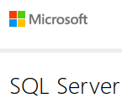



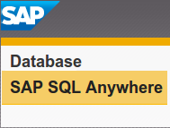


Doctrine basics
database support
Notes:
Harken back to “Scratch your own itch” development. sometimes it worked, sometimes it didn’t. That’s how we got things like an AOLSERVER SAPI. Someone needed it, nobody cared, it got added into the codebase.
What Are RFCs?
Invented in 1969 by Steve Crocker for ARPANET, RFCs were popularized by the Internet Engineering Task Force. In PHP, they are how we present a suggestion for a change to the language. Some changes are small, others are sweeping. Once an RFC is presented, it is discussed on the Internals mailing list. Eventually, it is voted upon. If it passes, it is implemented.
RFCs affecting the language itself (Namespaces, Scalar Type Hints, etc) require a 2/3 majority, while RFCs like “Remove the date.timezone warning” only require a 50%+1 majority to pass.
How I’ve classified them
RFCs are not classified by php.net. However, looking at them, it is easy to tell which ones are important and which are not. So I’ve broken them up into two categories.
High Impact
These RFC will impact how developers write PHP code.
BC breaks
These RFCs may affect your existing applications. You will need to get your code to make sure everything still works.

Slide 14
Doctrine basics
DBal (dATABASE ACCESS LAYER)
$ticketData = $formData['ticket'];
foreach ($ticketData as $nameOnTicket) {
$attendee = $this->attendeeRepo
->persist($reg,
$nameOnTicket);
$reg->setAttendees($attendee);
$this->registrationRepo->update($reg);
}
ibm_db2
DBAL
Notes:
Harken back to “Scratch your own itch” development. sometimes it worked, sometimes it didn’t. That’s how we got things like an AOLSERVER SAPI. Someone needed it, nobody cared, it got added into the codebase.
What Are RFCs?
Invented in 1969 by Steve Crocker for ARPANET, RFCs were popularized by the Internet Engineering Task Force. In PHP, they are how we present a suggestion for a change to the language. Some changes are small, others are sweeping. Once an RFC is presented, it is discussed on the Internals mailing list. Eventually, it is voted upon. If it passes, it is implemented.
RFCs affecting the language itself (Namespaces, Scalar Type Hints, etc) require a 2/3 majority, while RFCs like “Remove the date.timezone warning” only require a 50%+1 majority to pass.
How I’ve classified them
RFCs are not classified by php.net. However, looking at them, it is easy to tell which ones are important and which are not. So I’ve broken them up into two categories.
High Impact
These RFC will impact how developers write PHP code.
BC breaks
These RFCs may affect your existing applications. You will need to get your code to make sure everything still works.

Slide 15
Doctrine basics
ORM (Object relational mapping)
/**
* @ORM\Column(type="string",
* length=255,
* name="first_name")
*/
protected $firstName;
ibm_db2
ORM
DBAL
Notes:
Harken back to “Scratch your own itch” development. sometimes it worked, sometimes it didn’t. That’s how we got things like an AOLSERVER SAPI. Someone needed it, nobody cared, it got added into the codebase.
What Are RFCs?
Invented in 1969 by Steve Crocker for ARPANET, RFCs were popularized by the Internet Engineering Task Force. In PHP, they are how we present a suggestion for a change to the language. Some changes are small, others are sweeping. Once an RFC is presented, it is discussed on the Internals mailing list. Eventually, it is voted upon. If it passes, it is implemented.
RFCs affecting the language itself (Namespaces, Scalar Type Hints, etc) require a 2/3 majority, while RFCs like “Remove the date.timezone warning” only require a 50%+1 majority to pass.
How I’ve classified them
RFCs are not classified by php.net. However, looking at them, it is easy to tell which ones are important and which are not. So I’ve broken them up into two categories.
High Impact
These RFC will impact how developers write PHP code.
BC breaks
These RFCs may affect your existing applications. You will need to get your code to make sure everything still works.

Slide 16
Doctrine basics
relationships
One to One | One to Many | Many to One | Many to Many
Registration
$id
$event
Event
$id
$registrations[ ]
Parent (“owning” side)
Child (“inverse” side)
Notes:
Harken back to “Scratch your own itch” development. sometimes it worked, sometimes it didn’t. That’s how we got things like an AOLSERVER SAPI. Someone needed it, nobody cared, it got added into the codebase.
What Are RFCs?
Invented in 1969 by Steve Crocker for ARPANET, RFCs were popularized by the Internet Engineering Task Force. In PHP, they are how we present a suggestion for a change to the language. Some changes are small, others are sweeping. Once an RFC is presented, it is discussed on the Internals mailing list. Eventually, it is voted upon. If it passes, it is implemented.
RFCs affecting the language itself (Namespaces, Scalar Type Hints, etc) require a 2/3 majority, while RFCs like “Remove the date.timezone warning” only require a 50%+1 majority to pass.
How I’ve classified them
RFCs are not classified by php.net. However, looking at them, it is easy to tell which ones are important and which are not. So I’ve broken them up into two categories.
High Impact
These RFC will impact how developers write PHP code.
BC breaks
These RFCs may affect your existing applications. You will need to get your code to make sure everything still works.

Slide 17
Doctrine basics
query builder expressions
lt($x, $y) | lte($x, $y)
$qb
expr()
gt($x, $y) | gte($x, $y)
isNull($x) | isNotNull($x)
like($x, $y) | notLike($x, $y)
in($x, $y)* | notIn($x, $y)*
* $y can be string or array
Notes:
Harken back to “Scratch your own itch” development. sometimes it worked, sometimes it didn’t. That’s how we got things like an AOLSERVER SAPI. Someone needed it, nobody cared, it got added into the codebase.
What Are RFCs?
Invented in 1969 by Steve Crocker for ARPANET, RFCs were popularized by the Internet Engineering Task Force. In PHP, they are how we present a suggestion for a change to the language. Some changes are small, others are sweeping. Once an RFC is presented, it is discussed on the Internals mailing list. Eventually, it is voted upon. If it passes, it is implemented.
RFCs affecting the language itself (Namespaces, Scalar Type Hints, etc) require a 2/3 majority, while RFCs like “Remove the date.timezone warning” only require a 50%+1 majority to pass.
How I’ve classified them
RFCs are not classified by php.net. However, looking at them, it is easy to tell which ones are important and which are not. So I’ve broken them up into two categories.
High Impact
These RFC will impact how developers write PHP code.
BC breaks
These RFCs may affect your existing applications. You will need to get your code to make sure everything still works.

Slide 18
Doctrine basics
cache
Metadata | Query | Results | Second Level
Your App
Output
Cache
$output = '';
foreach() {
$output .= xxx;
}
echo $output;
Notes:
Harken back to “Scratch your own itch” development. sometimes it worked, sometimes it didn’t. That’s how we got things like an AOLSERVER SAPI. Someone needed it, nobody cared, it got added into the codebase.
What Are RFCs?
Invented in 1969 by Steve Crocker for ARPANET, RFCs were popularized by the Internet Engineering Task Force. In PHP, they are how we present a suggestion for a change to the language. Some changes are small, others are sweeping. Once an RFC is presented, it is discussed on the Internals mailing list. Eventually, it is voted upon. If it passes, it is implemented.
RFCs affecting the language itself (Namespaces, Scalar Type Hints, etc) require a 2/3 majority, while RFCs like “Remove the date.timezone warning” only require a 50%+1 majority to pass.
How I’ve classified them
RFCs are not classified by php.net. However, looking at them, it is easy to tell which ones are important and which are not. So I’ve broken them up into two categories.
High Impact
These RFC will impact how developers write PHP code.
BC breaks
These RFCs may affect your existing applications. You will need to get your code to make sure everything still works.

Slide 19
Demystifying Doctrine
Installing the Doctrine ORM module for Zend Framework 2
https://github.com/doctrine/DoctrineORMModule
Notes:
The output buffering technique is used to speed up output, but also to capture intermediate output and use it elsewhere.
Often, particularly with functions which directly generate output, this is the only way to accumulate that data.

Slide 20
Doctrine ORM module for ZF2
composer.json
{
"name": "zendframework/skeleton-application",
"description": "Skeleton Application for ZF2",
"license": "BSD-3-Clause",
"homepage": "http://framework.zend.com/",
"require": {
"php": ">=5.5",
"zendframework/zendframework": "2.5.*",
"doctrine/doctrine-orm-module": "*"
}
}
Notes:
Harken back to “Scratch your own itch” development. sometimes it worked, sometimes it didn’t. That’s how we got things like an AOLSERVER SAPI. Someone needed it, nobody cared, it got added into the codebase.
What Are RFCs?
Invented in 1969 by Steve Crocker for ARPANET, RFCs were popularized by the Internet Engineering Task Force. In PHP, they are how we present a suggestion for a change to the language. Some changes are small, others are sweeping. Once an RFC is presented, it is discussed on the Internals mailing list. Eventually, it is voted upon. If it passes, it is implemented.
RFCs affecting the language itself (Namespaces, Scalar Type Hints, etc) require a 2/3 majority, while RFCs like “Remove the date.timezone warning” only require a 50%+1 majority to pass.
How I’ve classified them
RFCs are not classified by php.net. However, looking at them, it is easy to tell which ones are important and which are not. So I’ve broken them up into two categories.
High Impact
These RFC will impact how developers write PHP code.
BC breaks
These RFCs may affect your existing applications. You will need to get your code to make sure everything still works.

Slide 21
Doctrine ORM module for ZF2
config/autoload/local.php
return [
'doctrine' => [
// paths to entities are defined in individual module.config.php files
'connection' => [
// default connection name
'orm_default' => [
'driverClass' => 'Doctrine\DBAL\Driver\PDOMySql\Driver',
'params' => [
'host' => 'localhost',
'port' => '3306',
'user' => 'test',
'password' => 'password',
'dbname' => 'sweetscomplete',
]
]
],
Notes:
Harken back to “Scratch your own itch” development. sometimes it worked, sometimes it didn’t. That’s how we got things like an AOLSERVER SAPI. Someone needed it, nobody cared, it got added into the codebase.
What Are RFCs?
Invented in 1969 by Steve Crocker for ARPANET, RFCs were popularized by the Internet Engineering Task Force. In PHP, they are how we present a suggestion for a change to the language. Some changes are small, others are sweeping. Once an RFC is presented, it is discussed on the Internals mailing list. Eventually, it is voted upon. If it passes, it is implemented.
RFCs affecting the language itself (Namespaces, Scalar Type Hints, etc) require a 2/3 majority, while RFCs like “Remove the date.timezone warning” only require a 50%+1 majority to pass.
How I’ve classified them
RFCs are not classified by php.net. However, looking at them, it is easy to tell which ones are important and which are not. So I’ve broken them up into two categories.
High Impact
These RFC will impact how developers write PHP code.
BC breaks
These RFCs may affect your existing applications. You will need to get your code to make sure everything still works.

Slide 22
Doctrine ORM module for ZF2
config/autoload/local.php
// Provide the appropriate config for caching and proxy support
'configuration' => [
'orm_default' => [
'metadata_cache' => 'array',
'query_cache' => 'array',
'result_cache' => 'array',
'hydration_cache' => 'array',
'generate_proxies' => true,
'proxy_dir' => __DIR__ . '/../../data/proxy',
'driver' => 'orm_default',
],
],
]
];
Notes:
Harken back to “Scratch your own itch” development. sometimes it worked, sometimes it didn’t. That’s how we got things like an AOLSERVER SAPI. Someone needed it, nobody cared, it got added into the codebase.
What Are RFCs?
Invented in 1969 by Steve Crocker for ARPANET, RFCs were popularized by the Internet Engineering Task Force. In PHP, they are how we present a suggestion for a change to the language. Some changes are small, others are sweeping. Once an RFC is presented, it is discussed on the Internals mailing list. Eventually, it is voted upon. If it passes, it is implemented.
RFCs affecting the language itself (Namespaces, Scalar Type Hints, etc) require a 2/3 majority, while RFCs like “Remove the date.timezone warning” only require a 50%+1 majority to pass.
How I’ve classified them
RFCs are not classified by php.net. However, looking at them, it is easy to tell which ones are important and which are not. So I’ve broken them up into two categories.
High Impact
These RFC will impact how developers write PHP code.
BC breaks
These RFCs may affect your existing applications. You will need to get your code to make sure everything still works.

Slide 23
Doctrine ORM module for ZF2
config/application.config.php
'modules' => [
'Application',
'DoctrineModule',
'DoctrineORMModule',
'ZendDeveloperTools',
],
Notes:
Harken back to “Scratch your own itch” development. sometimes it worked, sometimes it didn’t. That’s how we got things like an AOLSERVER SAPI. Someone needed it, nobody cared, it got added into the codebase.
What Are RFCs?
Invented in 1969 by Steve Crocker for ARPANET, RFCs were popularized by the Internet Engineering Task Force. In PHP, they are how we present a suggestion for a change to the language. Some changes are small, others are sweeping. Once an RFC is presented, it is discussed on the Internals mailing list. Eventually, it is voted upon. If it passes, it is implemented.
RFCs affecting the language itself (Namespaces, Scalar Type Hints, etc) require a 2/3 majority, while RFCs like “Remove the date.timezone warning” only require a 50%+1 majority to pass.
How I’ve classified them
RFCs are not classified by php.net. However, looking at them, it is easy to tell which ones are important and which are not. So I’ve broken them up into two categories.
High Impact
These RFC will impact how developers write PHP code.
BC breaks
These RFCs may affect your existing applications. You will need to get your code to make sure everything still works.

Slide 24
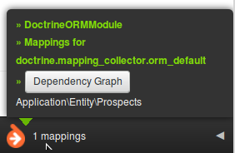
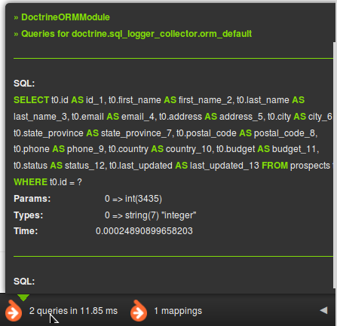
Doctrine ORM module for ZF2
zend developer tools add-ons
Notes:
Harken back to “Scratch your own itch” development. sometimes it worked, sometimes it didn’t. That’s how we got things like an AOLSERVER SAPI. Someone needed it, nobody cared, it got added into the codebase.
What Are RFCs?
Invented in 1969 by Steve Crocker for ARPANET, RFCs were popularized by the Internet Engineering Task Force. In PHP, they are how we present a suggestion for a change to the language. Some changes are small, others are sweeping. Once an RFC is presented, it is discussed on the Internals mailing list. Eventually, it is voted upon. If it passes, it is implemented.
RFCs affecting the language itself (Namespaces, Scalar Type Hints, etc) require a 2/3 majority, while RFCs like “Remove the date.timezone warning” only require a 50%+1 majority to pass.
How I’ve classified them
RFCs are not classified by php.net. However, looking at them, it is easy to tell which ones are important and which are not. So I’ve broken them up into two categories.
High Impact
These RFC will impact how developers write PHP code.
BC breaks
These RFCs may affect your existing applications. You will need to get your code to make sure everything still works.

Slide 25
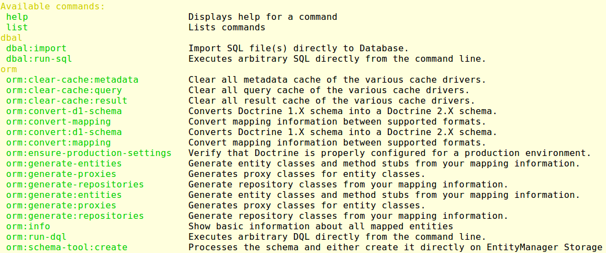
Doctrine ORM module for ZF2
command line tool
Notes:
Harken back to “Scratch your own itch” development. sometimes it worked, sometimes it didn’t. That’s how we got things like an AOLSERVER SAPI. Someone needed it, nobody cared, it got added into the codebase.
What Are RFCs?
Invented in 1969 by Steve Crocker for ARPANET, RFCs were popularized by the Internet Engineering Task Force. In PHP, they are how we present a suggestion for a change to the language. Some changes are small, others are sweeping. Once an RFC is presented, it is discussed on the Internals mailing list. Eventually, it is voted upon. If it passes, it is implemented.
RFCs affecting the language itself (Namespaces, Scalar Type Hints, etc) require a 2/3 majority, while RFCs like “Remove the date.timezone warning” only require a 50%+1 majority to pass.
How I’ve classified them
RFCs are not classified by php.net. However, looking at them, it is easy to tell which ones are important and which are not. So I’ve broken them up into two categories.
High Impact
These RFC will impact how developers write PHP code.
BC breaks
These RFCs may affect your existing applications. You will need to get your code to make sure everything still works.

Slide 26
Demystifying Doctrine
From TableGateway to Doctrine
https://github.com/doctrine/DoctrineORMModule
Notes:
The output buffering technique is used to speed up output, but also to capture intermediate output and use it elsewhere.
Often, particularly with functions which directly generate output, this is the only way to accumulate that data.

Slide 27
From TableGateway to Doctrine
update configuration
application.config.php
Add entries for appropriate doctrine modules
db.local.php
Add doctrine config for “connection” and “orm_default”
module.config.php
For each module add doctrine “driver” configuration
Identifies entity namespaces and directories for given module
Notes:
Harken back to “Scratch your own itch” development. sometimes it worked, sometimes it didn’t. That’s how we got things like an AOLSERVER SAPI. Someone needed it, nobody cared, it got added into the codebase.
What Are RFCs?
Invented in 1969 by Steve Crocker for ARPANET, RFCs were popularized by the Internet Engineering Task Force. In PHP, they are how we present a suggestion for a change to the language. Some changes are small, others are sweeping. Once an RFC is presented, it is discussed on the Internals mailing list. Eventually, it is voted upon. If it passes, it is implemented.
RFCs affecting the language itself (Namespaces, Scalar Type Hints, etc) require a 2/3 majority, while RFCs like “Remove the date.timezone warning” only require a 50%+1 majority to pass.
How I’ve classified them
RFCs are not classified by php.net. However, looking at them, it is easy to tell which ones are important and which are not. So I’ve broken them up into two categories.
High Impact
These RFC will impact how developers write PHP code.
BC breaks
These RFCs may affect your existing applications. You will need to get your code to make sure everything still works.

Slide 28
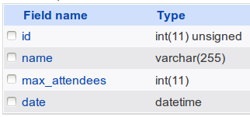
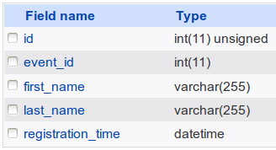

From TableGateway to Doctrine
database tables
event
registration
attendee
1:N
1:N
Notes:
Harken back to “Scratch your own itch” development. sometimes it worked, sometimes it didn’t. That’s how we got things like an AOLSERVER SAPI. Someone needed it, nobody cared, it got added into the codebase.
What Are RFCs?
Invented in 1969 by Steve Crocker for ARPANET, RFCs were popularized by the Internet Engineering Task Force. In PHP, they are how we present a suggestion for a change to the language. Some changes are small, others are sweeping. Once an RFC is presented, it is discussed on the Internals mailing list. Eventually, it is voted upon. If it passes, it is implemented.
RFCs affecting the language itself (Namespaces, Scalar Type Hints, etc) require a 2/3 majority, while RFCs like “Remove the date.timezone warning” only require a 50%+1 majority to pass.
How I’ve classified them
RFCs are not classified by php.net. However, looking at them, it is easy to tell which ones are important and which are not. So I’ve broken them up into two categories.
High Impact
These RFC will impact how developers write PHP code.
BC breaks
These RFCs may affect your existing applications. You will need to get your code to make sure everything still works.

Slide 29
From TableGateway to Doctrine
generate entities
vendor/bin/doctrine-module orm:convert-mapping
--from-database
annotation | php | xml | yaml
<target directory>
“registration” table
“registration” entity
$id
$event
$firstName
$lastName
$registrationTime
NOTE: don't forget to add the proper “namespace” to the new entities!!!
Notes:
Harken back to “Scratch your own itch” development. sometimes it worked, sometimes it didn’t. That’s how we got things like an AOLSERVER SAPI. Someone needed it, nobody cared, it got added into the codebase.
What Are RFCs?
Invented in 1969 by Steve Crocker for ARPANET, RFCs were popularized by the Internet Engineering Task Force. In PHP, they are how we present a suggestion for a change to the language. Some changes are small, others are sweeping. Once an RFC is presented, it is discussed on the Internals mailing list. Eventually, it is voted upon. If it passes, it is implemented.
RFCs affecting the language itself (Namespaces, Scalar Type Hints, etc) require a 2/3 majority, while RFCs like “Remove the date.timezone warning” only require a 50%+1 majority to pass.
How I’ve classified them
RFCs are not classified by php.net. However, looking at them, it is easy to tell which ones are important and which are not. So I’ve broken them up into two categories.
High Impact
These RFC will impact how developers write PHP code.
BC breaks
These RFCs may affect your existing applications. You will need to get your code to make sure everything still works.

Slide 30
From TableGateway to Doctrine
define relationships
/**
* @ORM\OneToMany(targetEntity="Application\Entity\Attendee",
* indexBy="id", mappedBy="registration")
*/
protected $attendees = array();
“registration” entity
“attendee” entity
$id
$attendees
$id
$registration
$name
$id
$registration
$name
$id
$registration
$name
Notes:
Harken back to “Scratch your own itch” development. sometimes it worked, sometimes it didn’t. That’s how we got things like an AOLSERVER SAPI. Someone needed it, nobody cared, it got added into the codebase.
What Are RFCs?
Invented in 1969 by Steve Crocker for ARPANET, RFCs were popularized by the Internet Engineering Task Force. In PHP, they are how we present a suggestion for a change to the language. Some changes are small, others are sweeping. Once an RFC is presented, it is discussed on the Internals mailing list. Eventually, it is voted upon. If it passes, it is implemented.
RFCs affecting the language itself (Namespaces, Scalar Type Hints, etc) require a 2/3 majority, while RFCs like “Remove the date.timezone warning” only require a 50%+1 majority to pass.
How I’ve classified them
RFCs are not classified by php.net. However, looking at them, it is easy to tell which ones are important and which are not. So I’ve broken them up into two categories.
High Impact
These RFC will impact how developers write PHP code.
BC breaks
These RFCs may affect your existing applications. You will need to get your code to make sure everything still works.

Slide 31
From TableGateway to Doctrine
define relationships
/**
* @ORM\ManyToOne(targetEntity="Application\Entity\Registration",
* inversedBy="attendees")
*/
protected $registration;
“registration” entity
“attendee” entity
$id
$attendees
$id
$registration
$name
Notes:
Harken back to “Scratch your own itch” development. sometimes it worked, sometimes it didn’t. That’s how we got things like an AOLSERVER SAPI. Someone needed it, nobody cared, it got added into the codebase.
What Are RFCs?
Invented in 1969 by Steve Crocker for ARPANET, RFCs were popularized by the Internet Engineering Task Force. In PHP, they are how we present a suggestion for a change to the language. Some changes are small, others are sweeping. Once an RFC is presented, it is discussed on the Internals mailing list. Eventually, it is voted upon. If it passes, it is implemented.
RFCs affecting the language itself (Namespaces, Scalar Type Hints, etc) require a 2/3 majority, while RFCs like “Remove the date.timezone warning” only require a 50%+1 majority to pass.
How I’ve classified them
RFCs are not classified by php.net. However, looking at them, it is easy to tell which ones are important and which are not. So I’ve broken them up into two categories.
High Impact
These RFC will impact how developers write PHP code.
BC breaks
These RFCs may affect your existing applications. You will need to get your code to make sure everything still works.

Slide 32
From TableGateway to Doctrine
define repositories
<?php
namespace Application\Repository;
use Doctrine\ORM\EntityRepository;
use Application\Entity\Attendee;
class AttendeeRepo extends EntityRepository
{
public function persist($regEntity, $nameOnTicket)
{
$attendee = new Attendee();
$attendee->setRegistration($regEntity);
$attendee->setName($nameOnTicket);
$em = $this->getEntityManager();
$em->persist($attendee);
$em->flush();
return $attendee;
}
// … etc.
}
Notes:
Harken back to “Scratch your own itch” development. sometimes it worked, sometimes it didn’t. That’s how we got things like an AOLSERVER SAPI. Someone needed it, nobody cared, it got added into the codebase.
What Are RFCs?
Invented in 1969 by Steve Crocker for ARPANET, RFCs were popularized by the Internet Engineering Task Force. In PHP, they are how we present a suggestion for a change to the language. Some changes are small, others are sweeping. Once an RFC is presented, it is discussed on the Internals mailing list. Eventually, it is voted upon. If it passes, it is implemented.
RFCs affecting the language itself (Namespaces, Scalar Type Hints, etc) require a 2/3 majority, while RFCs like “Remove the date.timezone warning” only require a 50%+1 majority to pass.
How I’ve classified them
RFCs are not classified by php.net. However, looking at them, it is easy to tell which ones are important and which are not. So I’ve broken them up into two categories.
High Impact
These RFC will impact how developers write PHP code.
BC breaks
These RFCs may affect your existing applications. You will need to get your code to make sure everything still works.

Slide 33
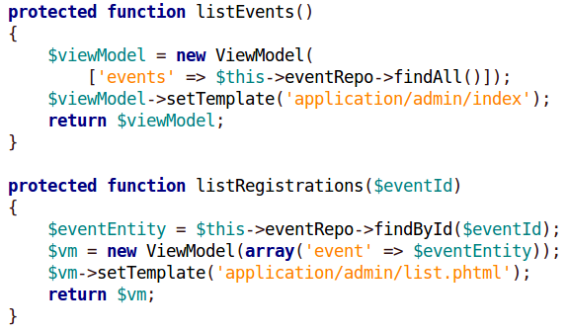
From TableGateway to Doctrine
rewrite controller and views
Application\Controller\AdminController
Notes:
Harken back to “Scratch your own itch” development. sometimes it worked, sometimes it didn’t. That’s how we got things like an AOLSERVER SAPI. Someone needed it, nobody cared, it got added into the codebase.
What Are RFCs?
Invented in 1969 by Steve Crocker for ARPANET, RFCs were popularized by the Internet Engineering Task Force. In PHP, they are how we present a suggestion for a change to the language. Some changes are small, others are sweeping. Once an RFC is presented, it is discussed on the Internals mailing list. Eventually, it is voted upon. If it passes, it is implemented.
RFCs affecting the language itself (Namespaces, Scalar Type Hints, etc) require a 2/3 majority, while RFCs like “Remove the date.timezone warning” only require a 50%+1 majority to pass.
How I’ve classified them
RFCs are not classified by php.net. However, looking at them, it is easy to tell which ones are important and which are not. So I’ve broken them up into two categories.
High Impact
These RFC will impact how developers write PHP code.
BC breaks
These RFCs may affect your existing applications. You will need to get your code to make sure everything still works.

Slide 34
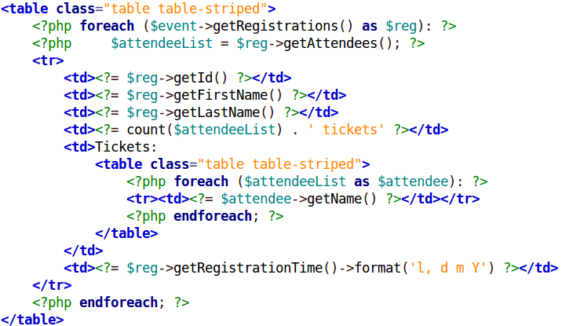
From TableGateway to Doctrine
rewrite controller and views
view/admin/list.phtml
Notes:
Harken back to “Scratch your own itch” development. sometimes it worked, sometimes it didn’t. That’s how we got things like an AOLSERVER SAPI. Someone needed it, nobody cared, it got added into the codebase.
What Are RFCs?
Invented in 1969 by Steve Crocker for ARPANET, RFCs were popularized by the Internet Engineering Task Force. In PHP, they are how we present a suggestion for a change to the language. Some changes are small, others are sweeping. Once an RFC is presented, it is discussed on the Internals mailing list. Eventually, it is voted upon. If it passes, it is implemented.
RFCs affecting the language itself (Namespaces, Scalar Type Hints, etc) require a 2/3 majority, while RFCs like “Remove the date.timezone warning” only require a 50%+1 majority to pass.
How I’ve classified them
RFCs are not classified by php.net. However, looking at them, it is easy to tell which ones are important and which are not. So I’ve broken them up into two categories.
High Impact
These RFC will impact how developers write PHP code.
BC breaks
These RFCs may affect your existing applications. You will need to get your code to make sure everything still works.

Slide 35
Conclusion
Doctrine ...
… implements important aspects of the domain model
… facilitates modeling complex relationships
… provides various forms of cache to improve
performance
… integrates seamlessly with ZF2
Notes:
5:10 in
it is important to stay current
Keep your server upgraded to the latest patch
Keep your skills upgraded with Zend Training

Slide 36
Thank You!
QUESTIONS?
doug@unlikelysource.com

