Slide 1
The Provincial Patriotism of “In Flanders Fields”
Amanda French

Slide 2
    In Flanders fields the poppies blow
    Between the crosses, row on row,
    That mark our place; and in the sky
    The larks, still bravely singing, fly
    Scarce heard amid the guns below.
    We are the Dead. Short days ago
    We lived, felt dawn, saw sunset glow,
    Loved and were loved, and now we lie
    In Flanders fields.
    Take up our quarrel with the foe:
    To you from failing hands we throw
    The torch; be yours to hold it high.
    If ye break faith with us who die
    We shall not sleep, though poppies grow
    In Flanders fields.

Slide 3


Slide 4
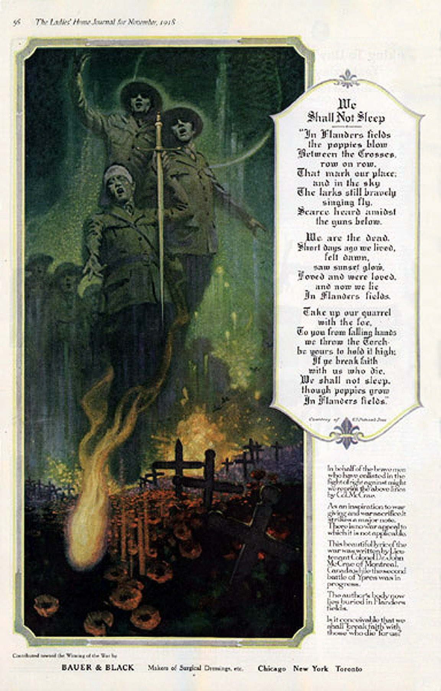
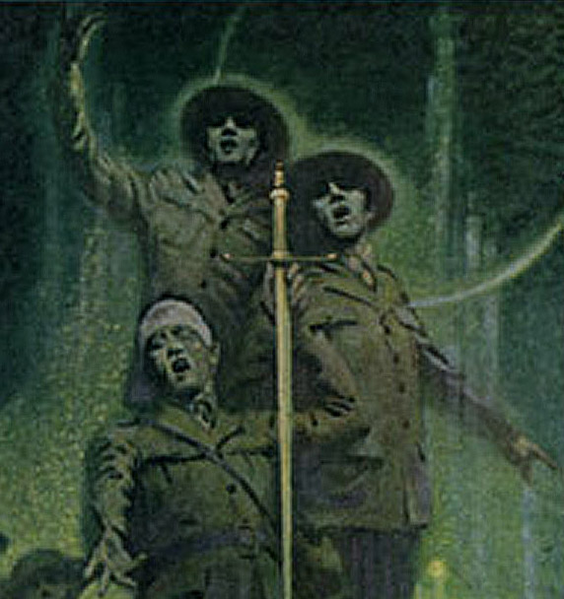
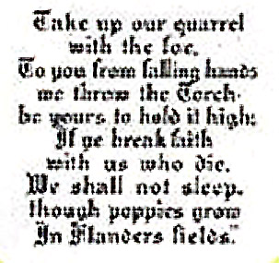
Contributed toward the Winning of the War by
BAUER & BLACK
Makers of Surgical Dressings, etc.

Slide 5
    In Flanders fields the poppies blow
    Between the crosses, row on row,
    That mark our place; and in the sky
    The larks, still bravely singing, fly
    Scarce heard amid the guns below.
    We are the Dead. Short days ago
    We lived, felt dawn, saw sunset glow,
    Loved and were loved, and now we lie
    In Flanders fields.
    Take up our quarrel with the foe:
    To you from failing hands we throw
    The torch; be yours to hold it high.
    If ye break faith with us who die
    We shall not sleep, though poppies grow
    In Flanders fields.
    Ra
    a
    b
    b
    a
    a
    a
    b
    R
    a
    a
    b
    b
    a
    R

Slide 6
    Oh! you who sleep in Flanders Fields,
    Sleep sweet -- to rise anew!
    We caught the torch you threw
    And holding high, we keep the Faith
    With All who died.
    We cherish, too, the poppy red
    That grows on fields where valor led;
    It seems to signal to the skies
    That blood of heroes never dies,
    But lends a lustre to the red
    Of the flower that blooms above the dead
    In Flanders Fields.
    And now the Torch and Poppy Red
    We wear in honor of our dead.
    Fear not that ye have died for naught;
    We'll teach the lesson that ye wrought
    In Flanders Fields.
    Moina MIchael
    aR
    b
    b
    c
    d
    e
    e
    f
    f
    g
    g
    R
    g
    g
    h
    h
    R

Slide 7
    The poem was first called to my attention by a Sapper officer, then Major, now Brigadier. […] This officer could himself weave the sonnet with deft fingers, and he pointed out many deep things. It is to the sappers that the army always goes for "technical material."
    The poem, he explained, consists of thirteen lines in iambic tetrameter and two lines of two iambics each; in all, one line more than the sonnet's count. There are two rhymes only, since the short lines must be considered blank, and are, in fact, identical. But it is a difficult mode. It is true, he allowed, that the octet of the sonnet has only two rhymes, but these recur only four times, and the liberty of the sestet tempers its despotism,--which I thought a pretty phrase.[…]
    One is so often reminded of the poverty of men's invention, their best being so incomplete, that one welcomes what--this Sapper officer surmised--may become a new and fixed mode of expression in verse.
    Andrew Macphail

Slide 8
    Instinctively, if not consciously, the Canadian poets discovered that, culturally, Canada was not Britain. They understood what poets like Owen were talking about; they had the personal experience required to appreciate that. But they knew in their poetic guts that the grim vision of life that energized Owen's verse was not relevant to Canadian imagination in a central way. […] Among intelligent Canadians, there was no denial of the obscenities of war or of the moral implications of these brutalities, but there was also no denial of the perception that war contributed significantly to national maturation […]
    Thomas B. Vincent

Slide 9
    The books listed above are mostly journalism, but now and then some poem lifts the emotion of the moment into song, thus winning a chance of survival after the moment has passed. John McCrae achieves this in the much-quoted In Flanders Fields--achieves it by sheer simplicity and concentration in the expression of a moving and tragic appeal. Another poem on the same motive‑‑a living soldier's address to The Anxious Dead‑‑is perhaps still finer, and its quatrains fit the subject better than the too‑slight rondeau form of the first.
    Alice Corbin Henderson

Slide 10
    In Flanders fields the poppies blow
    Between the crosses, row on row,
    That mark our place; and in the sky
    The larks, still bravely singing, fly
    Scarce heard amid the guns below.
    We are the Dead. Short days ago
    We lived, felt dawn, saw sunset glow,
    Loved and were loved, and now we lie
    In Flanders fields.
    Take up our quarrel with the foe:
    To you from failing hands we throw
    The torch; be yours to hold it high.
    If ye break faith with us who die
    We shall not sleep, though poppies grow
    In Flanders fields.

