Slide 1
Your Twitter Followers and Facebook
Friends Won't Read Your
Peer-reviewed Article If They Have to
Pay for It, and Neither Will Strangers
The Open Professoriat
Modern Language Association
Los Angeles, CA, January 2011
Amanda French

Slide 2
Can social media help broaden the audience for academic work?
Can Twitter and Facebook help earn more readers for peer-reviewed articles?
Notes:
The question before today’s panel is “Can social media help broaden the audience for academic work?” I’m going to talk about a more specific version of this question, namely, “Can Twitter and Facebook help earn more readers for peer-reviewed articles?”

Slide 3
Yes, but those readers will not pay to read peer-reviewed articles.
Notes:
The answer is “Yes, but those readers will not pay to read peer-reviewed articles.”

Slide 4
Jason Priem and Kaitlin Light Costello. "How and Why Scholars Cite on Twitter." Proceedings of the ASIS&T Annual Meeting no. 47, ed. Andrew Grove. Richard B. Hill, June 2010.
http://mail.asis.org/asist2010/proceedings
/proceedings/ASIST_AM10/submissions/
201_Final_Submission.pdf
Notes:
In December of 2010, I tweeted a link to a PDF of an article from the recently published proceedings of the 2010 meeting of the American Society of Information Science and Technology titled “How and Why Scholars Cite on Twitter."

Slide 5
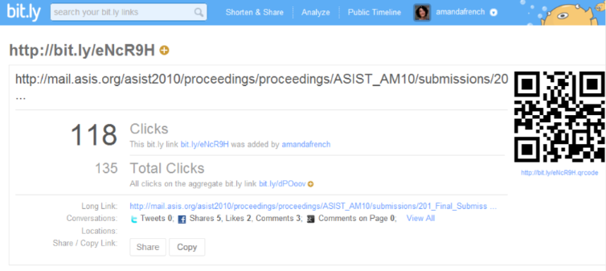
Notes:
It was one of my most clicked-on links for the year, with 118 views—many of the links I tweet to news articles and so on get only thirty or so clicks.

Slide 6
In our sample of tweets containing hyperlinks, 6% were citations. Of these, 52% were first-order links and 48% were second-order.
Notes:
The authors studied a sample of 46,515 tweets from 28 scholars: seven scientists, fourteen social scientists, and seven humanists, and they reported that “In our sample of tweets containing hyperlinks, 6% were citations. Of these, 52% were first-order links and 48% were second-order.” By this, they meant that 52% of the links that went directly to peer-reviewed work, while 48% were links that went to non-peer-reviewed work about peer-reviewed work: blog posts and news articles, for instance.

Slide 7
[S]cholars may prefer to link directly to the article when it is open access but will resort to second-order links to bypass paywall restrictions. Participants were attracted to open-access articles for Twitter citations; Ben said “I would certainly be much more likely to link to things if they were more readily available.”
Notes:
One of the main reasons that scholars tweeted these “second-order” links was that they worked for everyone: “[S]cholars may prefer to link directly to the article when it is open access but will resort to second-order links to bypass paywall restrictions. Participants were attracted to open-access articles for Twitter citations; Ben said “I would certainly be much more likely to link to things if they were more readily available.”
This article doesn’t study who exactly was clicking on the links the scholars tweeted, although it does report that scholars regarded Twitter as a way to share information with members of their discipline. Certainly this is one of the chief things I use Twitter for, myself: sharing and acquiring information from my colleagues in the digital humanities.

Slide 8
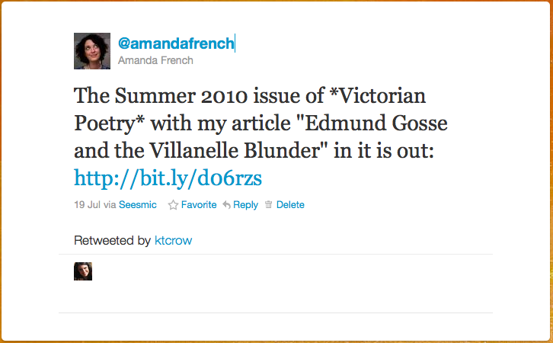
Notes:
In July of 2010, however, I used Twitter for a slightly different purpose: to let members of my network know that a peer-reviewed article of my own had just appeared: “The Summer 2010 issue of *Victorian Poetry* with my article ‘Edmund Gosse and the Villanelle Blunder’ in it is out,” I wrote, and included a link to the article’s landing page in Project Muse.

Slide 9
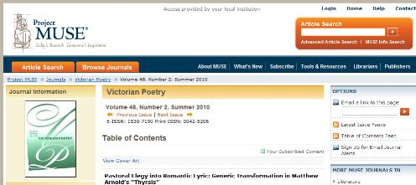

Slide 10
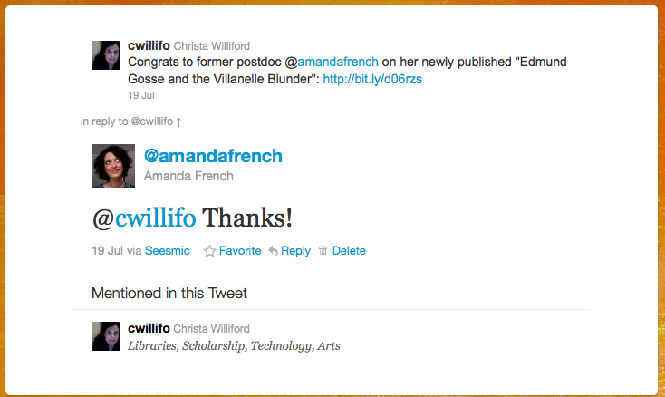
Notes:
Several friends, scholars themselves in entirely different fields, replied with congratulations on Twitter: one at least showed that she had read at least a little of the article, because she mentioned a word I used in the first paragraph.

Slide 11
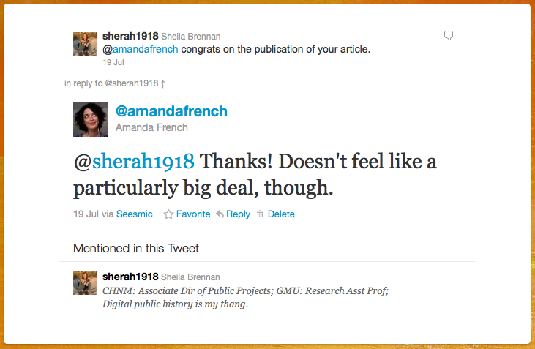

Slide 12
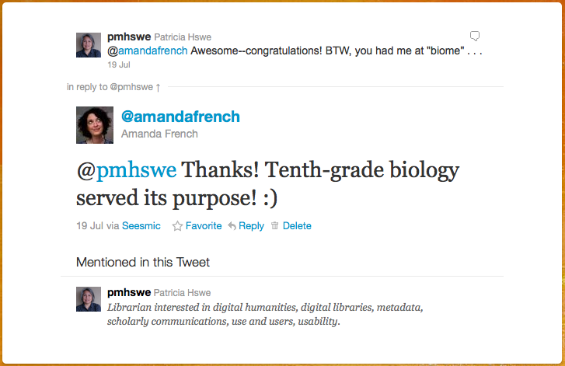
Notes:
one at least showed that she had read at least a little of the article, because she mentioned a word I used in the first paragraph.

Slide 13
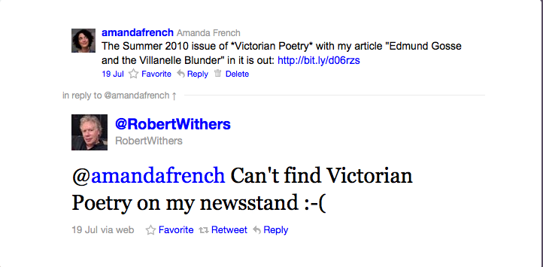
Notes:
And one complete stranger, a follower, wrote that he couldn’t “find Victorian Poetry on his local newsstand,” with what degree of seriousness I simply don’t know. I replied with a link to my (openly available) dissertation, on which the article draws, and we had a short exchange about poetic form.

Slide 14
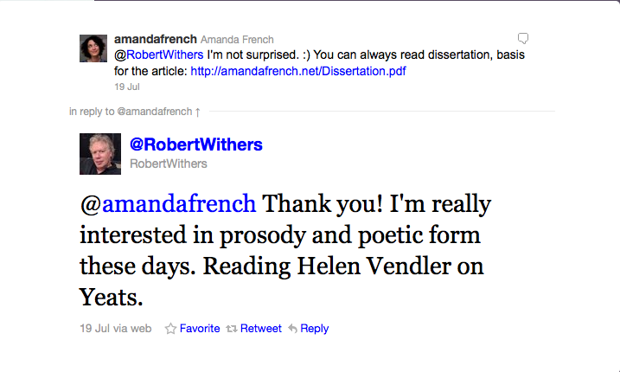

Slide 16
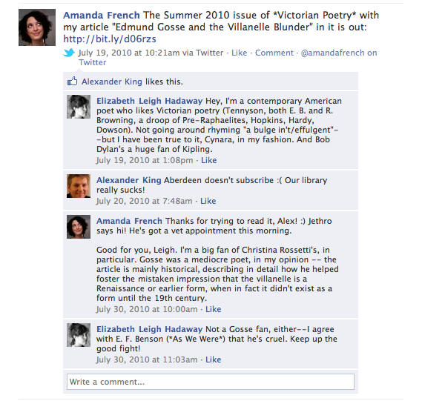
Notes:
I feed my Twitter updates to Facebook, and so my Facebook friends saw the tweet as well. There, two friends, one an anthropologist in Aberdeen and one a poet in New England, also expressed interest and congratulations: my friend Alex the anthropologist, however, complained that his university didn’t subscribe to the journal and that he therefore wouldn’t be able to read the article.
So this is six people, five of them my friends. Hardly earth- or academy-shattering. But of that small sample, two were not scholars, and they are terrific examples of a broader audience for peer-reviewed scholarly work. I haven’t spoken to my friend Leigh Palmer in person for years, and I would never have thought to (say) e-mail her my article, but as you can see, she was very interested in and engaged with what I wrote. Robert Withers is a stranger to me, but I looked him up for this piece and discovered that he is an independent filmmaker by trade; he was interested in the article for its own sake, but could not read it because it was behind a paywall. The “broader audience” that is indeed reachable via Twitter and Facebook was in this case halved because the article is not openly available. I might mention, too, that when the article was accepted by Victorian Poetry, I negotiated with them to be allowed to post the article openly online, but I did not gain that right.

Slide 17
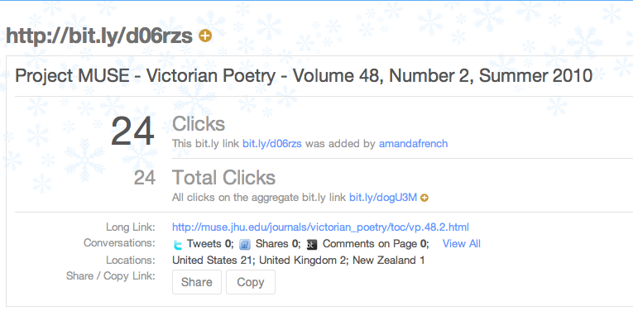
Notes:
The audience for an article on Edmund Gosse and the villanelle, of course, is small to begin with – the link that appeared on Twitter and Facebook was clicked on only twenty-four times. How many people might be reading the article through Project Muse or in print, of course, I do not know and have no way of telling: my article is as yet uncited (unsurprisingly, given how recent it is) by anyone else writing about the villanelle or a related scholarly topic. But it’s also clearly the case that Twitter and Facebook can indeed help earn more readers for peer-reviewed articles, as long as those articles are openly and freely available on the web.

Slide 18
Sources for this presentation can be found at
http://www.zotero.org/amandafrench/items/collection/RQT3X4II

