Slide 1


CTR - COVID Tracking Record
Notes:
Hi , My name is Amanda Haydaw, I am going to represent a web page tool which can support health team with covid cases tracking whatever if the have identify as primary or secondary contact.

Slide 2

Tracing team loosing communication record.
Identified primary /secondary contact miss to inform recent visited place.
Tracing team miss to upload data into system
Tracing team miss to follow up with active coronavirus holder.

Slide 3
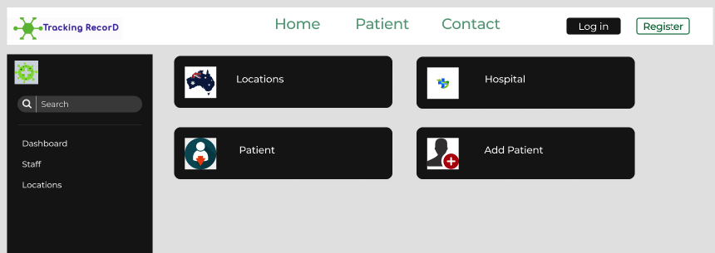

Importance Solution
Notes:
Creating a webpage tool which can help staff to trace coronavirus holder and enable tracing team members to record and fill person’s details virus holder. having one tool page which can help the tracing team to reduce pressure, entering all communications entries which will avoid miss communication with patients which is a common scenario happen, Visibility to enter new patient details, tracing active virus holder across all states, a view to clearance active virus, a view if a patient is in ICU across states, etc.

Slide 4
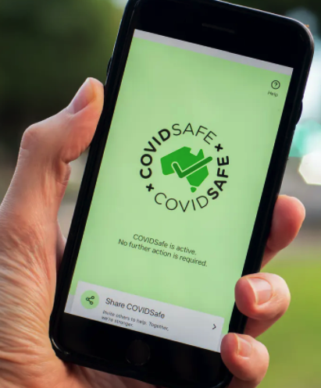
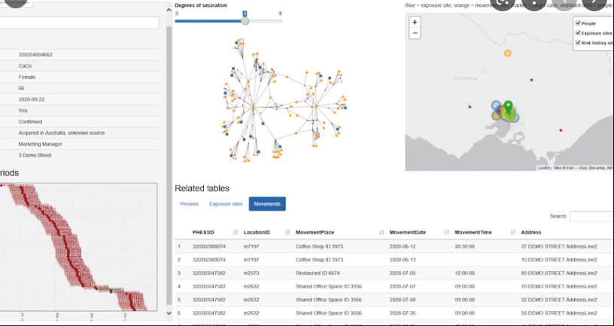
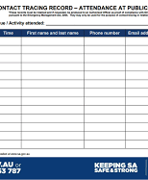

COVIDSafe app
Mystery Case Tracker
Contact Tracing Record
Current Solution
Notes:
Current solution is done by different team and high possibility to be missed by team ,
Having one tool page which can help the tracing team to reduce pressure, enter all communications entries which will avoid miss communication with patients which is a common scenario happen, Visibility to enter new patient details, tracing active virus holder across all states, a view to clearance active virus, a view if a patient is in ICU across states, etc.

