Slide 1
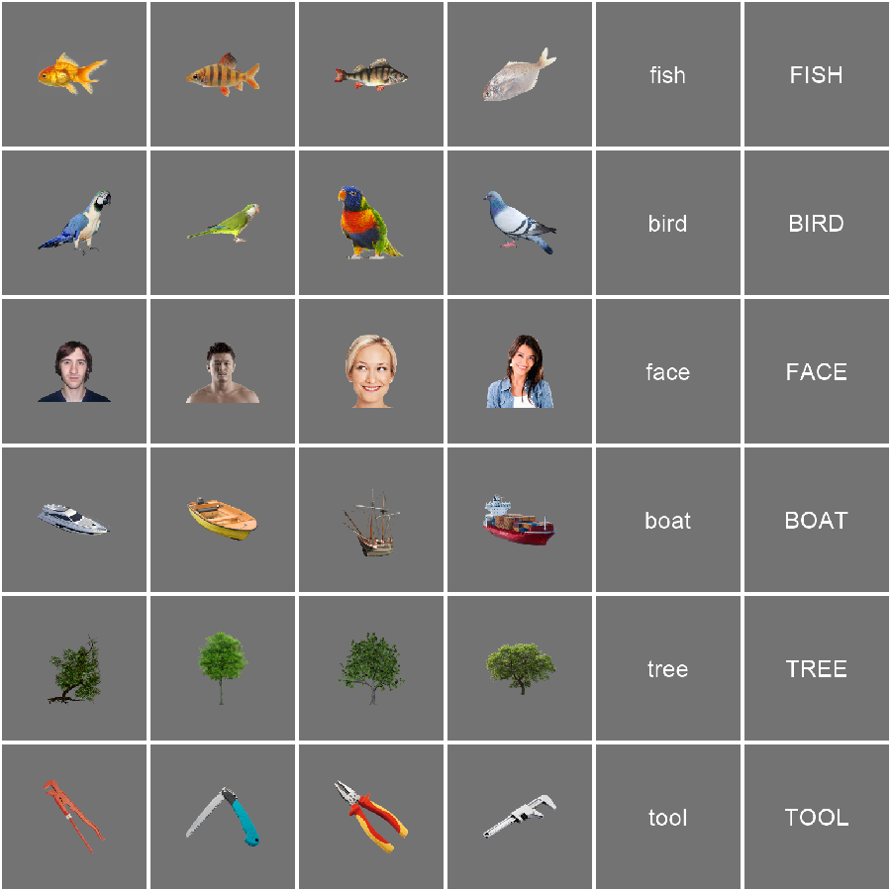


A
B
Red target
C
ISI (100 ms)
Presentation (100 ms)
Initial fixation (1000 ms)

