Slide 1

From Raw EEG to Embeddings: Task Label Prediction via Machine Learning
𝒜𝓂𝒶𝓃𝒹𝒶 ℒ𝒾𝓃
Graduate Institute of Linguistics
(& Data Science Degree Program),
National Taiwan University

Slide 2
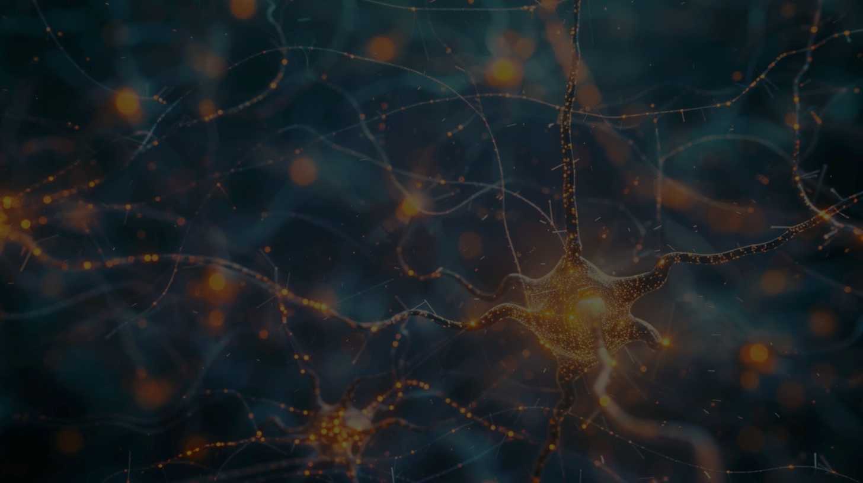
When Biological Neural Networks Meet Artificial Neural Networks

Slide 3
Neuron vs Neuron
🧠 Neuron:
A nerve cell. Neurons are the fundamental units of the brain and nervous system.
🤖 Neuron:
A computational unit that processes input data before passing the information on to the next layer.

Slide 4
Epoch vs Epoch
🧠 Epoch:
In EEG/ERP, an epoch refers to a specific time window, e.g.,
-100 ms – +1000 ms.
🤖 Epoch:
In machine learning, an epoch refers to an iteration over the entire dataset during model training.

Slide 5
Motivation: Why EEG “Representational Embeddings”?
Short answer:
Because I just so happened to find the
NeurIPS EEG Challenge on Discord (✕)

Slide 6


If you want to join, let me know! (Challenge itself is over, but I plan
to expand and build on it!)
See paper at arXiv

Slide 7
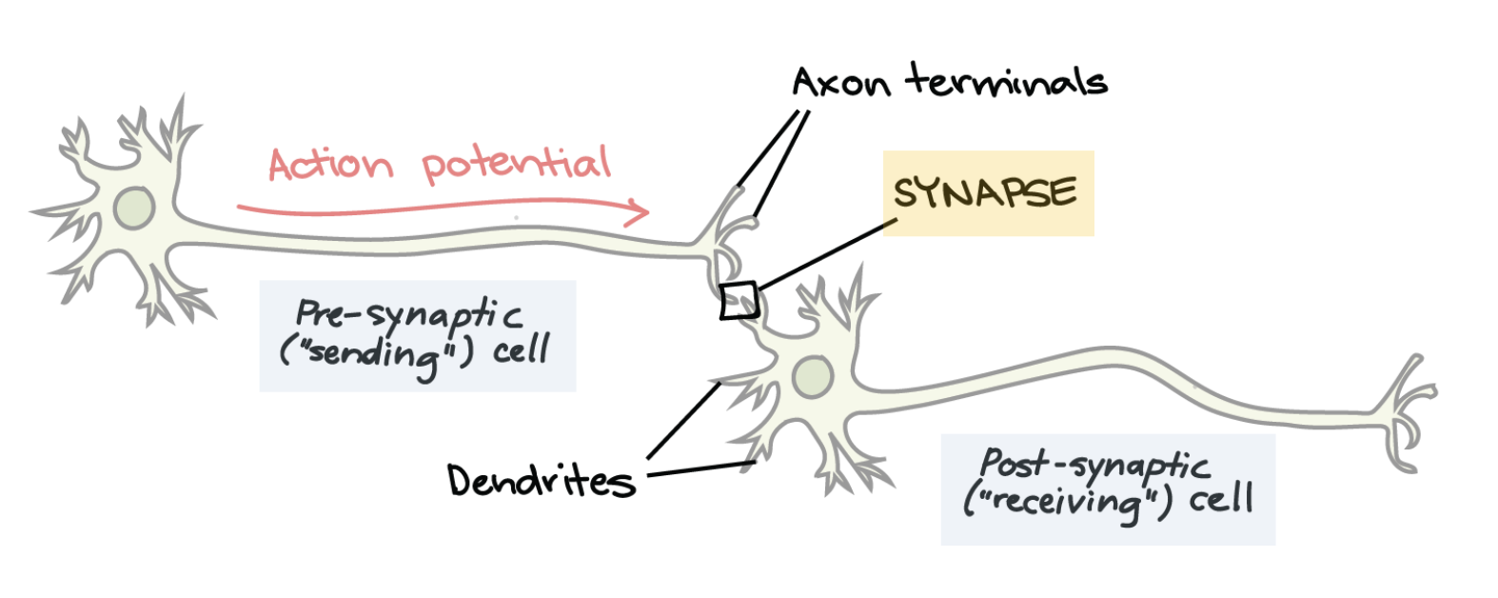
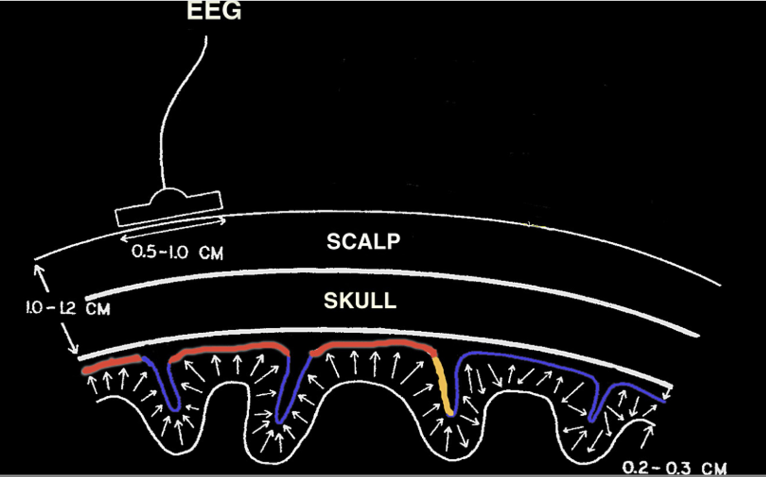
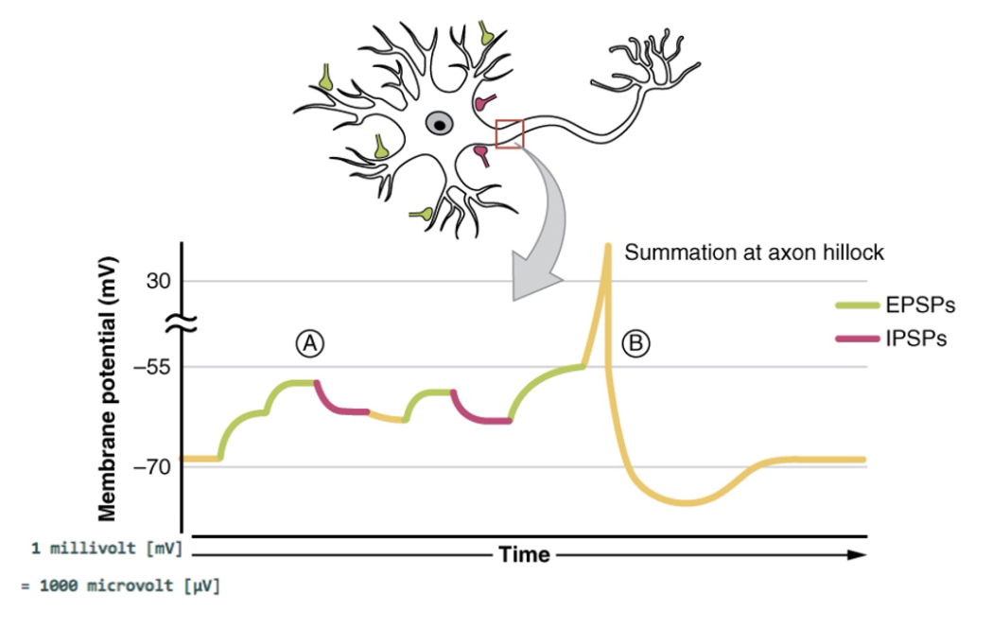
Back to Basics: What Are EEGs?

Slide 8
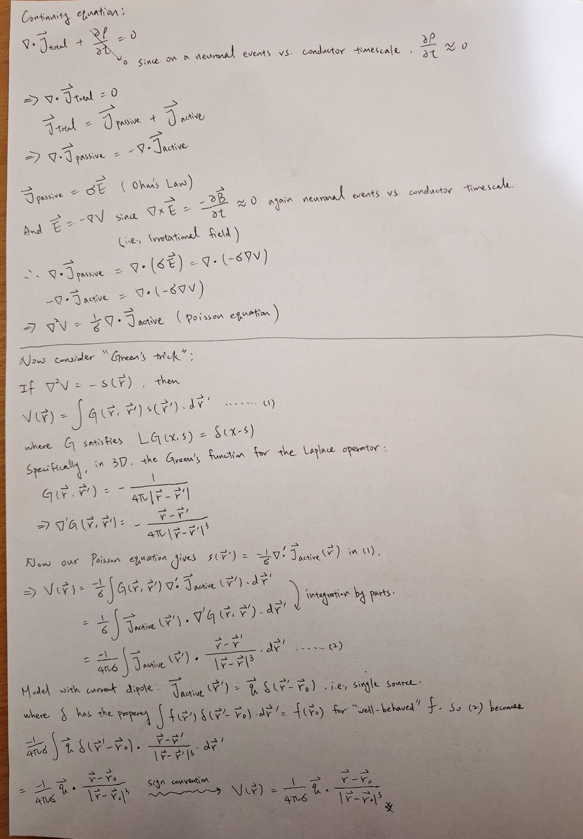
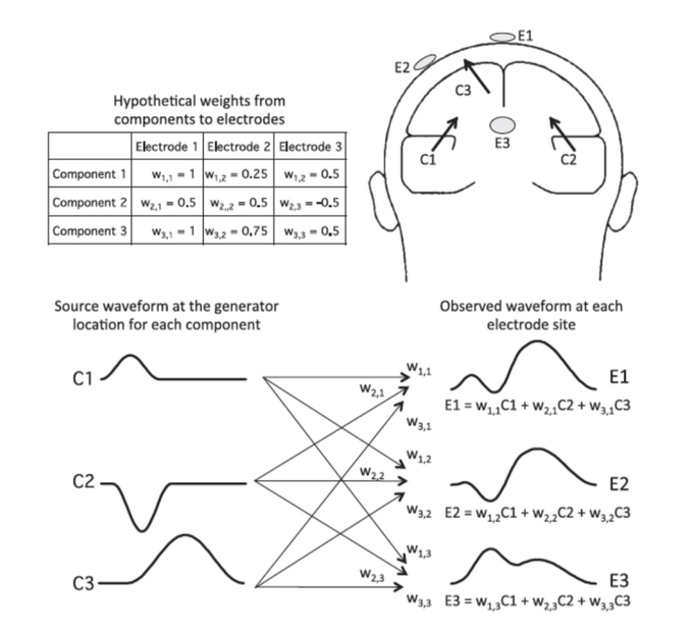
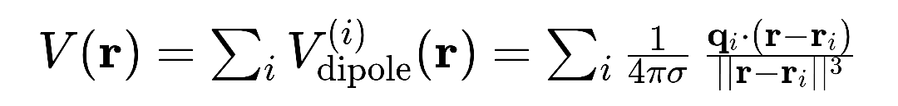
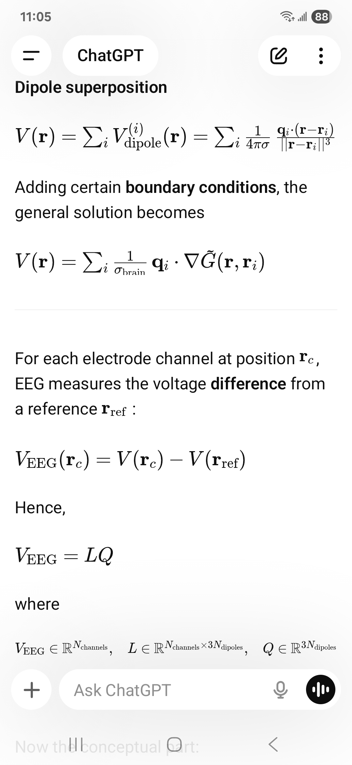
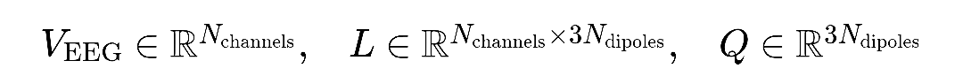
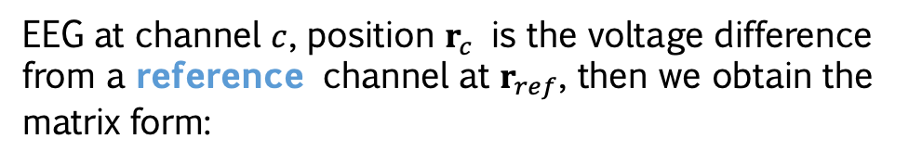
Why EEG Is Messy: Forward Model
(The Part That Nobody Wants to Look at)
Current dipole superposition:
Imposing boundary conditions (e.g., non-infinite space, inhomogeneous conductivity) and solve for the general solution using modified Green’s functions:
EEG at channel $c$, position $r_{c}$ is the voltage difference from a reference channel at $r_{ref}$, then we obtain the matrix form:
Photo from Steven J. Luck,
An Introduction to the Event-Related Potential Technique
Notes:
那這其中會牽涉到像是跟 conductivity 有關的 boundary conditions，以及當然電位差相對的，所以量測到的數據一定會有個 reference 電極。

Slide 9
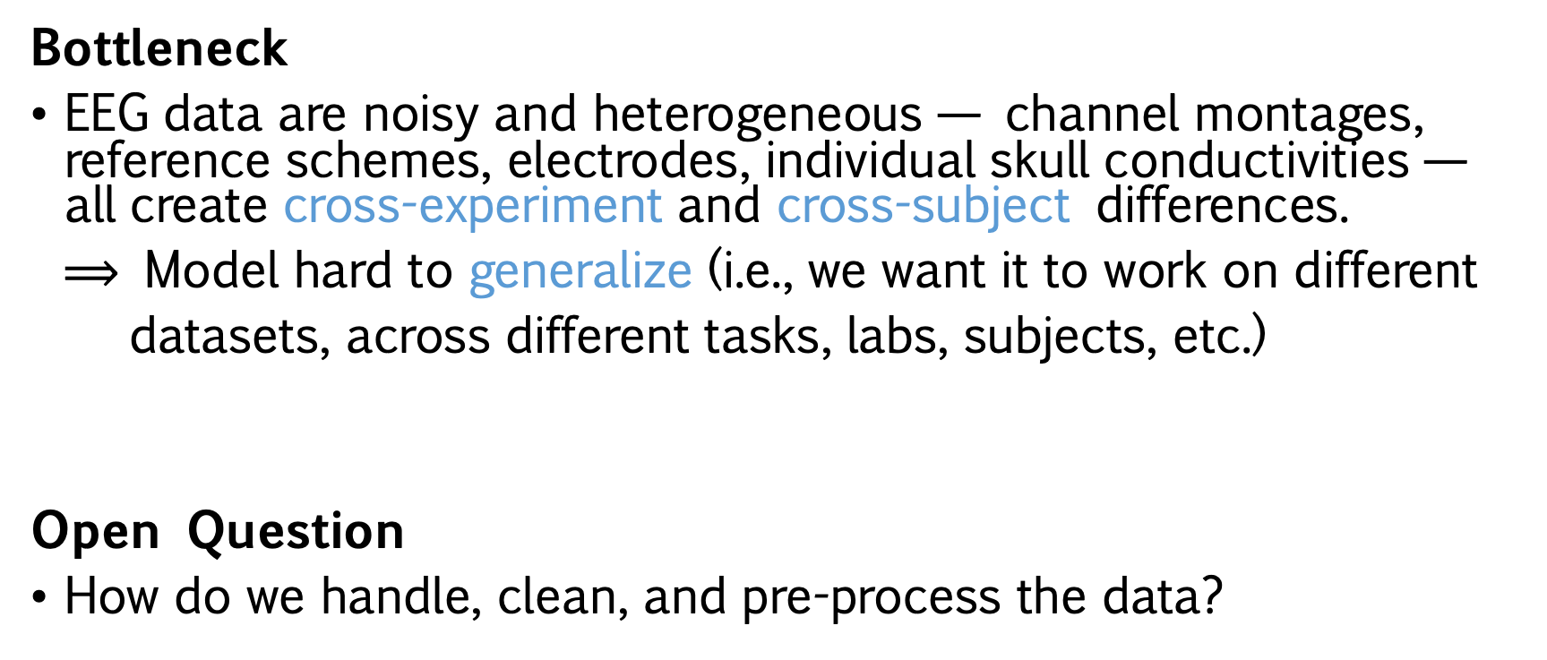
Challenges in Encoding EEGs
Bottleneck
EEG data are noisy and heterogeneous — channel montages, reference schemes, electrodes, individual skull conductivities — all create cross-experiment and cross-subject differences.
$⟹$ Model hard to generalize (i.e., we want it to work on different
datasets, across different tasks, labs, subjects, etc.)
Open Question
How do we handle, clean, and pre-process the data?

Slide 10
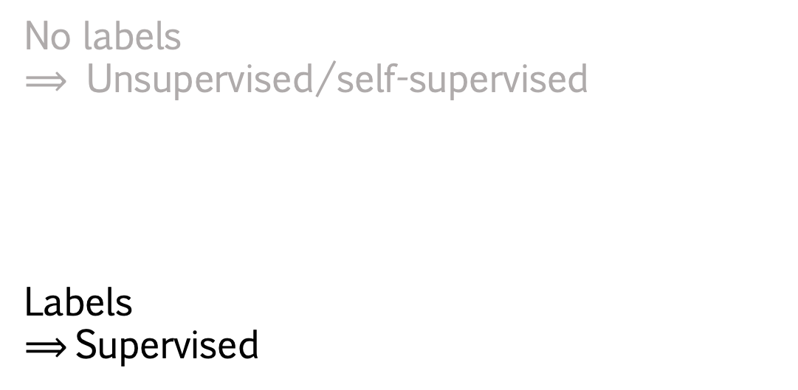
Datasets
HBN-EEG (Healthy Brain Network EEG Datasets)
Passive tasks
- Resting state
- Surround Suppression
- Movie Watching
Active tasks
- Contrast Change Detection
- Sequence Learning
- Symbol Search
No labels
$⟹$ Unsupervised/self-supervised
Labels
$⟹$Supervised

Slide 11
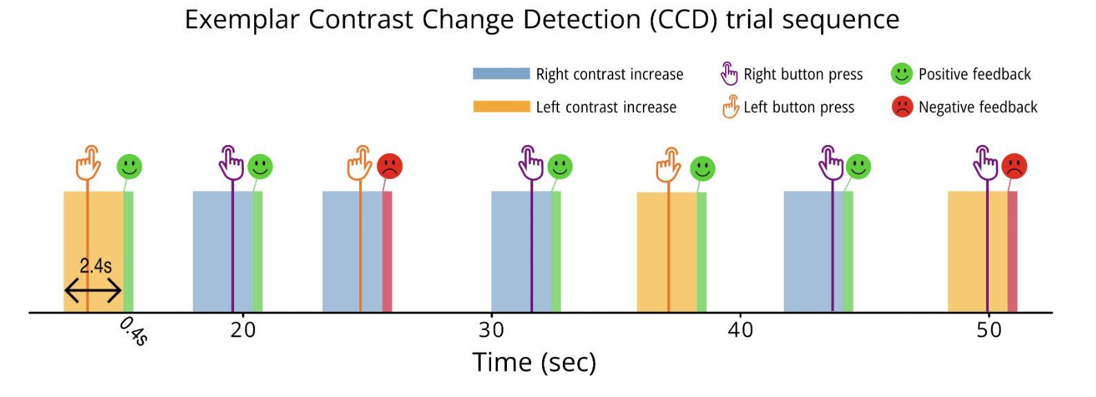
Datesets
Participants monitored two co-centric flickering grated disks (one left-leaning, one right-leaning) and identified which disk showed increased contrast when a change occurred. They received feedback (smiley or sad face) based on response accuracy. This task measures visual attention, decision-making, and contrast sensitivity.

Slide 12
Pipeline: EEG → Model (EEGNeX)→ RT (Response Time)
Download CCD dataset mini
(already pre-processed)
Windowing/epoching
(+500 ms - +2500 ms)
Train/validation/test data split
(split by subject)
Create DataLoader objects
ML training pipeline
Data inspection in MATLAB EEG/ERPLAB

Slide 13
Tools
EEGDash: access to data (BIDS), PyTorch compatible
Braindecode: EEGNeX, wrapper pipeline for functions
MNE: EEG data anlysis package
PyTorch: deep learning framework

Slide 14
How This Actually Runs on
a Computer: Enough Slides, Summon the Code
Based on NeurIPS Starter-Kit (model choice, windowing, data split, training loop).
Amanda added
Export utilities for MATLAB EEG/ERPLAB.
Re-annotation (positive/negative feedback) as a classification example.
Extra explanation cells to clarify the key functions used in the code.
Additionsl evaluation (R^2, train/validation loss plots).

Slide 15
Machine Learning Pipeline:
10-Minute(-ish) Crash Course

Slide 16
Models: What Are Neural Networks?
DNN, CNN, RNN, Transformer, etc. — what are they?
Fully connected/dense DNN (deep neural network)
Each layer is fully connected to the next; treats input features as unordered vectors.
CNN (convolutional neural network)
Learns local patterns via shared weights with sliding kernels.
RNN (recurrent neural network)
Sequential modelling: current hidden state depends on the previous hidden state.
Transformer
Attention is All You Need
So… what is a neuron?

Slide 17
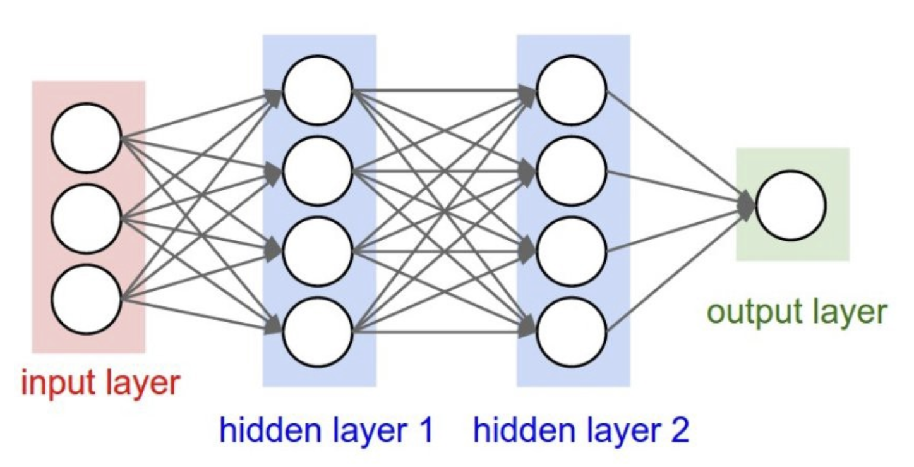
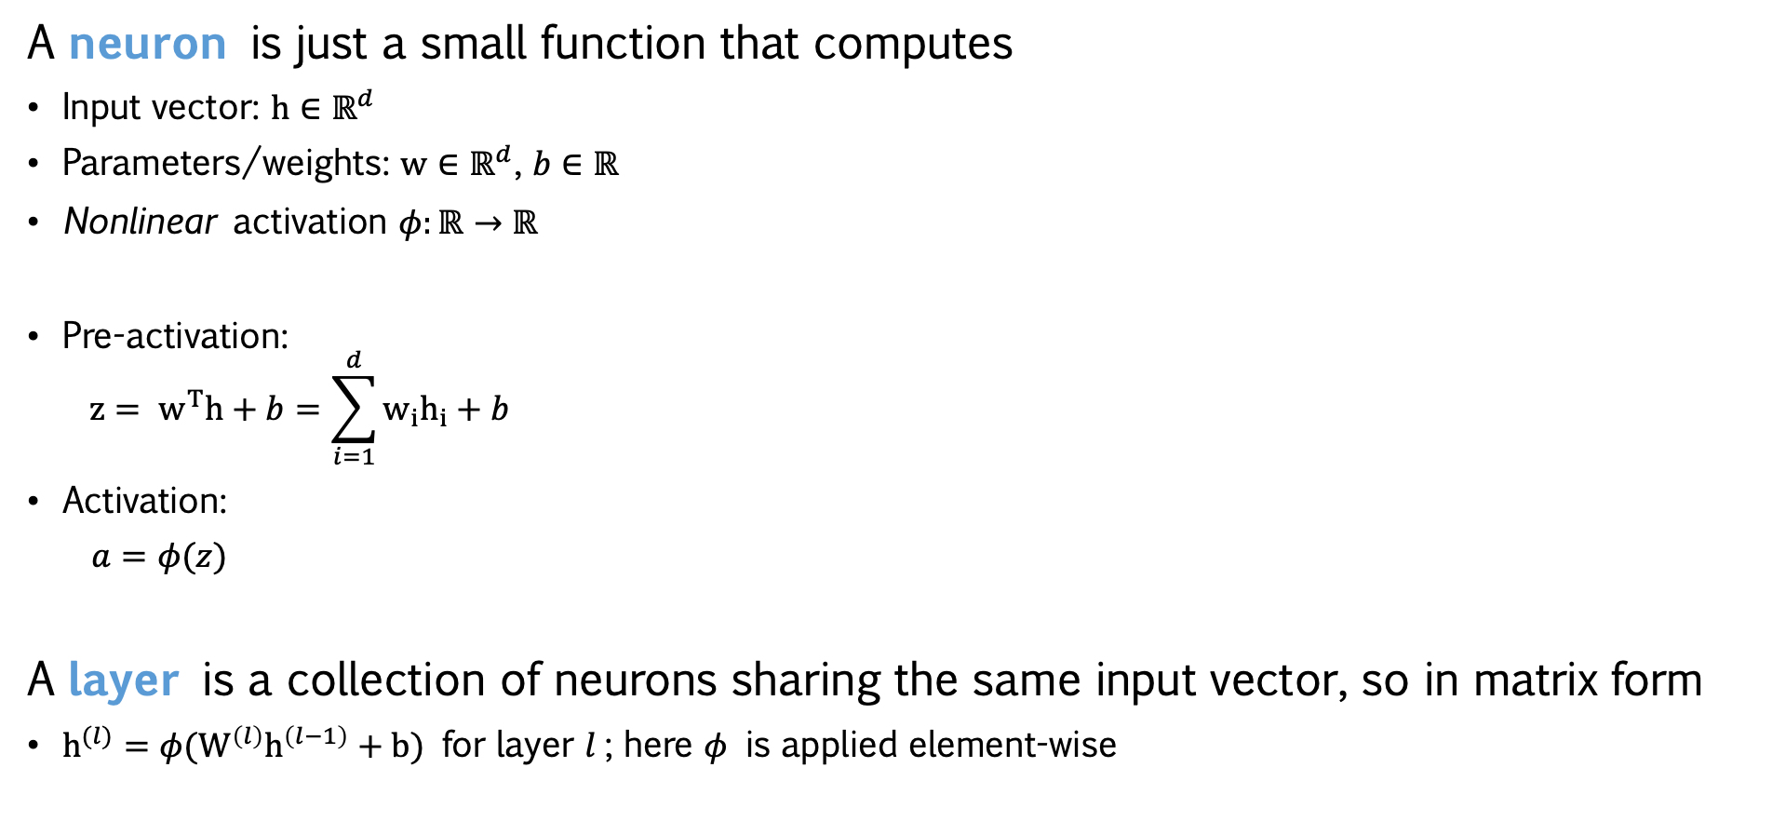
Models: Basic DNN (Fully Connected, Dense)
A neuron is just a small function that computes
Input vector: $h∈ℝ^{d}$
Parameters/weights: $w∈ℝ^{d}$, $b∈ℝ$
Nonlinear activation $φ:ℝ→ℝ$
Pre-activation:
$$z= w^{T}h+b=\sum_{i=1}^{d}{w_{i}h_{i}+b}$$
Activation:
$a=φ(z)$
A layer is a collection of neurons sharing the same input vector, so in matrix form
$h^{(l)}=φ(W^{\left(l\right)}h^{\left(l−1\right)}+b)$ for layer $l$; here $φ$ is applied element-wise

Slide 18
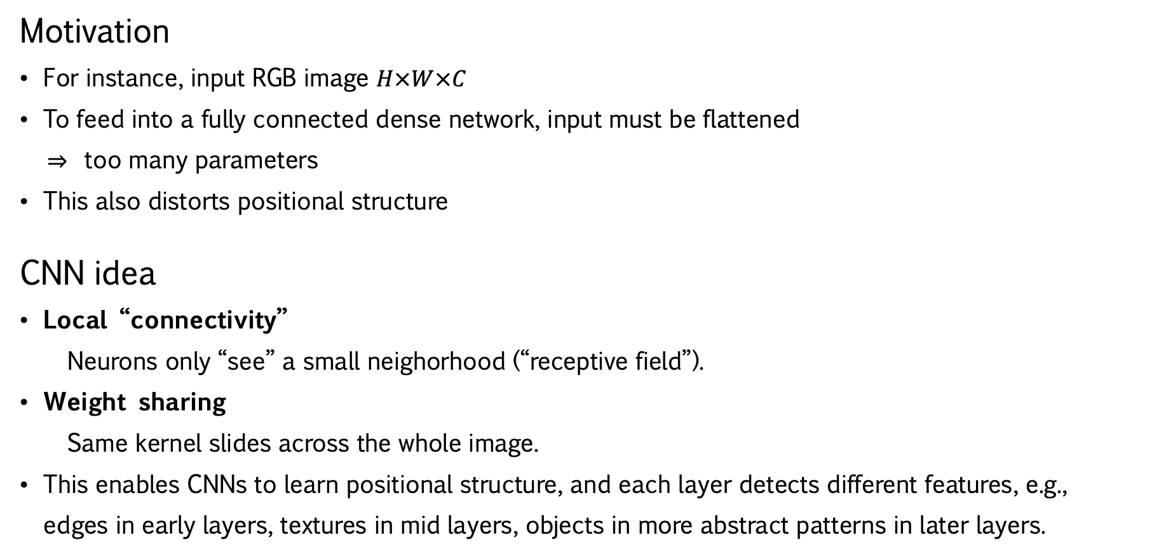
Models: CNN (Convolutional Neural Network)
Trivia: CNNs actually do cross-correlation
Motivation
For instance, input RGB image $H×W×C$
To feed into a fully connected dense network, input must be flattened
$⇒$ too many parameters
This also distorts positional structure
CNN idea
Local “connectivity”
Neurons only “see” a small neighorhood (“receptive field”).
Weight sharing
Same kernel slides across the whole image.
This enables CNNs to learn positional structure, and each layer detects different features, e.g.,
edges in early layers, textures in mid layers, objects in more abstract patterns in later layers.

Slide 19
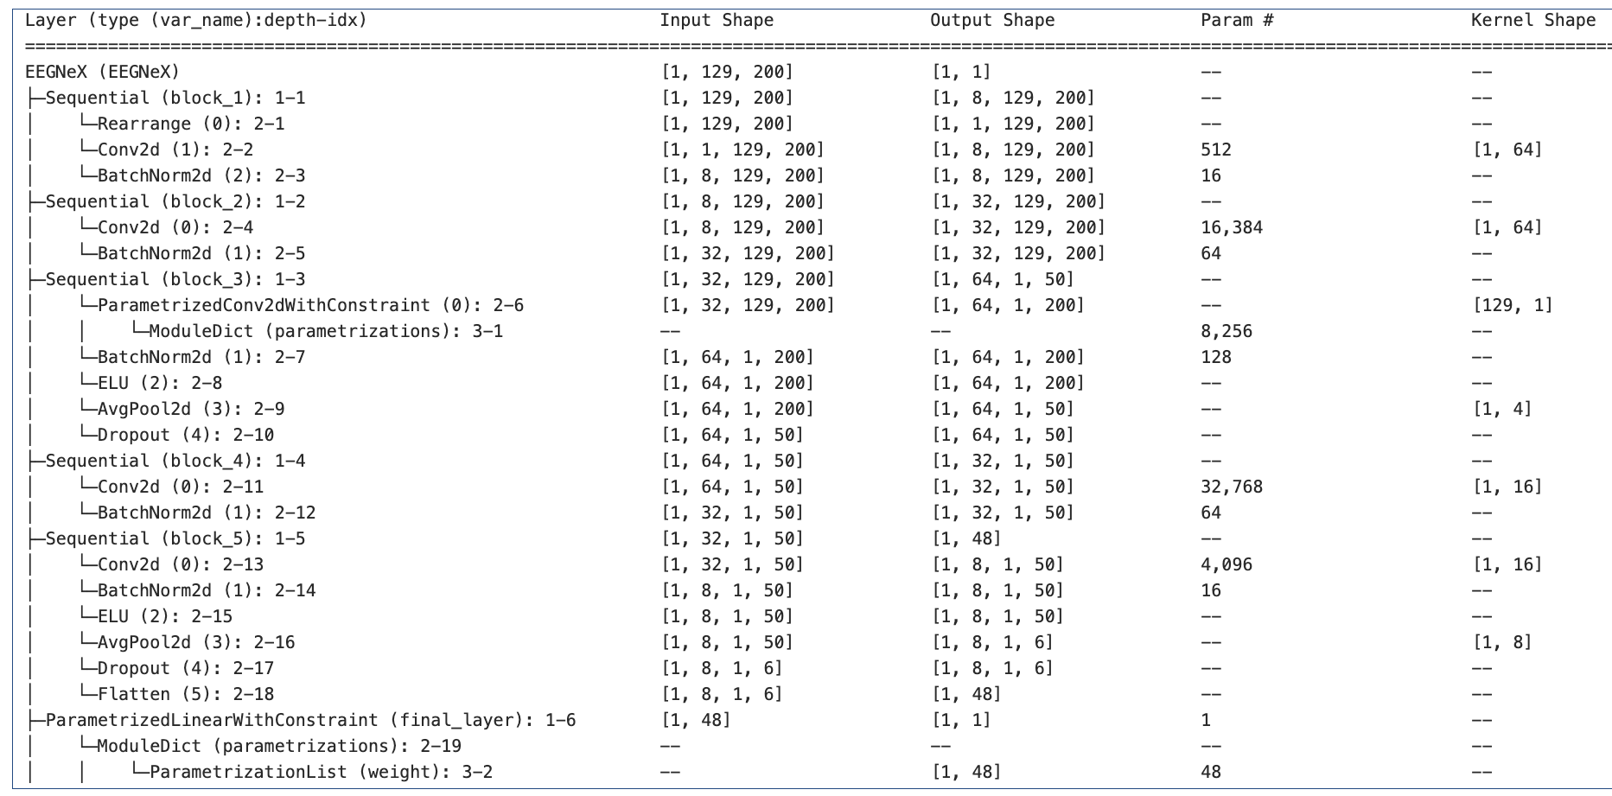
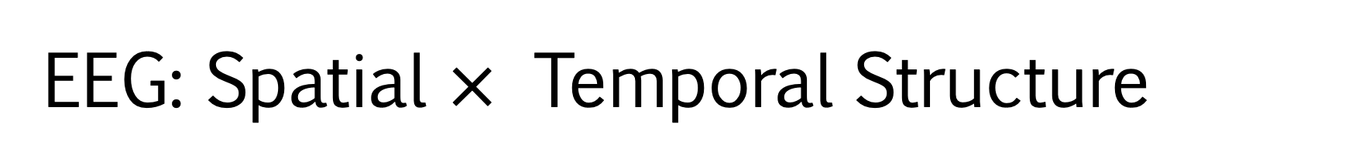
EEG: Spatial $×$ Temporal Structure
Encoder
Head

Slide 20
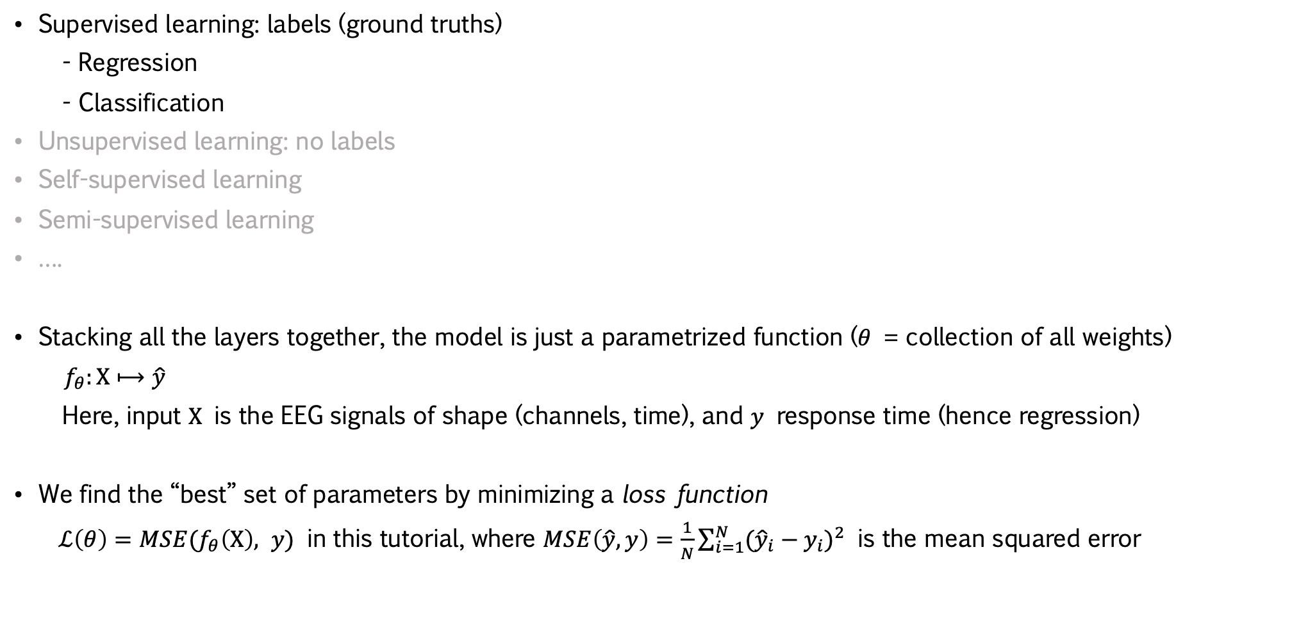
Training: How Does a Model “Learn”?
Supervised learning: labels (ground truths)
- Regression
- Classification
Unsupervised learning: no labels
Self-supervised learning
Semi-supervised learning
….
Stacking all the layers together, the model is just a parametrized function ($θ$ = collection of all weights)
$f_{θ}:X⟼\hat{y}$
Here, input $X$ is the EEG signals of shape (channels, time), and $y$ response time (hence regression)
We find the “best” set of parameters by minimizing a loss function
$ℒ\left(θ\right)=MSE(f_{θ}\left(X\right), y)$ in this tutorial, where $MSE\left(\hat{y}, y\right)=\frac{1}{N}\sum_{i=1}^{N}{{({\hat{y}}_{i}−y_{i})}^{2}}$ is the mean squared error

Slide 21
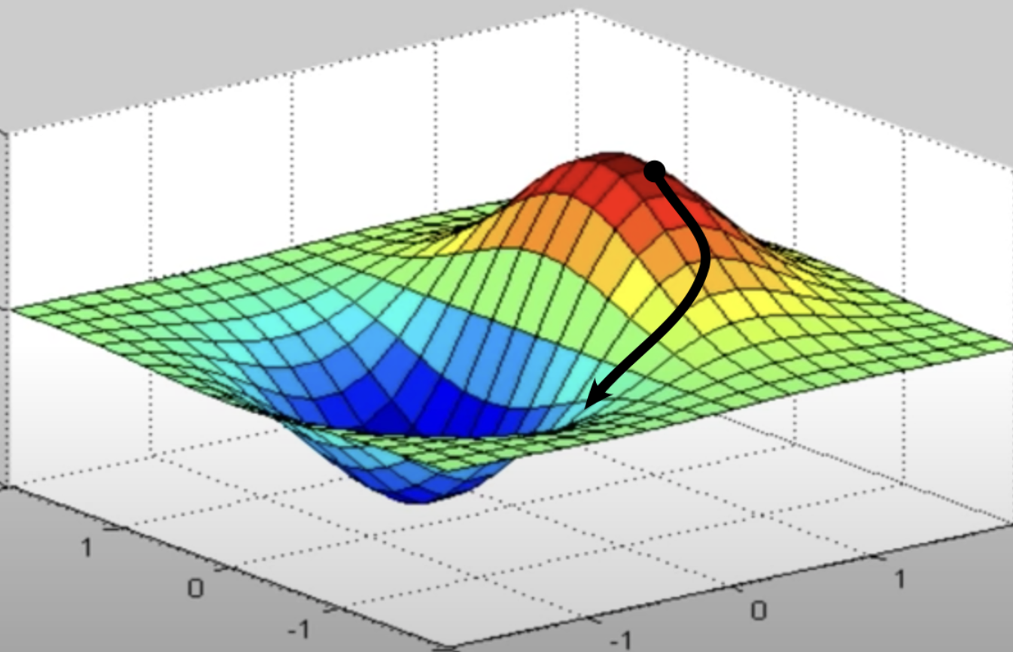
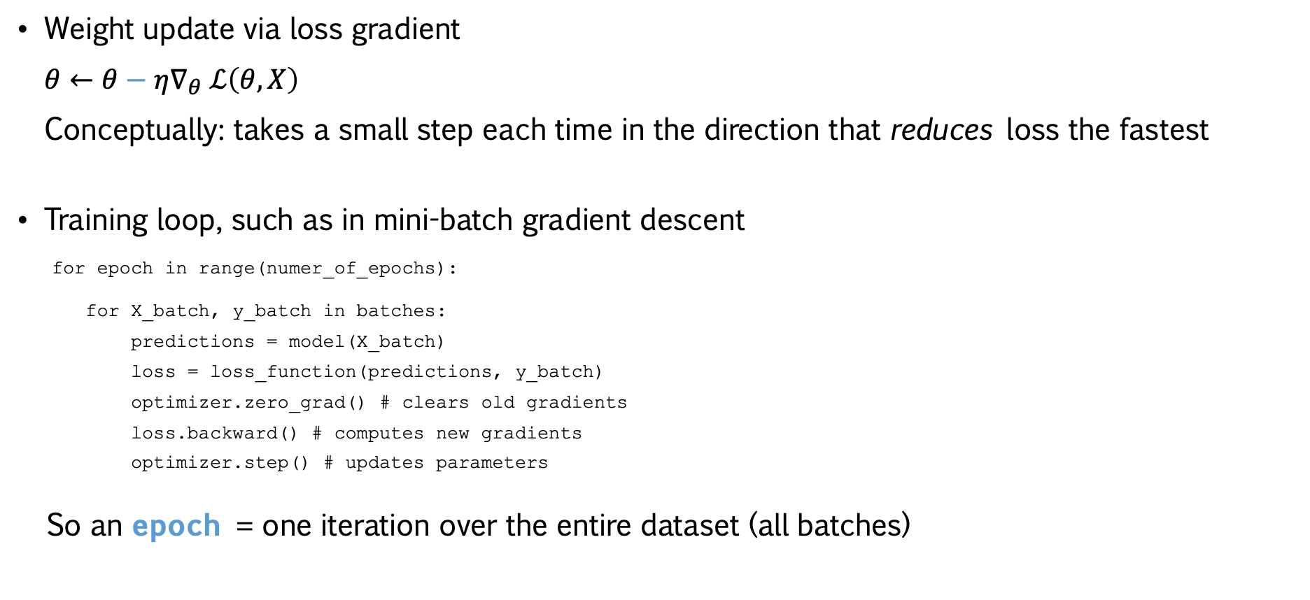
Training: Gradient Descent
Weight update via loss gradient
$θ←θ−η∇_{θ}$ $ℒ\left(θ, X\right)$
Conceptually: takes a small step each time in the direction that reduces loss the fastest
Training loop, such as in mini-batch gradient descent
for epoch in range(numer_of_epochs):
for X_batch, y_batch in batches:
predictions = model(X_batch)
loss = loss_function(predictions, y_batch)
optimizer.zero_grad() # clears old gradients
loss.backward() # computes new gradients
optimizer.step() # updates parameters
So an epoch = one iteration over the entire dataset (all batches)

Slide 22
Training: Dataset Splits, and Why
Training set (where the model learns weights)
Forward pass: makes predictions
Weight updates through backpropagation
Validation set (best setting selection, used repeatedly)
Forward pass only: makes predictions, no weight updates
Hyperparameter tuning, e.g., learning rate
Regularization, e.g., early stopping
Test set (final exam, used once at the end)
Forward pass only: makes predictions, no weight updates
Evaluation

Slide 23
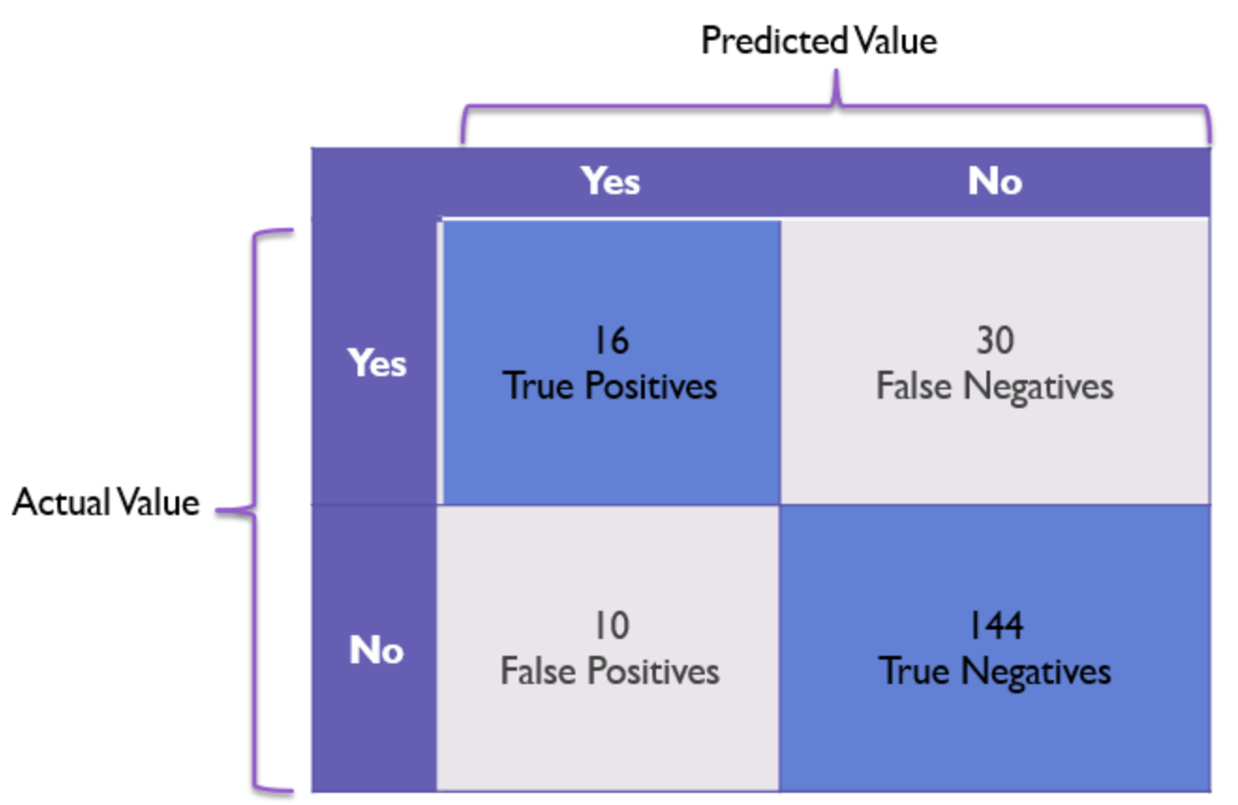
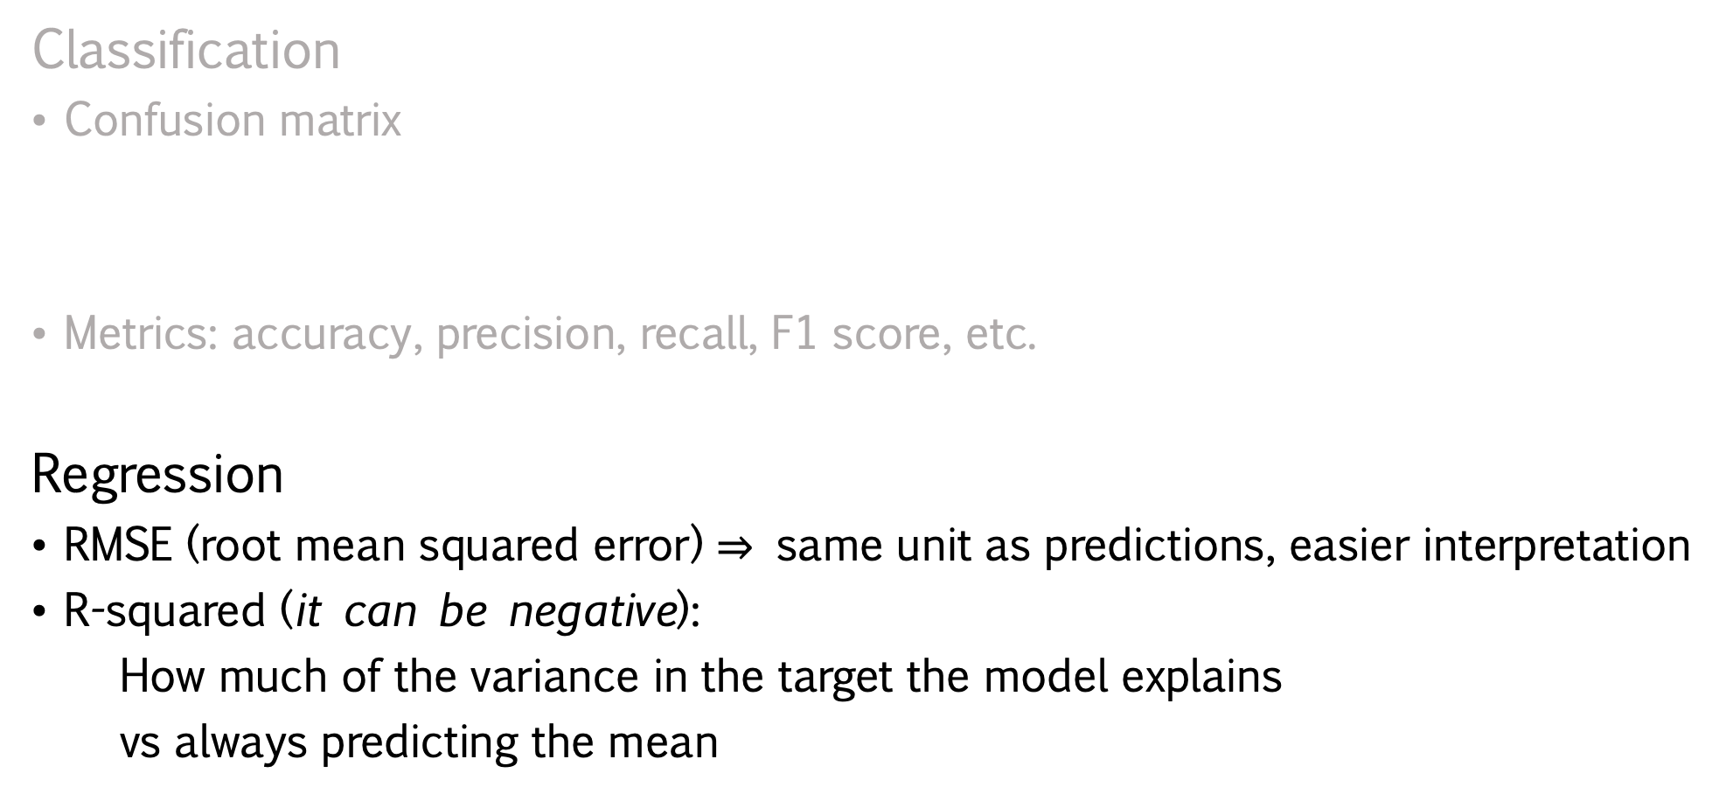
Evaluation
Classification
Confusion matrix
Metrics: accuracy, precision, recall, F1 score, etc.
Regression
RMSE (root mean squared error) $⇒$ same unit as predictions, easier interpretation
R-squared (it can be negative):
How much of the variance in the target the model explains
vs always predicting the mean

Slide 24
How This Actually Runs on
a Computer: Enough Slides, Summon the Code

Slide 25
That’s All from My Neurons
— Thanks for Staying in Phase ☺
Now Let’s Fire Some Questions!

