Slide 1
Predicting future stock price of Microsoft Micro Project #3 Microsoft Stock Data | Kaggle
Amanda Lovell

Slide 2
Flowchart
Select Analytical Technique
Multiple Linear Regression
Select Estimator
Import ‘LinearRegression’ from Scikit-learn
Split Data for Training & Testing
Split dataset in two train and test
Train the Estimator
Train using training data
Assess Models Performance
Mean Absolute Error
Mean Square Error
Root Mean Square
Visualize Expected vs Predicted Prices
Test the Estimator
Predict using test data

Slide 3

Import Library

Slide 4
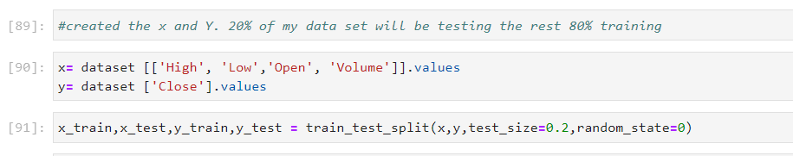
Split the Data

Slide 5
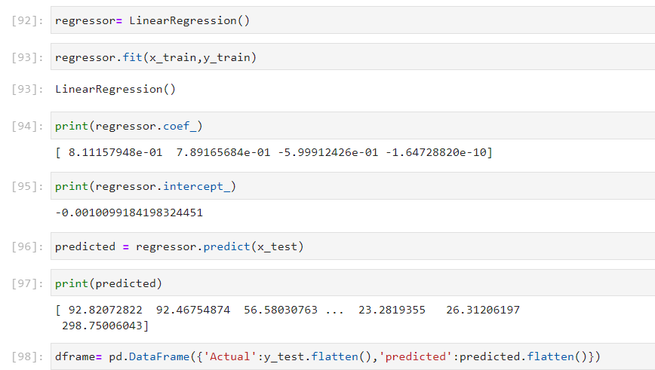
Train Data

Slide 6
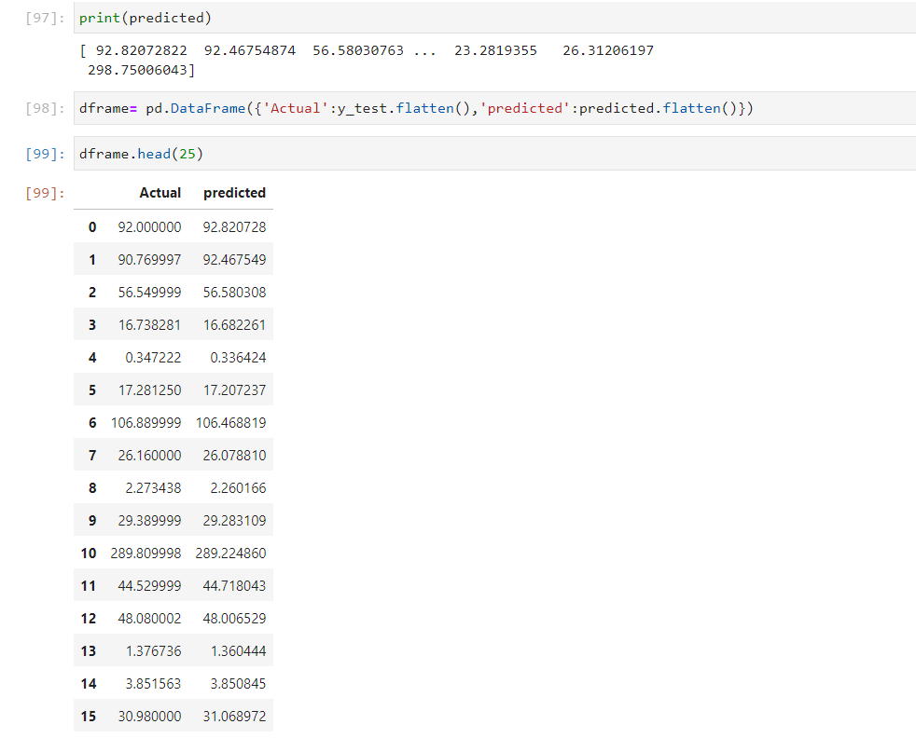
Predict vs Actual
We see here the predicted vs the actual and that based on the output predicted appears to be very close to the actual therefore by looking at this I would say its pretty accurate

Slide 7
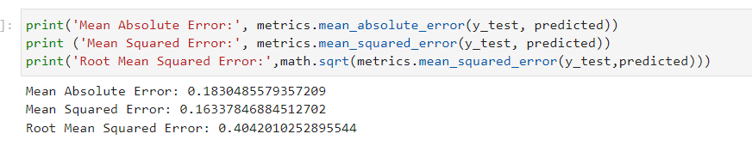
Assessing Model Performance
By taking a look at this out put the one you really want to take a look at the RMSE (Root Mean Squared Error) you want it to be below 10 therefore the lower it is the better and it is very low therefore making my data very accurate

Slide 8
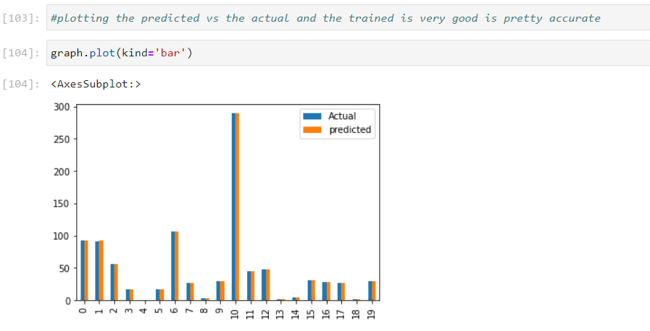
Assessing Model Performance Continued…
By taking a look at the bar graph we see the actual and predicted are very close to each other therefore making my training data pretty accurate

