Slide 1
Batman vs Superman Micro-Project 4-Machine Learning Batman-VS-Superman | Kaggle
Amanda Lovell

Slide 2
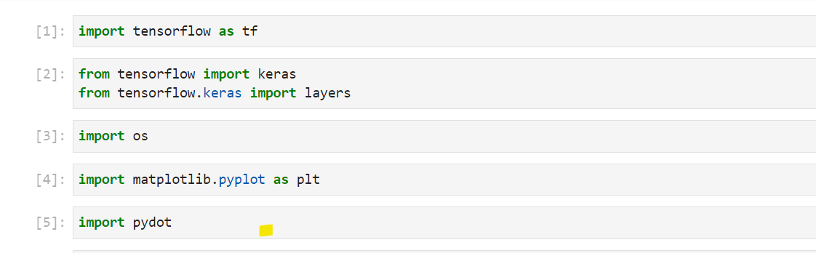
Import Library

Slide 3
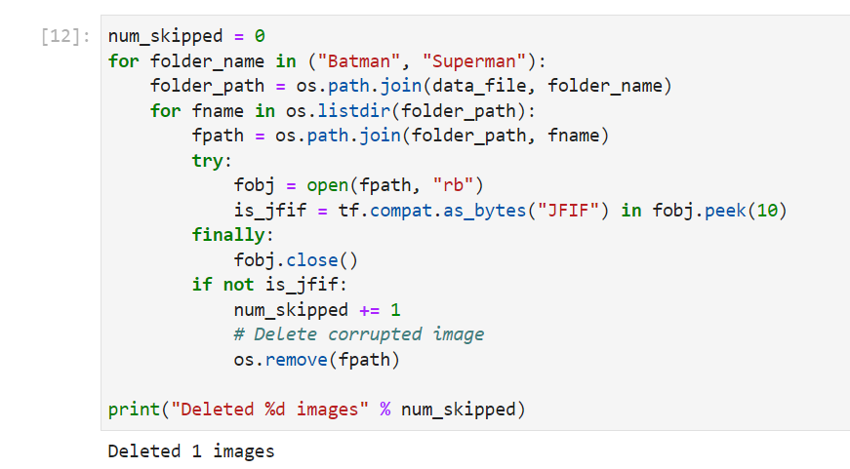
Get rid of any images that are damaged

Slide 4
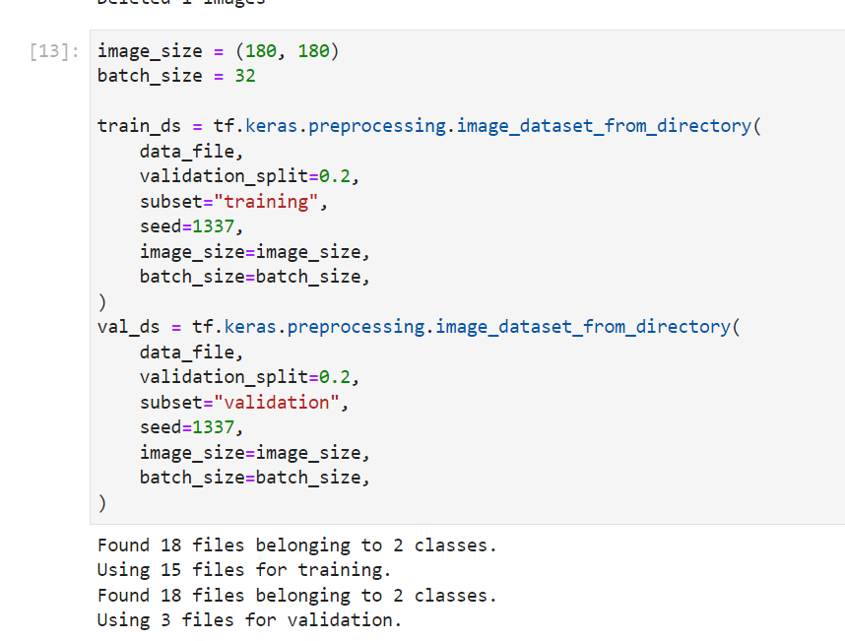
Splitting the data

Slide 5
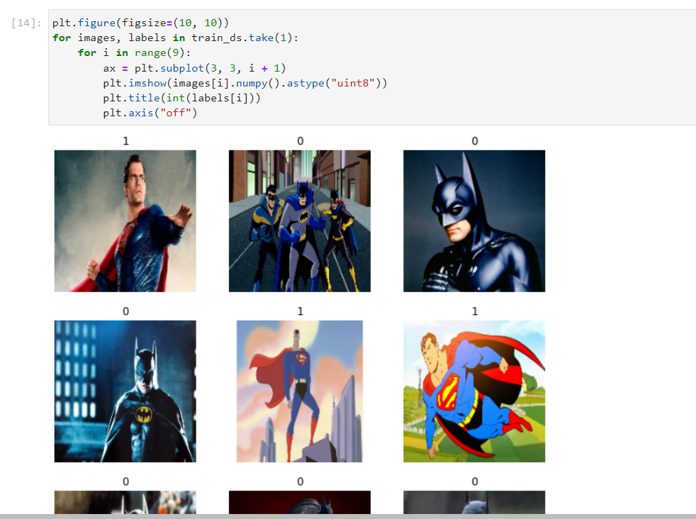
Showing the first 9 images in dataset

Slide 6
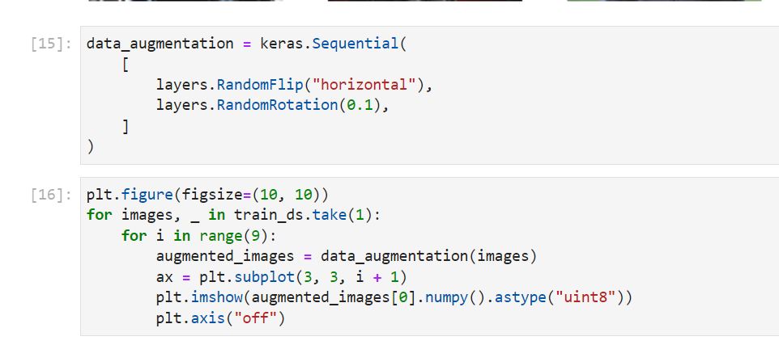
Augmenting Images

Slide 7
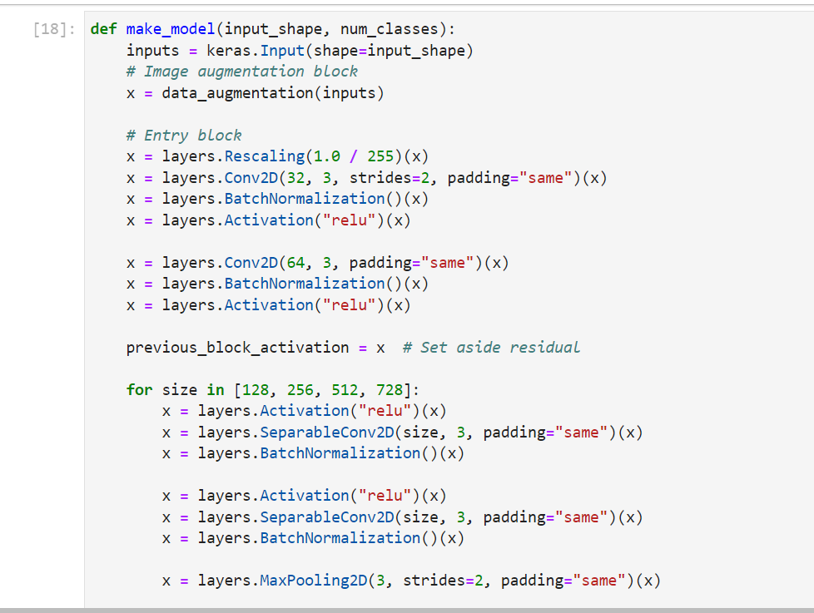
Creating Model and creating layers

Slide 8
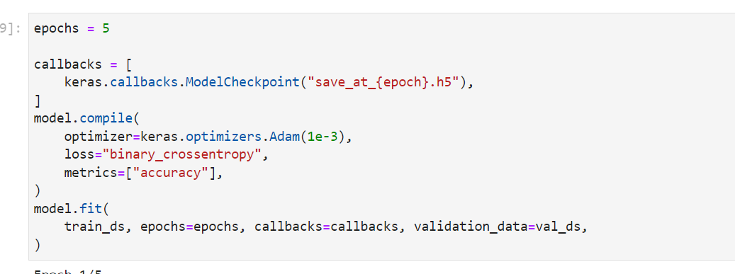
Testing Trained Data

Slide 9
Conclusion
There was not enough data to come up with a more accurate model. More data is needed actually since when the epochs were running the highest accuracy was no more than 69% therefore it is not the best trained data. This model will probably lack the ability to accurately make the distinction between a batman and a superman with only no more than a 70% accuracy.

