Slide 1
Cost of Homes In The United States USA Real Estate Dataset | Kaggle
Amanda Lovell

Slide 2
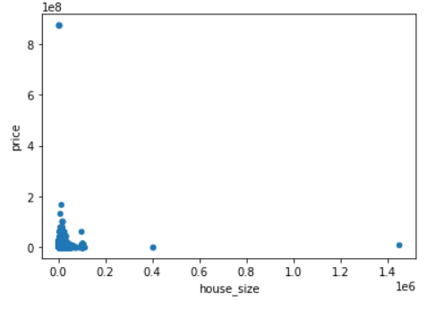
House Size vs Price
When taking a look at the scatter plot we see a couple of outliers for both price and house size. It appears most homes are below 0.2 in size and most homes tend to cost in the $200,000 or so by taking a look at this I would say something is wrong we might have a lot of missing values no home cost 0.

Slide 3
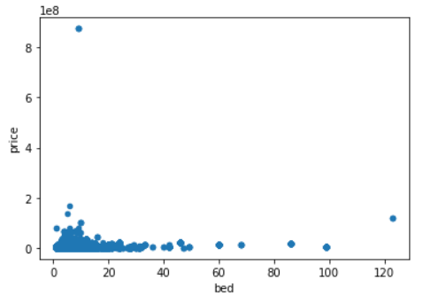
Bed vs Price
Taking a look at the scatter plot for bed and price most homes only have 4 bedrooms or below some 6, 8, 10 or 12 but those are your outliers. Again most homes cost below $200,000 we have an outlier for price that’s above the $800,000. We have homes sitting at the 0’s therefore we probably have missing values

Slide 4
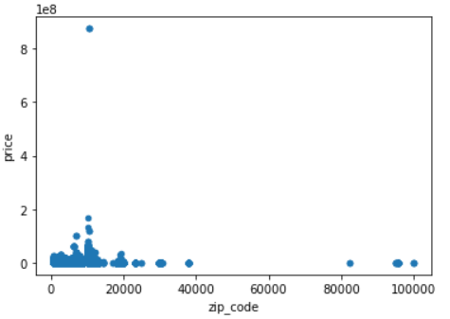
Zip_Code vs Price
We see a few outliers when it come to price and zip code again we have a few in 0s therefore there is a few missing values but regardless of the zip code home prices are $200,000 or below.

Slide 5
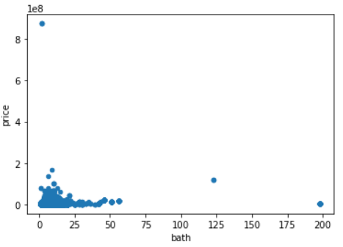
Bath vs Price
Most homes have no more then 5 baths anything above that is an outlier it seems and again price is $200,000 or below which is where we see the cluster we have a few 0s which again can signal missing values.

Slide 6
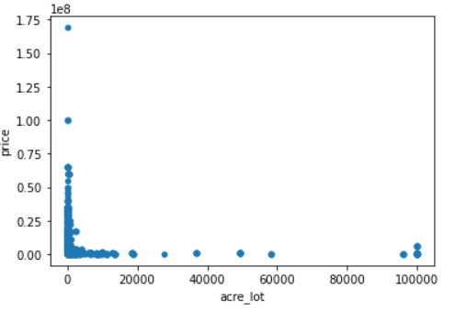
Acre_lot vs Price
When we take a look at this we see that most homes are below 2 acres and the priced tends to be below the $150,000 any acre above 2 we see are outliers by looking at the scatter plot.

Slide 7
Conclusion
When we take a look at all the graphs are right skewed they all have a couple of outliers the average cost of a home is $200,000 below even when you take or add baths, acres, size, rooms, and zip code.

