Slide 1
Modification of Membrane Materials in Carbon Capture
Sakura Science Program (Japan Science & Technology Agency): Amanda Huang

Slide 2
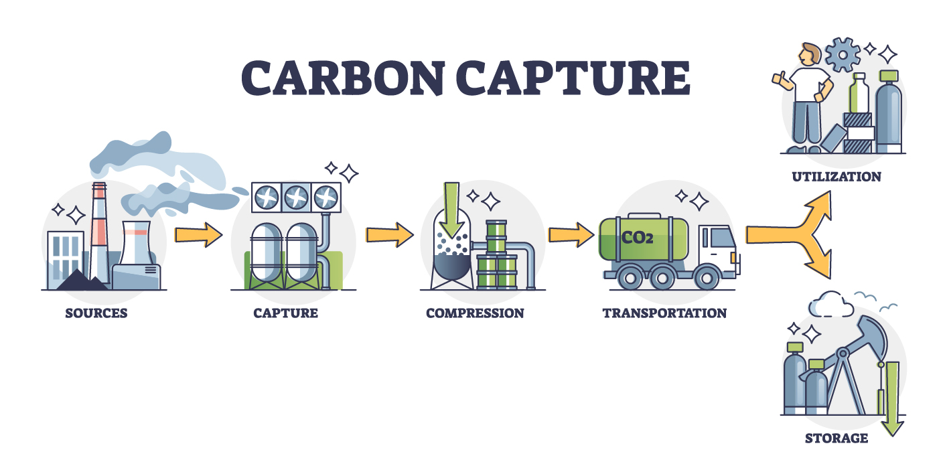
Carbon capture has the potential to decrease carbon emissions by reducing carbon dioxide levels AND using carbon as a renewable source of energy!
Currently our CO2 levels is 417 ppm → Scientists predict that 400 ppm was the tipping point.

Slide 3
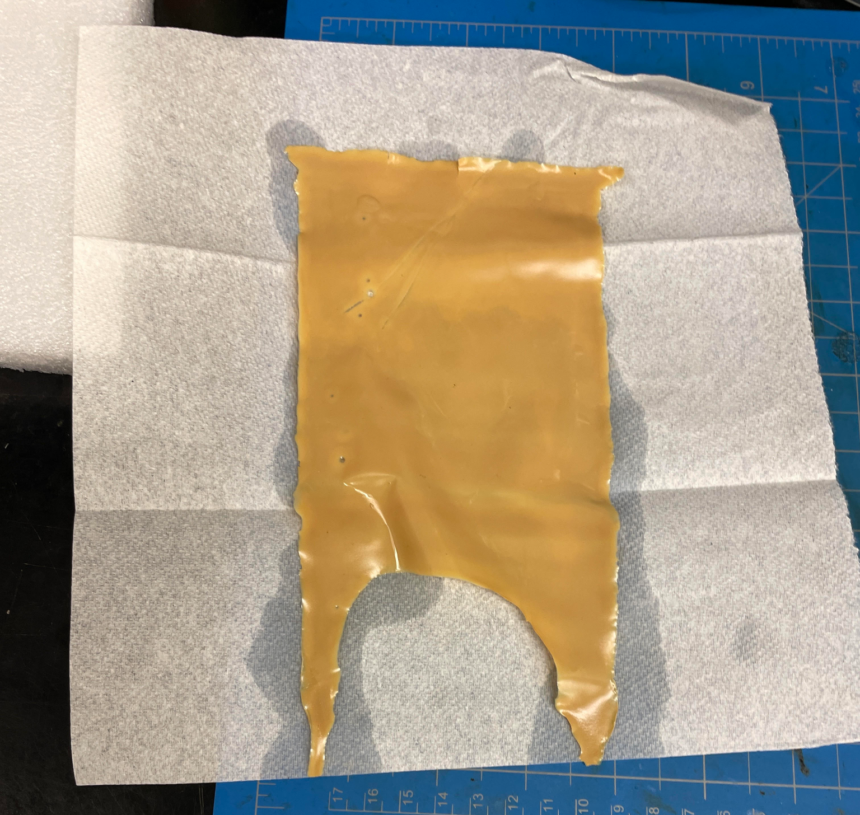
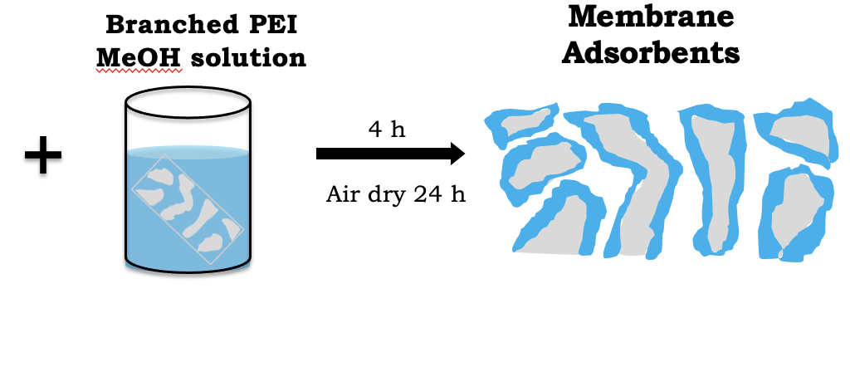

Modification of Sorbents
Sorbents
  Materials that can absorb carbon
  Ideally: Cheap, efficient, reusable, and require little to no energy.
Membranes:
Low resistance in gas transport
Light Weight
Porous

Slide 4
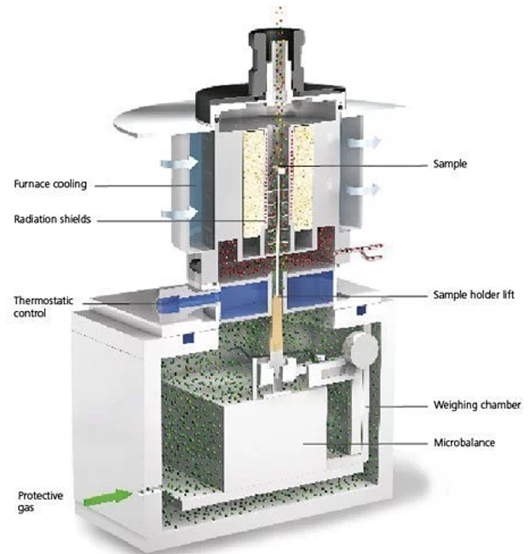
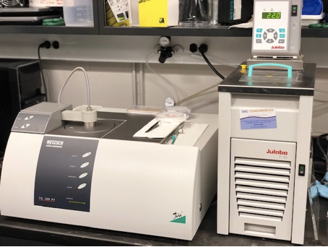
Use TGA (Thermogravimetric Analyzer) to measure sorbent’s performance in direct air capture.

Slide 5
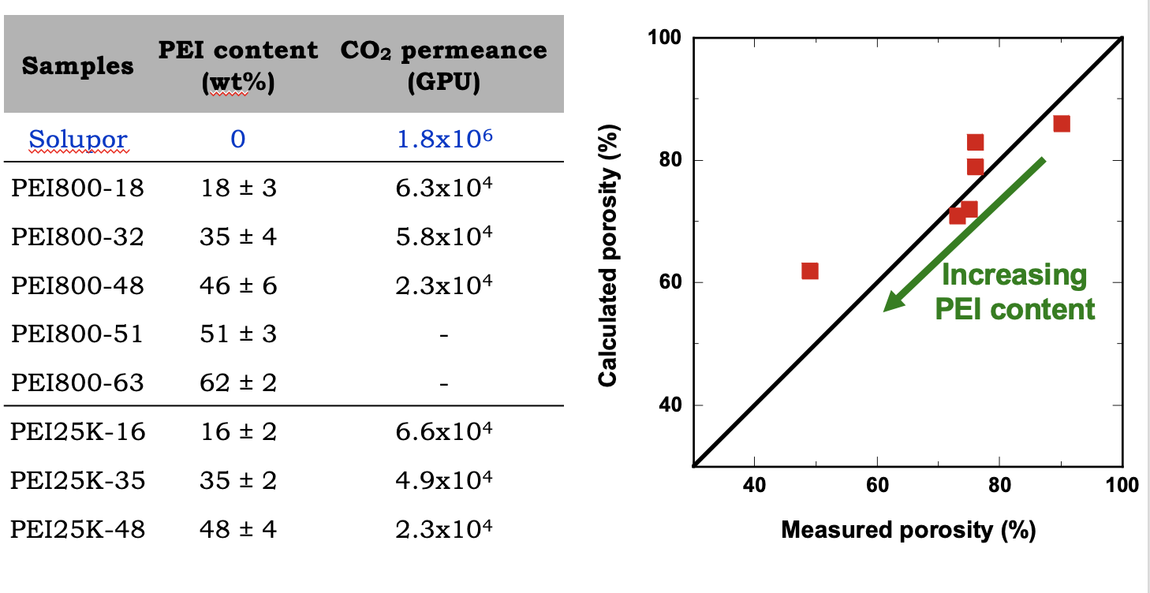
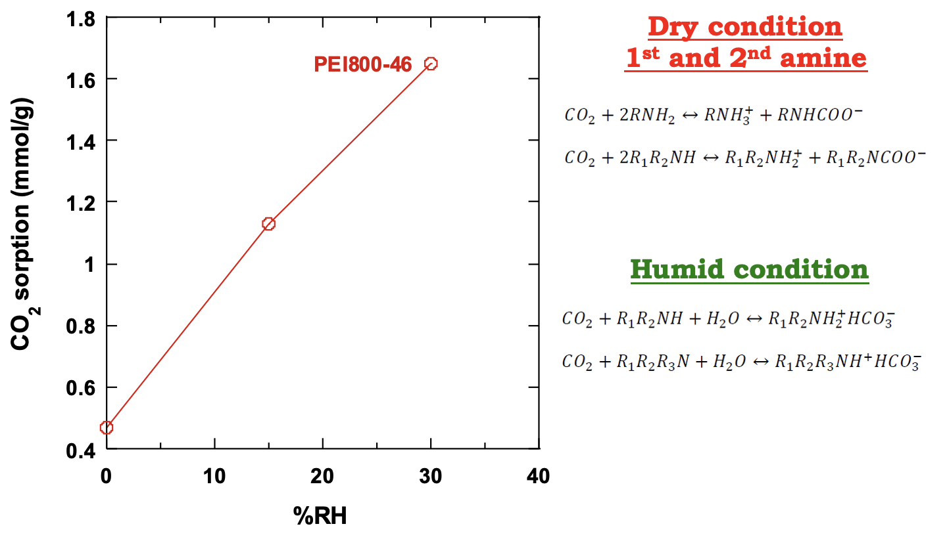
Multiple Factors

Slide 6
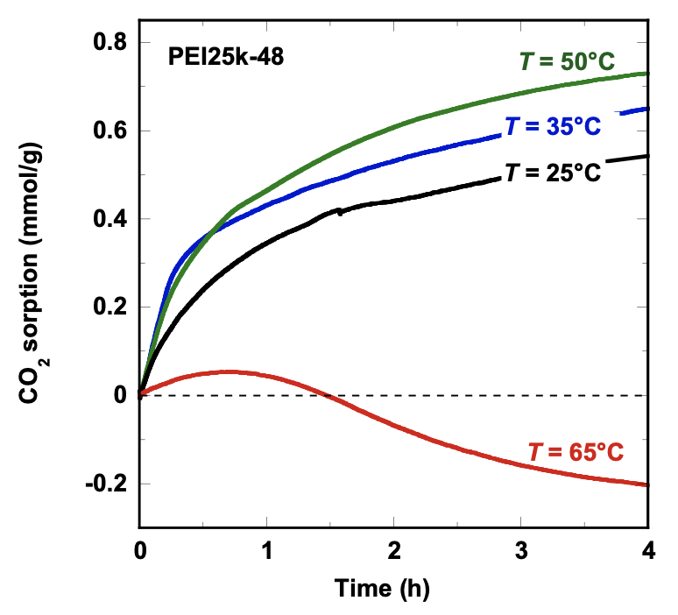
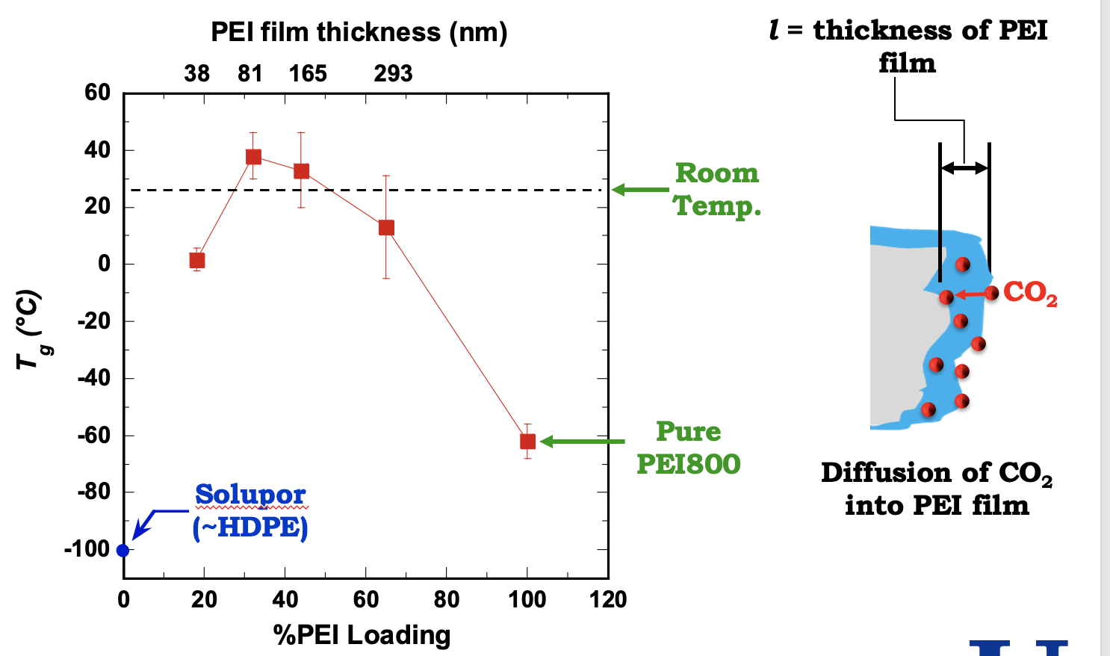
Multiple Factors

Slide 7
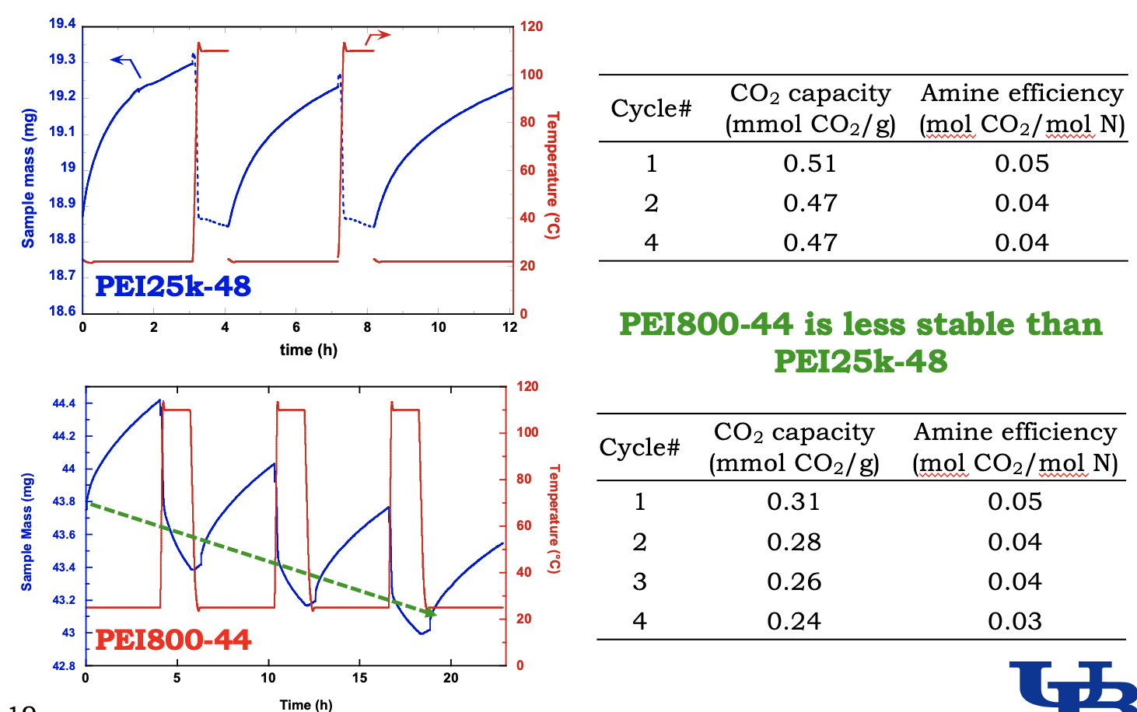
In dept

Slide 8
Conclusion
There is a lot of potential in Carbon Capture – especially if we want to decrease carbon emissions!
There are still many factors to figure out for making the most efficient, cheap, durable, and absorbent sorbent in carbon capture.

Slide 9
Thank you!
Many thanks to to the Lin Lab (University at Buffalo), the Japanese Science and Technology Agency, and Ritsumeikan High School for making this possible.

