Slide 1
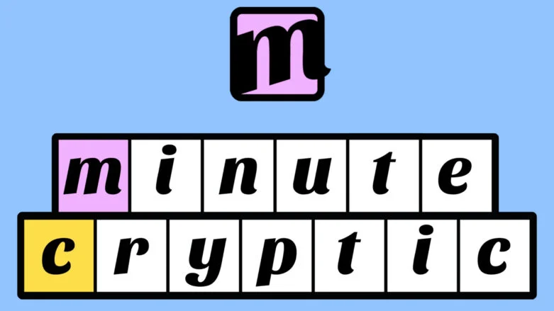
Presented By: Amanda Huang, Gbemiga Salu, & Miya Zhao
2025
d
e
c
r
y
p
t
e
r
Notes:
Miya

Slide 2
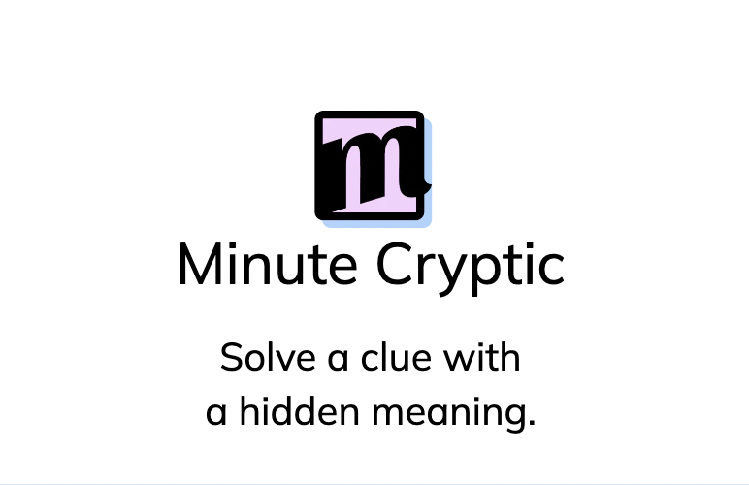
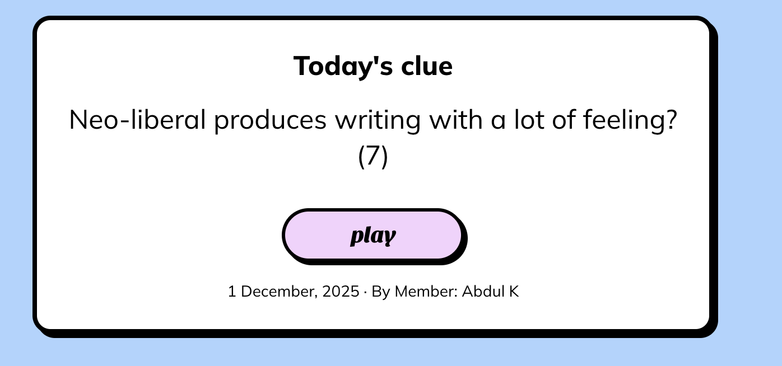
An Introduction

Slide 3
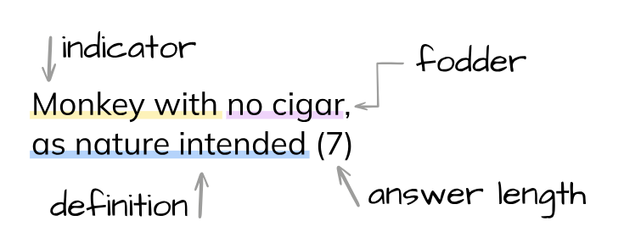
An Introduction
Minute Cryptic
  Crossword game that incorporates letterplay and wordplay to create a linguistic puzzle
  3 Components of a puzzle: Fodder, Indicator, and Definition
  Various types of puzzles (and combinations of puzzles!)
    Anagrams: Take some letters and scramble them to make a new word
    Selectors: Picking specific letters from each word
    Hiddens: Word is hidden amongst the clue
    And several more! Substitutions, Reversals, Homophones, etc!
Notes:
Amanda

Slide 4
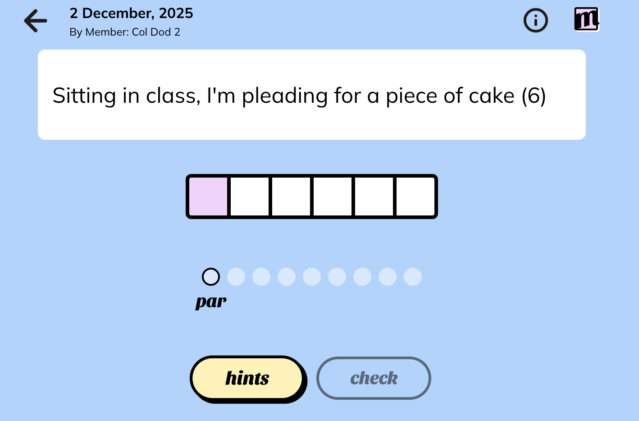
Introduction
Notes:
Amanda

Slide 5
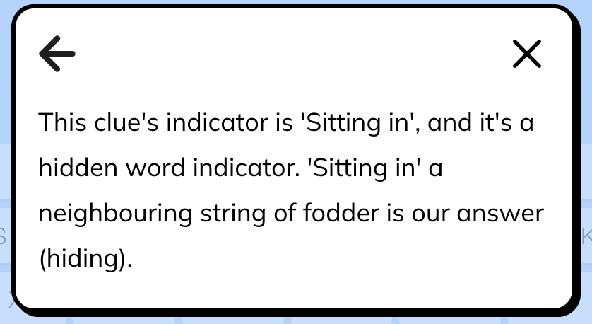
Introduction

Slide 6
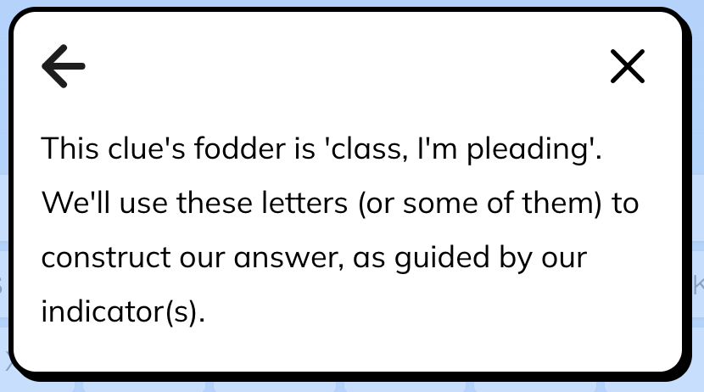
Introduction

Slide 7
Introduction

Slide 8
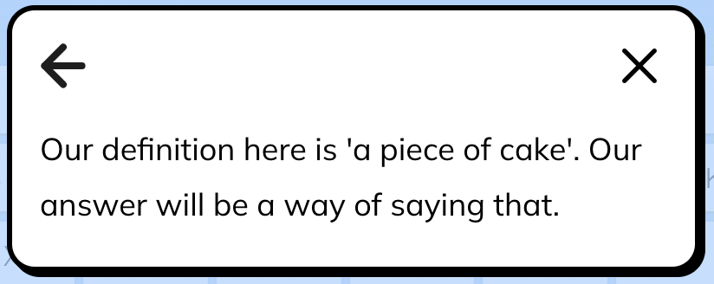
Introduction

Slide 9
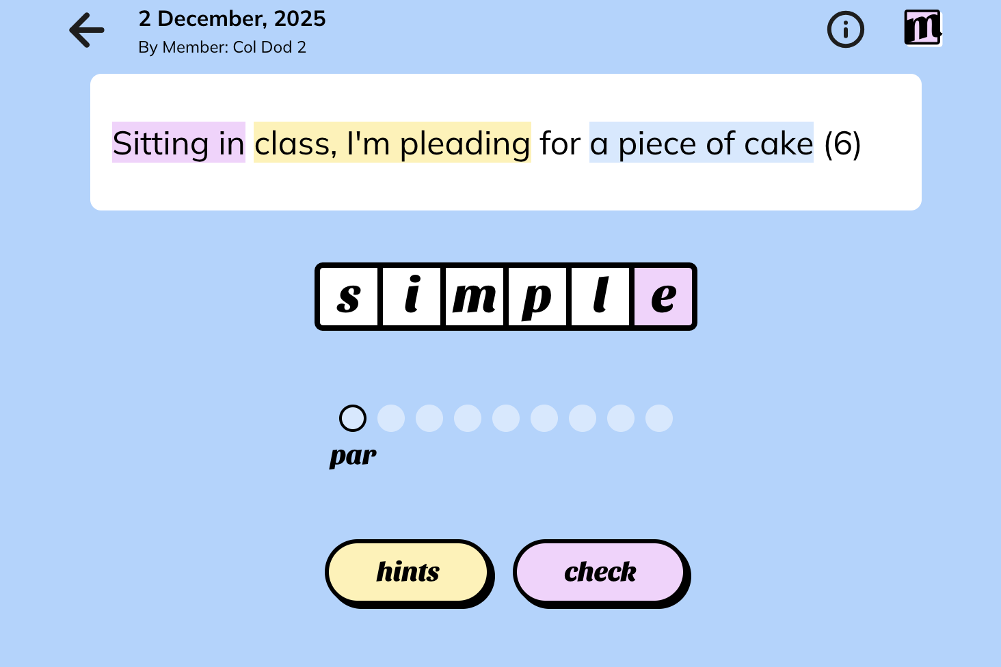
Introduction

Slide 10
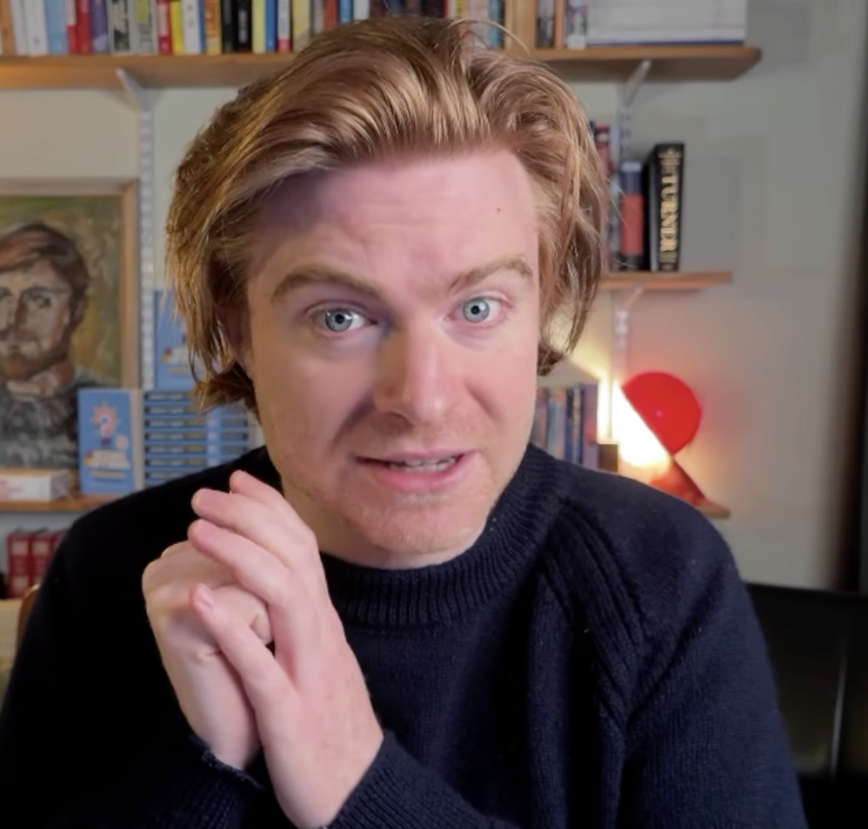
Objective
To create a program to solve
a minute cryptic clue
  First, by classifying the puzzle type given the indicator
  Then, producing potential answers via wordplay
  Eventually, using definitions, producing a most likely answer
Notes:
Gbemiga

Slide 11
Methods
Gather Minute Cryptic Data
  Compile a training set of ~30 acceptable puzzles
  Compile a test set of ~10 acceptable puzzles
Create a Classifier:
  Classify what type of puzzle we are attempting to solve using multinomial logistic regression (Sci-kit)
  Add features like Cosine Similarity, Length of Clues, and so on
Create a Solver:
  For every type of puzzle, we designed an algorithm to systematically solve for the correct solution
  N-grams, Word2Vec, Dictionaries…
Assign probabilities to potential answers
  Using cosine similarity between vectors for each candidate and the definition (average vector in the case of multi-word definitions)
Notes:
Gbemiga

Slide 12
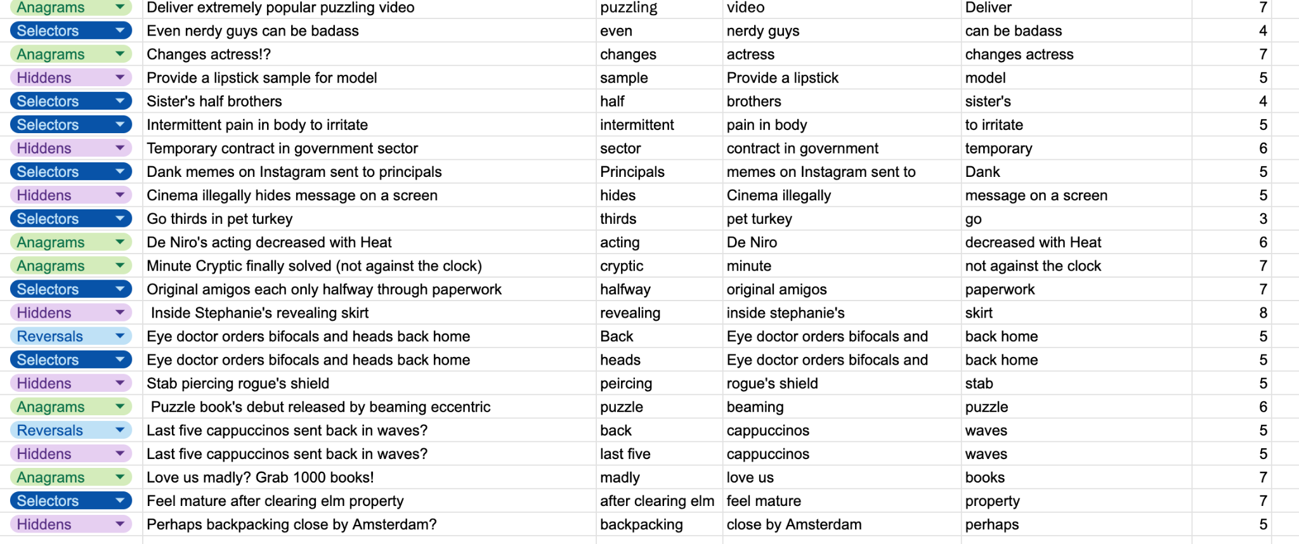
Data Gathering
Notes:
Miya

Slide 13
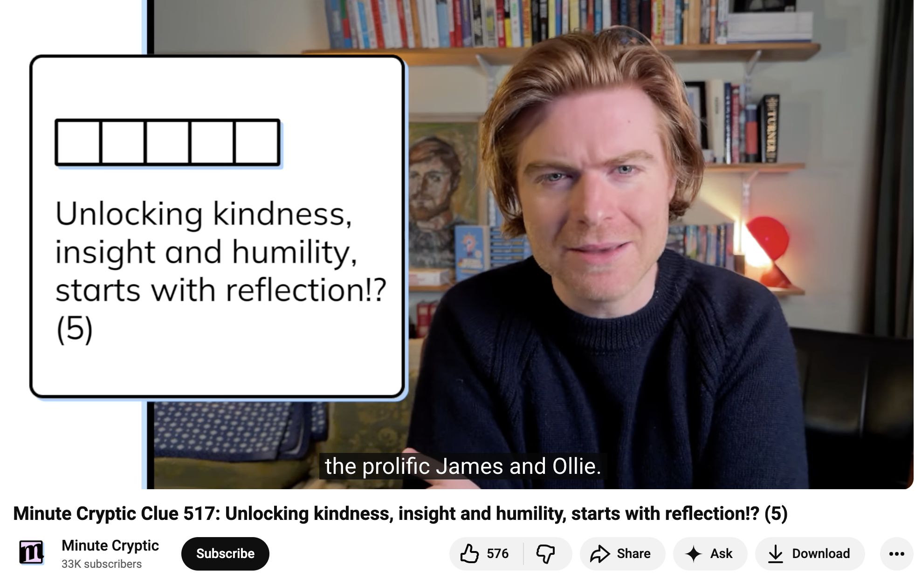
Data Gathering
Notes:
Miya - angus tiernan

Slide 14
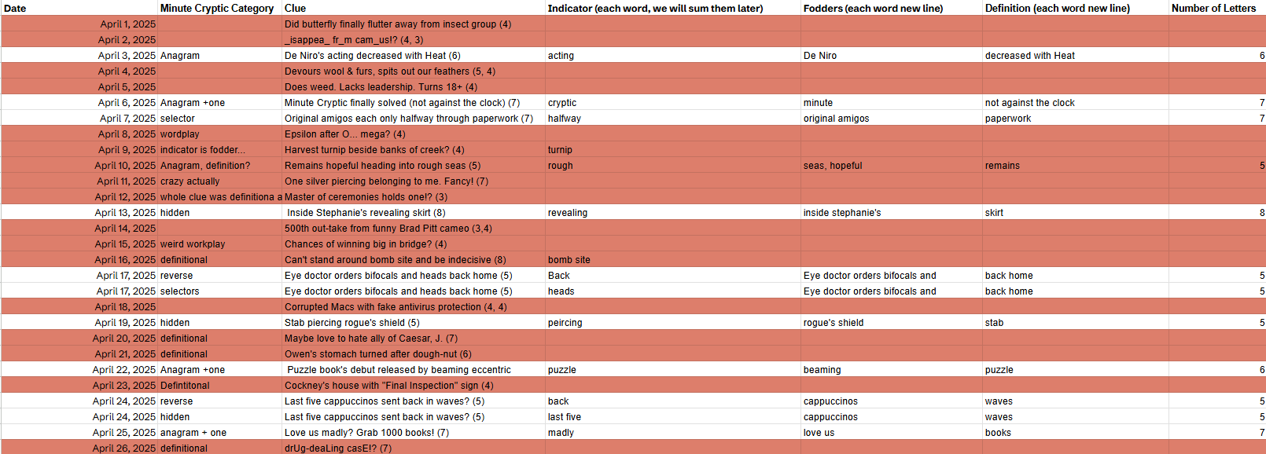
Data Gathering

Slide 15

Data Gathering

Slide 16
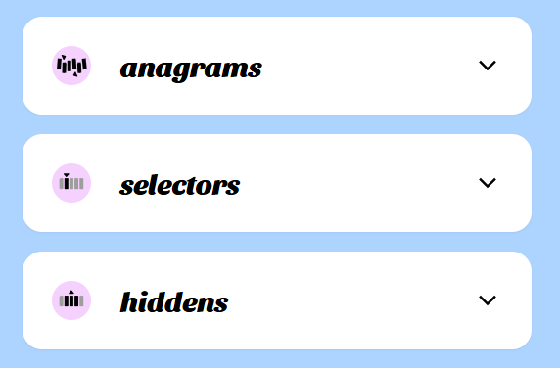
Indicator Cracker

Slide 17
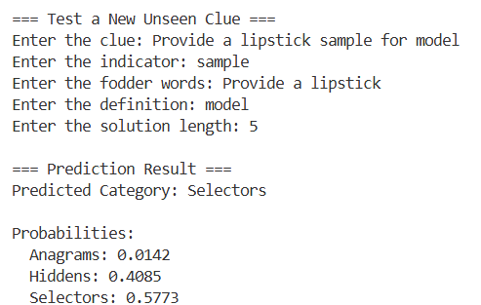
Indicator Cracker

Slide 18
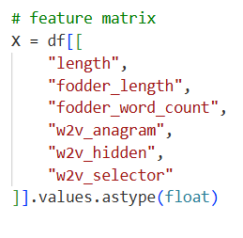
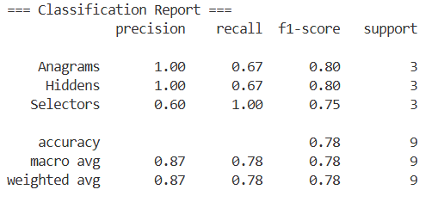
Indicator Cracker
Some pretty good results…

Slide 19
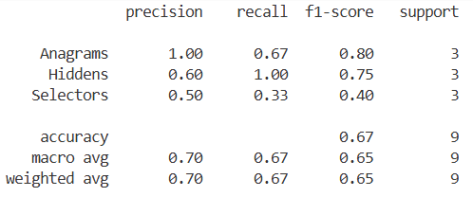
Indicator Cracker
We tried adding other features…
  But L2 complexity penalties stopped us in our tracks

Slide 20
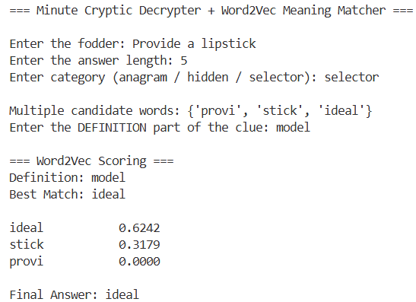
Algorithmic Solving!

Slide 21
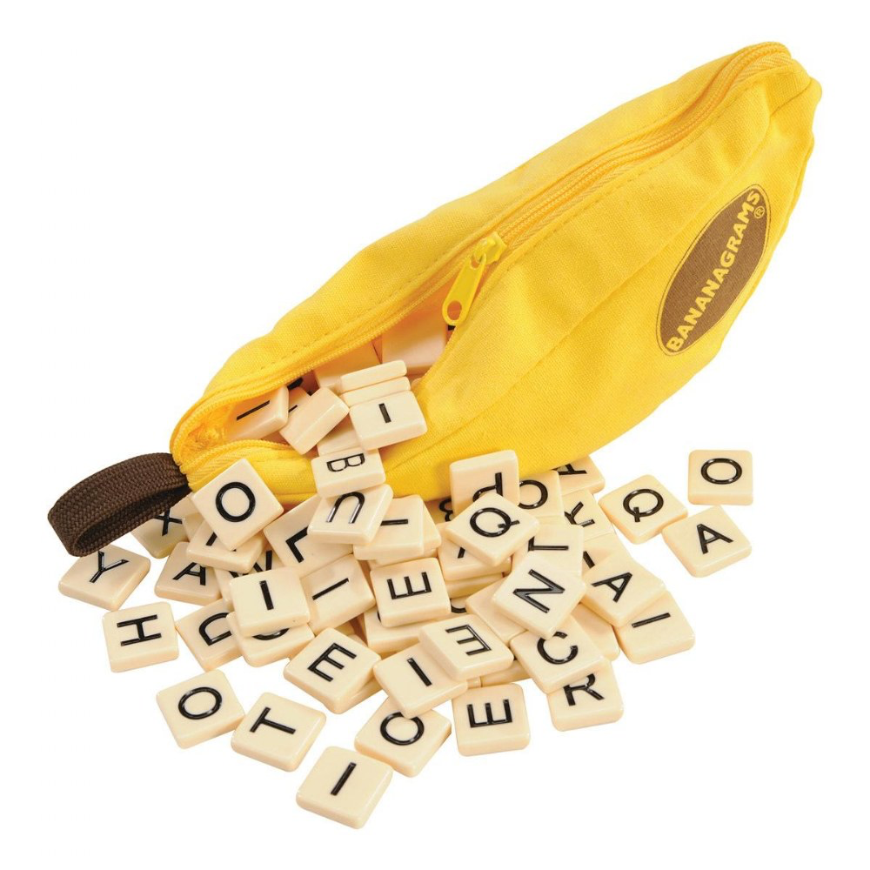
Anagrams
Step 1: Find all the anagrams of the fodder
Step 2: Filter the anagrams for “real” words
Step 3: find the “+1 variants” for each original anagram
Step 5: combine the filtered lists and remove the original fodder
Step 4: filter the variants
tea
atea
btea
ctea
…
aetx
aety
aetz
…
tea
atea
btea
ctea
…
aetx
aety
aetz
…
bate
…
eat
…
zeta
tea
tae
eat
eta
ate
aet
tea
eat
eta
ate
tea
Notes:
Gbemiga

Slide 22
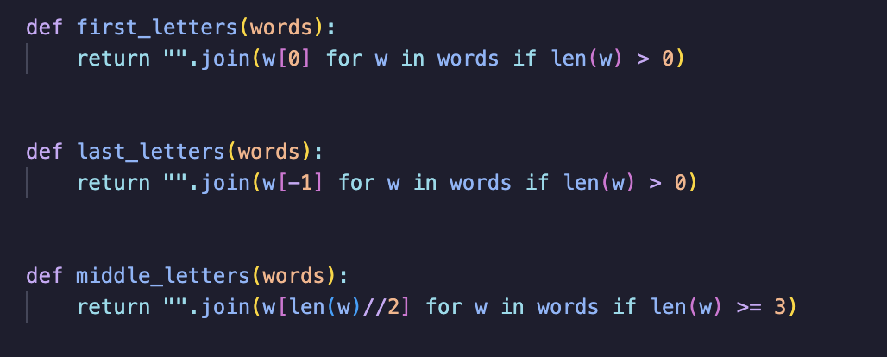
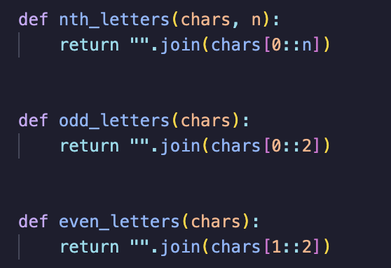
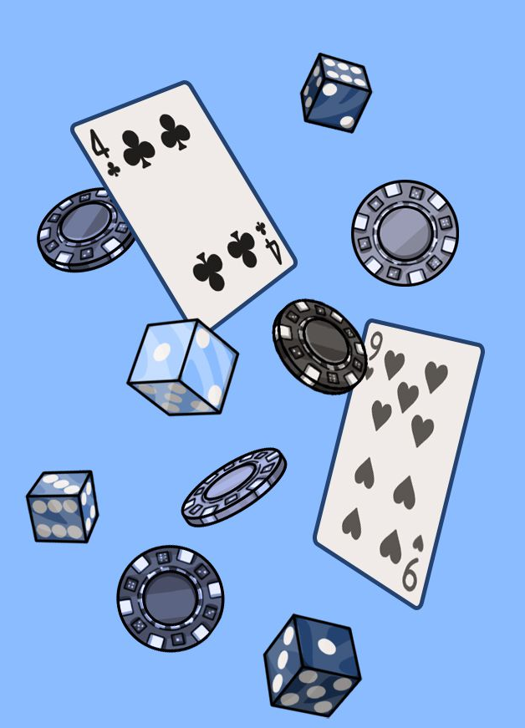
Selectors
Step 1: Find all the different types of “indicators” for selectors
Step 2: Create a list of all possible words based on all the clues
Step 3: Filter the list through the 100k most common words
half of a word
…
and so on
pibt
nidt
…
annoy
Intermittent pain in body to irritate (5)
annoy

Slide 23

Hiddens
Step 1: “clean” the fodder using regex
Step 2: Find all n-grams of the fodder length
Step 3: filter among the most most frequent 100k English word
“Temporary contract in government sector” (6)
{'acting','artnoc','cartno','contra',
'ctingo','emnrev','ernmen','evogni','
Gnitca','govern','ingove','itcart','mnrevo','nemnre','ngover','nitcar',
'nrevog','ntact','ognitc', 'ontrac', 'overnm', 'ractin','revogn','rnment', 'tcartn','tingov','tnemnr','tracti',
'vernme','vognit'}
contract in government
{'acting', 'contra', 'govern'}
"contract in government"
"contractingovernment"

Slide 24
Algorithmic Solving!
Notes:
Amanda

Slide 25
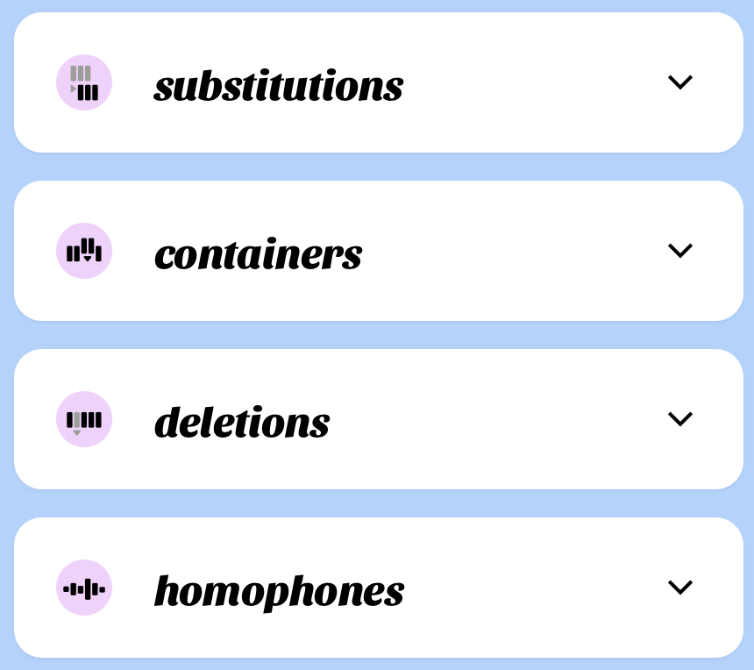
Potential Next Steps
Account for more puzzle types
  Definitional substitutions
  Multi-word answers
  Multiple indicators
Make the program figure out what the indicator, fodder, and definitions are on its own (part of speech tagging maybe)
Hyperparameter optimization in the machine learning (lambda smoothing)
Have a larger training set
Notes:
Gbemiga

Slide 26
The Conclusion
Thank You For Listening!
Questions?

