Slide 1
EZ-Merge
An AI powered website to log and detect anti-competitive mergers below the Hart-Scott Rodino threshold.
Micah Gold
Amanda Huang
Natalie Miller
Fiona Vitali
Maryanne Xu
Joanne Zhao
TAP @ Yale

Slide 2
Federal Merger Review Misses Harmful Local Consolidation
Current Regulatory Gap
Sectors Impacted by Unreviewed Small Mergers
Federal HSR Threshold ($133.9M):
Only large mergers reviewed federally
Small local acquisitions go unreviewed
Serial acquisitions are particularly problematic
Mini-HSR Acts, “Baby-HSR” Acts:
Onerous for small businesses
Costly to state agencies
Fail to distinguish between harmless transactions and potentially dangerous rollups
Dialysis Clinics: Unreviewed serial acquisitions by large chains create concentrated local markets linked to higher prices, lower quality of care, and increased patient mortality.
Pharmacies: Pharmacy benefit manager consolidation and vertical integration push independent pharmacies out of business, creating pharmacy deserts in rural and low income areas.
Nursing Homes: Private equity firms purchase nursing home properties and increase their real estate costs, leading to reduced staffing levels and higher mortality rates.
Child Care: Private equity-backed consolidation increase costs for families and lowered staffing stability, accessibility, and quality of care.
Funeral Homes: Corporate acquisition of independent funeral homes reduce competition in highly localized markets where families often have few nearby alternatives.
Grocery Stores: Mergers in concentrated grocery markets are associated with higher consumer prices, reduced product variety, and lower worker wages.
State AGs need more assistance in identifying potentially monopolistic mergers even if they fall below the HSR thresholds.

Slide 3
EZ-Merge
Step-by-Step Process
AG chooses an extended review
Clarifications
Acquisition involving in-state business activities occurs
Small business action
1. Extends waiting period by 60 additional days
1. Confidentiality: All submitted materials must be confidential, with permitted disclosure to:
FTC
DOJ Antitrust Division
State Attorney General
Judicial proceedings
2. Exemptions: The state can also exempt mergers from particular industries or backgrounds if it is less concerned about particular acquisitions.
It can also place higher boundaries to alert the state if a merger from a particular industry is merging, similar to Pennsylvania’s pending Mini-HSR act that prioritizes healthcare mergers.
→
2. Requires supplemental materials
Electronic filing through EZ-merge website
Small business action
→
Prohibits consummation without further written authorization.
15-day waiting period automatically begins
AG office action
AG does not choose an extended review
→
Does the AG issue extended review?
Parties may proceed
Yes or No,
Depending on whether the AG determines the acquisition may substantially decrease competition within the state.
Regardless of action, the Act preserves the AG’s authority to challenge the transaction later for any section of the Act or other law.

Slide 4
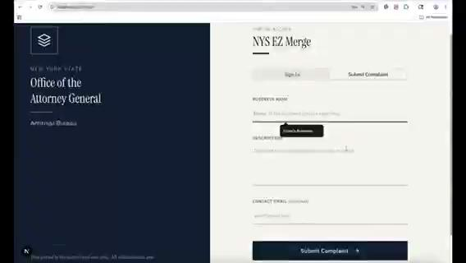
EZ-Merge Website Demo
TAP@ Yale

