Slide 1
Car Detection from Local Shape Information
Nov 5, 2014
Andrew Brethorst
Ronald Fitzgerald
Nehal Desai
Stuart Kerr
ACC Imagery Project

Slide 2
Data Set Generation
Image
.bpf + Image
Object Detection
x₀,y₀, long₀, lat₀, metadata₀
x₁, y₁, long₁, lat₁, metadata₁
.
.
x_{m}, y_{m}, long_{m}, lat_{m}, metadata_{n}
x₁,y₁, image_size₁
x₂, y₂, image_size₂
.
.
x_{n}, y_{n}, image_size_{n}
x₁,y₁, long₁, lat₁, z₁, I₁, image_size₁, metadata_₁
x₂, y₂, long₂, lat₂, z₂, I₂, image_size₂, metadata_₂
.
x_{n}, y_{n}, long_{n}, lat_{n}, z_{n}, I_{n}, image_size_{n}, metadata__{n}

Slide 3
Overview
Car Detection from Satellite Images
Proposed Solution: Phase Symmetry
Preliminary Results
Challenges
Future Work

Slide 4
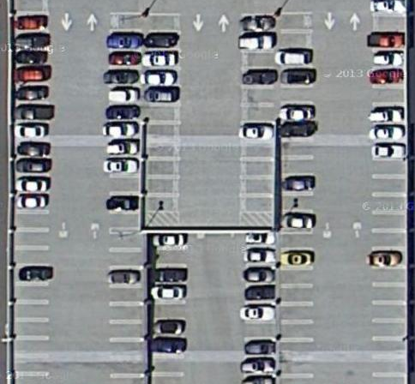
Objective: Car Detection from Satellite Imagery
Develop a method that can accurately identify vehicles from satellite images
Several different approaches
Blob detection
Machine learning
Bayesian Networks

Slide 5
Proposed Solution: Local Shape Information from Phase Symmetry

Slide 6
Proposed Solution: Local Shape Information from Phase Symmetry

Slide 7
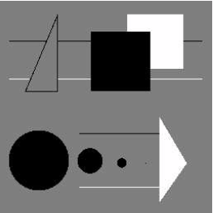
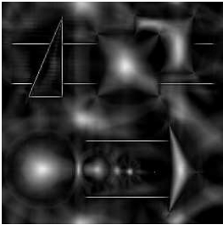
Proposed Solution: Local Shape Information from Phase Symmetry
Man made objects tend to be highly symmetrical
Utilize symmetry information to identify blobs or regions of interest
Accept/reject detected blobs based on local shape information
Tolerant of illumination and contrast changes
Simple, paramaterizable, embarrassingly parallizable
No machine learning required

Slide 8
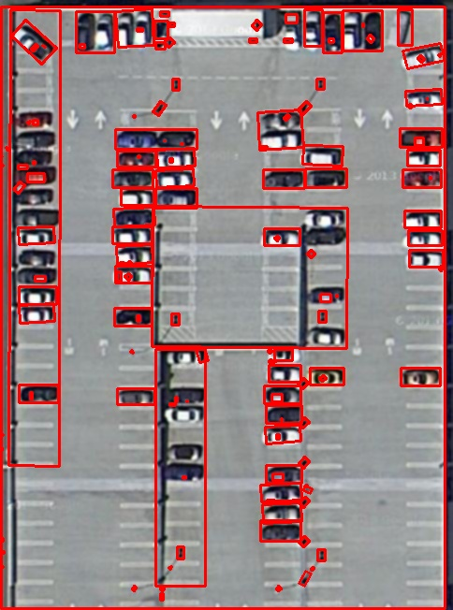
Benchmark: Vanilla Blob Detection
“No thought required” blob detection using OpenCV
Useful for benchmarking progress
47/72 = 65% Hit rate
Unfiltered Blob Detection

Slide 9
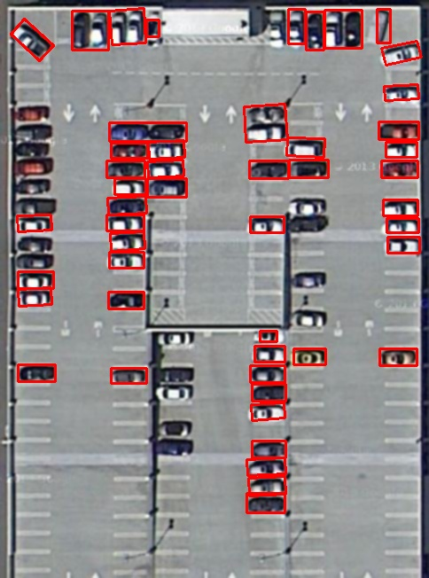
Benchmark: Vanilla Blob Detection
“No thought required” blob detection using OpenCV
Useful for benchmarking progress
47/72 = 65% Hit rate
Filtered Blob Detection

Slide 10
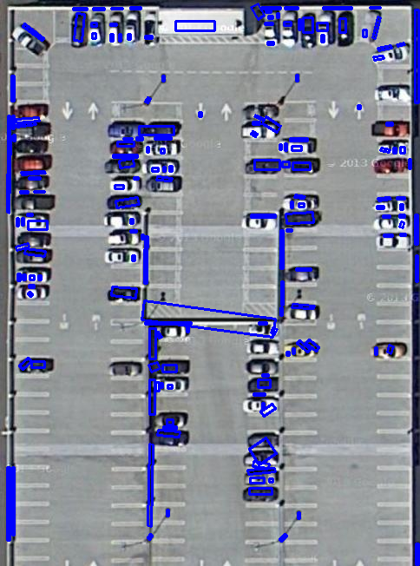
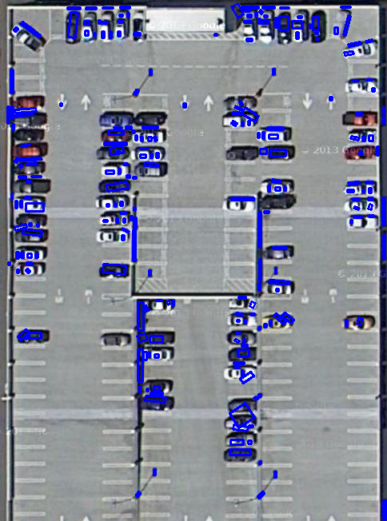
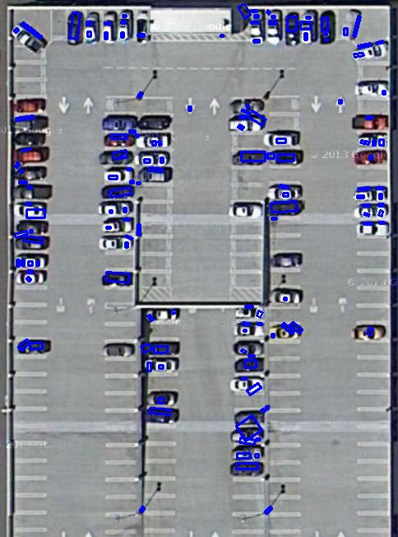
Preliminary Results
65% Hit
37% Accurate
77% Hit
37% Accurate
83% Hit
57% Accurate
Initial
Current

Slide 11
Challenges
Illumination and contrast
Parameter tuning
Sparse literature
Majority of literature covers machine learning
Multi-staged Filter
Objects not detected early will not be detected later

Slide 12
Future Work
Histogram Comparison
Blob Merging
Final Verification
(x,y) → (lat,long)

