Slide 1
UTSA CS 4593: CS-CURE
Course-based Undergraduate Research Experience in CS
Amanda Fernandez, Ph.D
UTSA Department of Computer Science
Spring 2024

Slide 2
Week 10: Conferences & Journals

Slide 3
UTSA CS-CURE
Week 10
Objectives:
Understand the publication process in CS
Learn from expert(s) in diverse fields within CS
Deliverables:
Guest Lecture Survey (in-class Thursday)

Slide 4
Publishing

Slide 5
Publication Review Process
General overview
Paper preparation
Review
Revisions / Rebuttals
Notifications
More on this in week 12!

Slide 6
Conferences vs. Journals
Peer-reviewed publication venues
Feature | Conferences | Journals
Frequency | Held annually or bi-annually | Published regularly (monthly, quarterly, etc.)
Paper Length | Shorter (4-10 pages initial work) | Longer (14+ pages, extends initial work)
Turnaround Time | Faster (typically a few months for notification) | Slower (can take up to a year or more for final decision)
Presentation Format | Oral presentations, posters, demonstrations | N/A
Benefits of Participating | Networking, staying current in the field, permanent record | Building reputation, permanent record
Cost | Registration fees, travel expenses (if attending in person) | Author processing charges (for some open-access journals)

Slide 7
Measuring Impact
H-Index, Impact Factor
Metrics attempt to quantify individual researcher productivity as well as the overall impact of a publication source.
Conferences use h-index (h publications have at least h citations)
Journals use impact factor (# of citations in the last 2 years / # of citable articles published in the previous 2 years)

Slide 8
Journals
In CS
Peer-reviewed publications that archive & disseminate research findings.
Publication process:
Manuscript preparation
Peer review
Revise & resubmit
Notification of acceptance
Publication

Slide 9
Predatory Journals & Conferences
What to watch out for
Entities that prioritize self-interest and financial gain over scholarly merit and the advancement of knowledge.
Why to avoid them:
Damage to academic/professional reputation
Disseminate unreliable information
Waste time & resources

Slide 10
Predatory Journals & Conferences
What to watch out for
Entities that prioritize self-interest and financial gain over scholarly merit and the advancement of knowledge.
Red flags:
Guaranteed publication
Excessive fees (author processing charges, APCs)
Unusually fast publication turnaround (“publish in 4 days!”)
Unprofessional website/email

Slide 11
Conferences

Slide 12
Types of Conferences
Each has a “proceedings” of publications
Conferences
Flagship - highly selective
Joint - two communities on related topics
Workshops - smaller & very focused
Symposium - smaller, localized

Slide 13
Conference Structure
Most CS conferences consist of some subset of these
Presentations
Keynote talks - high-level view of the field and future directions (“big names”)
Invited talks - experts asked to talk about technical topics
Technical talks - researchers present their papers
Poster sessions - 1-3 hour blocks where researchers present their papers
Workshops - a smaller, focused mini-conference at the conference
Tutorials - dedicated 2-3 hour courses with labs/hands-on experience
Socials/networking events
Expo halls - vendors selling relevant resources

Slide 14
Call for Papers (CFP)
Information
Important dates
Topic or theme
Submission format (abstracts, full papers, templates)
Review process (including evaluation metrics)
Presentation format
Publication details (if applicable)

Slide 15
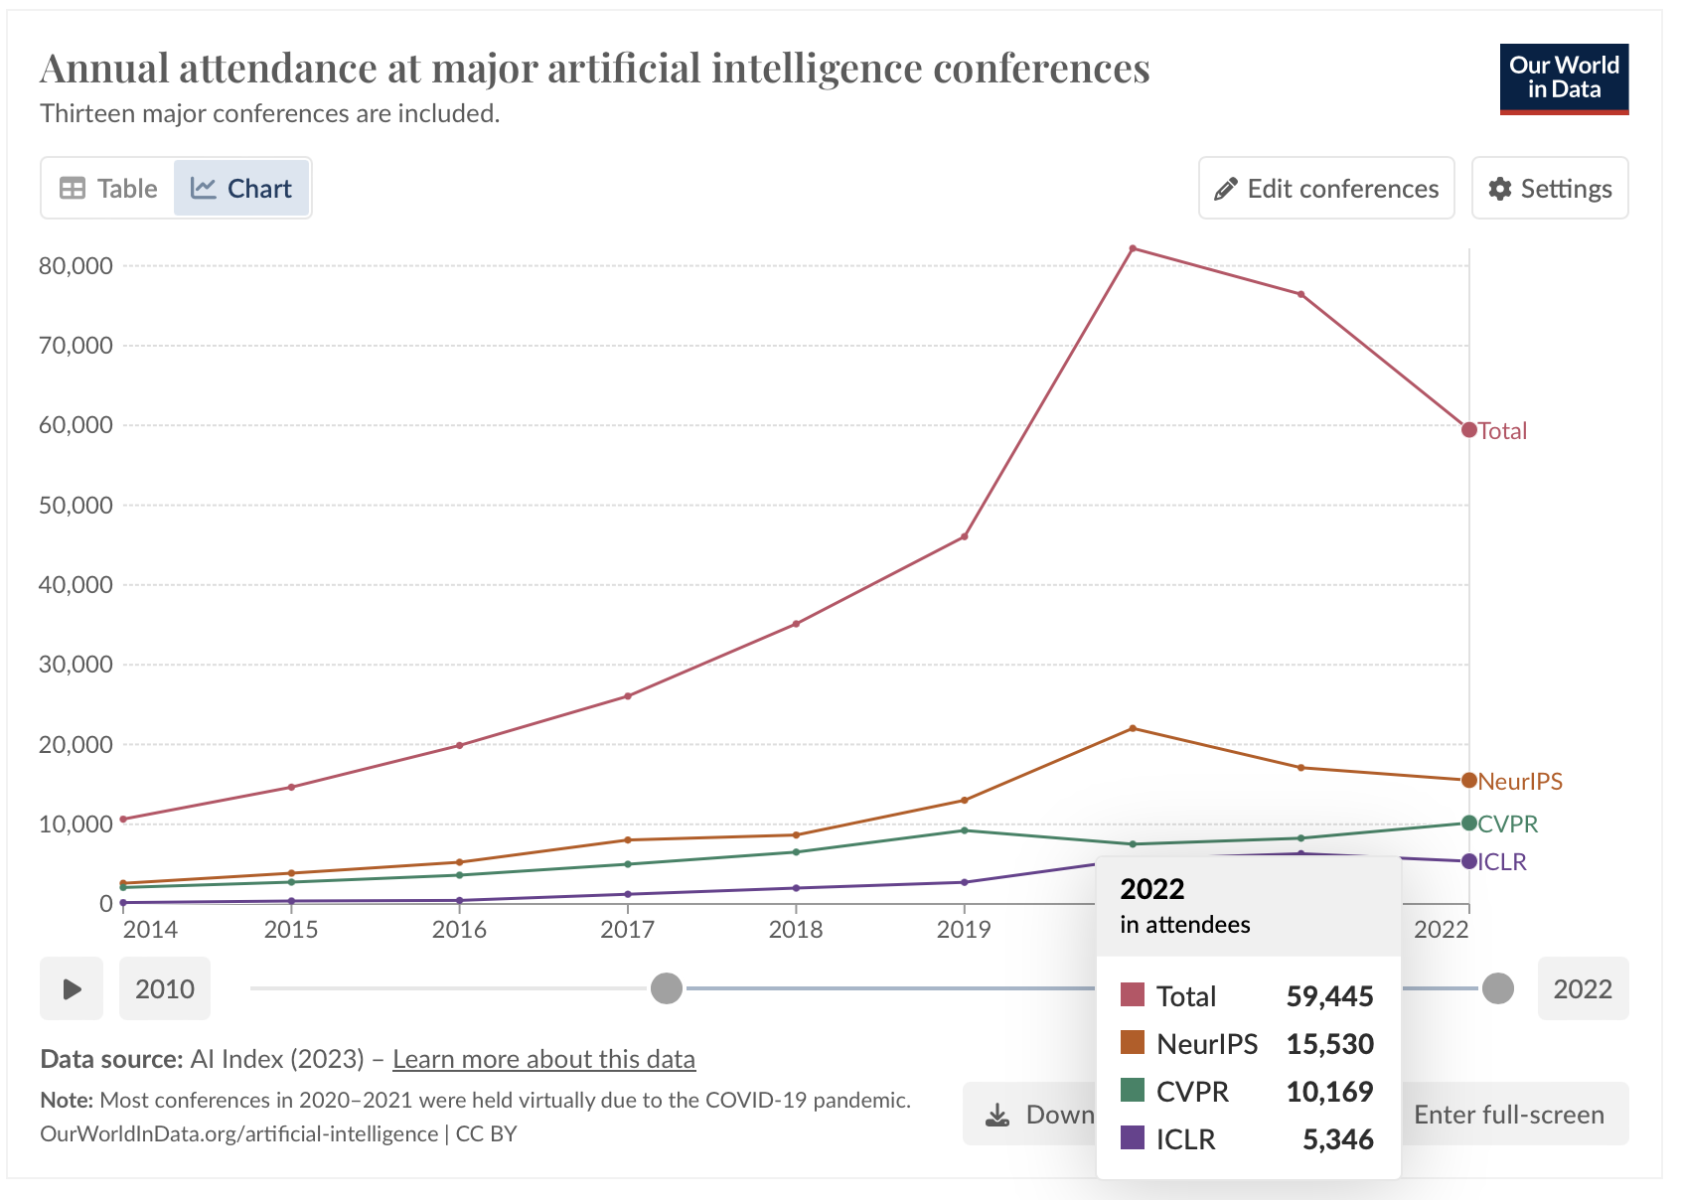
https://ourworldindata.org/grapher/attendance-major-artificial-intelligence-conferences?time=2014..latest

Slide 16
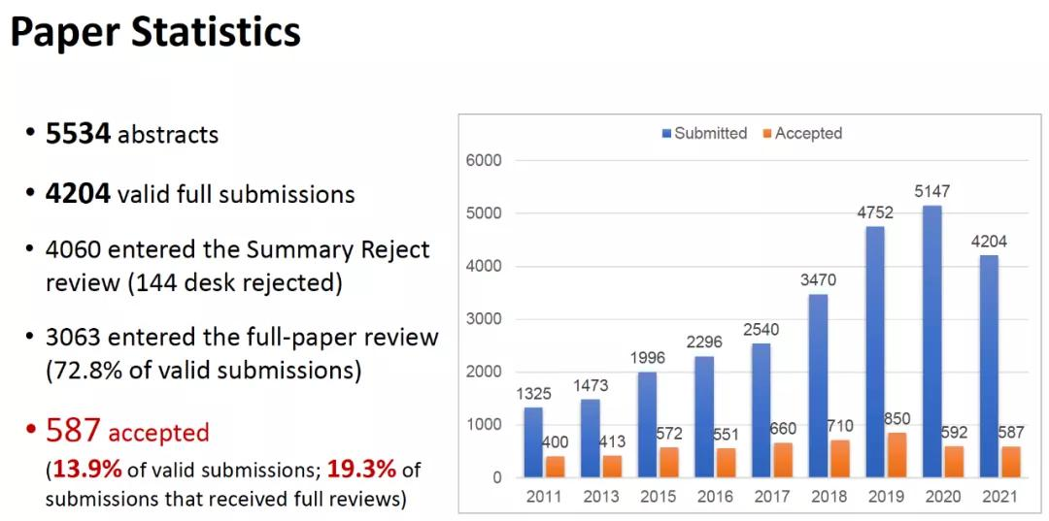
?
?
?
Source: AAAI 2021

Slide 17
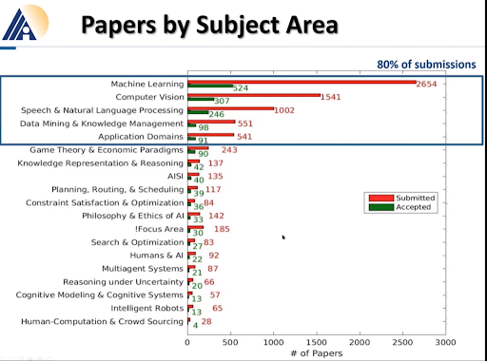
Paper statistics demonstrate interests of the community
Specify topics beyond the CFP
Show trends in topics over time (evaluating one year to the next)

Slide 18
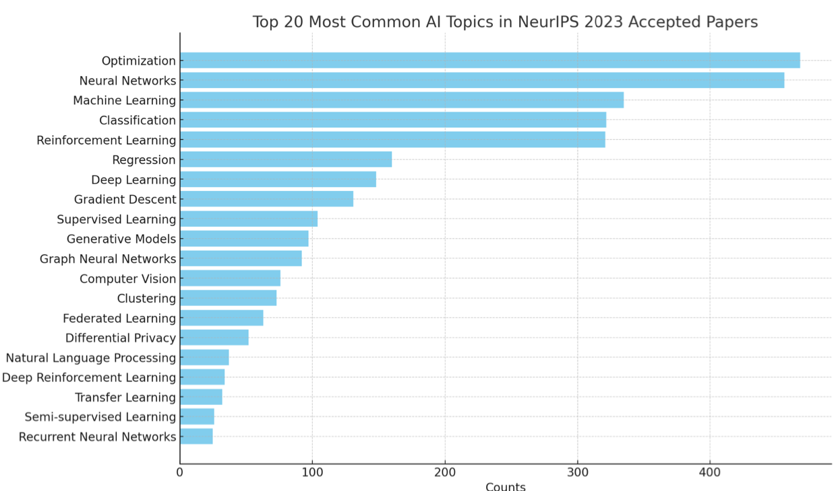
Paper statistics demonstrate interests of the community
Specify topics beyond the CFP
Show trends in topics over time (evaluating one year to the next)
Source: NeurIPS 2023

Slide 19
Case Study: NeurIPS 2023 conference
Neural Information Processing Systems
Seven conference tracks
7 Invited Talks - 6 keynotes, 1 panel
58 Workshops
14 Tutorials
20 Competitions
77 Orals
9 Socials
9 Affinity Group Workshops
Registration numbers:
● Total: 16,382
● In-person registrations: 13,307
● Virtual registrations: 3,075
Source: NeurIPS 2023

Slide 20
Case Study: NeurIPS 2023 conference
Neural Information Processing Systems
Paper acceptance rate:
26.1% main conference track
32.6% datasets and benchmark
Paper reviews:
3,540 total accepted combined papers
3,218 main conference track
322 datasets and benchmarks track
13,330 total submissions
12,343 main conference track
987 datasets and benchmarks (more than double the previous year's 487 submissions)
Reviewers
■ 968 Area Chairs
■ 98 Senior Area Chairs
■ 12,974 main conference reviewers
■ 1,503 datasets and benchmark reviewers
■ 396 Ethics reviewers - 502 papers (3.77% of all submissions) were flagged for ethics review, down from 474 papers ( 4.37% of all submissions) in 2022
Source: NeurIPS 2023

Slide 21
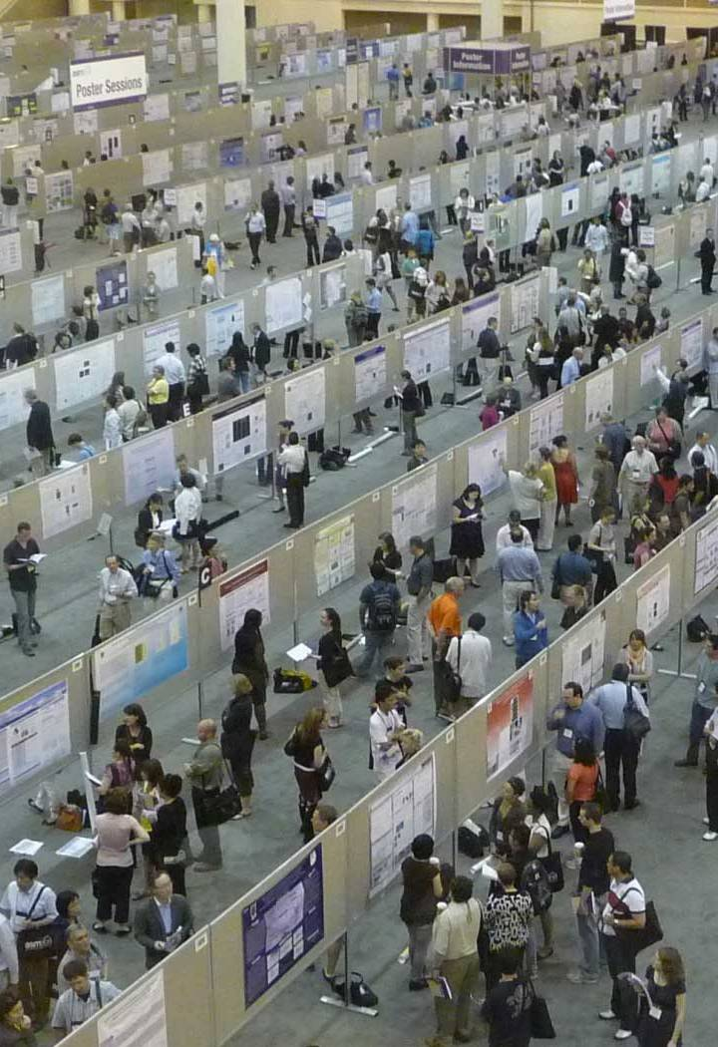
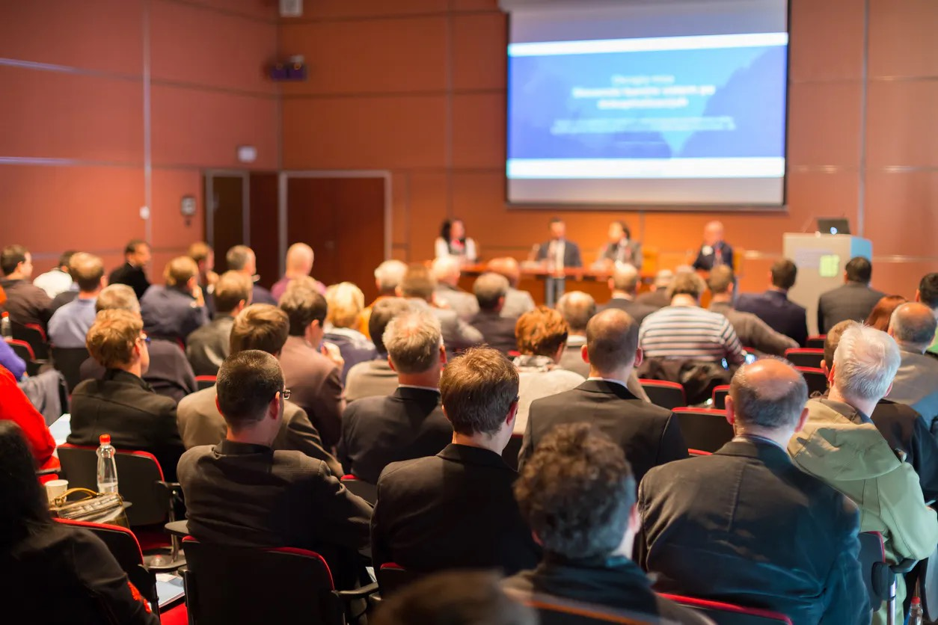
Image source: Wikipedia

Slide 22
How to “Conference”

Slide 23
How to “Conference”
Getting the most out of attending, networking, & presenting
Before: make a schedule!
Day 1: registration check-in. Get your badge, familiarize yourself with the venue, attend keynote talks.
During sessions:
Take notes only if it helps you later on - remember, all presentations are published papers! Easier to highlight a title in your schedule & get the paper later on.
Ask questions only if pertinent to the talk (save tangents for the coffee break, especially if it’s “more of a comment than a question”)

Slide 24
How to “Conference”
Getting the most out of attending, networking, & presenting
Logistics..
If attending through a company or university, someone needs to approve your travel and book for you.
This takes time, so start months in advance.
Some expenses you have to pay for and be reimbursed - talk to someone if this isn’t an option!

Slide 25
How to “Conference”
Budget sample
Registration | $800 | Typical cost for members
Airfare | $800 | Round-trip
Hotel | $1100 | $250/day for 4 days + tax
Food (per diem) | $300 | $75/day
Transportation | $100 | Parking, travel to/from airport
Total | $3100

Slide 26
How to “Conference”
Getting the most out of attending, networking, & presenting
What to wear?
Learn about your community (discussion boards, or ask an expert)
Some fields are more formal than others (e.g. more business attire at cybersecurity conferences, more jeans at systems meetings)
Avoid burnout!
Pace yourself, you can’t attend every session
Take breaks if needed, big events can be overwhelming

Slide 27
How to “Conference”
Getting the most out of attending, networking, & presenting
Bringing it back - presenting what you learned to a peer audience.
Don’t give a play-by-play of what talks you went to on which days
Do:
Summarize topics of interest at the conference
Bullet interesting questions
Share your new contacts

Slide 28
Networking

Slide 29
Networking
For computer scientists
Plan to talk to people! Have an elevator pitch ready, and listen.
If there’s someone you want to meet, contact them before the conference to set up a coffee break or lunch. Follow up after the conference with everyone.
Recommended reading:
“Taking the Work Out of Networking” by Karen Wickre
Book, for introverts :)

Slide 30
Networking
For computer scientists
Understand that most attendees have an agenda!
Recruiters
Expo hall vendors
Students
Professors

Slide 31
Networking
For computer scientists
Understand your agenda
Will you be on the job market in the next year or so?
Are you looking for collaborators?
Are you applying to graduate school?
Remember that you’re representing your institution

Slide 32
Q&A

Slide 33
Wrap-Up
Tuesday
Understand the publication process in CS
Learn from expert(s) in diverse fields within CS
To Do:
Guest Lecture Survey (in-class Thursday)
See you Thursday!

Slide 34
Guest Research Lecture:
Dr. Paul Rad

Slide 35
Guest Research Lectures
Questions for experts in the field - ask them anything!
About their research..
What challenges did you face during this research, and how did you overcome them?
What are the real-world applications of your research?
What are the existing approaches to your research work?
About their research field..
What emerging trends do you see? What promising new areas?
What advice would you give to an undergraduate student interested in this research field?
What resources or communities can you recommend?
About careers & skills..
What skills do you find important in your field?
What was your career path?
How do you balance your research with other academic & personal commitments?

