Slide 1
UTSA CS 4593: CS-CURE
Course-based Undergraduate Research Experience in CS
Amanda Fernandez, Ph.D
UTSA Department of Computer Science
Spring 2024

Slide 2
Week 3: Research Problems

Slide 3
UTSA CS-CURE
Week 3
Objectives:
Identify potential topics of research interest within your field
Learn to clearly articulate research problems in a field
Learn from expert(s) in diverse fields within CS
Deliverables:
Guest Research Lecture survey (in class on Thursday)
Research proposal - due on Canvas this Saturday!

Slide 4
Beginning Research:
Finding Relevant Themes
Continued….

Slide 5
Finding Research Topics
Starting out in your field
Debrief on Activity 2
Identifying specific topics & problems in your field (SIG-specific flowchart)
Did you discover anything new?

Slide 6
Finding Research Topics
Starting out in your field
Debrief on SIG Meeting 0
Finding the top 3 conferences for your field
Were they difficult to identify?
Did you find any you might want to attend? (virtually?)

Slide 7
Finding Research Topics
Starting out in your field
Debrief on Activity 2 & SIG Meeting 0
Discovering what is relevant to your community via a CFP
What did you learn about your community?

Slide 8
More About CFPs & Papers
What to know
CFPs are released on a predictable schedule - conferences are held around the same time(s) each year (or every other year).
Conferences generally change location
The 1st day “opening” talk usually contains stats - acceptance rate for papers that year, total # of attendees, h-index, …
Most require authors to attend & present their work if accepted for publication.

Slide 9
More About CFPs & Papers
Key terms found on CFPs
Terms to know
citation = reference to a source
Papers include citations directly in the text to identify sources, giving credit and allowing readers to find the source.
Some fields within CS have higher citations on average than others.
h-index = the # of papers with the same # or more citations
e.g. h-index of 10 means they have at least 10 papers that have at least 10 citations each.
i-index = the # of papers with x or more citations
e.g. i10 index refers to the # of papers with 10+ citations

Slide 10
Finding Research Topics
Starting out in your field
…So how do we refine research questions?
Quick demo activity:
Identify topic or set of keywords
Go to the website of the top conference in your field (from this year if already held, or last year if not yet held)
Find the list of accepted papers
Search the list for 1 or more keywords
Skim/review the paper
Paper Reading:
The research problem should be justified briefly in the abstract.
Toward the end of the introduction, the authors should additionally state & motivate the research questions.
Outline of every* research paper:
Abstract
Introduction
Related work
Method
Experiments & Results
Conclusion

Slide 11
Characteristics of a Good Research Problem
Refining a topic
Novelty / significance
Feasibility / solvability
Alignment with your expertise & resources
Potential impact & real-world relevance

Slide 12
Characteristics of a Good Research Proposal
Identifying Research Problems
Clear & concise
Measurable
Open-ended
Poorly-framed research questions:
Unoriginal - lack novelty
overly broad: address questions already extensively explored
Subjective or vague: lack clear objective measures or definitions for key terms
Unfeasible: exceed practical limitations or available resources
Leading or biased: frame the question with a predetermined answer or ignore alternative perspectives
Unfocused: lack a clear direction or potential contribution to the field

Slide 13
Brainstorming Techniques
Refining a topic
Finding gaps
Alternate applications
Social & ethical implications
Mind mapping

Slide 14
Mind Mapping
Brainstorming activity
Personal interests
/ side projects
(Where do you enjoy spending your time?)
CS Topics
(What fields and/or topics are you interested in within CS?)
short-term goals
(let these set the scope)
e.g. 1 semester course
e.g. finishing grad degree
Skills & experience
(What can you already do? What other skills can you learn quickly?)
long-term goals
(Are your career goals related to this at all?)
Resources
(What do you already have access to?)

Slide 15
Mind Mapping
Brainstorming activity
Notes:
- “Definitely cybersecurity”
works on data science for traffic, not a long term career desire
Enjoys VR/AR, stays up to date in that community
Wants to know how neural networks work

Slide 16
Articulating Research Problems/Questions
Example: Computer Vision
Can computer vision be used to improve driving?
How can convolutional neural networks be made more robust to image distortions caused by fog and rain conditions in autonomous driving applications?
Notes:
Too broad
Lacks specific focus
(From there, we cannot narrow down related approaches to note novelty, etc)

Slide 17
Articulating Research Problems/Questions
Example: Software Engineering
Are microservices better than traditional software development approaches?
How can the adoption of microservices architecture be optimized for large-scale software development projects, balancing agility and maintainability?
Notes:
Oversimplified and presents a false dichotomy

Slide 18
Articulating Research Problems/Questions
Example: Cybersecurity
How can we make cyberattacks less successful?
How can blockchain technology be leveraged to enhance the security and accountability of data sharing in healthcare systems, while mitigating privacy concerns?
Notes:
Too vague and lacks actionable research direction

Slide 19
Articulating Research Problems/Questions
Example: Natural Language Processing (NLP)
How can computers understand language?
Can the integration of sentiment analysis and topic modeling techniques improve the effectiveness of automated news summarization for low-literacy audiences?
Notes:
Too vague and lacks actionable research angle

Slide 20
Articulating Research Problems/Questions
Example: Human-Computer Interaction (HCI)
Are AR headsets good for learning?
How can augmented reality interfaces be designed to promote collaborative learning and engagement in STEM education for visually impaired students?
Notes:
Lack of specificity and ignores relevant context

Slide 21
Articulating Research Problems/Questions
Example: AI Applications
Is AI dangerous?
What are the ethical and social implications of using facial recognition technology in law enforcement, and how can we design responsible AI systems that mitigate bias and protect privacy?
Notes:
Oversimplified and ignores nuances of different AI approaches

Slide 22
Beyond this course:
Finding Relevant Themes

Slide 23
Finding Relevant Themes
Refining research directions
How do we know if the research question is relevant?
Ask an LLM (really!) - Google Bard is connected with search and does an OK job at this.
Ask an expert - much better, but you may get varying opinions..
Ask a community of experts - online forums, at meetings/conferences
Look for a resource on it - does a paper on this exact topic already exist?
Are there YouTube videos, GitHub repos, or tutorials already teaching this?
If so, this is when you begin to look for gaps & differences

Slide 24
Finding Relevant Themes
Refining research directions
That time Google scooped me..
That time Google scooped Google..

Slide 25
Finding Relevant Research
Graduate Students
Good research problems additionally…
Align with the research of your advisor
Scoped within a timeframe that is reasonable for you to graduate
Set you up for success after graduation
Check the institution too!
e.g.:
https://research.utsa.edu

Slide 26
Finding Relevant Research
Postdoctoral Researchers
Good research problems additionally…
Allow you to make significant progress during your contract
Align with recent job postings
Align with recent grant funding opportunities

Slide 27
Finding Relevant Research
Industry Researchers
Good research problems additionally…
Align with the strategic goals of the company
Enable you to grow your career
Do not require company resources (unless legal arrangements are made)

Slide 28
Finding Relevant Research
Academic Researchers & Faculty
Good research problems additionally…
Align with the strategic goals of the university
Align with the strategic goals of the funding agency
Extend beyond a single project (open-ended enough to expand on)

Slide 29
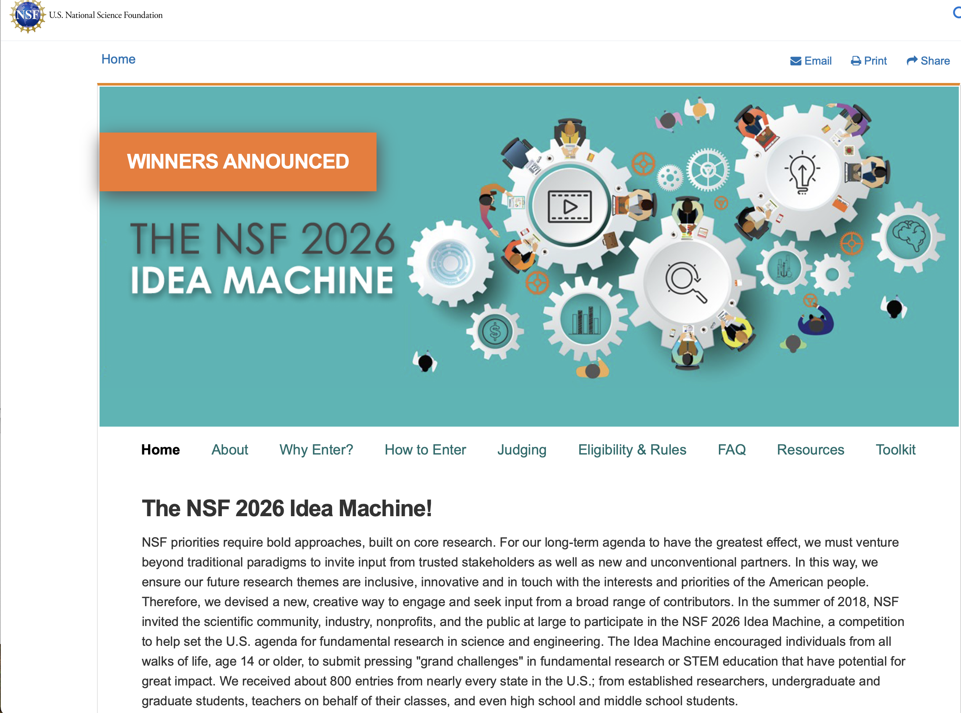
Interesting video!
https://www.nsf.gov/news/special_reports/nsf2026ideamachine/index.jsp

Slide 30
Q&A
?
Questions about…
CFPs or conferences
Your research topic or problem
Life (research) after this course

Slide 31
Wrap-Up
Tuesday
Identify potential topics of research interest within your field
Learn to clearly articulate research problems in a field
To Do:
Guest Research Lecture survey (in class on Thursday)
Research proposal - due on Canvas this Saturday!
See you Thursday!

Slide 32
Guest Research Lecture:
Dr. Sushil Prasad

Slide 33
Guest Research Lectures
Questions for experts in the field - ask them anything
About their research..
What challenges did you face during this research, and how did you overcome them?
What are the real-world applications of your research?
What are the existing approaches to your research work?
About their research field..
What emerging trends do you see? What promising new areas?
What advice would you give to an undergraduate student interested in this research field?
What resources or communities can you recommend?
About careers & skills..
What skills do you find important in your field?
What was your career path?
How do you balance your research with other academic & personal commitments?

Slide 34
Wrap-Up
Thursday
Learning from experts in research
To Do:
Guest Research Lecture survey (in class on Thursday)
Research proposal - due on Canvas this Saturday!
See you next week!

