Slide 1
UTSA CS 4593: CS-CURE
Course-based Undergraduate Research Experience in CS
Amanda Fernandez, Ph.D
UTSA Department of Computer Science
Spring 2024

Slide 2
Week 5: Literature Review

Slide 3
UTSA CS-CURE
Week 5
Objectives:
Practice strategies for efficiently finding & summarizing relevant literature
Leverage tools to facilitate, organize, & guide your research
Deliverables:
Activity 4: Effective Literature Reviews (in-class Thursday)
SIG Meeting 1: Literature in Your Field (in-class Thursday)

Slide 4
Literature Reviews

Slide 5
Literature Reviews
literature review = a survey of credible sources on a topic.
Research Paper
Survey Paper
Masters Thesis
Masters Project
PhD Dissertation
Introduction
Introduction
Introduction
Introduction
Related Work
Related Work
Chapters:
Introduction (survey paper)
Research paper 1
Research paper 2
…
Related Work
Related Work
Proposed Approach
Proposed Approach
Experiments, results, & evaluation
Experiments, results, & evaluation
Proposed Approach
Experiments, results, & evaluation
Conclusions, discussion, & future work
Conclusions, discussion, & future work
Conclusions, discussion, & future work
Conclusions, discussion, & future work

Slide 6
Literature reviews differ across disciplines
CS vs. other fields
Emphasis on technical details and methodologies in CS.
Greater use of specialized technical terms and citations.
Importance of evaluating algorithms, models, and software implementations.
Focus on quantitative analysis and evidence-based arguments.
Peer-reviewed sources are more inclusive of conferences & workshops.

Slide 7
Characteristics of a good literature review
Guidelines for discussing SOTA
Focused & relevant: Narrow scope aligned with your research question and avoid tangential topics.
Comprehensive: Cover key publications and seminal works (avoiding cherry-picking).
Critical analysis: Don't just summarize! Evaluate methods, results, and contributions.
Organized & well-structured: Logical flow, clear transitions, and proper citations. Group by strategy!
Credible sources: Utilize peer-reviewed publications, reputable conferences, and relevant research platforms.

Slide 8
Common pitfalls
Lit reviews
Superficiality: Avoid summaries without critical analysis or insights.
Lack of context: Frame research within larger field and existing knowledge gaps.
Bias: Maintain objectivity and acknowledge limitations of existing research.
Limited scope: Ensure comprehensive coverage of relevant literature.
Improper referencing: Cite correctly and avoid plagiarism.

Slide 9
Getting Started:
Literature Review

Slide 10
Tools for Automating Research
Reminders
Finding articles
Google Scholar, Research Gate, IEEE Collabratec, ResearchRabbit, …
Organizing articles
Zotero, Mendeley, Endnote, …
Writing & citing
Overleaf + bibtex

Slide 11
Advanced Search Techniques
Reminders
Boolean operators: use “AND", “OR”, "NOT" for more precise searching!
Citation chaining: follow citations from relevant papers to find related work.
CS-specific peer-reviewed sources:
ACM Digital Library
IEEE Xplore

Slide 12
Advanced Search Techniques
Large language models (LLMs)
Don’t:
Do:
Find papers on the topic of X.
I’m interested in topic X.
Can you summarize the latest approaches?
Resources won’t be peer-reviewed (unless specified)
Most credible-looking citations are fake
Provides organized feedback
Summarizes the concepts
Doesn’t help find papers!

Slide 13
Evaluating Research Quality
Lit reviews
Read all papers skeptically!
Is the research well-supported?
Data collection and analysis: Assess the quality of data collection and whether the analysis is appropriate and rigorous.
Transparency and replicability: Check if the research methods and data are clearly described, allowing for replication of the study.
Are there clear results and discussion?
Evidence and support: Are the findings well-supported by data and evidence presented in the research?
Limitations and future work: Acknowledge the study's limitations and identify potential areas for future research.
Originality and contribution: Does the research offer new insights, contribute to existing knowledge, or address unresolved questions?

Slide 14
Writing Strategies
Structuring a literature review
Doing a literature review is critical to ensure you are contributing to a field.
Writing a good summary of the SOTA is equally important!
There are general structures you can follow to make it easier.
Use just one or layer multiple.
Example: Chronological
Best for..
Tracing historical development of a concept, understanding evolution of methodologies or theories.
Organization:
Order literature based on publication date, highlighting key advancements and shifts in focus over time.
Example Research:
How has the approach to natural language processing for sentiment analysis changed over time?

Slide 15
Writing Strategies
Structuring a literature review
Structure: Thematic
Best for..
Identifying major themes, trends, or debates within a research area.
Organization:
Group literature around predefined themes (e.g., interpretability techniques, ethical considerations, comparison of different approaches).
Example Research:
What are the main challenges and proposed solutions for improving the explainability of deep learning models?

Slide 16
Writing Strategies
Structuring a literature review
Structure: Methodological
Best for..
Comparing & contrasting different methodologies used in similar research areas.
Organization:
Group literature based on methodologies employed (e.g. specific AI/ML architectures, evaluation metrics, datasets used)
Example Research:
How do various convolutional neural network architectures differ in their effectiveness for image recognition tasks?

Slide 17
Writing Strategies
Structuring a literature review
Structure: Problem-solution
Best for..
Exploring different solutions proposed to address a specific research problem.
Organization:
Organize literature around the problem, showcasing different proposed solutions & their evaluations.
Example Research:
What are the various approaches to mitigating bias in recommender systems?

Slide 18
Writing Strategies
Structuring a literature review
Structure: Comparison / Contrast
Best for..
Critically evaluating similarities & differences between multiple existing concepts or methods.
Organization:
Analyze each approach separately, then directly compare & contrast their strengths, weaknesses, & suitability for different applications.
Example Research:
How do reinforcement learning & supervised learning approaches compare in their effectiveness for robotic manipulation tasks?

Slide 19
Writing Strategies
Avoiding plagiarism
plagiarism = practice of taking someone else's work or ideas and passing them off as one's own.
Paraphrasing counts!
Images/media count!
You can self-plagiarize, if you reuse your writing.
Tips:
Always cite any information you take from external sources, even if it's just for a single sentence or statistic.
Use quotation marks if using anything verbatim (but this is largely discouraged in CS!)
Avoid AI or online “checkers” - uploading your work to a company often means they now own it!

Slide 20
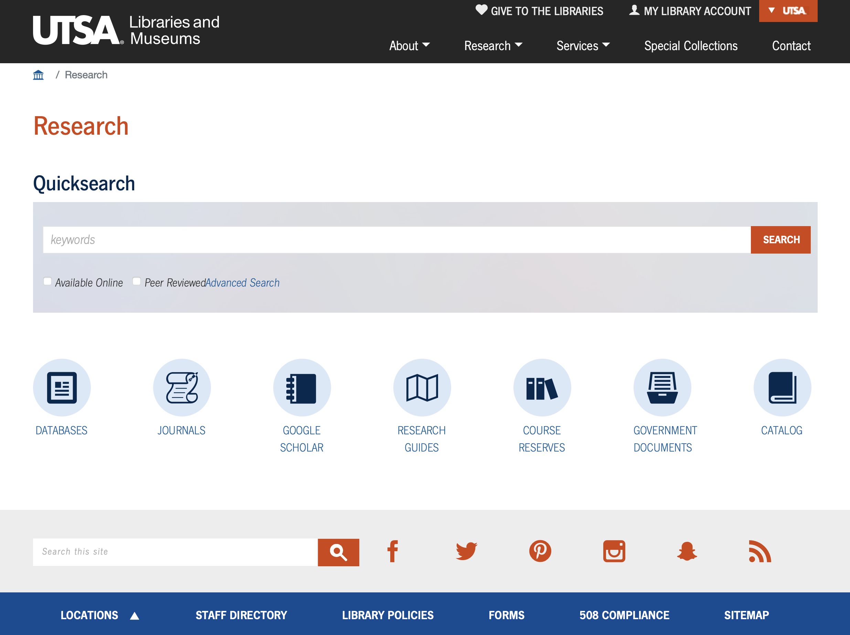

Slide 21
Beyond Traditional Reviews
Lit reviews
Grey literature is a term for information produced outside of traditional publishing and distribution channels, like academic journals and commercial books.
Government agencies and departments: Reports, policy documents, technical manuals, white papers.
Non-governmental organizations (NGOs) and think tanks: Research reports, policy briefs, conference proceedings.
Academia: Working papers, dissertations, theses, conference presentations (not published in formal journals).
Industry: Market reports, technical reports, white papers, company publications.
Individual researchers and consultants: Blogs, websites, personal reports.

Slide 22
Beyond Traditional Reviews
Lit reviews
A systematic review is a rigorous and structured approach to summarizing and evaluating existing research on a specific topic.
Explicit research question: Clearly defined and focused on a specific issue.
Systematic search strategy: Extensive use of databases and search techniques to identify relevant studies.
Inclusion/exclusion criteria: Defined criteria for selecting studies based on specific characteristics (e.g., methodology, publication date).
Critical appraisal: Careful evaluation of the quality and potential biases of each included study.
Data synthesis: Summarizing and analyzing the findings of multiple studies in a transparent manner.

Slide 23
Beyond Traditional Reviews
Lit reviews
meta-analysis = a statistical technique used to combine the results of multiple studies addressing the same research question.
Key steps:
Standardizing data: Ensuring data from different studies is comparable.
Calculating effect sizes: Quantifying the magnitude and direction of the observed effect in each study.
Pooling data: Combining effect sizes across studies using appropriate statistical methods.
Analyzing heterogeneity: Assessing whether the studies are similar enough to be pooled and addressing any inconsistencies.
Presenting results: Reporting the overall effect size and its confidence interval, along with potential limitations and sources of variability.

Slide 24
Collaborations &
Literature Review

Slide 25
SIG Literature Review Collaborations
Each SIG has a page on Canvas now (Modules > SIGs)
Includes a link to a shared Overleaf document for collaboration on useful papers & discussions.
Also good practice area for learning LaTeX & Bibtex!
This will not be a graded component of the course, but will allow your instructor to provide resources (papers & info) useful to your projects and to your SIG in general.

Slide 26
Wrap-Up
Tuesday
Practice strategies for efficiently finding & summarizing relevant literature
Leverage tools to facilitate, organize, & guide your research
To Do:
Activity 4: Effective Literature Reviews (in-class Thursday)
SIG Meeting 1: Literature in Your Field (in-class Thursday)
Review your proposal feedback (on Canvas) - message me before Thursday if not yet accepted!
See you Thursday!

Slide 27
Activity 4:
Effective Literature Reviews

Slide 28
Activity 4: Effective Literature Reviews
Thorough & objective search through the state-of-the-art (SOTA)
What are some of the types/categories of approaches to your research problem?
Literature review worksheet
What is your next step in conducting your literature review?

Slide 29
Activity 4: Literature Reviews
Category:
_______________________________________
Category:
_______________________________________
Characteristics:
___________________________________
Characteristics:
___________________________________
_________________________________________________
_________________________________________________
Relevant papers:
__________________________________
Relevant papers:
__________________________________
Research Problem
_________________________________________________
_________________________________________________
_________________________________________________
_________________________________________________
Category:
_______________________________________
Category:
_______________________________________
Characteristics:
___________________________________
Characteristics:
___________________________________
_________________________________________________
_________________________________________________
Relevant papers:
__________________________________
Relevant papers:
__________________________________
_________________________________________________
_________________________________________________
_________________________________________________
_________________________________________________
Instructions: Begin by writing your research problem in the center circle. Review the most relevant research paper to your problem (you can use the one you identified in your approved research proposal!). If the paper identifies categories of related approaches to the problem, write 1 in each box. If it does not categorize the approaches, look for how they differentiate their contribution from other existing work, then write their approach in 1 box and the other approaches in another box. Write the “relevant papers” down as “author-publisher-year” (e.g. Smith-AAAI-2023”). As you find additional papers, try to fit them into one of the boxes here, or add them to a new box if they represent a new category.

Slide 30
SIG Meeting 1:
Literature in Your Field

Slide 31
SIG Meeting 1: Literature in Your Field
Identifying & defining the state-of-the-art (SOTA)
Share your research question/problem with your SIG
Identify collaboration opportunities
Share early feedback & questions
Brainstorm additional resources or search strategies within your field
What kind of support can your instructor provide?

Slide 32
AI Applications
AI Ethics & Fairness
Deep learning for early detection of illness in exotic birds
Impacts and efficacy of deep learning for drug discovery
How can we use deep learning for more efficient drug discovery?
Datasets & machine learning approaches to problems in astronomy
Ethical AI for autonomous driving
Ethics of AI for CS Education
What are the ethical implications of using AI for surveillance and data collection, and how can privacy be safeguarded?
Systems
Lack of memory protection in unikernels
Optimizing and validating secure memory allocation techniques
Data Science
Predicting traffic congestion in urban areas
Sentiment analysis
Optimizing ML to minimize energy consumption with big data
Algorithms & Quantum
Quantum programming
?
?
Cybersecurity
Blockchain solutions for improving the security of IoT devices
Cybersecurity systems for protection of personal data
Analyzing the effect of and methods of preventing ransomware attacks and vulnerabilities in hospitals with blockchains
How can Digital Twins secure Cyber-Physical Systems?
Physical security assurance of quantum systems
Misinformation detection on social media
Mitigating cyberattacks on medical devices
Computer Vision
How can 3d reconstruction through a single image be implemented for spatial recognition and interfacing with augmented reality
Improving bird eyes view for object detection in autonomous vehicles by fusing camera data with radar data
Can existing consumer devices utilize gesture control through computer vision in situations where physical touch is not possible?
VR HCI through haptics or visual feedback to improve immersion and reduce cybersickness
Spring 2024 SIGs & Research Projects

Slide 33
Wrap-Up
Thursday
Practice strategies for efficiently finding & summarizing relevant literature
Leverage tools to facilitate, organize, & guide your research
To Do:
Activity 4: Effective Literature Reviews (in-class Thursday)
SIG Meeting 1: Literature in Your Field (in-class Thursday)
Review your proposal feedback (on Canvas) - all proposals must be accepted this week!
See you next week!

