Slide 1
VMSApp
Volunteer Management System
By: Amanda Priscilla A. da Silva
M.S in Computer Science candidate – Northeastern University

Slide 2
VMSApp Introduction
VOLUNTEER MANAGEMENT SYSTEM
OBJECTIVE: Manage volunteer opportunities (projects) for an organization that mobilizes volunteers.
MOTIVATION:
Observation of similar software in the market vs customer needs
Personal experience with a non-profit organization
Plan to bring volunteer culture to my home country which will require a VMS
PROJECT OWNER: The non-profit organization that recruits volunteers for projects.
USERS: The owner organization staff, volunteers registered in the system and general users prior to registration.

Slide 3
VMSApp Requirements
UC | ACTOR | STATUS
Delegate User Roles | Staff | Implemented
Query Projects | User | Implemented
Create Project | Staff | Implemented
Update Project | Staff | Implemented
Sign up to Volunteer in a Project | Volunteer | Implemented
Sign up to Lead a Project | V. Leader | Implemented
Quit Project | V + VL | Implemented
View Volunteer Profile | Volunteer | Basic List
View Leader Profile | V. Leader | Basic List
Manage Project Attendance | V. Leader | Missing UI
Create User | Staff | Additional

Slide 4
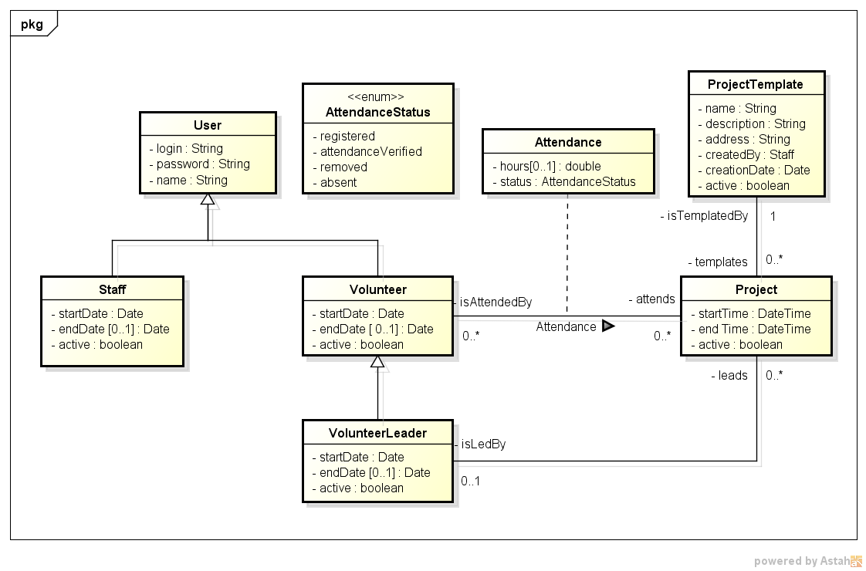
VMSApp Design: Class Diagram

Slide 5
VMSApp Design
DATABASE and DATA ACCESS
MySQL Database using its own driver connector JDBC
Implemented using PreparedStatements and SQL commands
No additional libraries used, such as JPA or Hibernate
SOFTWARE
JAVA, Java Server Pages and Servlets
MVC and Singleton design patterns
TOOLS
Eclipse
MySQL Workbench

Slide 6
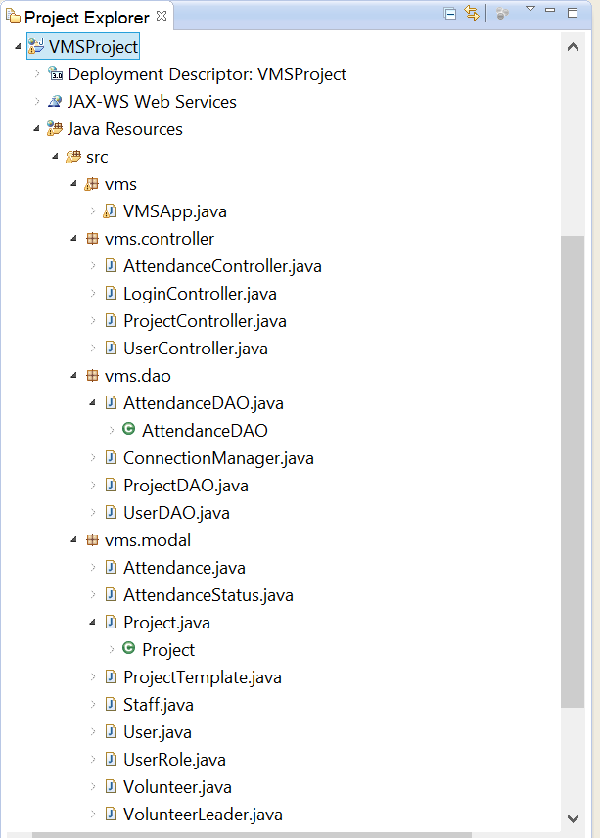
VMSApp Design:

Slide 7
VMSApp Discussion
Enough Use Cases were implemented to test the database manipulation and consistency
Difficulties using initial design: the cascade inheritance made implementation harder, also for being implemented using JOINED strategy.
In the software, I decided to create calculated fields to hold part of the information on creation of the object and reduce queries or working with different types of objects for the same data, i.e: roles list.
Helper functions to format date and convert to Database format.

Slide 8
VMSApp Conclusion
The software is working mostly as expected
Just need some improvements in the User Experience, functionality details and constraints which were not required for the objective of the course.
This software can be used by a volunteer organization for a long term use situation, or for managing volunteers for special events.

Slide 9
VMSApp References
Tool for layout: http://www.layoutit.com/build
Bootstrap: http://getbootstrap.com/
JEE with MySQL Web Tutorial: https://www.youtube.com/watch?v=LcTi546vj_A
Course materials:
http://www.ccs.neu.edu/home/kenb/15/fal/5200/

