Slide 1
Customer Churn Analysis
Identifying customer segments at risk of churn and opportunities for retention.

Slide 2
Analyst: Amanda Theuri Project: Telco Customer Churn Analysis Tools: Python • Pandas • Matplotlib • Seaborn
7,043 customers | 26.54% overall churn

Slide 3
Business Problem & Objective
BUSINESS PROBLEM
Customer churn reduces recurring revenue and customer lifetime value. The business needs to understand which customers are most likely to leave and what characteristics are associated with churn.
OBJECTIVE
Use customer data to:
Identify high-risk customer segments
Understand factors associated with churn
Identify business risks and retention opportunities
Recommend targeted actions to improve customer retention
Key question:
Who is most at risk of churning, and where should retention efforts be focused?

Slide 4
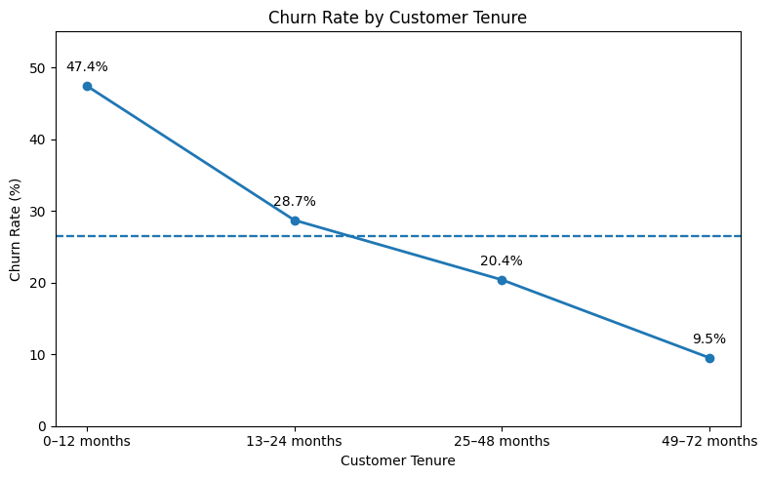
Overall Churn Rate | Total Customers | Churned | Retained
26.54% | 7,043 | 1,869 | 5,174
Approximately 1 in 4 customers in the dataset has churned.

Slide 5
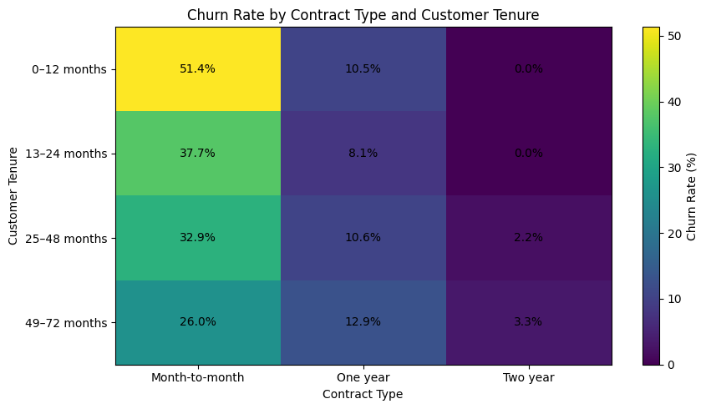
Tenure × Contract
47.44% Churn among 0–12 month customers
42.71% Churn among month-to-month customers
51.35% Churn among 0–12 month + month-to-month customers
Key takeaway
New customers without long-term contracts represent the highest-risk segment identified in the analysis.

Slide 6
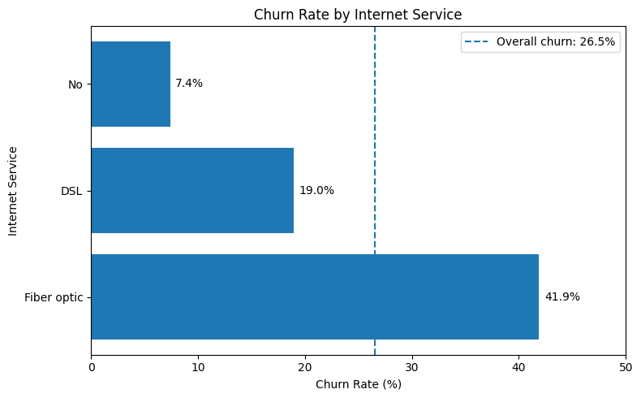
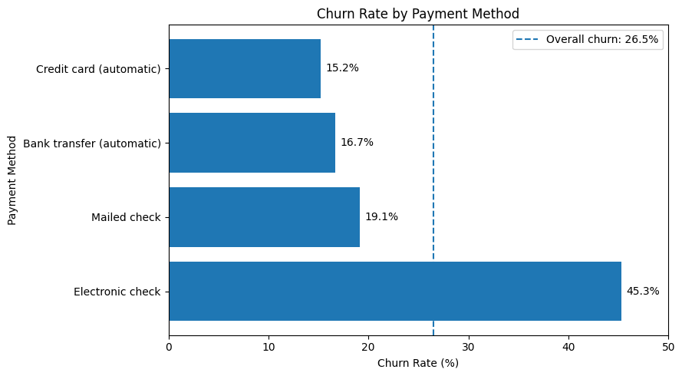
FIBER AND ELECTRONIC-CHECK CUSTOMERS SHOW ELEVATED CHURN
Both segments show substantially higher churn than the overall 26.54% rate and warrant further investigation.

Slide 7
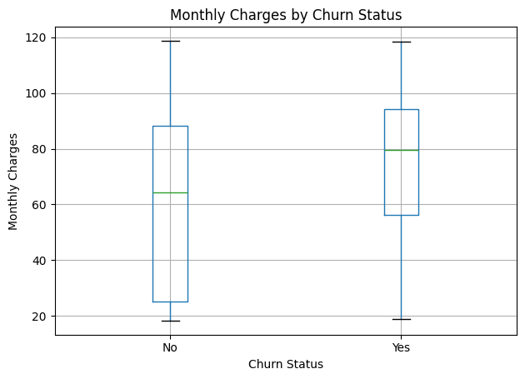
Higher Charges & Churn
$74.44 Average monthly charge — churned customers
$61.27 Average monthly charge — retained customers
Churned customers have higher average and median monthly charges, suggesting an association between higher monthly charges and churn.

Slide 8
Business Risks & Opportunities
BUSINESS RISKS
01 — Early customer attrition High first-year churn may reduce customer lifetime value.
02 — Revenue exposure High churn among fiber customers could affect recurring revenue.
03 — High-risk customer concentration A large month-to-month customer base creates significant retention exposure.
OPPORTUNITIES
01 — First-year retention Strengthen onboarding and early customer engagement.
02 — Contract conversion Encourage suitable customers to move to longer-term contracts.
03 — Fiber experience improvement Investigate service quality, pricing and support among fiber customers.

Slide 9
Recommendations
01 — Launch an early-tenure retention program Target customers during their first 12 months.
02 — Encourage longer-term contracts Use targeted incentives for suitable month-to-month customers.
03 — Investigate fiber churn Review pricing, reliability, technical support and customer complaints.
04 — Promote automatic payment methods Encourage electronic-check customers to consider automatic payment options while investigating the underlying churn relationship.
05 — Build a churn-risk segmentation strategy Prioritize customers exhibiting multiple risk indicators.

