Slide 1
Model Evaluation Results
Confusion Matrix and Metrics

Slide 2
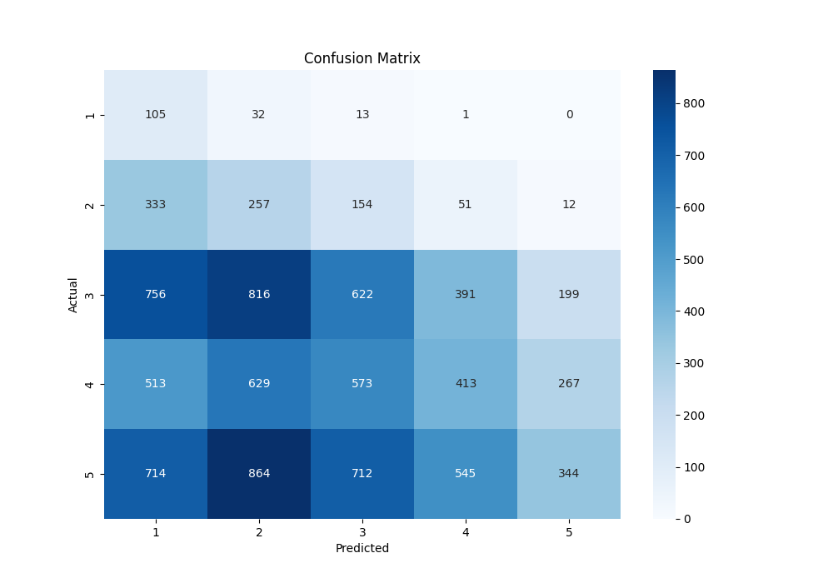
Confusion Matrix

Slide 3
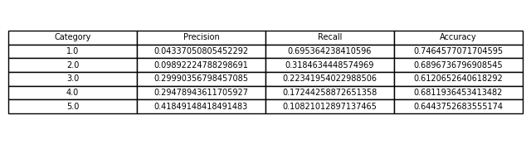
Metrics Table

