Slide 1
GPS Data Measurement Procedure
Contents of lab1 folder and how each contribute:
GPS_struct.lcm: Includes package name that defines a namespace for the data structure, and a structure definition for GPS data.
gen-types.sh: generates the python binding for the GPS_struct.lcm.
read_gps.py: python scripts that parses gps data and publish to lcm.
runspy.sh: Bash script that starts lcm-spy to view lcm messages
buildjar.sh: Bash script to generate related java files.
data and log folders: log files (lcm-log-dynamic, lcm-log-static) and data generated in ods format (utm_data.ods)are stored here.
gps_lcm folder: folder to store struct files.
gps_lcm_read.m: MATLAB script to read lcm log files and plot.
Bash script to set up and run the lcm for GPS:
#/usr/bin/env bash
sudo chmod 666 /dev/ttyUSB0 #give permission to GPS at /dev/ttyUSB0
lcm-logger -s ./log/lcm-log-%F-%T& #start lcm-logger
./gen-types.sh #generate lcm file
./buildjar #build java files
./runspy #start lcm-spy
python read_gps.py

Slide 2
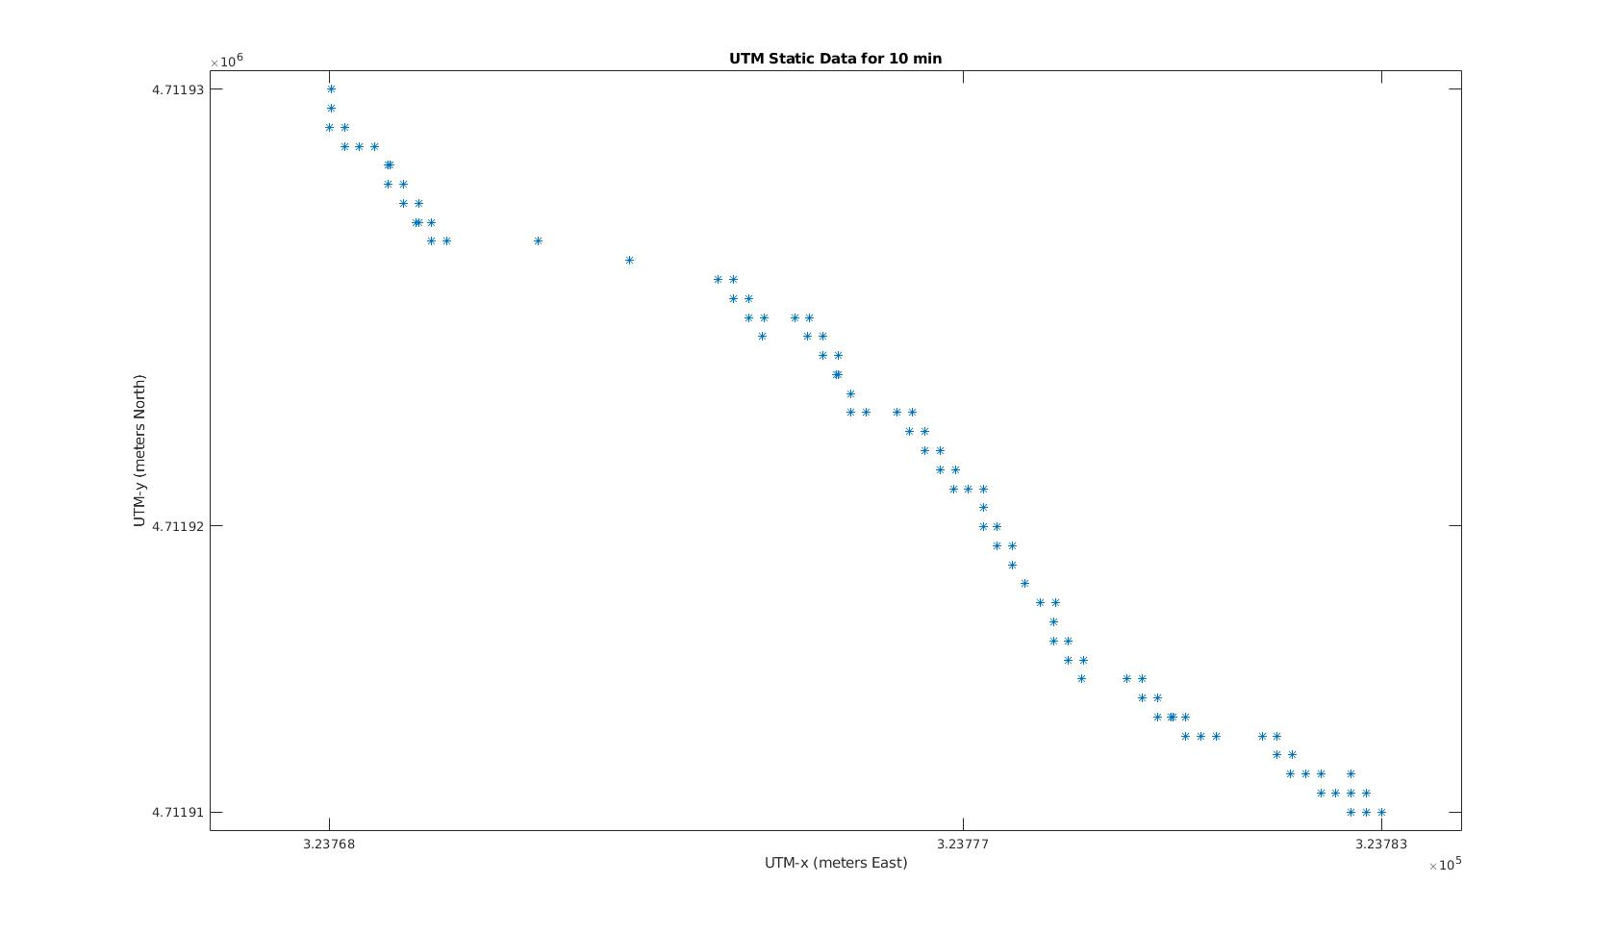
UTM Static Data Analysis
Experiment location:
46 Leon St, Boston, MA, 02115.
UTM: (x-ea: 327738, y-no: 4689355)
Experiment time: 656s
Averaged readings:
UTM: (x-ea: 323777, y-no: 4711918)
Error %: x-ea: 1.2%, y-no: 0.48%
Possible reasons for error:
Environmental factors: humidity, atmosphere pressure and local temperature can cause signal delay.
Multipath issues: radio signals reflect off surrounding terrain; buildings, canyon walls, hard ground, etc.
(source: https://en.wikipedia.org/wiki/Error_analysis_for_the_Global_Positioning_System)

Slide 3
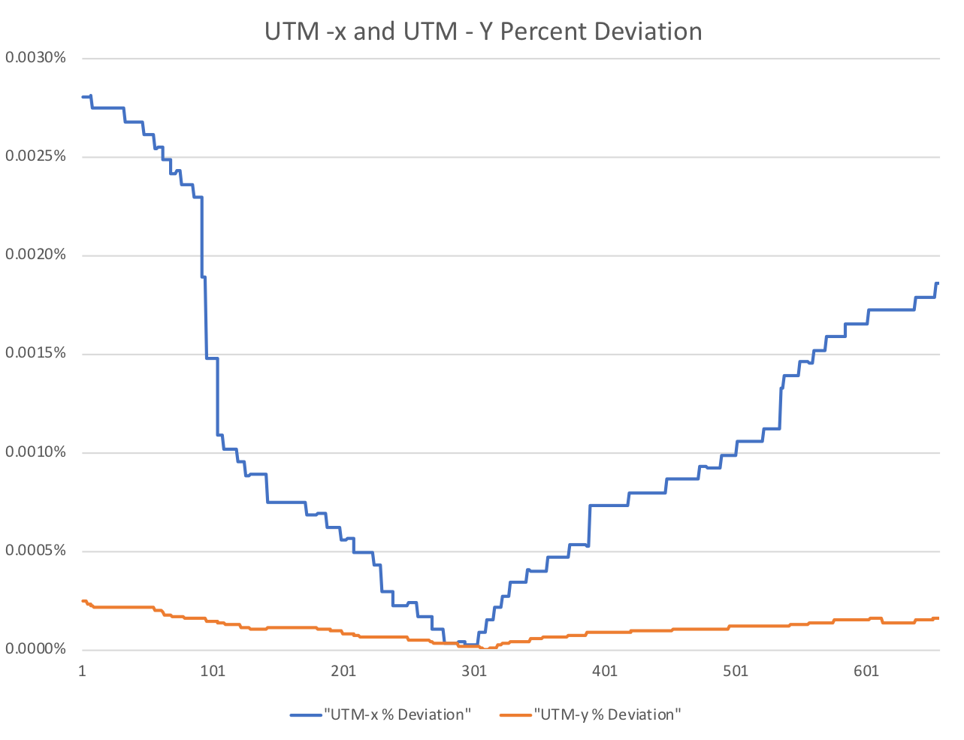
UTM Static Data Analysis
Observations:
UTM-x signals tend to have a higher deviation percentage. (Reason: Data taken on a windy evening, GPS might be fluctuating left to right more.)
Overall, UTM readings are stable.
Both UTM-x and UTM-y are most stable at time 300 second.

Slide 4
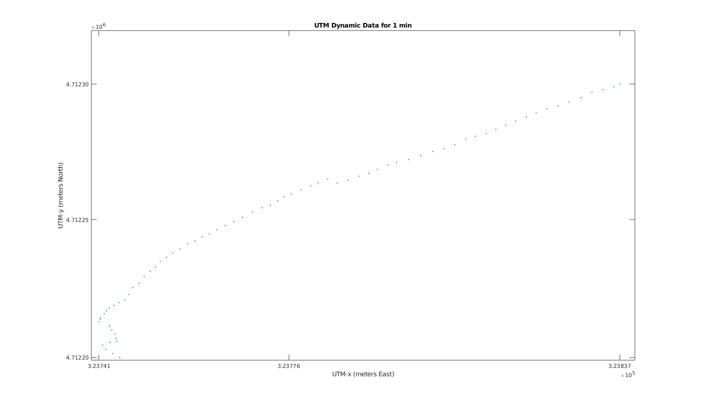
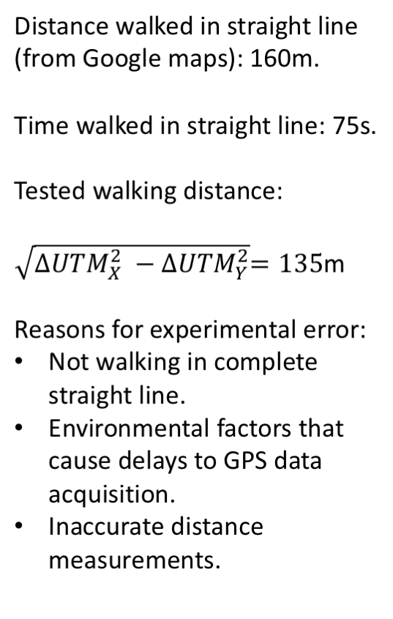
UTM Dynamic Data Analysis

