Slide 1
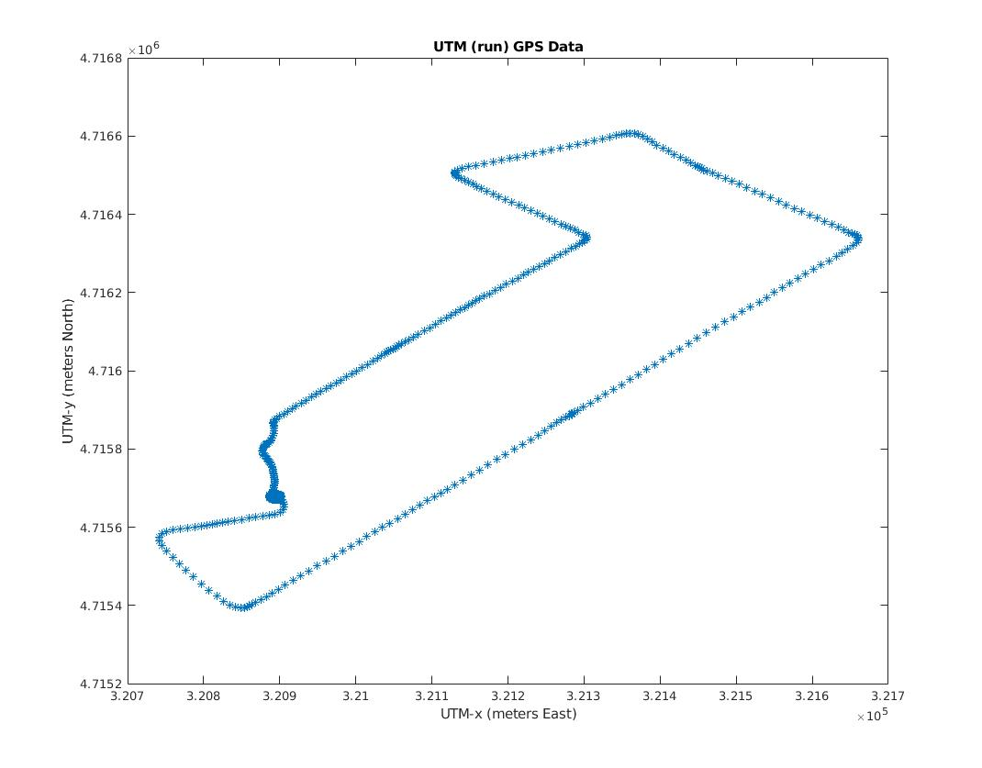
Lab 3 – IMU & GPS on LCM
1. GPS and IMU Configuration:
LCM set up same as lab 1, IMU, GPS sampling rate: 40hZ, 1Hz.
2. Data Collection:
Stationary – Outside ISEC
Moving – Neighbourhood near Micro Center on Memorial Drive, Cambridge.
- Route taken (GPS UTM plot):
Sensor 360 degrees calibration * 5
(142.7 seconds)

Slide 2
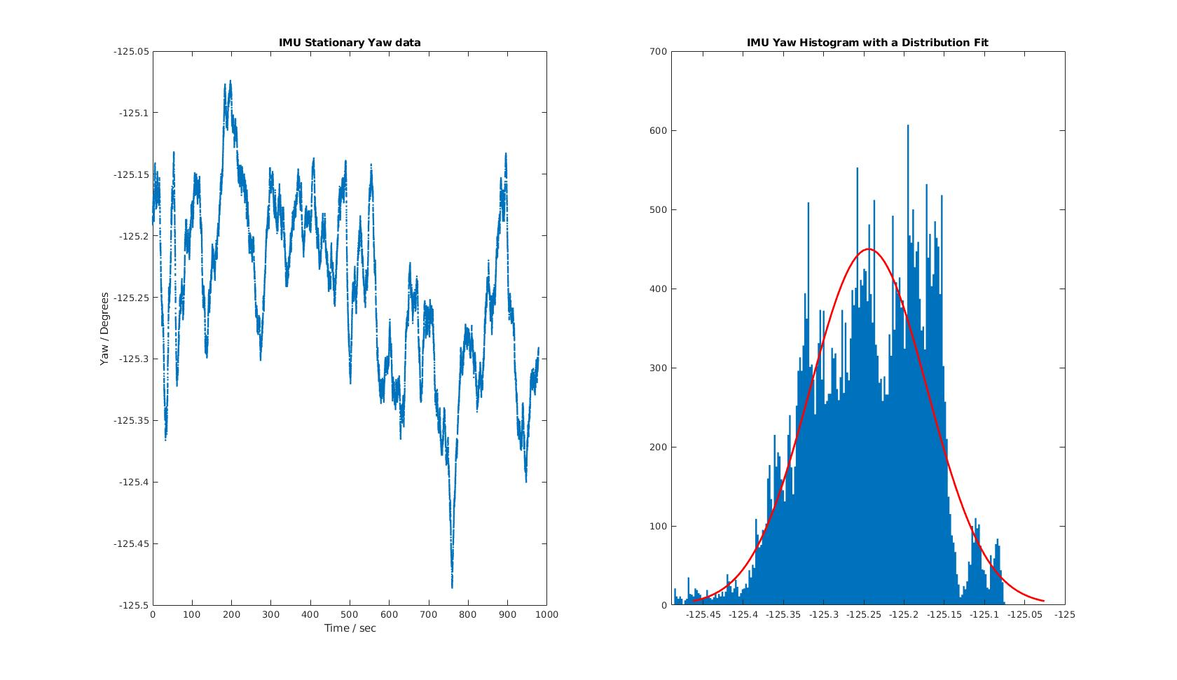
Stationary IMU Data - Yaw
Stationary yaw mean = -125.2441 degrees
Deviation in acceptable range, fluctuation due to windy condition.

Slide 3
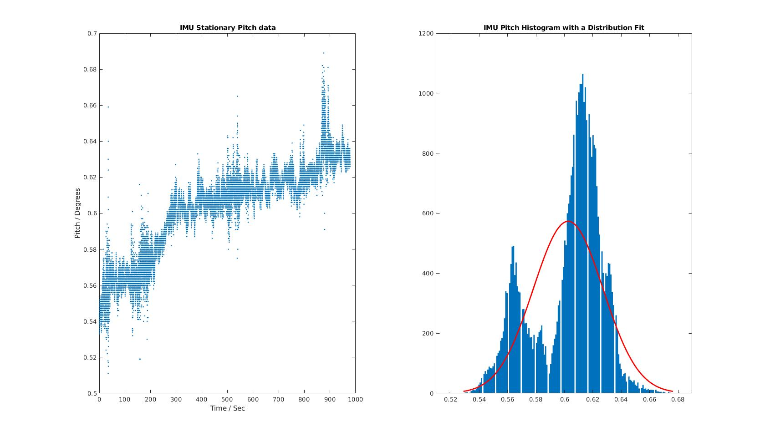
Stationary IMU Data - Pitch
Stationary pitch mean = 0.6026 degrees
Deviation in acceptable range, fluctuation might due to windy condition.

Slide 4
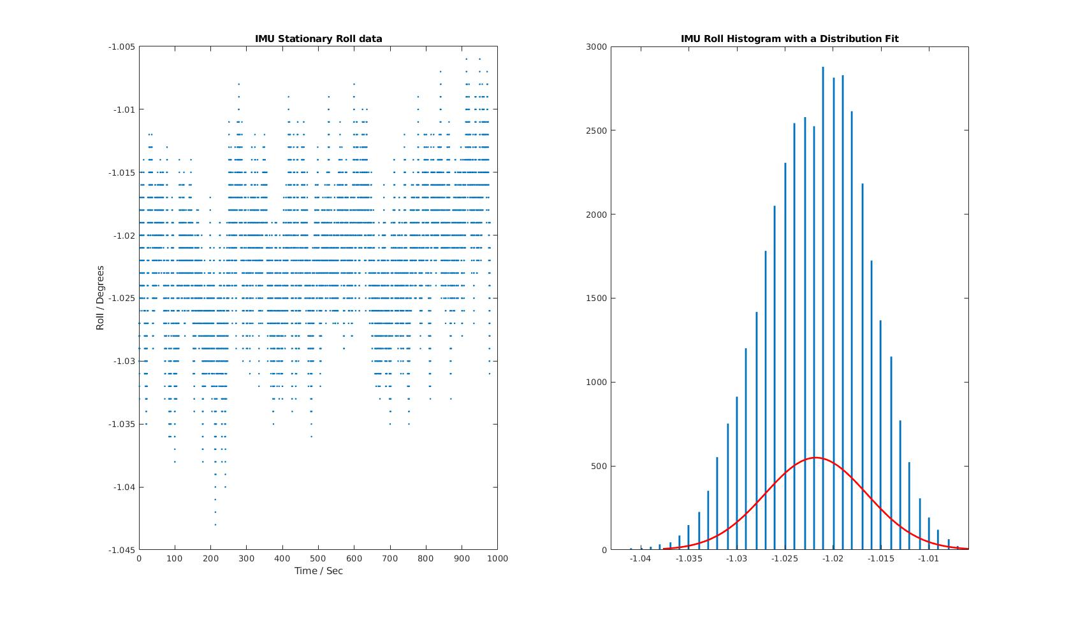
Stationary IMU Data - Roll
Stationary roll mean = -1.0218 degrees
Standard normal deviation, more stable compared to collected yaw and pitch data, IMU was placed under a brick .

Slide 5
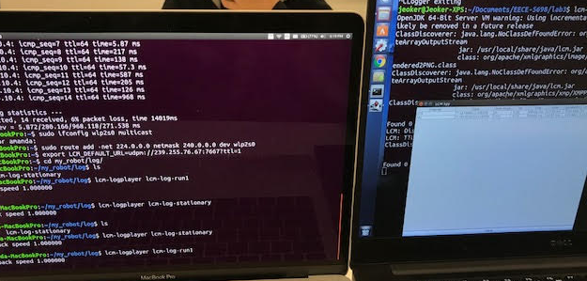
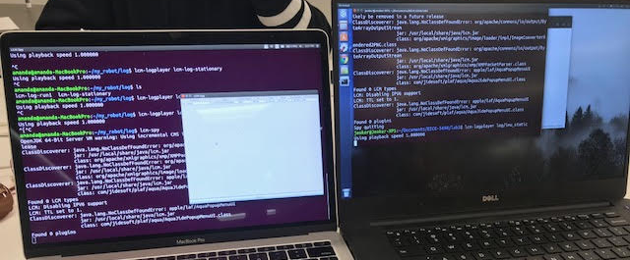
LCM Over the Network
Ifconfig // get ip and local adapter name
sudo ifconfig wlp2s0 multicast
sudo route add -net 224.0.0.0 netmask 240.0.0.0 dev wlp2s0
export LCM_DEFAULT_URL=udpm://239.255.76.67:7667?ttl=1
lcm-logplayer // lcm-spy on another machine
lcm-spy receiving undecodable data (no corresponding lcm_struct)

Slide 6
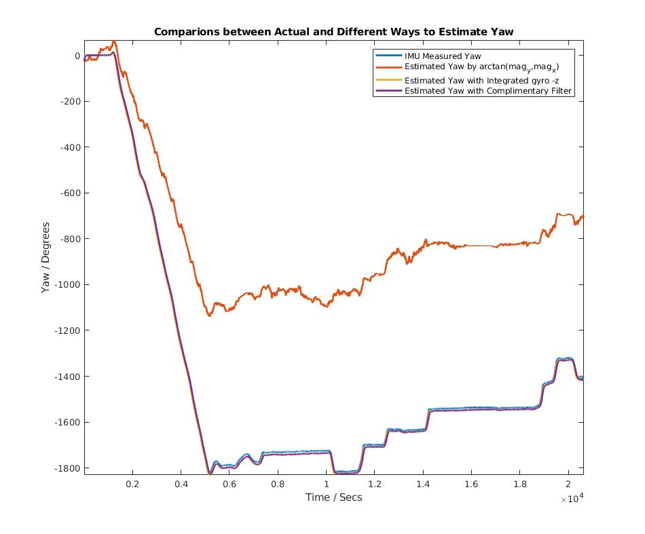
Motion IMU: Yaw Estimation Methods Comparison
1. Arctan(mag_y, mag_x):
Displayed as the orange line, the errors are caused by the distortion in mag_x and mag_y that is not completely removed after soft/hard iron compensation.
2. Integrating gyro -z with cumulative trapezoidal integration (yellow line):
Closer to the actual measured yaw.
3. Complimentary filters:
- Added a low pass butterworth filter to yaw calculated by arctan(mag_y, mag_x)
- Added a high pass butterworth filter to gyro -z
- Used the following formula with alpha = 0.033:
yaw = (1-alpha) * (yaw’ + high-pass filtered (gyro -z)* dt) + alpha*low-pass filtered(arctan(mag_y, mag_x)

Slide 7
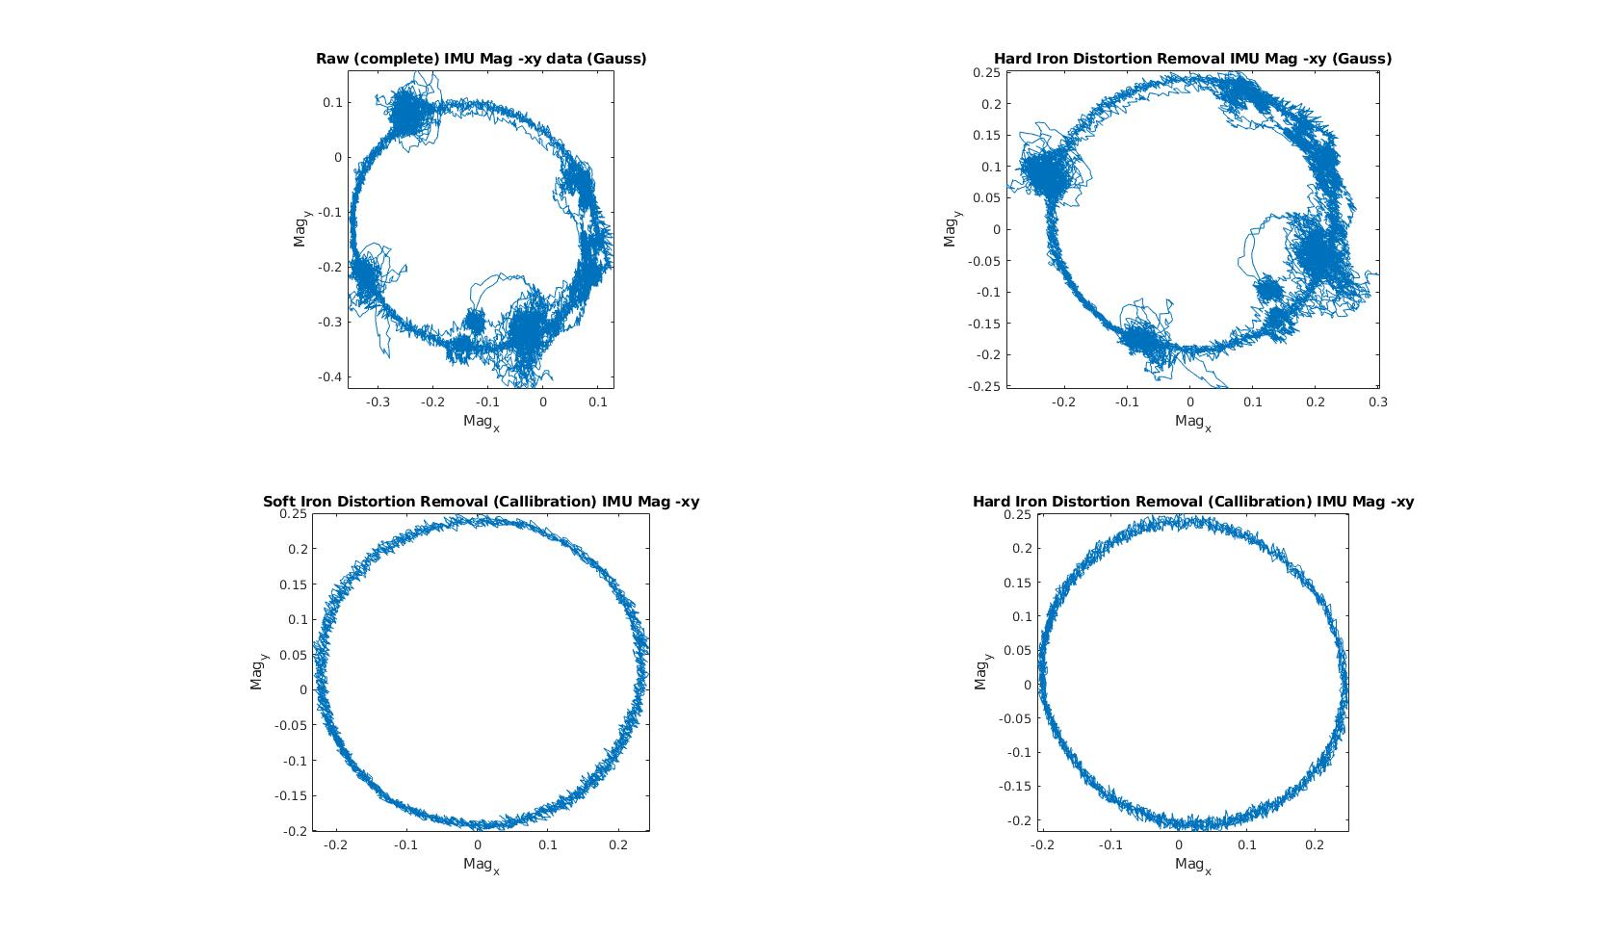
Motion IMU: Soft and Hard Iron Compensation
Hard iron effects : produced by produced by materials that exhibit a constant, additive field to the earth's magnetic field. Removing offsets: (max – min)/2 from both x and y axis, to move the ellipse to origin (0,0).
Soft iron effects: result of material that influences, or distorts, a magnetic field.
Compensated by first calculating the rotation angle when the major axis overlap x and y axis, then multiply the rotation matrix to the raw mag data. (credits: fit_ellipse.m)
All soft and hard iron correction parameters are taken during 360 degrees calibration (29 sec to 125 seconds)

Slide 8
Motion IMU: Yaw Estimation Methods Comparison
1. Arctan(mag_y, mag_x):
Displayed as the orange line, the errors are caused by the distortion in mag_x and mag_y that is not completely removed after soft/hard iron compensation.
2. Integrating gyro -z with cumulative trapezoidal integration (yellow line):
Closer to the actual measured yaw.
3. Complimentary filters:
- Added a low pass butterworth filter to yaw calculated by arctan(mag_y, mag_x)
- Added a high pass butterworth filter to gyro -z
- Used the following formula with alpha = 0.033:
yaw = (1-alpha) * (yaw’ + high-pass filtered (gyro -z)* dt) + alpha*low-pass filtered(arctan(mag_y, mag_x)

Slide 9
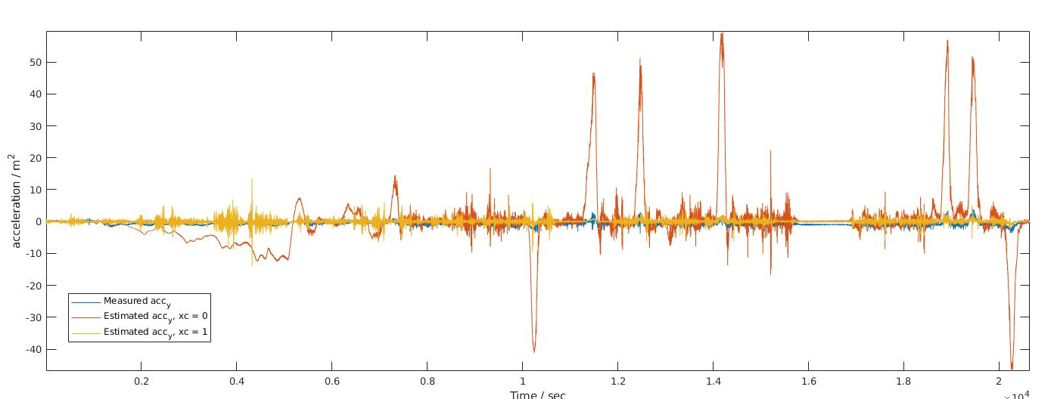

Motion IMU: acc_y Estimation and comparison
Assuming that 𝑌̇ = 0, according to the given formulas:
When xc = 0, acceleration – y is computed with acceleration -x integrated once and multiplied with gyro – z (shown in red). Compared with the measured acceleration – y, the main cause for the difference is because of setting xc = 0, neglecting the position of the IMU in the vehicle, implying that the IMU turns the same amount of degrees as when located in the center-of-mass in the vehicle.
The best fit for xc to make the estimated acc_y close to the measured acc_y is 1 (yellow line in above graph).

Slide 10
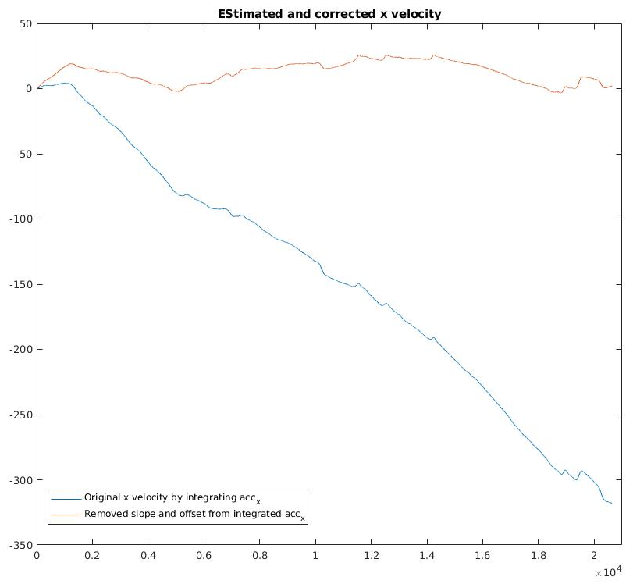
Motion IMU: Estimating and Correcting velocity - x
Estimation of the velocity is done by integrating the measured acceleration – x once (blue in left plot).
We do see a stable slope of the velocity due to the IMU is not placed completely flat at the time of data collection
A rotation angle was derived from “polyfit” and atan function, then used as a rotation matrix applied to the original estimated x velocity. Offset/bias also removed (setting min as 0).

Slide 11
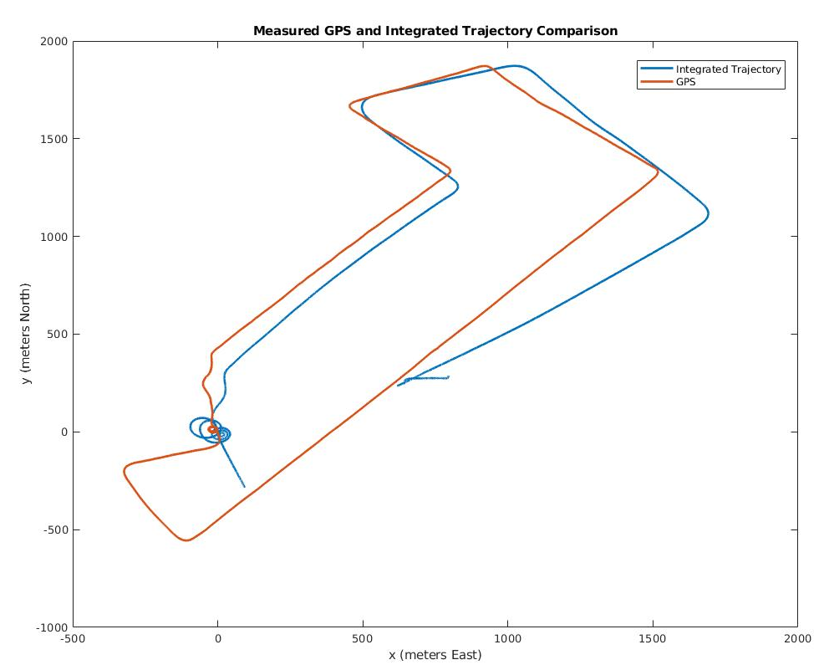
Motion IMU: Integrated vehicle position and GPS
Position of vehicle obtained by integrating (corrected) x – acceleration once again, then multiplying the estimated yaw angle to each segment of the integrated twice acceleration x data (multiply sin for x, cos for y).
Inaccuracy of estimated position plot due to accumulative error from yaw angle estimation, velocity estimation and existing pitch angle.
(two plots adjusted to same at the same origin (0,0), Integrated position rotated 20 degrees clockwise shifted to overlap starting point; GPS plot enlarged twice in size.)

