Slide 1
Lab 3 – Camera Calibration and Image Stitching
Step 1: Calibrate camera:
- Print out a plain checker board and stick to a flat surface.
- Take photos from different angles, height and distance with iphone.
- Use the Matlab Camera Calibration Tool.
- Get calibration data for camera. Save calibration results for undistorting photos.
Step 2: Undistort photos with the same Matlab Camera Calibration Tool (“undistort_image_color” command).
Step 3: Stitch undistorted images back together to form a panoramic mosaic with Harrison feature detector.
Location of photos:
- Mural of Latino Student Association located on Forsyth street.
- Cinder wall located on 2nd floor ISEC building.
- Mural located next to West Village Garage

Slide 2
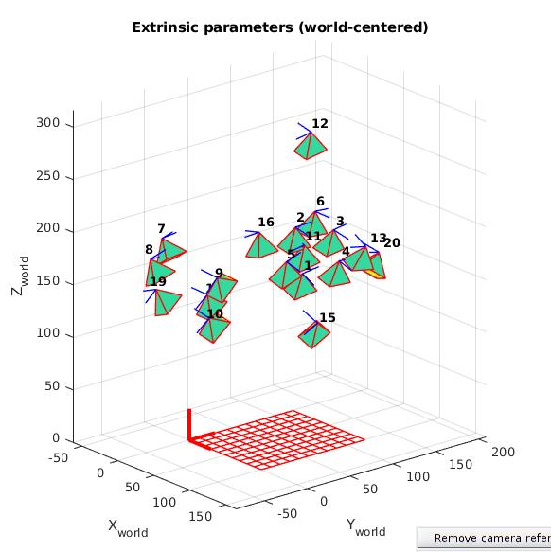
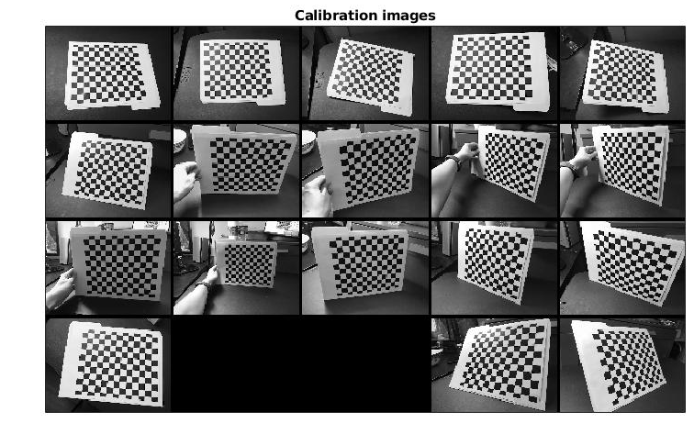
Camera Calibration
Calibration Results:
No. of image: 20
Focal length: fc = [ 515.06 ; 568.54 ]
Principal point: cc = [ 318.11 ; 242.63];
Skew coefficient: alpha_c = 0;
Distortion coefficients: kc = [ 0.16 ; -0.48 ; -0.003 ; 0.0008; 0 ];
Focal length uncertainty: fc_error = [ 2.81 ; 3.14];
Principal point uncertainty: cc_error = [ 3.75 ; 3.42 ];
Skew coefficient uncertainty: alpha_c_error = 0;
Distortion coefficients uncertainty: kc_error = [ 0.022 ; 0.091 ; 0.003 ; 0.003 ; 0 ];

Slide 3
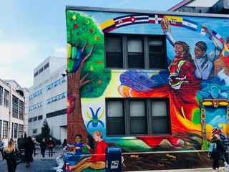
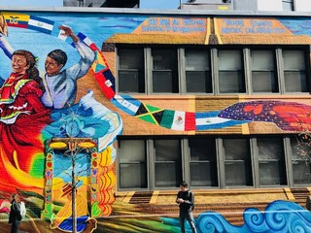
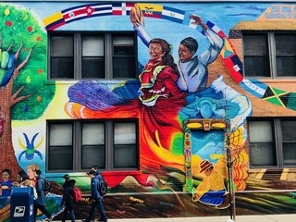
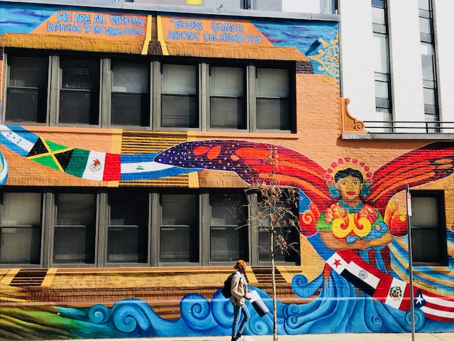
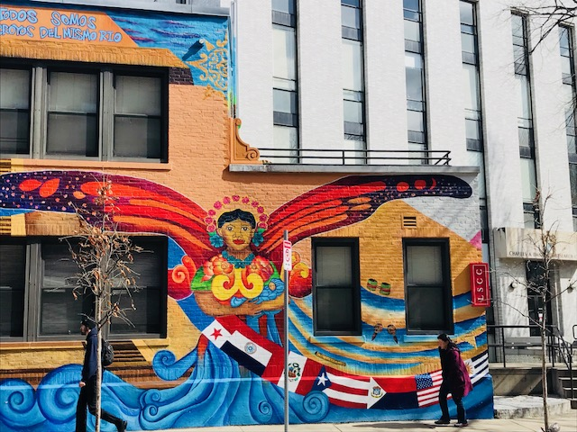
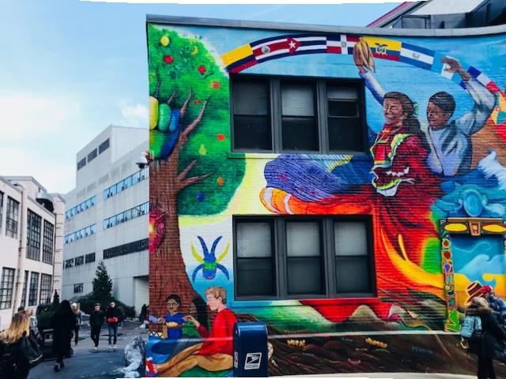
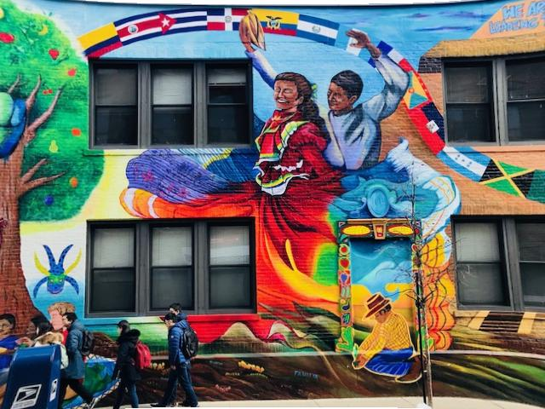
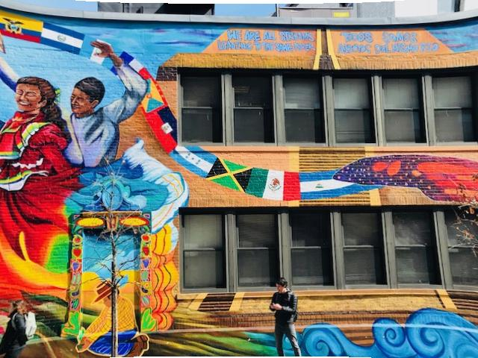
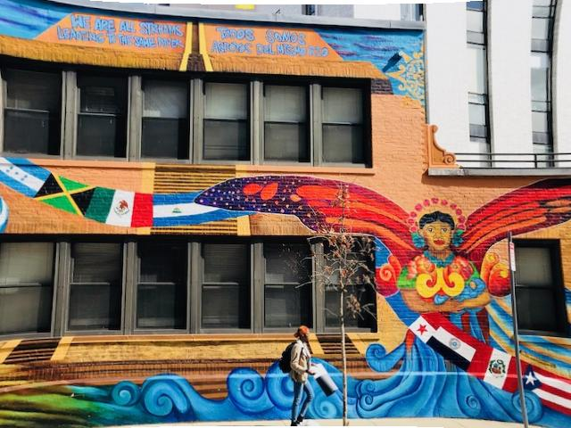
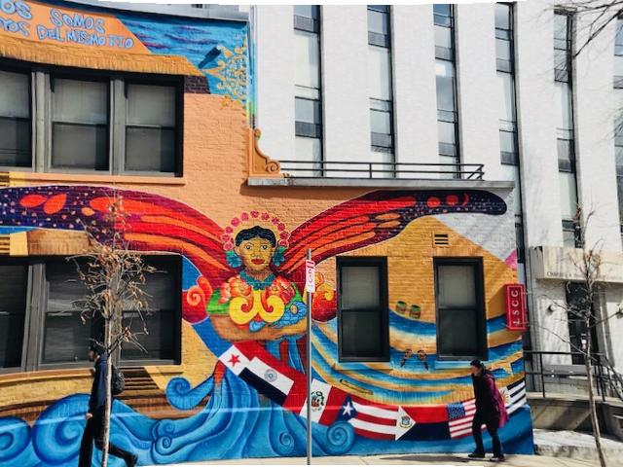
Mural 1 Images
Mural photos before camera calibration.
Mural photos after camera calibration.

Slide 4
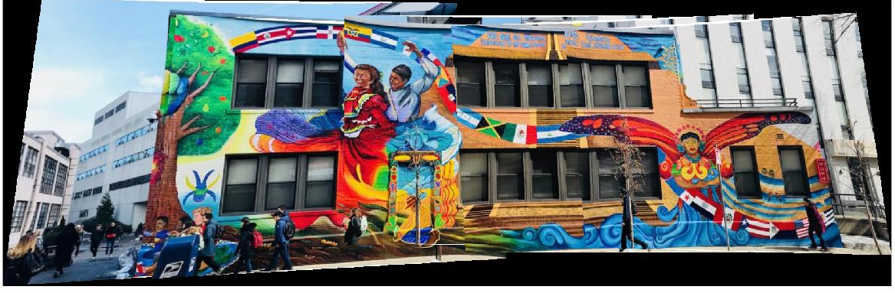
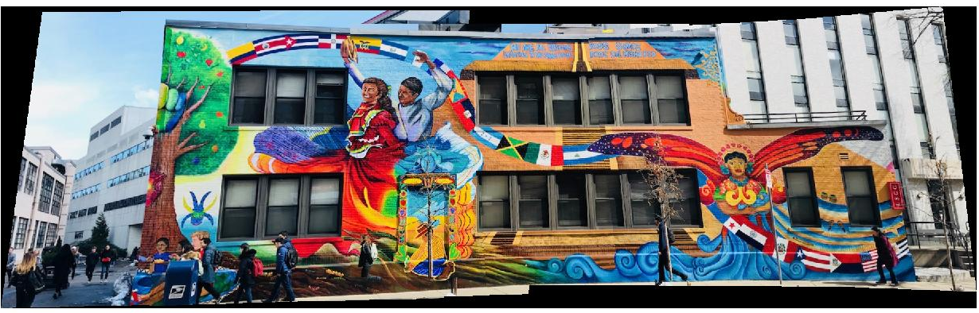
Mural 1 Stitching
Mural photo stitching after camera calibration for each image.
Mural photo stitching before camera calibration on each image.
(looks slightly better but seemed a bit curved in.)

Slide 5
Estimating Camera Position with calibrated Mural 1 Images
To estimate the amount of distance moved when taking the photos in different positions, we simply take the difference between the center pixel coordinates of the mural in the images.
First image center pixel point: (424.5, 226.5)
2nd image center pixel point: (320, 209). Distance moved: 105.95 pixel
3rd image center pixel point: (320, 227). Distance moved: 104.50 pixel
4th image center pixel point: (320, 220). Distance moved:: 104.70 pixel
5th image center pixel point: (240, 155). Distance moved:: 197.87 pixel

Slide 6
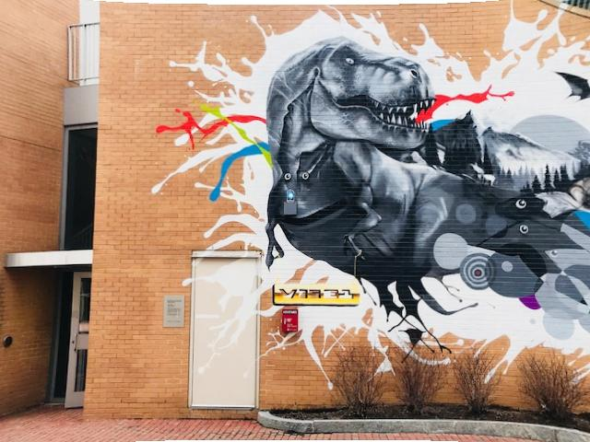
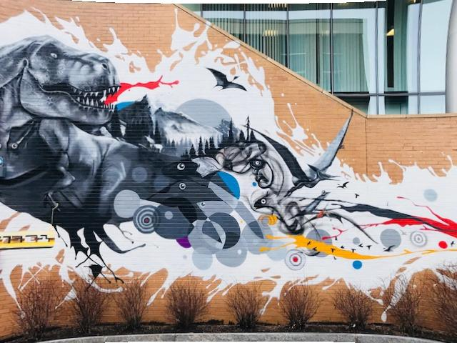
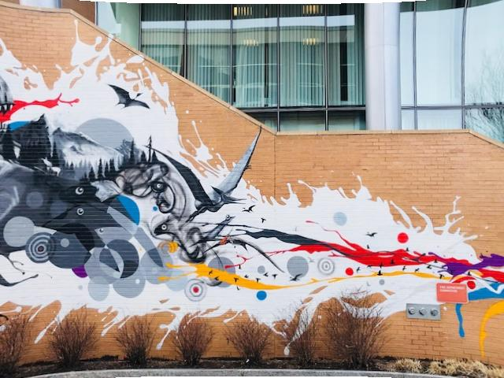
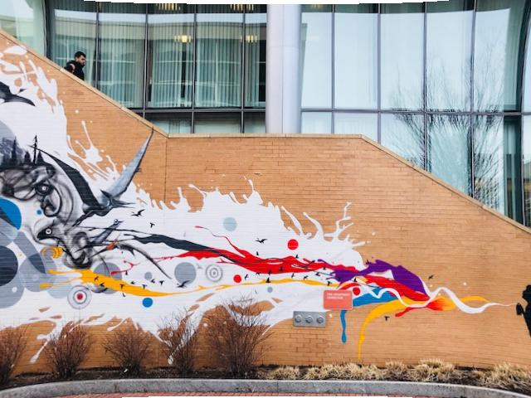
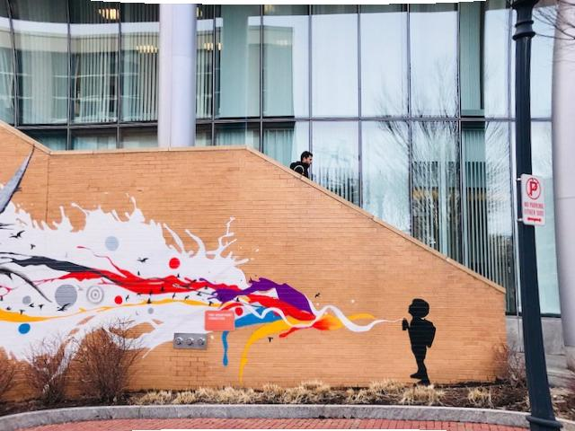
Mural 2 Images
Mural 2 photos after camera calibration.

Slide 7
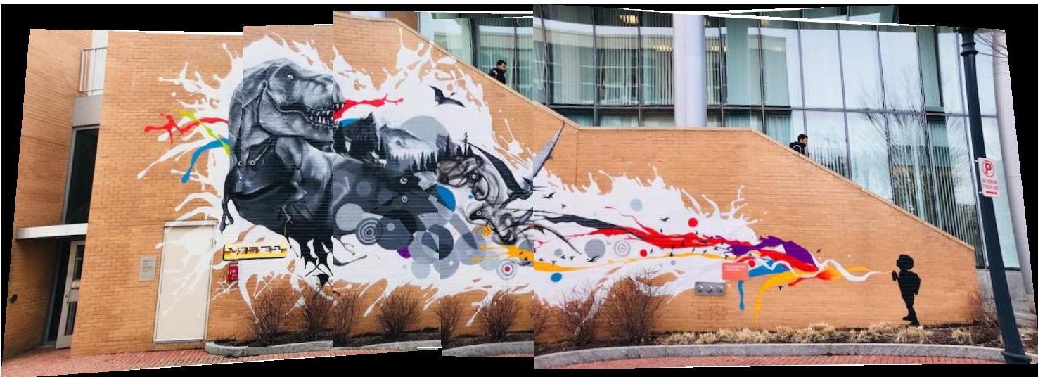
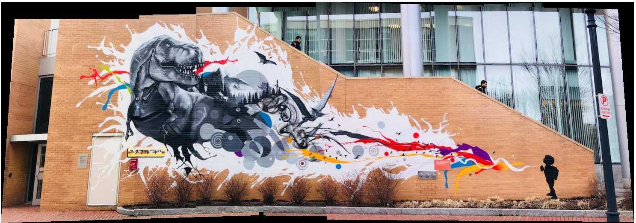
Mural 2 Stitching
Same person
Mural photo stitching after camera calibration for each image.
Same person
Mural photo stitching before camera calibration on each image. (Better result)

Slide 8
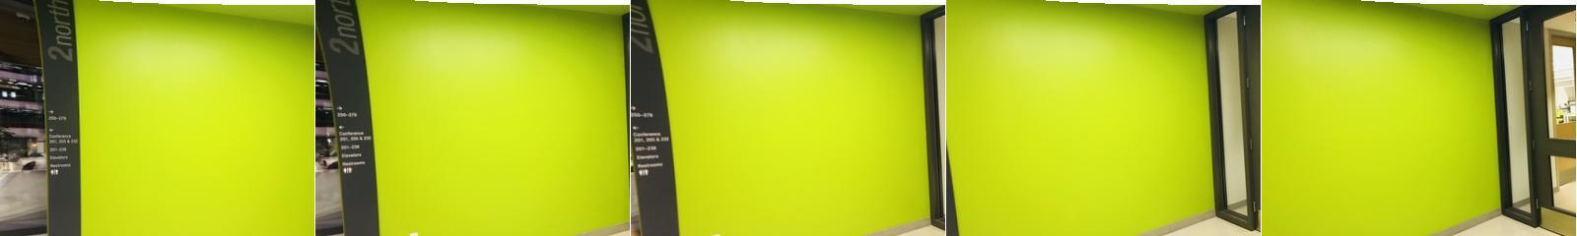
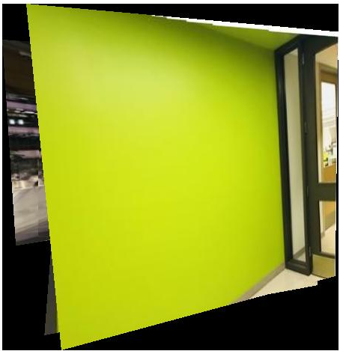
Cinder Wall Stitching
Stitched undistorted cinder wall image: distortion due to lack of features.
Improved by lowering confidence (Increasing this value improves the robustness of the results at the expense of additional computations) and increasing maximum distance (distance from a point to the projection of its corresponding point) in estimateGeometricTransform (Estimate geometric transform from matching point pairs) function.

