Slide 1
PPT of executive summary of case questions.
- By ‘The Good Karma’

Slide 2





Our Team & Backgrounds
Graduate students in M.S. Business Analytics
Leveraging our team’s combined 20+ years of experience across industries
Technology.
Finance.
Consulting
“Turning Analytics into Insights”
Abhishek Saha
Pooja Adiseshu
Prajwal Kuchangi
Aman Jiddewar

Slide 3
What is a “poison pill”?
Solution 1
Poison pill defense, also known as a shareholder rights plan, is used by the company's board of directors to guard against a hostile takeover.
Situation –
For instance, someone buys 20%, of the company shares he is a bidder now who can take over the company. In reaction to this, the board issues new shares at a discounted price and the other shareholders have the right to buy newly released shares. If the other shareholders can buy the recently issued shares at a discounted price, the percentage of that one shareholder dilutes and the cost of bid increases. Under these circumstances, the bidder will be less inclined to take over the corporation without the board's approval.

Slide 4
Is the poison pill good from shareholder’s perspective?
Solution 1
We argue that it is good from the shareholders perspective.
Since the board has the power to activate the poison pill, this avoids the bidder from negotiating with other shareholder and getting into an alliance or make malicious attempt to gain control over shares.
The poison pill pressurizes the bidder to present their best proposal.
The board works more closely with the managers than the shareholders do, the board is in a better position to access the prospective growth of the company.
Research at J.P Morgan showed that since 1997, corporations which had poison pill defense mechanism in place have received on an average 4% premium at takeover as compared to the companies without poison pill.

Slide 5
Proposed model for Earnings at Risk (EaR).
Solution 2.a
Six significant risks to focus on were identified by Willis Report.
Of those six, weather, inventory, and commodity are risks that would vary with the type of grain. We should also note that the impact and variance would be high in weather factor relative to inventory and commodity.
Segment by business function
Is board grain or not
Individual grain type

Slide 6
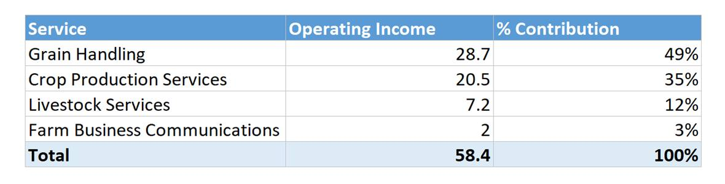
The model assumptions and assessment.
Solution 2.a
From the 1998 data, we can estimate the % contribution to revenue of each business function and allocate risk accordingly.
Since the government issuing a floor price regulates the board grain prices, its price fluctuation will be less and the impact on UGG’s revenue also will be less.
Risks associated with board and non-board grains are significantly different and need to be calculated separately.
The price variation of each crop within the business functions, because the weather conditions will affect each yield differently.
Assign the risk associated with each crop using probability.

Slide 7
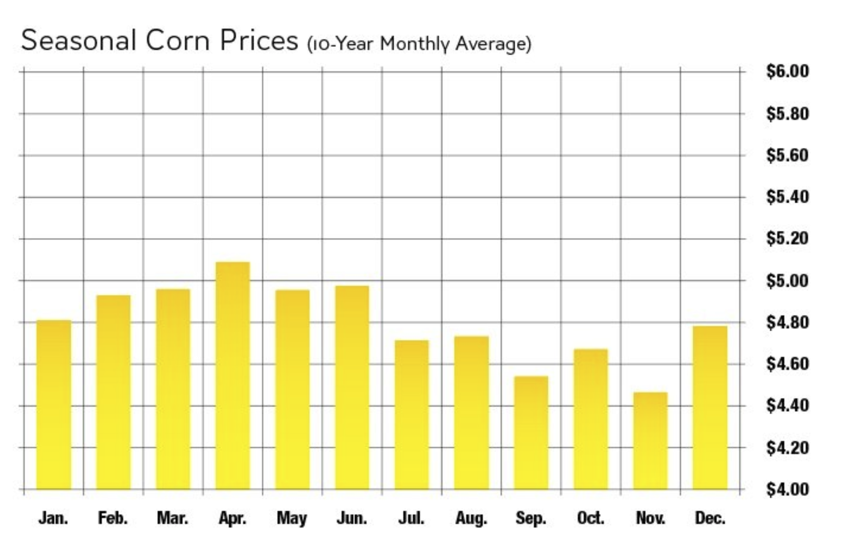
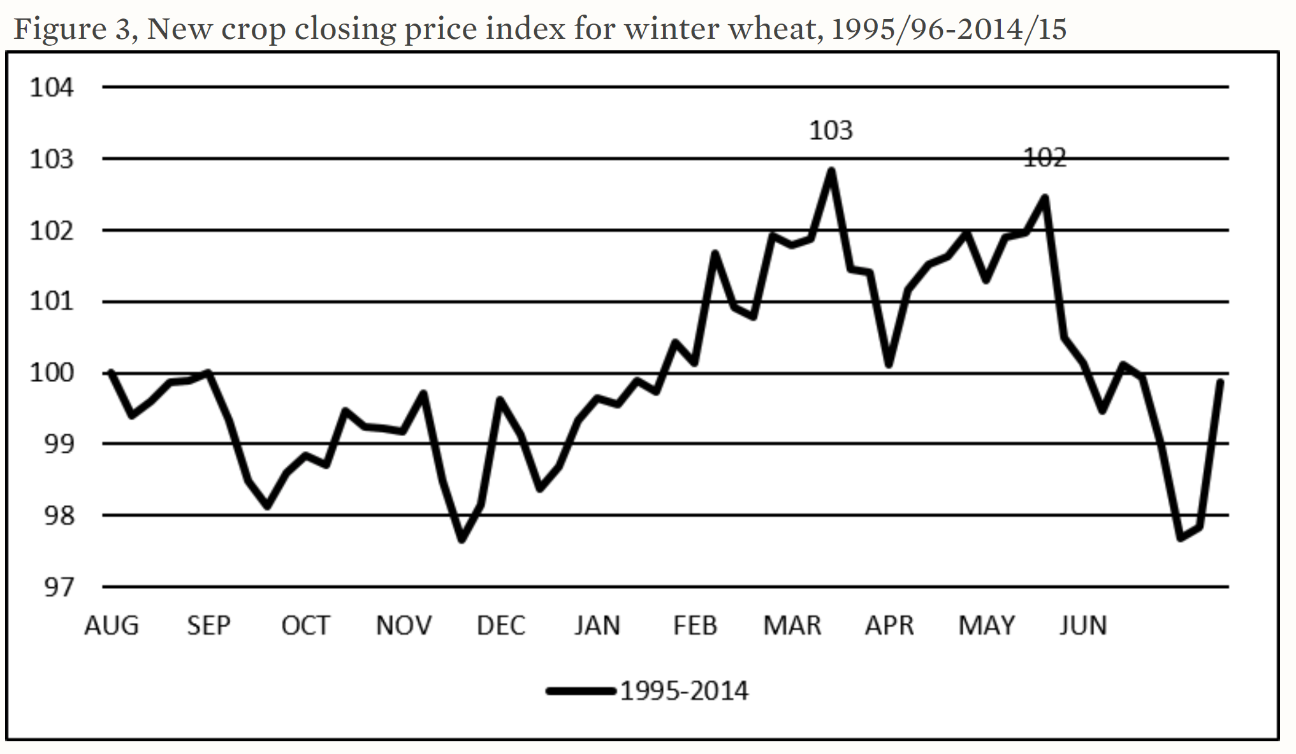
Corn and wheat prices generally tend to increase starting from November to March- April. Therefore, a general solution would be to enter into a futures contract with a long hedge starting from November till end of March
Solution 2.b
References
https://farm.unl.edu/crop-price-patterns
https://www.agriculture.com/markets/analysis/crops/corn-soybean-seasonal-patterns-are-changing

Slide 8
The most effective hedging strategy corn and wheat.
Solution 2.b
Ideal hedging strategy would be extended futures position for $500mn portfolio.
Corn:
A 60% corn portfolio implies a USD 300mn portfolio. A price rise of 10 cents would impact the portfolio negatively by nearly USD 8mn.
Hedge against rising corn price by taking up a position in the corn futures market.
To implement the long hedge, enough corn futures are to be purchased to cover the quantity of corn needed for the business and should be stored for more than a month.
To protect against this price rise, an extended futures position can be entered at 3.72 USD per bushel or lower if possible.
By entering into this agreement, USD 8mn or more can be saved.

Slide 9
The most effective hedging strategy corn and wheat (cnt…)
Solution 2.b
Winter Wheat:
The price of wheat is 202 USD per mt as of Dec 3rd, 2018. It rose to a cost of 204 USD per mt as of Jan 20th, 2019.
The quality risk associated with wheat could be evaluated to enter a strike price lesser than 202 USD per mt.
USD 1.98mn can be saved by entering at a strike price of 202 USD per mt.
A total of approximately $10mn can be saved by entering into a futures contract with a long hedge.

Slide 10
What is 94% variability of earnings explanation.
Solution 3
Four variables - precipitation in June & July, and average temperatures in February & September, explained 85% variation in crop yields.
The crop yields, i.e., the yields as a function of the four variables, were then used to model the variation in earnings of UGG’s grain handling.
In the model which explains the earnings, crop yields are explaining 94% of the variation in the earnings.

Slide 11
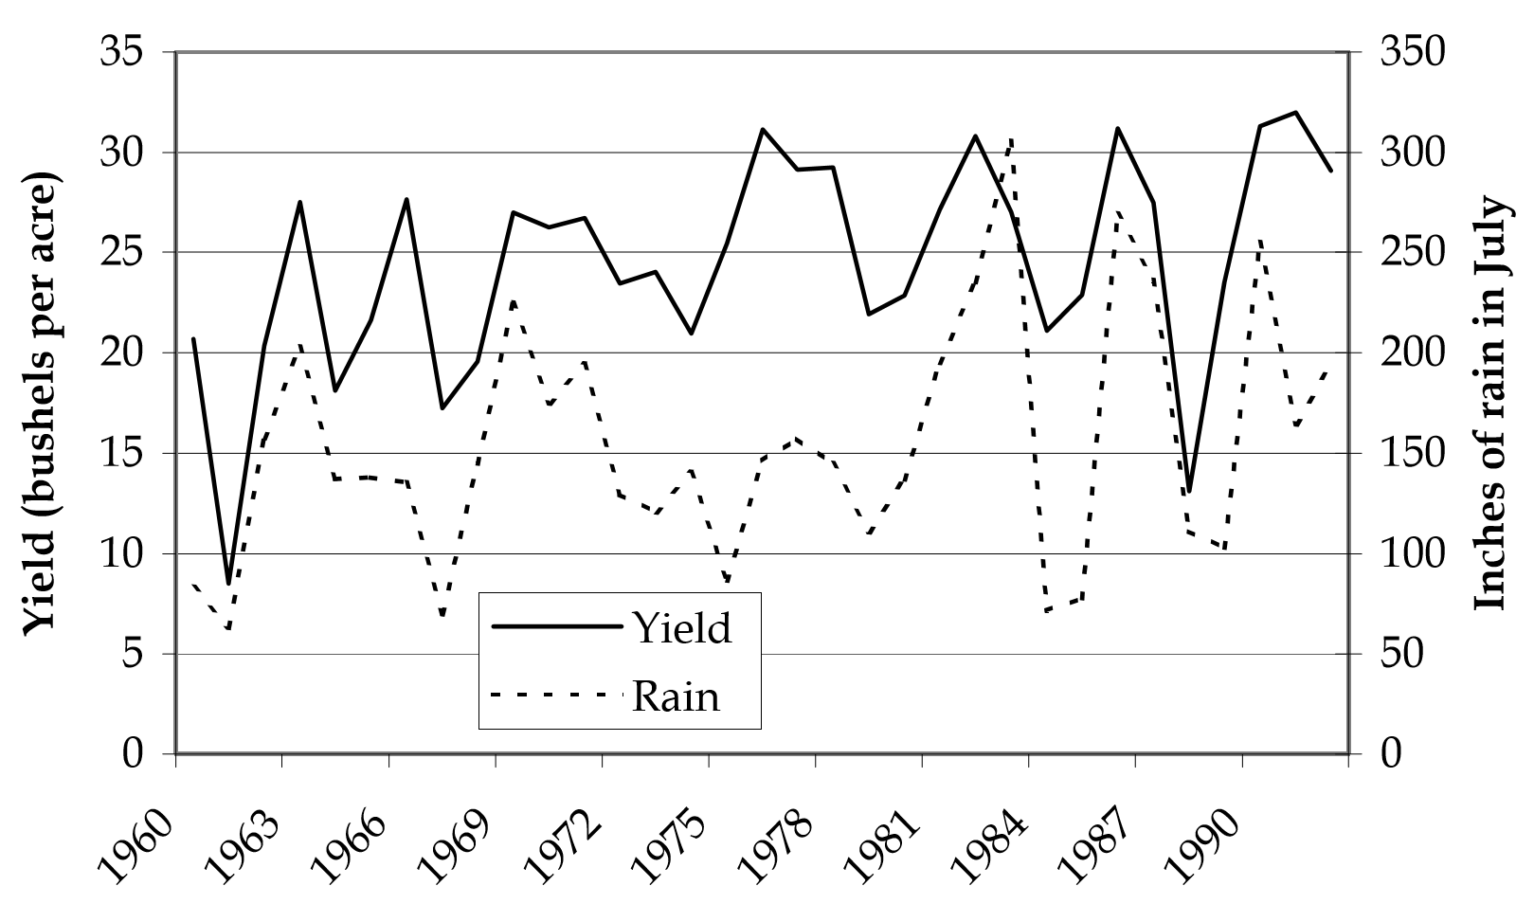
All-wheat yield in Saskatchewan and the July precipitation for 1960 through 1992
Solution 3
The yield depends on the rain according to the regression equation
Yield = 15.5 + 0.0577 * Rain, with an R-squared of 43%
*Refer exhibit 7

Slide 12
Pitfalls to a model that explains earnings.
Solution 3
The uncertainty of earnings increases for each year in the forecast
If we were to project earnings for future years, then for each outer year of earnings projection, we would build in more uncertainty in the model.
The further the projection, the more uncertain the earnings.
As per the model, the earnings are based on yields, which are in turn based on precipitation and average temperatures.
The projection of precipitation and average temperatures for a given year is based on previous years’ values.
Hence the more futuristic the earnings projection, the less the values are based on available data.
The sensitivity of growth rate assumption.
Assuming a single growth rate for all years could also lead to incorrect earnings projections.

Slide 13
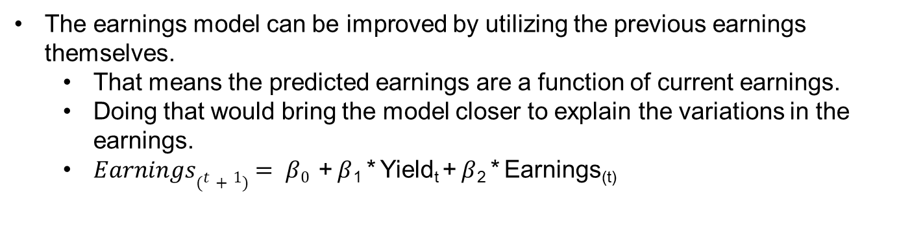
How to improve the model to better explain earnings.
Solution 3
The earnings model can be improved by utilizing the previous earnings themselves.
That means the predicted earnings are a function of current earnings.
Doing that would bring the model closer to explain the variations in the earnings.
$Earnings(t+1)= β0$ + $β$₁ * Yield_{t} + $β$₂ * Earnings_{(t)}

Slide 14
Insurer to provide unlimited protection for a crop.
Solution 3
Crop insurance requires several conditions to be fulfilled, like results of some events outside the control of the insured party, farmers facing a pure risk – a risk not offset by hope of gain & affordable premium for the party seeking coverage.
To be able to provide unlimited protection, all these conditions would need to be fulfilled to the fullest levels.
First, all risks must be accounted for, assuming negative results of all events outside control.
Secondly, the risks to the crop should not be speculative, thus not making profits from those risks.
Thirdly, the premium should be affordable, which typically happens through government subsidies.

Slide 15
Thank You. Questions?

Slide 16
Appendix

Slide 17
References
Takeover Defenses Work. Is That Such a Bad Thing? Mark Gordon
Pearce, John & Jr. Robinson, Richard. (2004). Hostile takeover defenses that maximize shareholder wealth. Business Horizons. 47. 15-24. 10.1016/j.bushor.2004.07.004.
Top 3 Pitfalls of Discounted Cash Flow Analysis (www.investopedia.com)
An Improved Earnings Forecasting Model, Richard D.F. Harris & Pengguo Wang (April 2013)
The Strange Economics of Crop Insurance (www.niskanencenter.org/blog/the-strange-economics-of-crop-insurance/)

