Slide 1
PROJECT PORTFOLIO
EDA|DATA VISUALIZATION
AMANDEEP KAUR

Slide 2

MYSELF
I’m Amandeep, a passionate and detail-oriented Data Analyst with expertise in data visualization, reporting, and analytics. Skilled in tools like Python, SQL, Power BI, Tableau and Excel, I enjoy transforming complex datasets into actionable insights that help businesses make informed decisions.
I have hands-on experience with real-world projects, and building interactive dashboards to present clear, impactful insights. Currently, I am seeking new opportunities where I can apply my analytical skills, learn from challenging projects, and contribute to data-driven decision-making. I am excited to bring my curiosity, problem-solving mindset, and passion for data to a dynamic team.

Slide 3
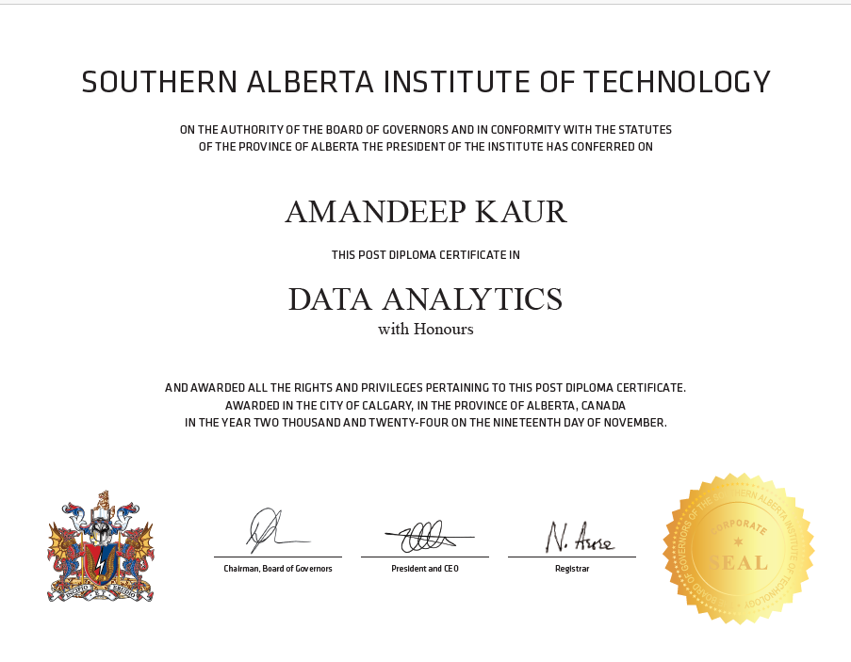

CERTIFICATES

Slide 4


EDUCATION(Contd…)
Southern Alberta Institute of Technology, Calgary | 2023 – 2024
Data Analytics
Advanced SQL query writing, python, database design & optimization
Data visualization using Power BI & Tableau
Data cleaning, warehousing, and ETL processes
Statistical analysis & forecasting
Olds College, Alberta | 2017 – 2019
Business Management Diploma
Business operations and administration
Strategic planning and decision-making
Financial analysis and budgeting
Marketing strategies and customer relationship management
Microsoft Office Suite (Excel, Word, PowerPoint)

Slide 5

EDUCATION(Contd…)
Punjabi University, Patiala, Punjab(India)|2016-2017
Masters in Information Technology
Proficient in programming languages: Java, Python, SQL
Knowledge of database management systems (DBMS) and query optimization.
Skilled in web technologies: HTML, CSS, JavaScript

Slide 6



TOOLS USED FOR THE PROJECT

Slide 7
Netflix Data Visualization Project
Overview: The Netflix dataset includes information about shows and movies such as title, genre, rating, country, and release year. Using this data, I created a dashboard to explore content distribution, user ratings, and trends over time.
Final Insights from Dashboard:
Visualized the number of shows by genre to identify the most popular categories.
Showed top-rated content across different countries.
Highlighted country-wise content availability and audience preferences.
Analyzed content release trends over the years to spot growth patterns.
Designed an interactive dashboard allowing filtering by genre, country, and year for deeper insights.

Slide 8
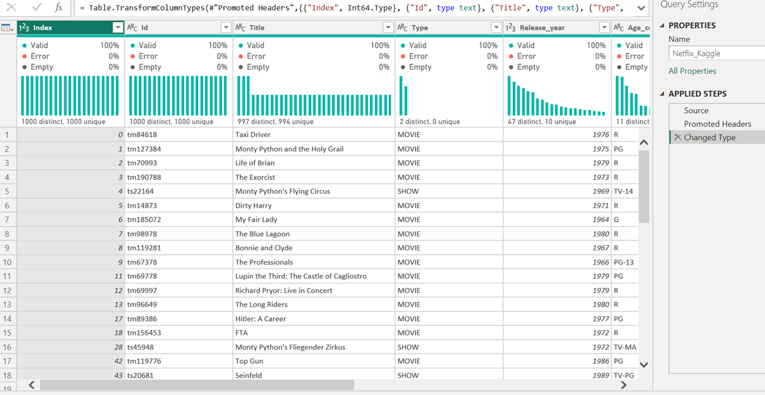
DATA CLEANING
Data Cleaning Steps in Power Query
Loaded Dataset: Imported the Netflix dataset downloaded from Kaggle into Power BI using Power Query.
Promoted Headers: Converted the first row into column headers for better readability and structure.
Changed Data Types: Assigned appropriate data types to each column for consistency and accuracy:
Index → Whole Number (Int64.Type)
Id → Text
Title → Text
Type (Movie/Show) → Text
Release_year → Whole number
Age_certification → Text
Validated Column Values: Checked for null, duplicate, or inconsistent values.

Slide 9
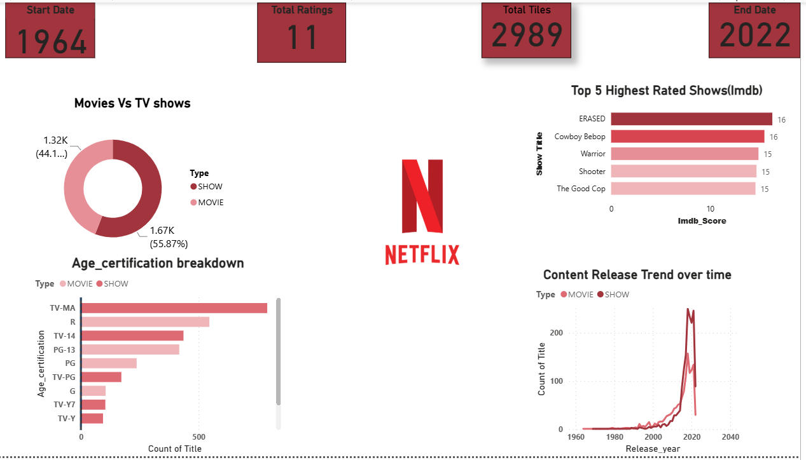
POWER BI DASHBOARD

Slide 10
LET’S CONNECT
GitHub: amandeepgill2312-eng
LinkedIn: www.linkedin.com/in/amandeep-kaur-136b45187
Email:Amandeepgill2312@gmail.com

