Slide 1
Variable Selection Using Random Forest
An Introduction to the “fifer” package in R

Slide 2
Overview
Introduce “small n, large p” problem
Brief review of traditional approaches
Review of Random Forest and Variable importance
Overview of Genuer’s approach
My algorithm
Show results from the Military dataset

Slide 3
The Problem
Small n, large p
i.e., Lots of variables, but few participants
How to cull the massive amounts of variables for the few that are predictive
Either prediction or “interpretation”

Slide 4
Example Dataset
Military Dataset
Has 205 lupus patients
For 55 of them, we measured cytokine levels
Each has two samples before diagnosis and one at diagnosis
32 cytokines
Attempt to predict who develops Lupus
Which do we choose?

Slide 5
Several Problems with Dataset
Lots of variables
Variables have funky distributions
Missing Data
“Clustering” caused by multiple measurements

Slide 6
Common Approaches
Pairwise tests to filter out bad predictors
ignores multivariate nature of data
E.g., interaction effects, collinearity, conditional estimates
Stepwise regression
Capitalizes on chance
Estimates of fit are biased (because they only consider final model)
Poor reproducibility and cross-validation
“All-subsets” (grid searches)
Implausible with large number of variables

Slide 7
More Advanced Approaches
Genetic Algorithms
Require some measure of “fit”
Randomly selects candidate models, assesses “fit,” then allows those that perform well to “mate.”
Yes, this is a gross simplification
Random Forest

Slide 8
Random Forest
Random forest is a collection of decision trees
Usually in the neighborhood of hundreds or thousands
Far less likely to capitalize on chance than traditional procedures
Implicitly detects interaction effects
It’s nonparametric (doesn’t require assumptions about the distribution of the variables)

Slide 9
RF Procedure
1. Randomly select 2/3 of the sample
We’ll call this the calibration sample
The remaining 1/3 = Out of Bag (OOB) sample
2. Randomly select a subset of the variables (typically sqrt(# variables)
3. Using those variables, build a decision tree for the calibration sample
4. Classify individuals in the OOB sample
Compute proportion of errors (OOB error)
5. Repeat
And repeat
And repeat (like, 1000 times).
Each “tree” is saved for later analysis.

Slide 10
Variable Importance
One feature of RF is the computation of “variable importance”
Lots of ways to compute it
Gini = kinda sorta like a measure of accuracy at a particular split
Permutation –
Permutation Variable Importance
For each tree and variable, randomly “permute” (shuffle) the scores on the predictor variables
This should “destroy” the relationship between Y and the Xs
Compare accuracy before and after shuffling
The difference in OOB error before and after permutation is the Variable Importance
E.g., If Variable A’s importance is .05, that means permuting Variable A’s scores results in a drop of 5% in accuracy

Slide 11
Random Forest and Variable Selection
We can use variable importance to select variables
Lots of variable selection algorithms out there for Random Forest (see Hapfelmeier and Ulm, 2013 for a review)
I’ll focus on Genuer, Poggi, & Tuleau-Malot’s (2010) algorithm.

Slide 12
Genuers et al’s Algorithm
1. Compute variable importance with all variables included in the model
Repeat 50 times and average VI (computed through GINI)
2. Eliminate “noisy” variables
This is done by using the standard errors in step 1 to estimate an “effectiveness threshold”
3. Add each of the remaining variables, in order of importance, in a stepwise fashion.
4. Select the top n variables according to some standard
Standard = model with smallest number of variables that is less than OOB error of OOB_{min} + SD_{OOBMin}
5. (Optional) With the remaining n variables, repeat the process and only add a variable if it improves fit beyond some threshold
i.e., the final model may not be consecutive
E.g., Might have Y = variable 1 + variable 72 + variable 888 (where numbers correspond to their importance)

Slide 13
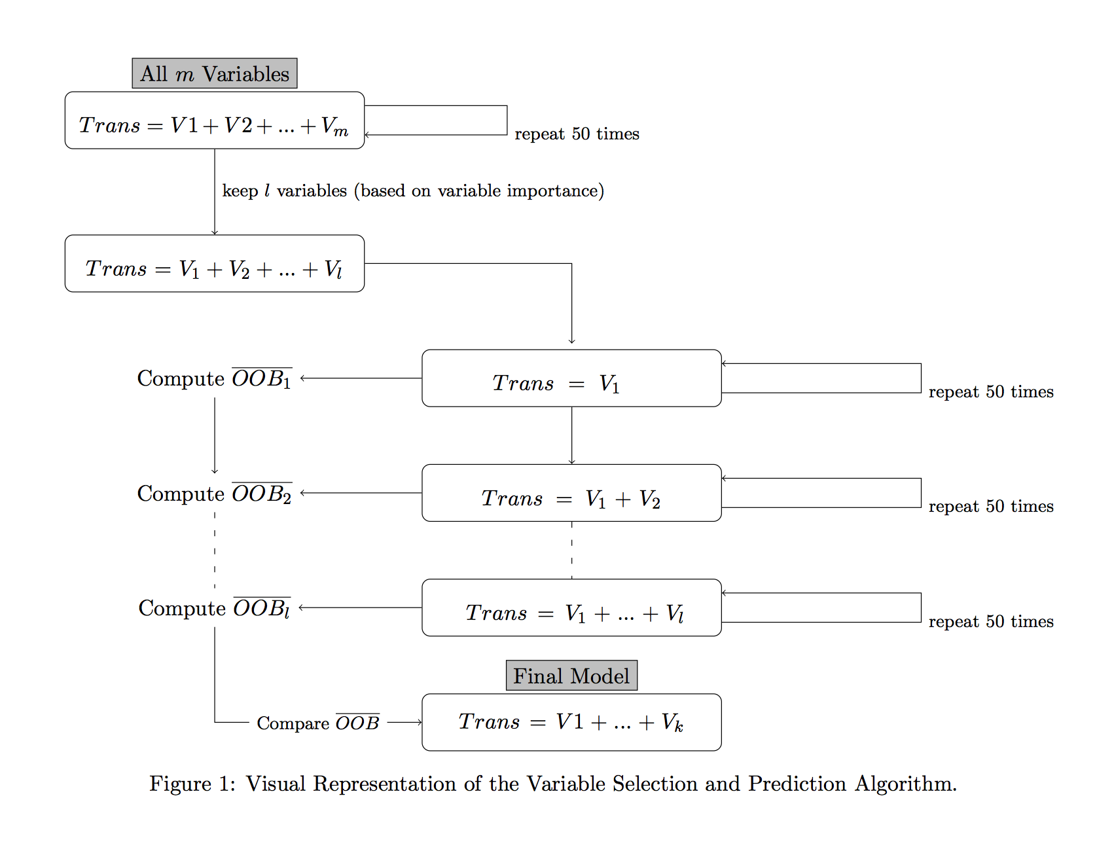

Slide 14
How well does it do?
Monte Carlo and studies show it does well at selecting “true” variables
see Hapfelmeier and Ulm, 2014 and Genuer, Poggi, & Tuleau-Malot, 2010.
Applied studies show promise as well

Slide 15
Limitations
Has biased variable importance measures
Cannot handle missing data
Does not handle clustered data

Slide 16
Random Forest in the fifer package
fifer package
A miscellaneous collection of functions for data manipulation, data analysis, and plotting in R.
Available on CRAN and on github.com/dustinfife/fifer
Contains the RF variable selection algorithms
Designed to address the limitations of Geneuer et al’s algorithm

Slide 17
Biased Estimates of Variable Importance
Geneuer’s algorithm VI estimate is biased when the number of “levels” of the predictor variables varies
E.g., including gender (two levels) and height (lots of levels)
Why? 2 Reasons (Math warning!)
1. VI measures (GINI) themselves are biased
Gini index computes accuracy at all possible split levels for a variable
For dichotomous variable, there’s only one split
For continuous data, there’s a LOT of places to split.
Continuous data are more likely to produce good splits by chance
Gini Index favors continuous data because of chance factors
My algorithm uses conditional inference trees (which avoid this problem)
Incorporates the number of categories (kinda like a chi-square test)
2. Bootstrapping (which is native to Geneuer’s algorithm) induces a spurious correlation between X and Y
Too technical to explain why
Subsampling (i.e., sampling without replacement) fixes this problem.
The fifer package implements subsampling.

Slide 18
Genuer’s Algorithm Cannot Handle Missing Data
Missing data is common
Typical methods include deleting a row or a column from dataset
Geneuer’s algorithm requires a complete dataset
Normally I would do multiple imputation
BUT—imputation model should be at least as sophisticated as the analysis model (Enders, 2010)
Put differently—they should match
Using parametric imputation, then analyzing with non-parametric methods doesn’t make sense
Wouldn’t it be nice if there were missing data techniques for Random Forest!

Slide 19
Imputation in Random Forest
Variable Importance for missing data
Rather than permuting (shuffling) the scores on the predictor variable, we permute the assignments to the child node (Hapfelmeier et al, 2013b)
E.g.,
Suppose we’re trying to compute VI for BMI
Old method: assign person B’s BMI score to person Q and compute the difference in fit.
New Method: instead of assigning people into “heart disease” based on BMI, we randomly assign them “heart disease”
Compute difference in classification errors just as before
New Method doesn’t care if data are missing

Slide 20
Clustered Data
Genuer’s algorithm can’t handle clustered data
It has been suggested (e.g., Karpievitch et al, 2009) that clustering can be handled by randomly selecting clusters, rather than individuals
Results in trees being independent from one another
Not fully implemented in fifer
Can be used when GINI index is used to compute variable importance
It’s on my to-do list!

Slide 21
Example on real data

Slide 24
Step | Current Variable | OOB Error | Model Selected
1 | IL.5 | 0.055 | IL.5
2 | IL.4 | 0.045 | IL.5 + IL.4
3 | IFNgamma | 0.029 | IL.5 + IL.4 + IFNgamma
4 | TGF.beta | 0.024 | IL.5 + IL.4 + IFNgamma + TGF.beta
5 | MCP.3 | 0.019 | IL.5 + IL.4 + IFNgamma + TGF.beta + MCP.3
6 | PAI.1 | 0.018 | IL.5 + IL.4 + IFNgamma + TGF.beta + MCP.3 + PAI.1
7 | IL.17A | 0.020 | IL.5 + IL.4 + IFNgamma + TGF.beta + MCP.3 + PAI.1
8 | IP.10 | 0.019 | IL.5 + IL.4 + IFNgamma + TGF.beta + MCP.3 + PAI.1
9 | IL.21 | 0.019 | IL.5 + IL.4 + IFNgamma + TGF.beta + MCP.3 + PAI.1

Slide 25
Summary (so far)
Random Forest able to achieve 98% accuracy.
Gives an idea of what variables are predictive
Doesn’t tell how these variables relate to Lupus
Nor how they change over time

Slide 26
Growth Curves
Goal: Show how cases change over time, relative to controls in each cytokine.
Problem is the same as before—
non-normal data
Non-independent data
Nonparametric mixed models?
OR used generalized mixed models
Mixed because there’s multiple timepoints
Generalized because the residuals are funky
I’d love to model the distribution of residuals using a Gamma distribution, but SAS and R both break
Instead, assume a Poisson
Computer doesn’t care that it’s not count data

Slide 27
What growth curves do
Essentially, they fit a regression line to each individual
Then, they average these regression lines across individuals.
The average regression coefficients = the “fixed” effects
The variability about these coefficients = the “random” effects

Slide 29
Future Directions
Comparison of RF to other methods
Use RF on GWAS data
Includes a built-in cross-validation component
Perhaps won’t require us to use such stringent p-value penalties (e.g., Bonferroni)
Will require a LOT of computational resources

