Slide 1
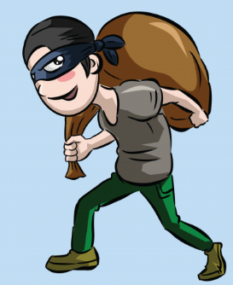
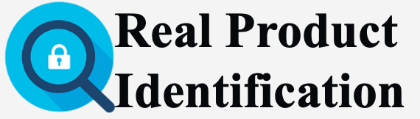
A Blockchain solution for identifying counterfeit products
Capstone Project
BCDV - 1014

Slide 2
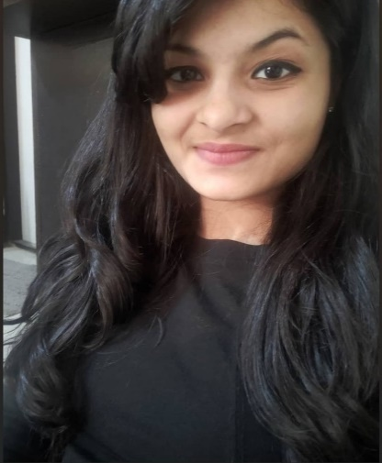
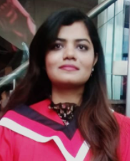
About Us:
I am Kinjal Ashra Postgrad Blockchain development student at George Brown College
I completed my Bachelor’s in Electronics and Telecommunication
I have about 3 years of experience as a Software Engineer
I am Amandeep Kaur Bal
Postgrad Blockchain development Student at George brown college
I completed my bachelor's in information technology in 2020 In 2021, I have done post graduate diploma in project management from Canadore college I have about one year experience as IT project manager

Slide 3

Problem:
How can the buyer recognize whether the brand and product is trustworthy or not?

Slide 4

Solution:
Counterfeit products are detected using a QR code scanner, where a QR code of the product is linked to a Blockchain.
So, this system may be used to store product details and generated unique code of that product as blocks in the database.
If the code matches, it will give a notification to the customer, otherwise it will give the notification to the customer that the product is fake.

Slide 5
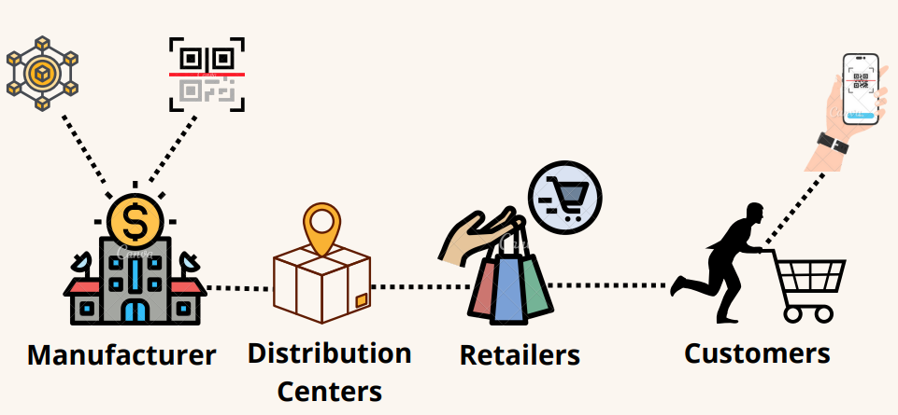
System Architecture:

Slide 6
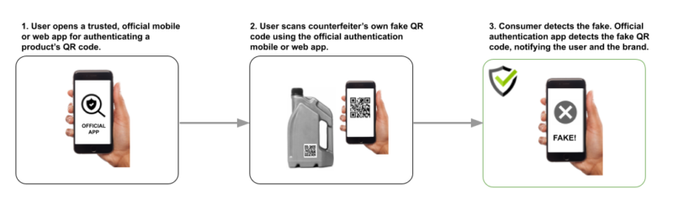
How the application will work:

Slide 7

Benefits:
Prevents the loss in sales.
Flexible.
Provides a secure and trusted tracking system from one end to another end.

Slide 8
Built With
Mobile App: Android Studio - Android app NodeJS - Server Environment MySQL - Database
Blockchain: Ethereum - Blockchain Network Solidity - Smart Contracts Ganache - Create private Ethereum blockchain to run tests

Slide 9

Restrictions:
Products that have already been manufactured prior to today cannot be tracked.
We currently depend on the company to register with our services.

Slide 10

Summary
Blockchain technology is used to detect fake products. Furthermore, the information is encoded into a QR code.
Customers can scan QR codes assigned to a product and can get all the information like transaction history, current owner based on which end-user can check whether the product is genuine or not.

Slide 11

Thank you!!
Amandeep Kaur Bal
amandeeprich@gmail.com | https://www.linkedin.com/in/amandeep-kaur-bal/ | https://github.com/amandeeprich
Kinjal Ashra
Kinjalashra098@gmail.com | https://www.linkedin.com/in/kinjalashra/ | https://github.com/KinjalAshra

