Slide 1
Agentic RAG Chatbot for Multi-Format Document QA using MCP
Aman Chinmai Dev Bondla

Slide 2
Agent-Based Architecture with MCP Integration
IngestionAgent: Parses and preprocesses documents.
RetrievalAgent: Performs embedding and semantic search.
LLMResponseAgent: Constructs prompt and generates final answers.
All communication is handled via structured MCP messages:
{ sender, receiver, type, trace_id, payload }

Slide 3
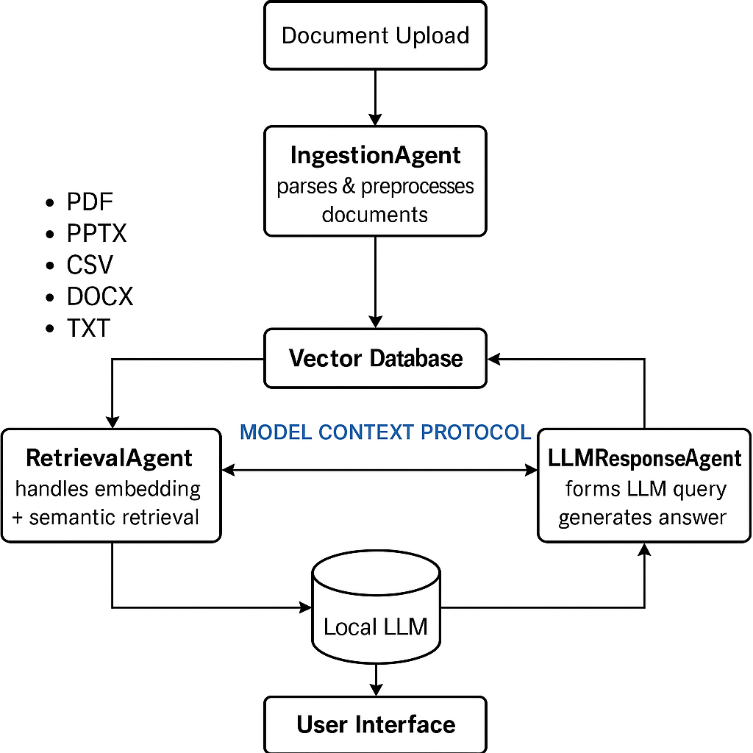
System Architecture

Slide 4
System Flow
1. User uploads document & asks question
2. IngestionAgent extracts and chunks text
3. RetrievalAgent fetches top semantic chunks
4. LLMResponseAgent forms LLM prompt and generates answer
5. UI displays answer + sources
Messages passed via MCP: CONTEXT_REQUEST, RETRIEVAL_RESULT, FINAL_ANSWER

Slide 5
Tech Stack Used
Frontend: Streamlit
Backend Agents: Python classes (modular)
Vector Store: FAISS
Embeddings: sentence-transformers (MiniLM)
LLM: HuggingFace Falcon-RW-1B (local)
Messaging: Custom in-memory MCP protocol
Tools: PyMuPDF, python-docx, pandas, etc.

Slide 6
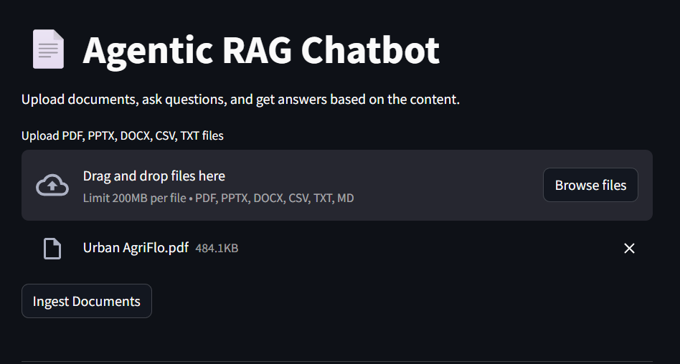
UI Screenshots- Document Uploading
🔍 Upload Document Screen – allows PDF, DOCX, CSV, PPTX, TXT
💬 Chat Screen – input questions and see contextual answers
📄 Source View – see relevant chunks used for each response

Slide 7
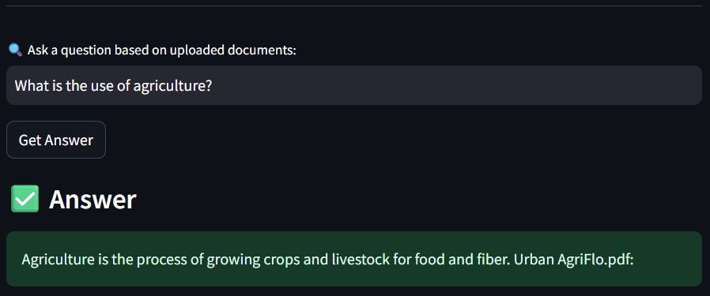
Chat Screen

Slide 8
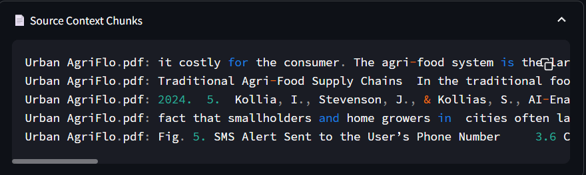
Source Chunks

Slide 9
Challenges Faced & Future Scope
Parsing multi-format documents reliably
Ensuring local LLMs produce accurate responses
Managing multi-turn context across agents
Future Scope:
Add API support for document ingestion
Integrate vector DB like ChromaDB
Deploy as Dockerized microservices for scalability

