Slide 1



DEPARTMENT OF COMPUTER SCIENCE & ENGINEERING
SCHOOL OF COMPUTING
10214CS602 MINOR PROJECT -2 INDUSTRY PROJECTS
WINTER SEMESTER(2023-2024)
REVIEW-1
“CHATBOT FOR HYDROPONICS”
SUPERVISED BY
PRESENTED BY
Dr.T.KAMALESHWAR, M.Tech., PhD.,
1.AMAN DEV (VTU 19464)(21UECB0002)
2.SHREYA TIGGA (VTU 19347)(21UECB0023)
3.SOWMIYA E (VTU 19486)(21UECM0338)

Slide 2
OVERVIEW
ABSTRACT
OBJECTIVES
TIMELINE OF THE PROJECT
INTRODUCTION
LITERATURE REVIEW
DESIGN AND METHODOLOGIES
IMPLEMENTATION
CONCLUSION
REFERENCES

Slide 3
ABSTRACT
Introduction The Hydroponics Chatbot project introduces an AI-driven solution for hydroponic farming, addressing the sector's unique challenges and opportunities.
Purpose: This project aims to develop a specialized chatbot to provide personalized guidance and recommendations to hydroponic farmers, leveraging AI technology and real-time data integration.
Method: Through AI algorithms and data integration, the chatbot engages users in natural language interactions, offering tailored crop management and decision-making advice.
Result: The Hydroponics Chatbot empowers farmers with accessible expertise, enhancing productivity and sustainability while promoting technology adoption and knowledge sharing.
Conclusion: This project marks a significant advancement in agricultural support, offering a valuable tool for driving progress and prosperity in hydroponic farming.

Slide 4
OBJECTIVES
Aim of the project:
This project aims to develop an AI-powered chatbot tailored for hydroponic farming, providing personalized support and advice to users while continuously improving its performance through machine learning techniques.
Scope of the project:
The scope of this project encompasses the creation of an intuitive multi-platform interface for seamless communication with the chatbot. It involves the integration of real-time data sources and the deployment of machine learning methods for ongoing performance enhancement. Additionally, the project entails building and maintaining a comprehensive hydroponics database and conducting usability testing to ensure an optimal user experience.

Slide 5
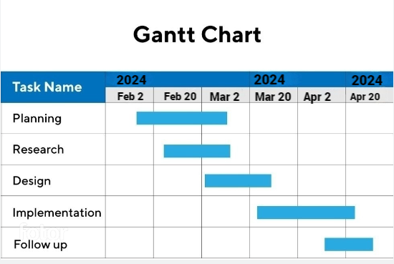
TIMELINE OF THE PROJECT

Slide 6
INTRODUCTION
“Imagine a world where hydroponic farmers have an expert advisor available 24/7, guiding them through every stage of crop cultivation. That's precisely the vision behind our groundbreaking project.“
Introduce the rising trend of hydroponic farming and its potential to revolutionize agriculture.
Highlight the challenges faced by hydroponic farmers in optimizing crop yields and sustainability.
Emphasize the importance of leveraging technology to overcome these challenges and drive innovation in agriculture.
Introduce the Hydroponics Chatbot project as a solution to empower farmers with personalized guidance and recommendations.
Mention the use of AI technology and real-time data integration to provide timely and relevant assistance.
Invite the audience to explore how this project aims to transform hydroponic farming practices and contribute to agricultural advancement.

Slide 7
LITERATURE REVIEW
Author’s Name | Paper name and publication details | Year of publication | Main content of the paper
Lakshmi Sudha Kondaka; Ritvij Iyer; Shreyas Jaiswal. | A Smart Hydroponic Farming System Using Machine Learning | 2023 | Smart Hydroponic Farming System to grow various crops by maintaining and controlling environmental parameters.
Chenchupalli Chathurya; Diksha Sachdeva; Mamta Arora. | Agriculture Chatbot(AGRIBOT)Using Natural Language Processing | 2023 | Agri-bot is a text-to-text chatbot which will help the farmers in answering the queries posed by them.

Slide 8
Anushka Marla; Rejath Paul; Arupam Kumar Saha. | An AgroBot: Natural Language Processing Based Chatbot for Farmers | 2023 | TensorFlow-built chatbots can provide instantaneous assistance to producers
Ruaa Suliman Al-Gharibi | IoT-Based Hydroponic System | 2021 | The project concentrates on developing a hydroponic system based on internet of things technology to provide a flexible growing environment.

Slide 9
DESIGN AND METHODOLOGIES
MODULE 1: Data Collection Module
MODULE 2:Natural Language Proccessing

Slide 10
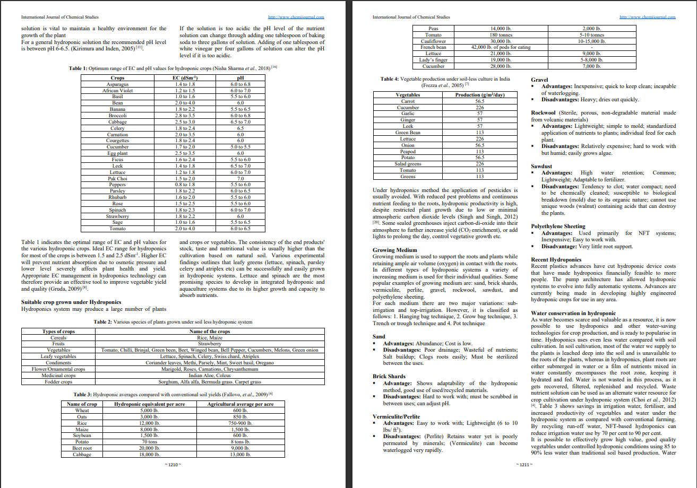
MODULE 1:Data Collection Module
Step:1 Collection of data

Slide 11
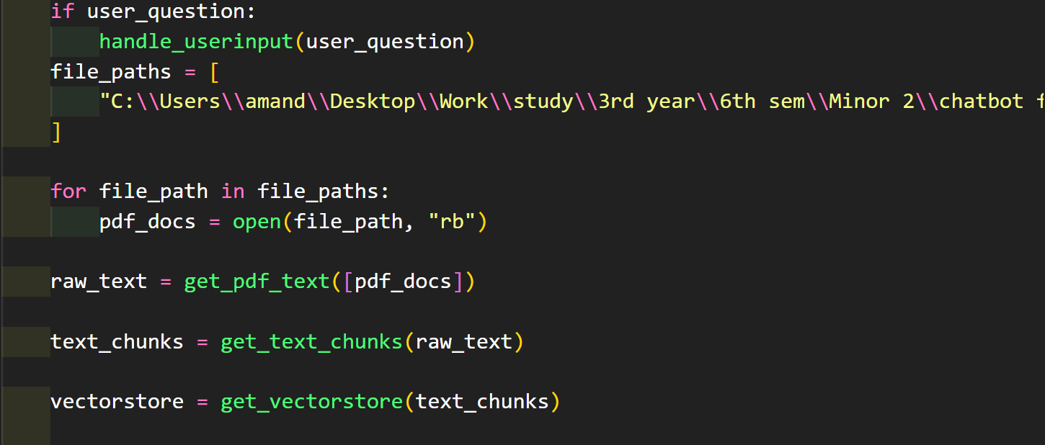
Step 2: Processing the data

Slide 12
Module 2- Natural Language Processing
1. Interpreting Human Language: NLP enables computers to understand and interpret human language, including both written text and spoken words.
2. Information Extraction: Through NLP techniques, computers break down text into smaller units and extract relevant information, such as identifying key words or phrases.
3. Linguistic Analysis: NLP algorithms apply linguistic rules and statistical models to analyse the structure and meaning of text data.
4. Tasks and Applications: NLP is used for various tasks, including sentiment analysis, named entity recognition, part-of-speech tagging, and machine translation.
5. Human-Computer Interaction: NLP facilitates natural interaction between humans and computers, powering applications such as chatbots, virtual assistants, and voice-controlled devices.
6. Data Processing: NLP processes large volumes of unstructured text data, enabling organizations to extract insights and derive value from sources like social media, customer reviews, and news articles.

Slide 13
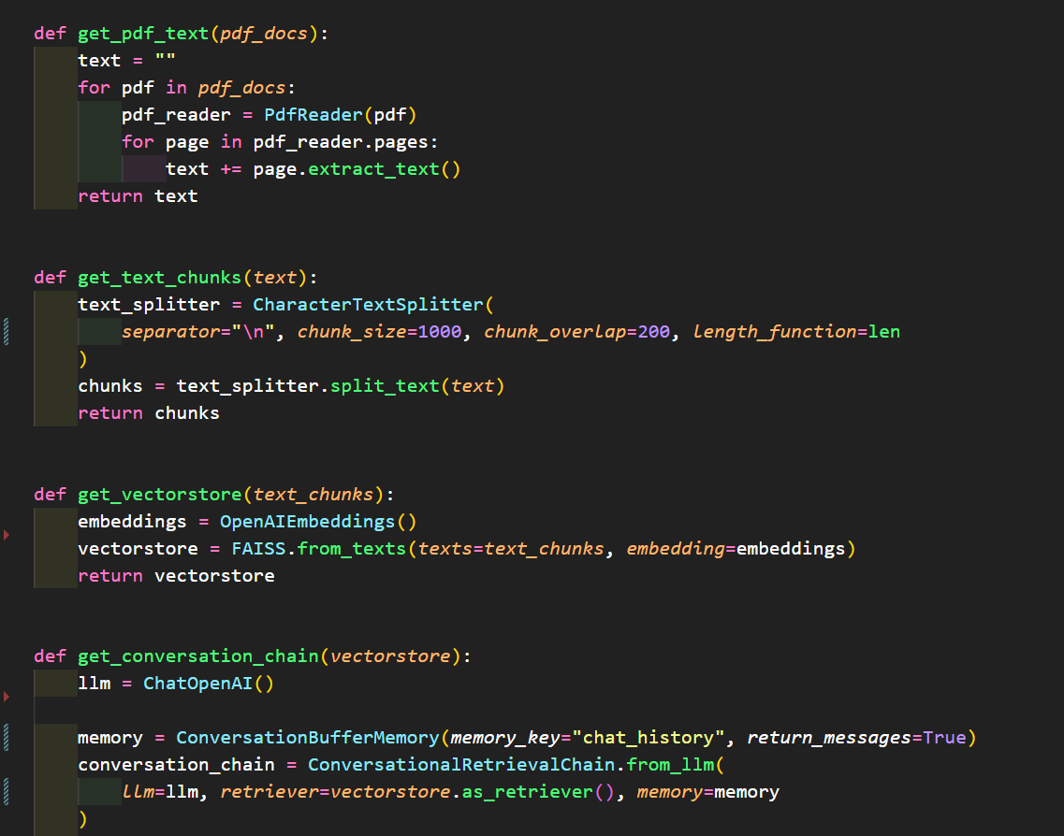
Step 3: NLP ALGORITHM

Slide 14
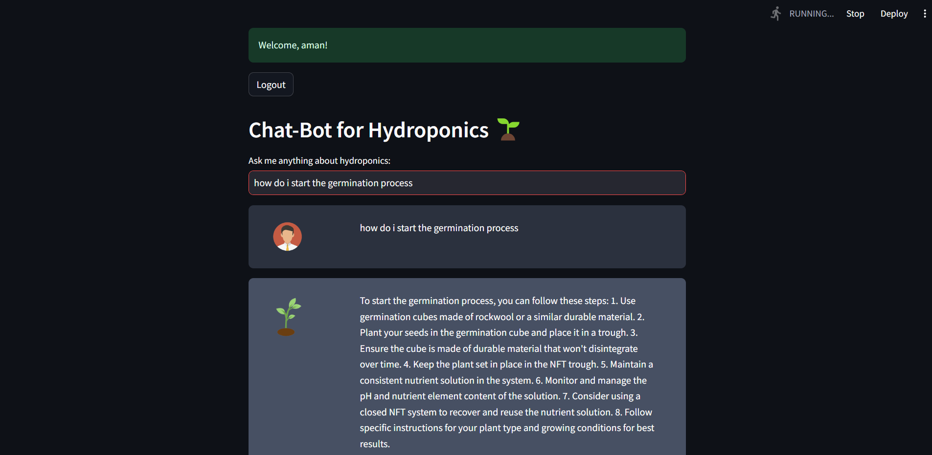
Step 4: The output

Slide 15
IMPLEMENTATION
Architecture Diagram
Data –Flow Diagram
Use Case Diagram
Class Diagram
Activity Diagram
Sequence Diagram
Collaboration Diagram(If applicable)
E-R Diagram

Slide 16
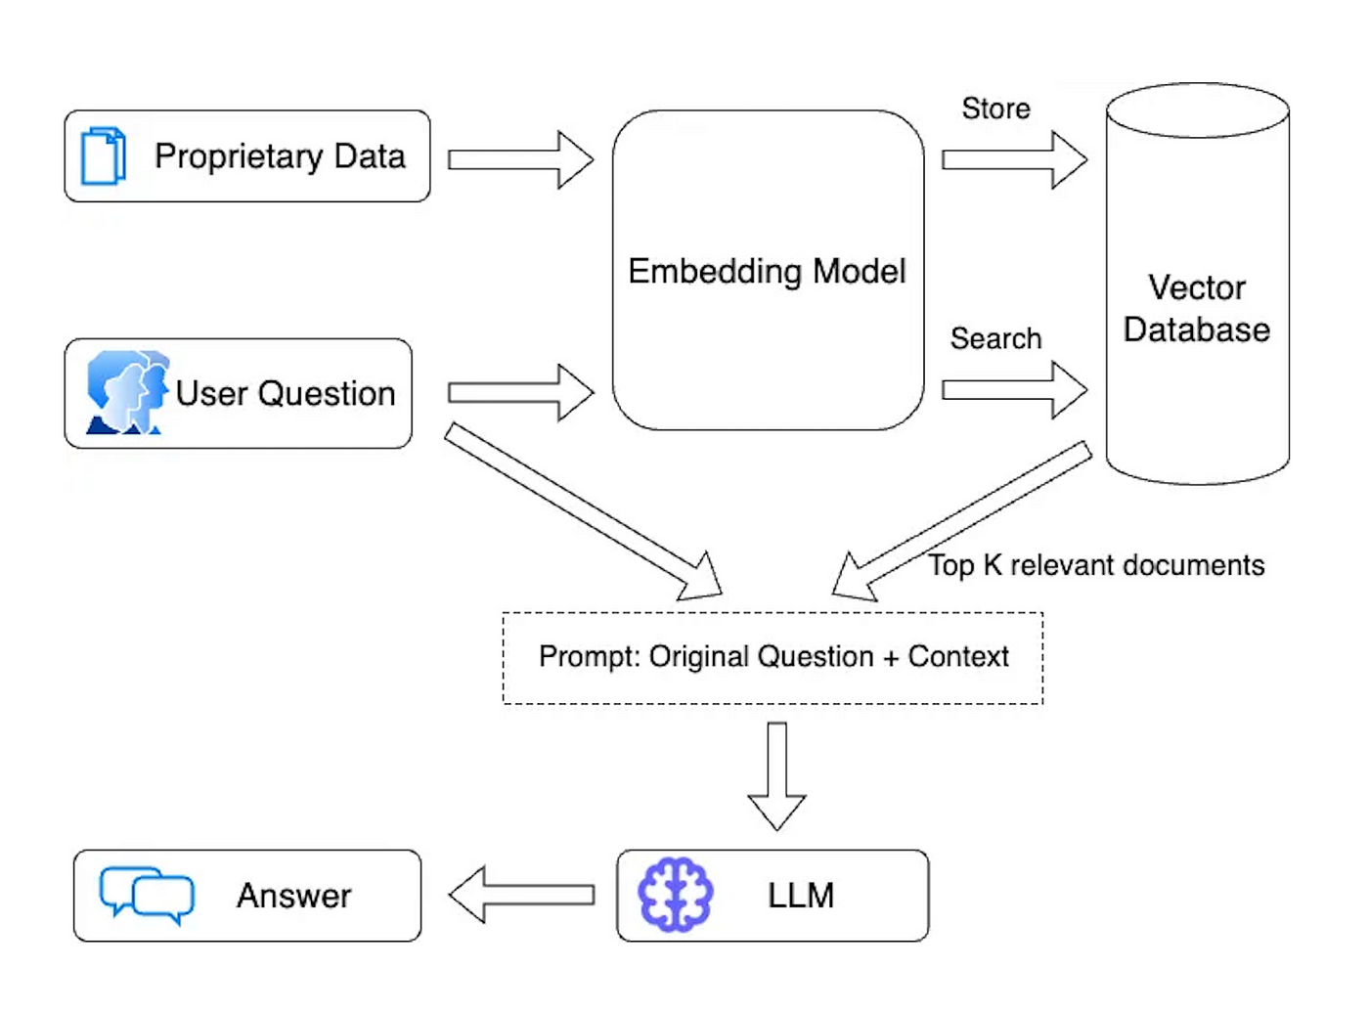
Architecture Diagram
.

Slide 17
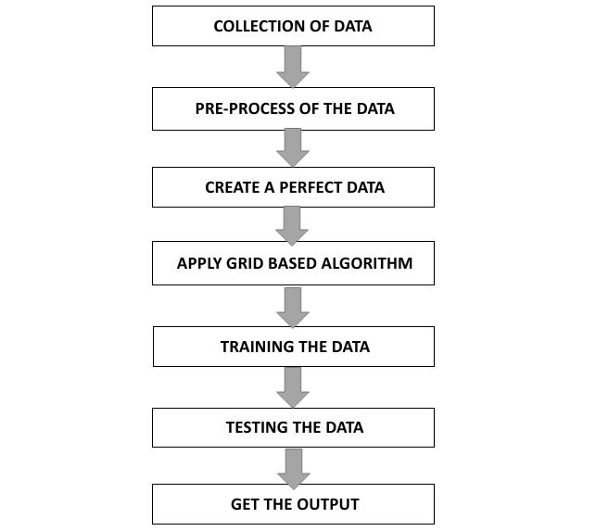
Data –Flow Diagram

Slide 18
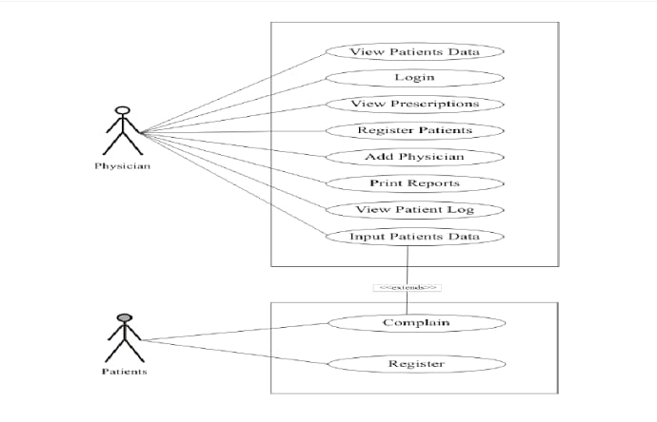
Use Case Diagram

Slide 19
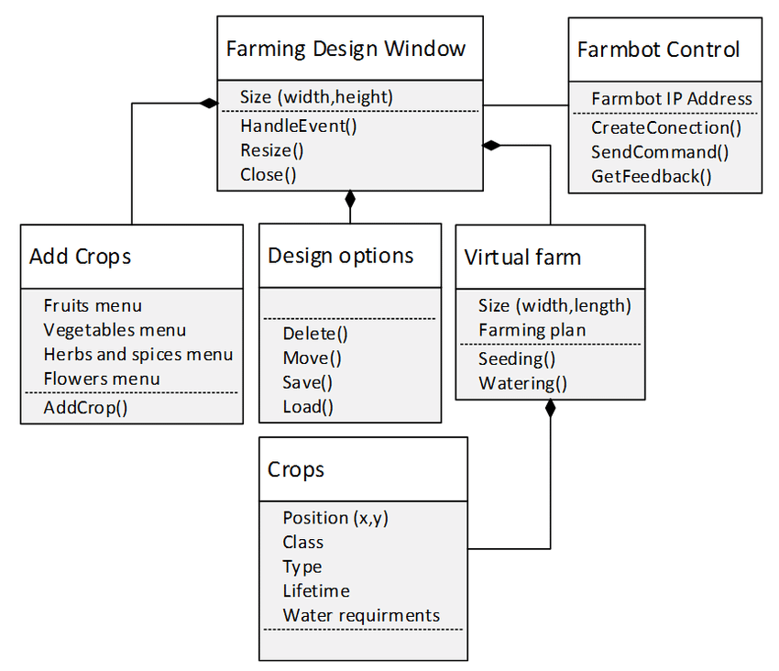
Class Diagram

Slide 20
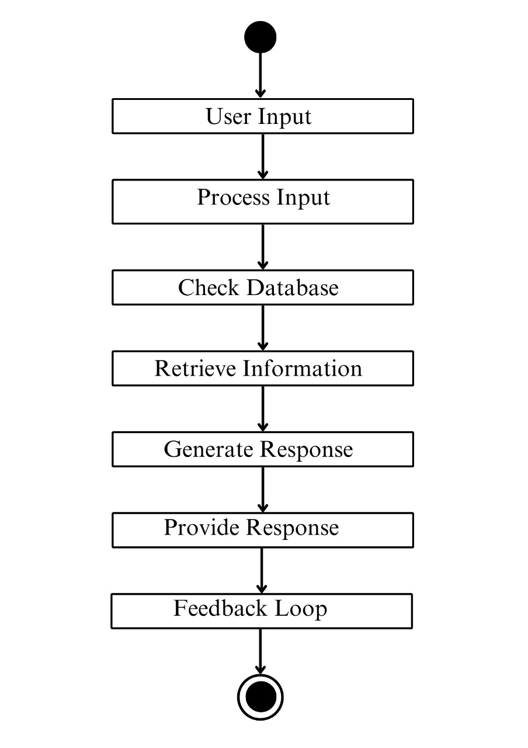
Activity Diagram

Slide 21
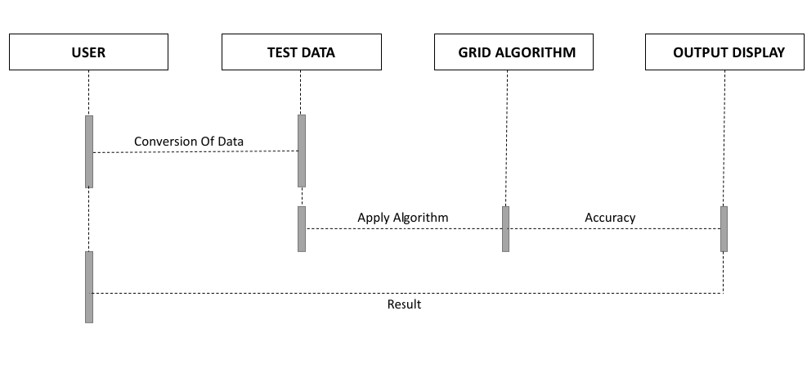
Sequence Diagram

Slide 22
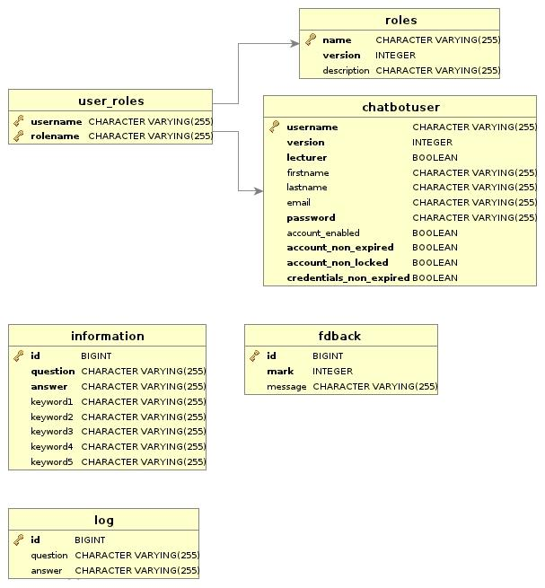
E-R Diagram

Slide 23
REFERENCES
[1] "5 Reasons Hydroponic Growing is More Profitable Than Soil Growing", 2017, [online] Available: Rimolgreenhouses.com.
Google Scholar
[2] R. Ahmed, "The Impact of TDS & pH on Quality of Drinking Water", Medium, 2021, [online] Available: https://medium.com/blueeast/tds-ph-and-their-impact-on-quality-of-drinking-water-68b2a7433043.
Google Scholar
[3] D. Martinez, "Light Wavelengths: Does Your Grow Light Have What Your Need for Your Next Harvest?", 2020, [online] Available: GrowAce.com.
Google Scholar
[4] J. Dobbin, "Lag! Top 5 Reasons your Ping is so High", 2020, [online] Available: Hp.com.
Google Scholar
[5] "How to Save Brown Tipped Plants", [online] Available: Pennington.com.
Google Scholar
[6] J. King, "The History of Greenhouses", 2020, [online] Available: Blog.growlink.com.
Google Scholar

Slide 24
THANK YOU

