Slide 1

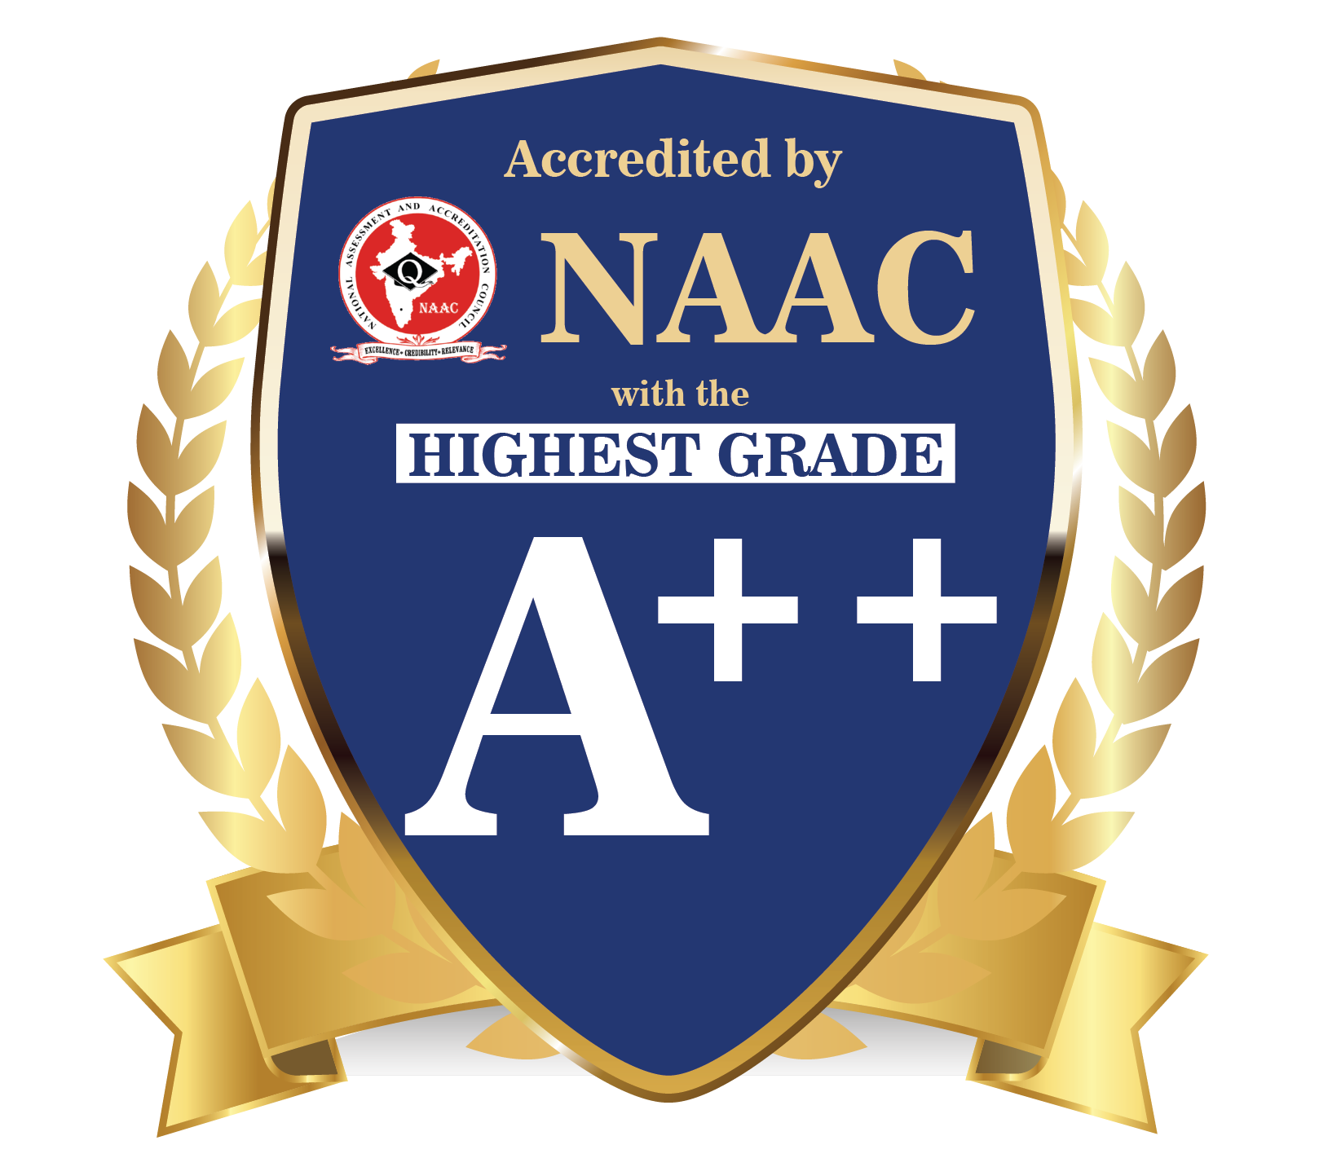

DEPARTMENT OF COMPUTER SCIENCE & ENGINEERING
SCHOOL OF COMPUTING
10214CS602 MINOR PROJECT -2 INDUSTRY PROJECTS
WINTER SEMESTER(2023-2024)
INITIAL REVIEW
“CHATBOT FOR HYDROPONICS”
SUPERVISED BY
PRESENTED BY
Dr.T.KAMALESHWAR, M.TECH., PhD.,
1.AMAN DEV (VTU19464)(21UECB0002)
2.SHREYA TIGGA(VTU19347)(21UECB0023)
3. SOWMIYA E (VTU 19486)(21UECM0338)

Slide 2
PROJECT TITLE JUSTIFICATION
Focus on Hydroponics: The name of the project highlights how the chatbot is customized especially for hydroponic gardening. This demonstrates the focused strategy used to solve the particular requirements and difficulties of hydroponic farming.
Cultivating Innovation: The project encourages innovation in the agricultural industry by integrating cutting-edge AI technologies with hydroponic growing methods.
Empowering Farmers: The project’s goal of providing farmers with access to cutting-edge technology to enable them to make well-informed decisions, overcome obstacles, and maximize their farming operations is reflected in the title.
Encouraging Growth: The project title alludes to the chatbot’s function in fostering growth and development within the agricultural community, much as hydroponic farming fosters plant growth in a regulated setting. It communicates the project’s overarching objective of fostering progress in terms of agricultural productivity and technological development.
Alignment with Goals: By utilizing technology to boost production, encourage innovation, and improve hydroponic farming methods, the title of the project is in line with its goals. It evokes notions of development, growth, and advancement while communicating the project's focus and aim.

Slide 3
OBJECTIVE
Create a chatbot with AI that is specialized for hydroponic farming.-
Give the chatbot permission to offer farmers, clients, and staff members individualized support and suggestions.
Create an intuitive user interface that is compatible with a variety of platforms to enable smooth communication.
Implement machine learning methods to help the chatbot continually enhance its performance and relevancy.
Build an extensive database with information about hydroponics to help the chatbot function.
To enhance the user experience of the chatbot, test its usefulness and collect user feedback.
Assure adherence to industry standards for security and privacy as well as data protection laws.
Analyze the chatbot's performance using pre-established metrics to get ideas for future improvements.
SCOPE OF THE PROJECT
Creation of an AI-driven chatbot specifically for hydroponics.
Tailored support and advice for farmers, clients, and staff members.-
Incorporation of real-time data sources such as market prices and weather forecasts.
An intuitive user interface that works on several platforms.
The application of machine learning techniques to ensure ongoing development.
Building and keeping up an extensive database of hydroponics.
Deployment, assessment, and iterative performance enhancement of the chatbot.

Slide 4
TOOLS TO BE USED IN THE PROJECT
Programming Languages: Python, JavaScript
Chatbot Frameworks: Rasa, Microsoft Bot Framework
Natural Language Processing (NLP) Libraries: NLTK, spaCy, TensorFlow
Machine Learning Platforms: TensorFlow, PyTorch
Development Environments: PyCharm, Visual Studio Code, Jupyter Notebook
Version Control Systems: Git, GitHub, GitLab
Deployment Platforms: Heroku, AWS (Amazon Web Services), Microsoft Azure
APIs and Web Services: Integration with external APIs for real-time data access

Slide 5
SOCIETAL IMPORTANCE OF THE PROJECT
Sustainable Agriculture: Hydroponic farming methods are renowned for using resources like water and space effectively. By promoting hydroponics and providing support through the chatbot, the project can contribute to sustainable agriculture practices, reducing environmental impact and conserving natural resources.
Access to Agricultural Knowledge: By filling the information gap between farmers and professional guidance, the chatbot acts as an easily available source of agricultural knowledge and expertise. Small-scale or distant farmers who might not have easy access to conventional agricultural extension services can especially benefit from this.
Empowerment of Farmers: The project gives farmers the knowledge and direction they need to solve issues, make wise decisions, and improve their farming methods. Farming communities may become more resilient and autonomous as a result of this empowerment.
Technology Adoption: Bringing AI-powered solutions, such as chatbots, into the agriculture industry encourages farmers to become digitally literate and adopt new technologies. This may have wider effects on rural communities' competitiveness and economic growth.
Knowledge Exchange and Cooperation: Within the hydroponic farming community, the chatbot promotes knowledge exchange and cooperation. Farmers can share knowledge, creative solutions, and best practices, promoting a culture of ongoing learning and development.

Slide 6
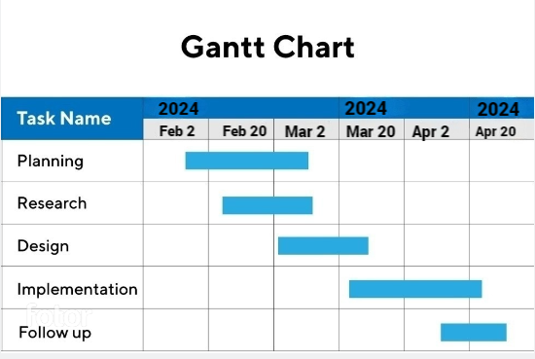
TIMELINE OF THE PROJECT

Slide 7

THANK YOU

