Slide 1


By :- Ravi

Slide 2
Tensorflow
TensorFlow is a Python library for fast numerical computing created and released by Google.
It is a foundation library that can be used to create Deep Learning models directly or by using wrapper libraries that simplify the process built on top of TensorFlow.
It was created and is maintained by Google and released under the Apache 2.0 open source license. The API is nominally for the Python programming language, although there is access to the underlying C++ API.

Slide 3
TensorFlow
TensorFlow is an open source software library for numerical computation using dataflow graphs. Nodes in the graph represents mathematical operations, while graph edges represent multi-dimensional data arrays (aka tensors) communicated between them. The flexible architecture allows you to deploy computation to one or more CPUs or GPUs in a desktop, server, or mobile device with a single API.

Slide 4
TensorFlow
Simple definition – look at TensorFlow as nothing but numpy with a twist. If you have worked on numpy before, understanding TensorFlow will be a piece of cake! A major difference between numpy and TensorFlow is that TensorFlow follows a lazy programming paradigm. It first builds a graph of all the operation to be done, and then when a “session” is called, it “runs” the graph. It’s built to be scalable, by changing internal data representation to tensors (aka multi-dimensional arrays). Building a computational graph can be considered as the main ingredient of TensorFlow.
You can literally do everything you normally would do in numpy! It’s aptly called “numpy on steroids”

Slide 5
TensorFlow
Nodes: Nodes perform computation and have zero or more inputs and outputs. Data that moves between nodes are known as tensors, which are multi-dimensional arrays of real values.
Edges: The graph defines the flow of data, branching, looping and updates to state. Special edges can be used to synchronize behavior within the graph, for example waiting for computation on a number of inputs to complete.
Operation: An operation is a named abstract computation which can take input attributes and produce output attributes. For example, you could define an add or multiply operation.

Slide 6
TensorFlow
The usual workflow of running a program in TensorFlow is as follows:
Build a computational graph, this can be any mathematical operation TensorFlow supports.
Initialize variables, to compile the variables defined previously
Create session, this is where the magic starts!
Run graph in session, the compiled graph is passed to the session, which starts its execution.
Close session, shutdown the session.

Slide 7
Terminologies used in TensorFlow
Placeholders – A way to feed data into the graphs.
Variables - Variable is a changeable parameter of the Graph.
Feed_dict – A dictionary to pass numeric values to computational graph

Slide 8
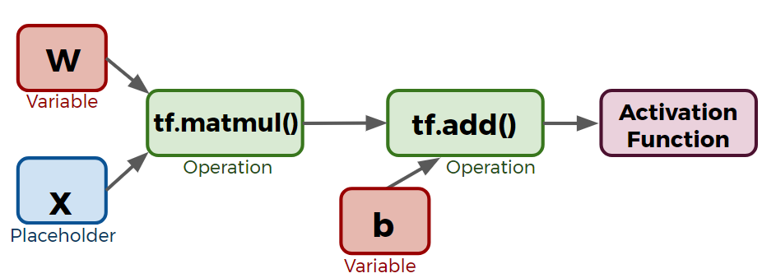
TensorFlow

Slide 9
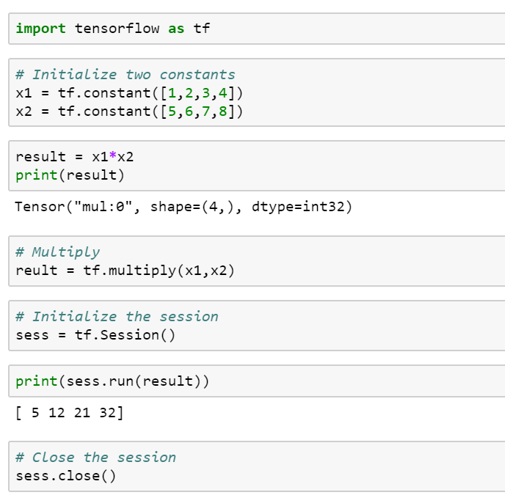
TensorFlow First Example

