Slide 1
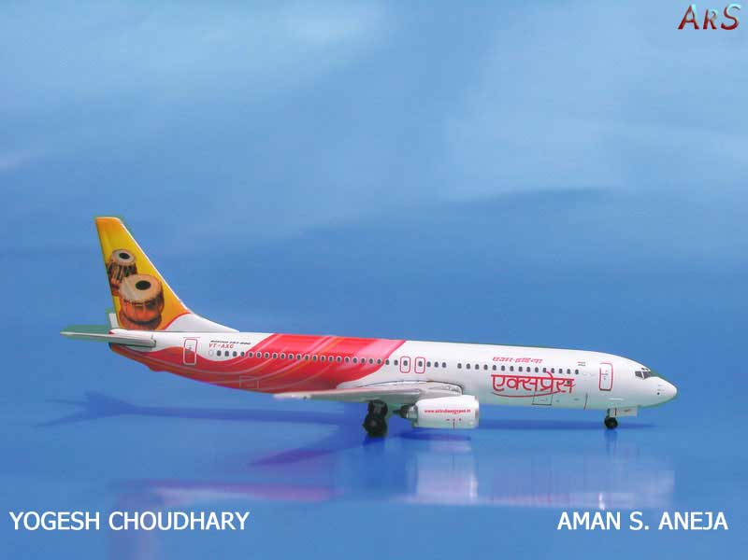
Project on
Airlines Reservation System

Slide 2
Introduction
ORGANISATIONAL OVERVIEW
PURPOSE
PROBLEM DEFINITION

Slide 3
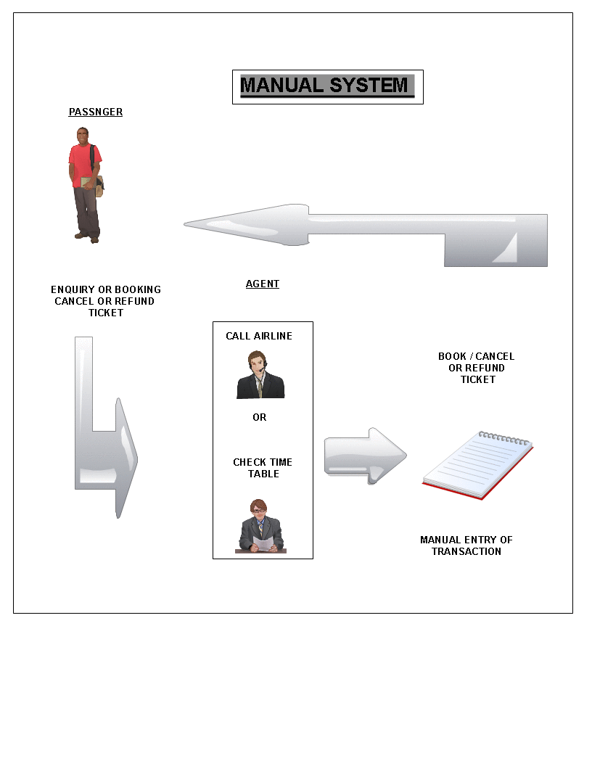
Existing System

Slide 4
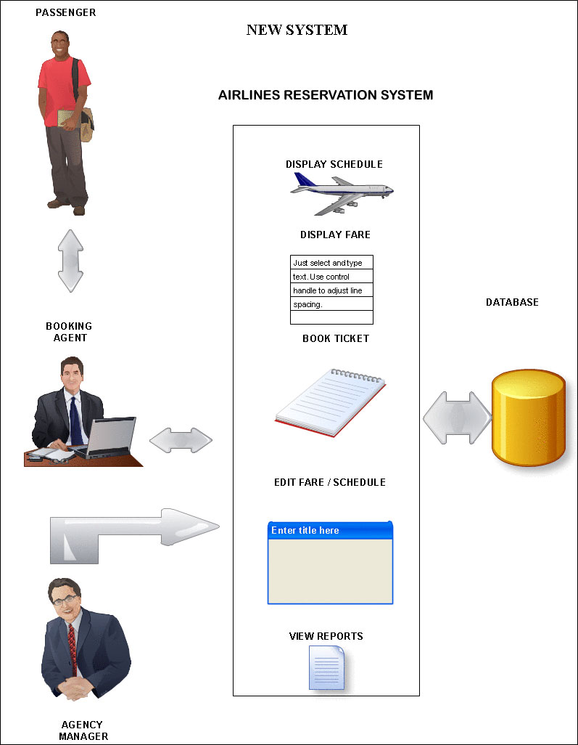
Proposed System

Slide 5
Advantages of New System
Enquries handled easily
Users calls up airlines only for bookings
Faster compared to manual system
Information retrieval faster
Automatic Record Keeping
Less Manpower

Slide 6
Data Flow Diagrams

Slide 7
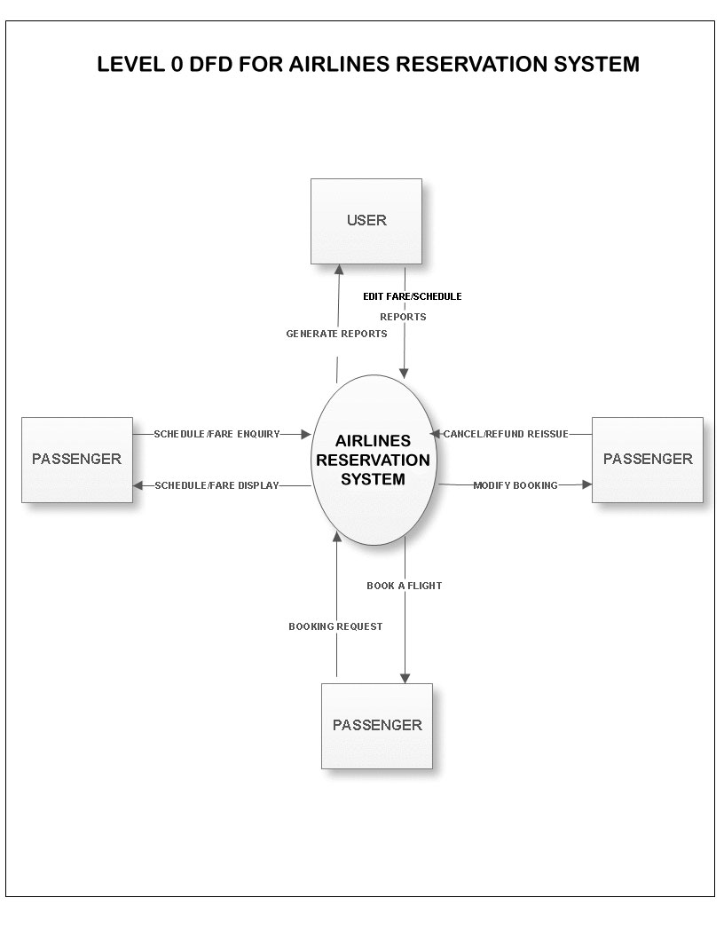

Slide 8
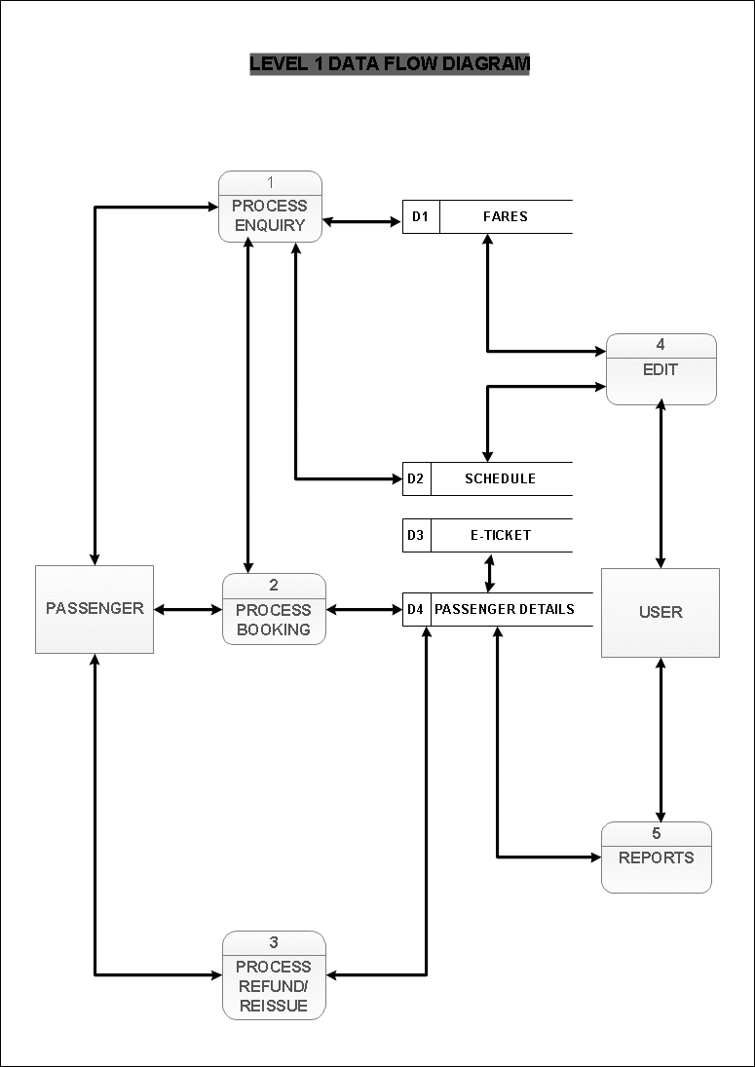

Slide 9
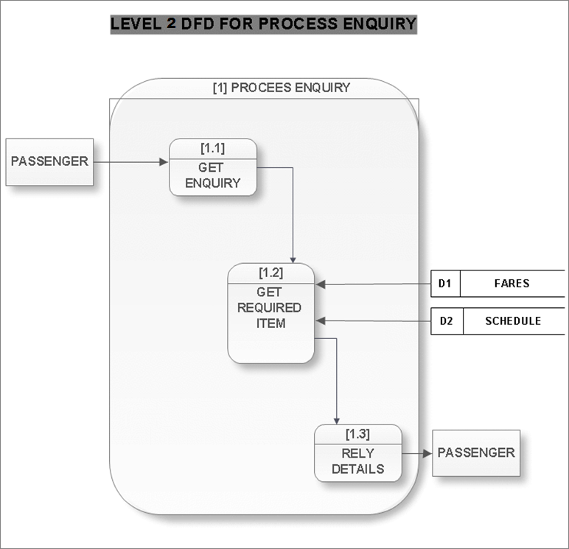

Slide 10
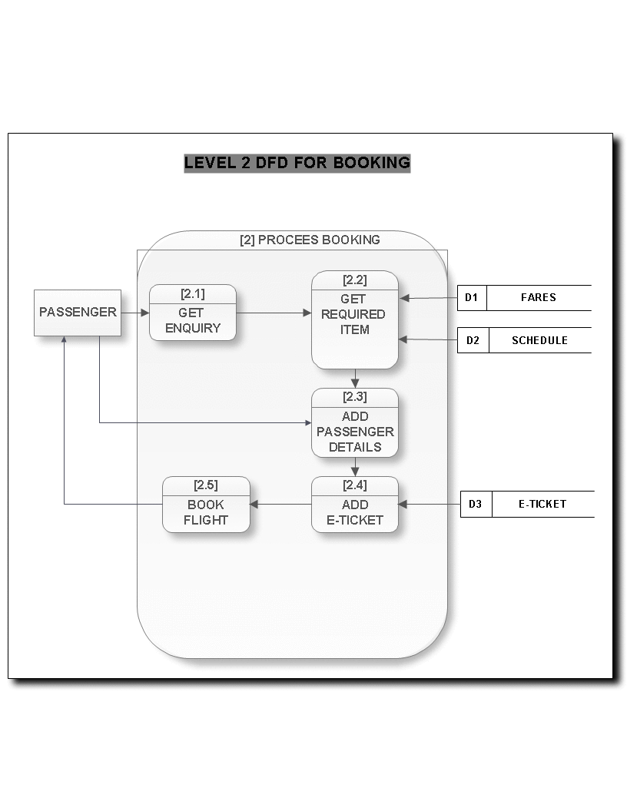

Slide 11
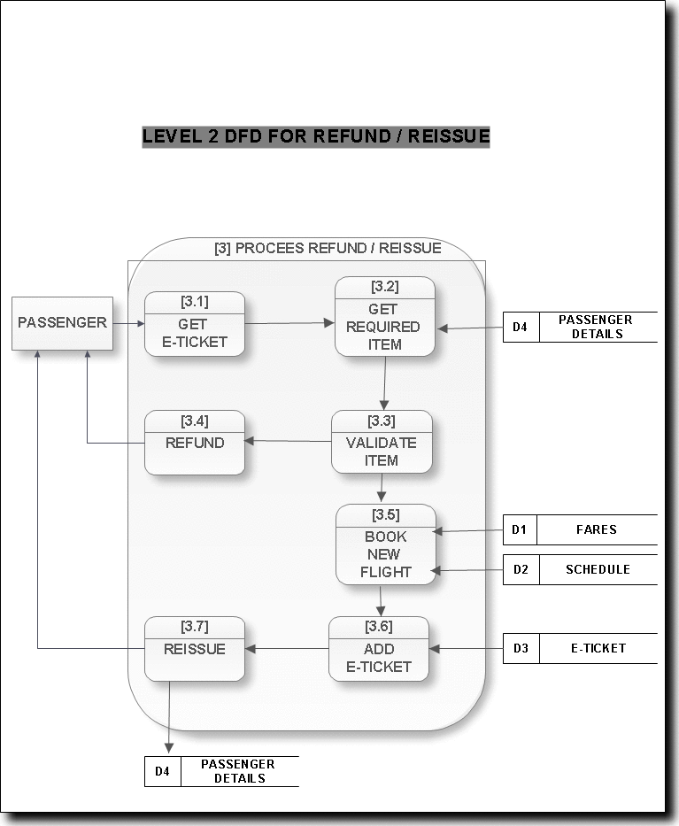

Slide 12
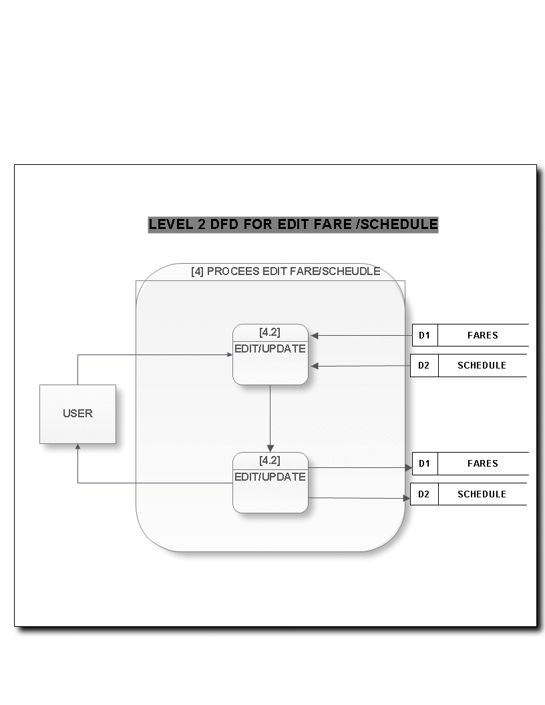

Slide 13
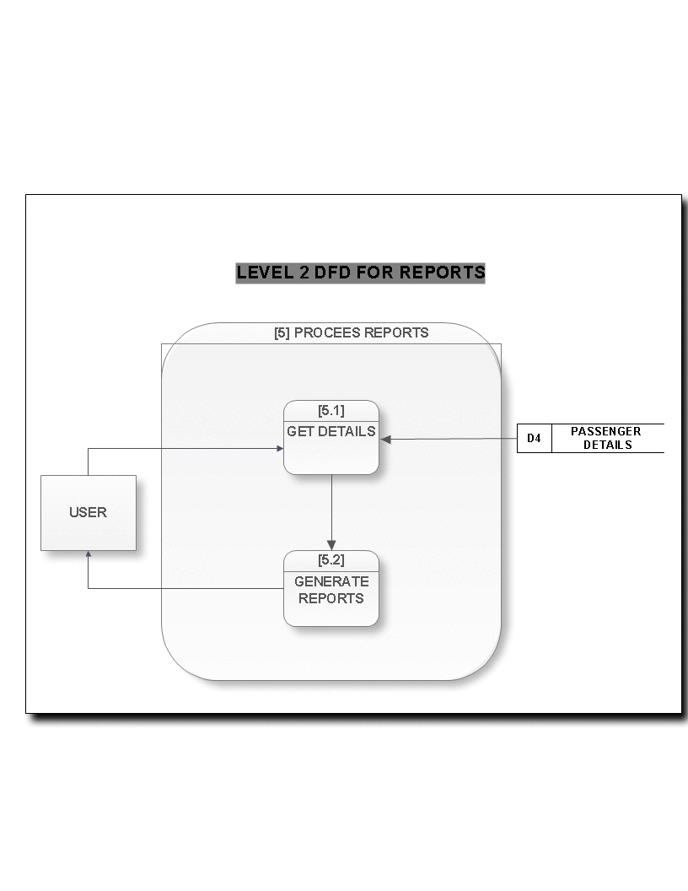

Slide 14
E-R Diagram

Slide 15
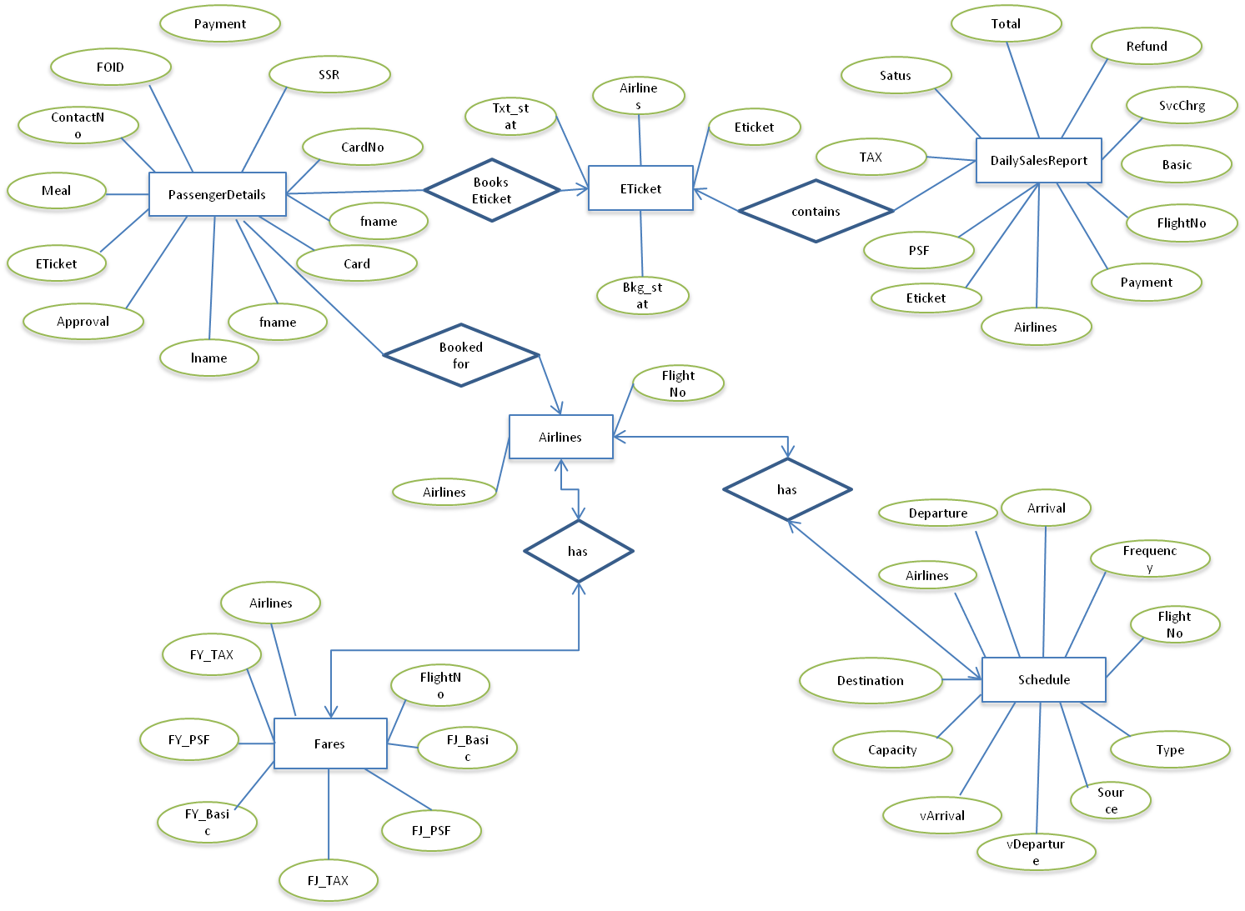

Slide 16
Case Study By
Amandeep Singh Aneja [6282]
Yogesh Choudhary [6332]

