Slide 1
EXERCISE 2: IMPLEMENTATION
Rois Lea Michaela (11810807)
Bhardwaj Aman (12333472)
Haubenburger Gabriel (11840531)
INTRODUCTION
In this exercise, we implemented a Random Forest algorithm (based on regression
Trees) for predicting numeric values. We selected two datasets, namely, colleges (large, high dimensional with missing values) and real estate valuation (small, low dimensional and no missing value). The colleges dataset has 51 attributes which are numeric, ordinal and nominal. The target attribute is taken as “percent_pell_grant”. The real estate valuation dataset has 8 attributes which are all numeric and the target attribute is “Y house price of unit area”.

Slide 2
Datasets
Real Estate Valuation
6 features + target
414 instances
Colleges
48 features
7063 instances
Large number of missing values

Slide 3
Preprocessing:
Real Estate Valuation:
Dropped the No column.
Transformed the X1 transaction date (which was in numeric decimal form) to Year and Month and placed these as the First and Second columns.
Scaled the X3 distance to the nearest MRT station column using Robust scalar as it had a large range of values. The last column “Y house price of unit area” is the target attribute.
Colleges:
Dropped some columns unnecessary for the analysis like school website, latitude, longitude, school name (as school can be identified by UNITID), zip and other columns having all missing values and all same values.
Used Mode (Most frequent) to impute and handle the missing values of Categorical columns . Used Median for imputing missing values in numeric columns.
Categorical columns were encoded by Label Encoder.
Using Robust Scaler, applied scaling for some columns which had large difference between values or large range of values.
Applied Feature Selection (Variance Threshold), threshold = 0.02, to remove features having very small variance.
Finally, we selected 'percent_pell_grant’ as the target variable and save this preprocessed dataset to a csv file.

Slide 4
Decision Tree Regressor
A variant of the simple decision tree model for regression tasks
Parameters and Flexibility:
Supports configurable depth, leaf sizes, and splitting strategies
Offers deterministic (best) and stochastic (random) splitting
Efficiency:
Computationally expensive for large datasets (random splitter reduces the cost a bit)
Lack of advanced optimizations (pre-pruning, post-pruning)

Slide 5
Random Forest Regressor
Uses multiple decision trees trained on random subsets of the whole data set
Counters inherent instability of decision trees
Key features:
Custom or sklearn trees
Bootstrap sampling
Aggregation of predictions
Flexible parameters
Reproducibility (random_state)

Slide 6
Hyperparameter optimization
We experimented with:
Number of trees
A maximum of features considered in a split
Maximum tree depth
A minimum of samples before a split
A minimum of samples per leaf
A maximum of leaf nodes
A maximum of samples for each tree

Slide 7
Comparison to scikit learn DecisionTreeRegressor
Much faster training times
Faster prediction times
Way worse scores overall (overfitting)

Slide 8
Comparison to scikit learn DecisionTreeRegressor
Real estate valuation: clf = RandomForestRegressor(use_skl_tree=False, max_samples=100, max_features=None)
# clf = DTRegressor(splitter='random')
 | Training time [s] | Prediction Time [s] | R² score | MSE | MAE
Real estate DT | 0.222 | 0.000 | 0.346 | 111.324 | 6.043
Real estate from scratch | 7.494 | 0.017 | 0.691 | 52.494 | 4.728

Slide 9
Comparison to scikit learn DecisionTreeRegressor
Colleges: clf = DTRegressor(splitter='random', max_leaf_nodes=100, verbose=True, random_state=random_state)
# clf = SKDT(splitter='random', random_state=random_state)
 | Training time [s] | Prediction Time [s] | R² score | MSE | MAE
Colleges Scikit learn DT | 0.0227 | 0.001 | 0.066 | 0.0469 | 0.152
Colleges DT from scratch | 8.700 | 0.000 | 0.357 | 0.032 | 0.1337

Slide 10
Comparison to scikit-learn RandomForestRegressor
Overall much faster training times
Slightly smaller prediction times
Roughly comparable, but usually slightly better scores

Slide 11
Comparison to scikit-learn RandomForestRegressor
Real estate valuation: clf = RandomForestRegressor(use_skl_tree=True)
clf = RandomForestRegressor(use_skl_tree=False, max_samples=100, max_features=None)
 | Training time [s] | Prediction Time [s] | R² score | MSE | MAE
Real estate Scikit-learn | 0.062 | 0.007 | 0.636 | 61.982 | 5.054
Real estate from scratch | 7.494 | 0.017 | 0.691 | 52.494 | 4.728

Slide 12
Comparison to scikit-learn RandomForestRegressor
clf = RandomForestRegressor(use_skl_tree=True, max_samples=500, max_features=30,random_state=random_state, n_estimators=50)
clf = RandomForestRegressor(use_skl_tree=False, max_samples=500, max_features=30,random_state=random_state, n_estimators=50)
 | Training time [s] | Prediction Time [s] | R² score | MSE | MAE
Colleges Scikit-learn | 0.159 | 0.0119 | 0.495 | 0.025 | 0.115
Colleges from scratch | 105.571 | 0.213 | 0.4749 | 0.026 | 0.118

Slide 13
Comparison to LLM version
Much shorter code (less parameters)
Seems to also work on the preprocessed data sets
LLM:
Uses pre-implemented class -- > Less complex and less coding effort
Less focus on details in splitting criteria
Benefits from optimizations in libraries (like sklearn – uses highly efficient compiled code
Scratch: requires deep knowledge of algorithmic details
More bugs possible
Performance may lag

Slide 14
Comparison to LLM version
Real estate valuation:
Insights:
LLM: faster training and prediction times, but sacrifies accuracy → lower R², MSE, and MAE.
RF from scratch: slower training, but better accuracy, lower MSE and MAE
 | Training time [s] | Prediction Time [s] | R² score | MSE | MAE
Real estate LLM | 0.849 | 0.001 | 0.465 | 91.233 | 7.043
Real estate from scratch | 5.547 | 0.021 | 0.683 | 53.990 | 4.808

Slide 15
Comparison to LLM version
Colleges:
Insights:
LLM: Slower training time, faster prediction time. But poor model performance → very low R² and higher error metrics compared to RF from scratch
RF from scratch: 5 x faster training times, but lower prediction times compared to LLM model. Better accuracy with higher R², lower MSE and MAE.
 | Training time [s] | Prediction Time [s] | R² score | MSE | MAE
Colleges LLM | 100.707 | 0.033 | 0.012 | 0.050 | 0.187
Colleges from scratch | 21.159 | 0.376 | 0.431 | 0.029 | 0.127

Slide 16
Efficiency
Our implementation had a notable gap in efficiency compared to the scikit learn version
Mainly from using own trees
Possible reasons:
Penalty from implementation in an interpreted language
Lacking optimization
Bugs

Slide 17
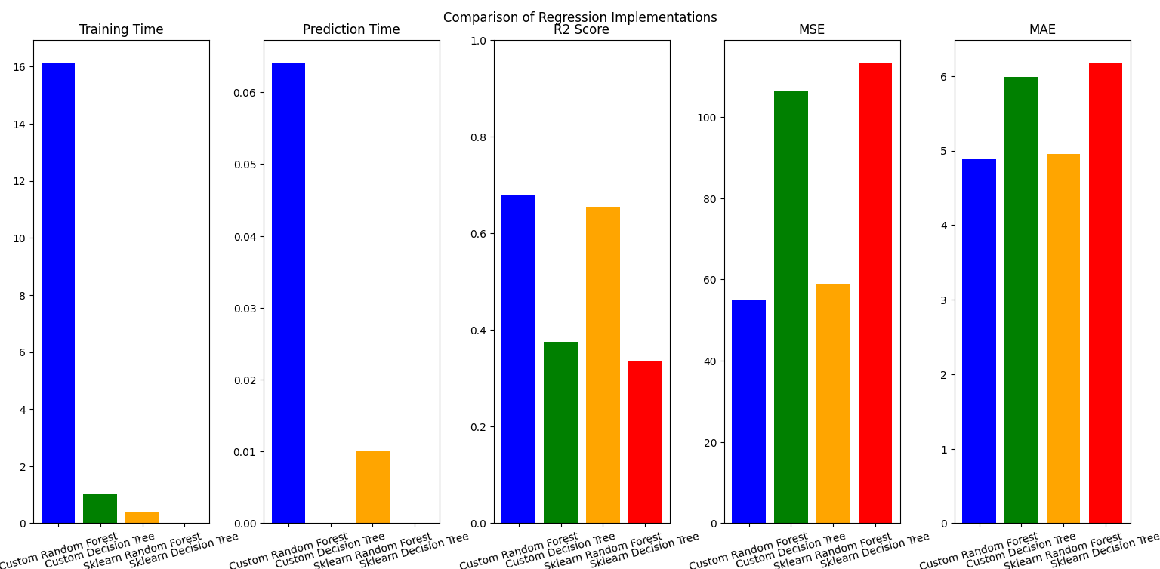
Plots: Real Estate

Slide 18
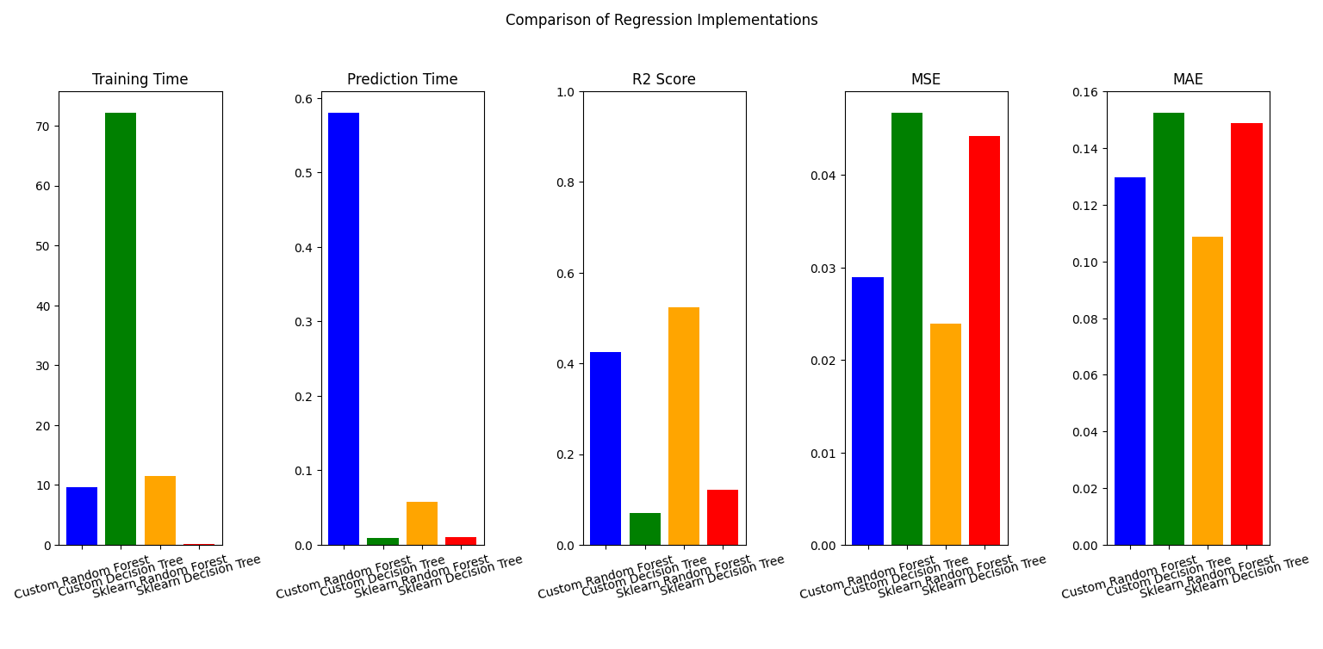
Colleges:

