Slide 1

Hackathon III
Voice based E-Commerce Ordering System

Slide 2
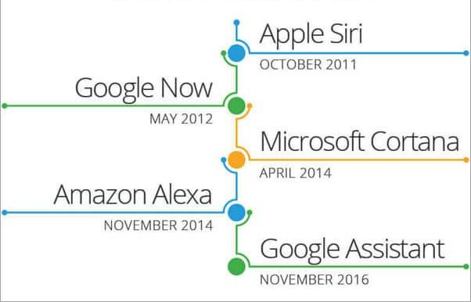

Speech recognition
Recognition and translation of spoken language into text by computers. It is also known as automatic speech recognition (ASR)

Slide 3
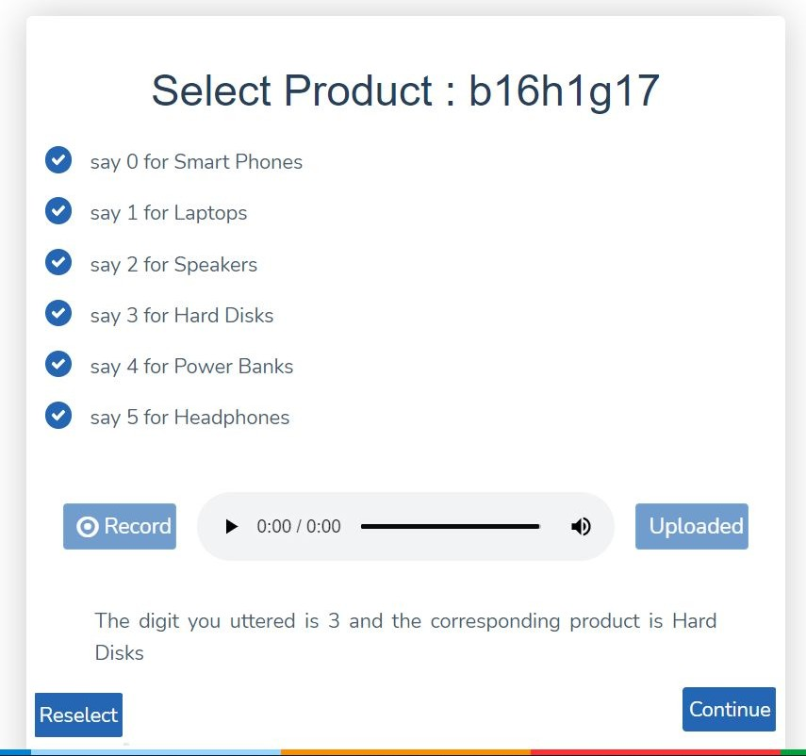
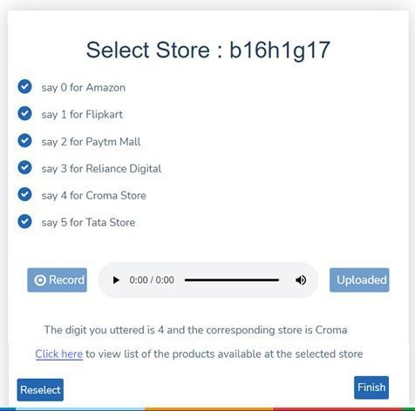

Hackathon-III problem statement
Build and integrate a classifier that can classify voice commands (number utterances) into an e-commerce ordering system

Slide 4
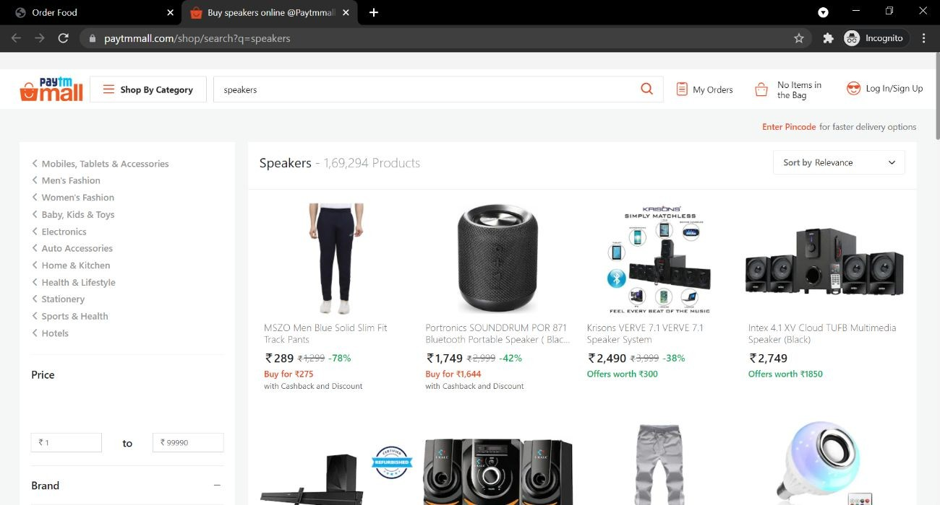
Open Filtered Product
Upon Clicking on the hyperlink the launch the selected store from the filtered product.

Slide 5






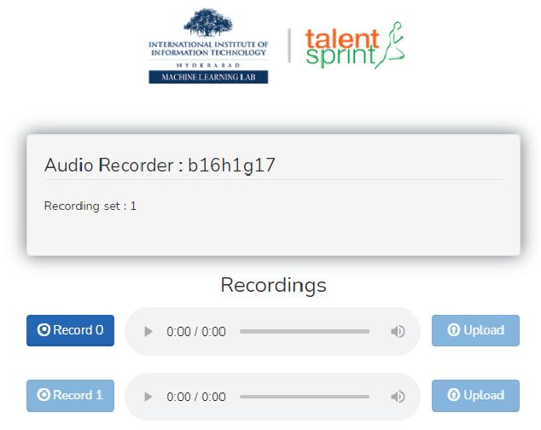

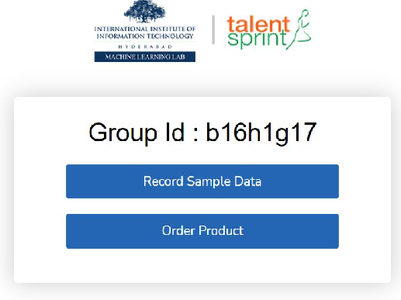
Overview
Dataset: Voice samples of number utterances
Studio data
Extract features (Colab notebook)
Train your model on the dataset and save model (Colab notebook)
Deploy on the E-Commerce Application
Interface on the Server
Studio Data Team Data
Team data

Slide 6
Tasks (40 Marks)
Stage 0 - Obtain Features from Audio samples
Stage 1 - Define and train a CNN model on Studio data and deploy the model in the server (22 Marks)
Stage 2 - Collect your voice samples (team data) and refine the classifier trained on Studio_data. Deploy the model in the server. (18 Marks)

Slide 7
Evaluation
Hackathon starts on Aug 24, 2026 and ends on Sep 06, 2026.
Server credentials will be provided by coming Tuesday EOD.
Presentations starts from 4:00 PM on Sep 06, 2026.
Prepare for 10 mins presentation
10 marks will be awarded for Presentation

Slide 8
Deployment Evaluation Criteria:
There are two stages in the E-Commerce ordering application
Select the product
Select the store
– If both the stages are cleared as per the evaluation criteria you will get complete marks. Otherwise, you will see a reduction in the marks

Slide 9

Good luck for the Hackathon!

